Slide 1
Seismic Processing
—Based on 2018 Field School Seismic Data
Yichuan Wang

Slide 2
Outline
1. Purpose of Seismic Processing
2. Seismic Processing Sequence
3. Summary

Slide 3
1. Purpose of Seismic Processing
To suppress noise in the field data and enhance the reflections.
—increase the signal noise ratio (SNR)
What is noise on seismic record?

Slide 4
1. Purpose of Seismic Processing
(1) random ambient noise
(2) coherent noise(ground roll, guided waves, multiples, cable noise et al.)
Generally, noise can be considered as anything other than
the desired signal.

Slide 5
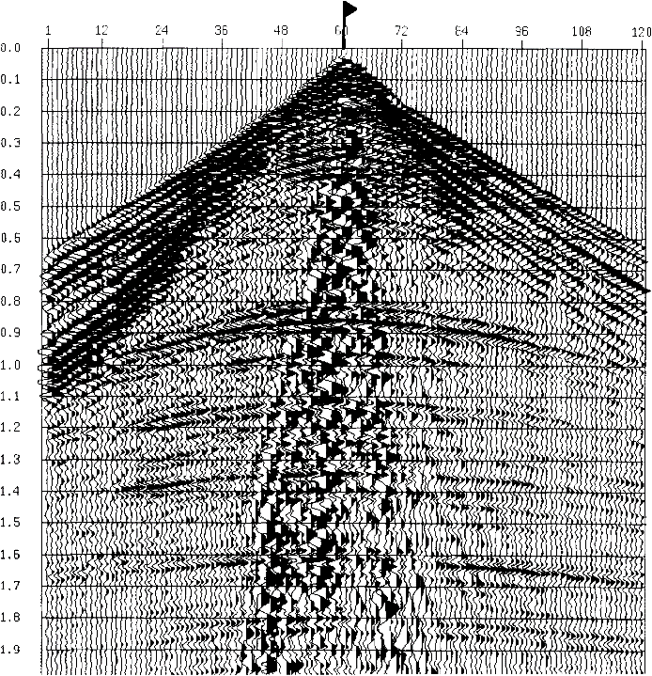
Guided waves
Ground roll
Reflections

Slide 6
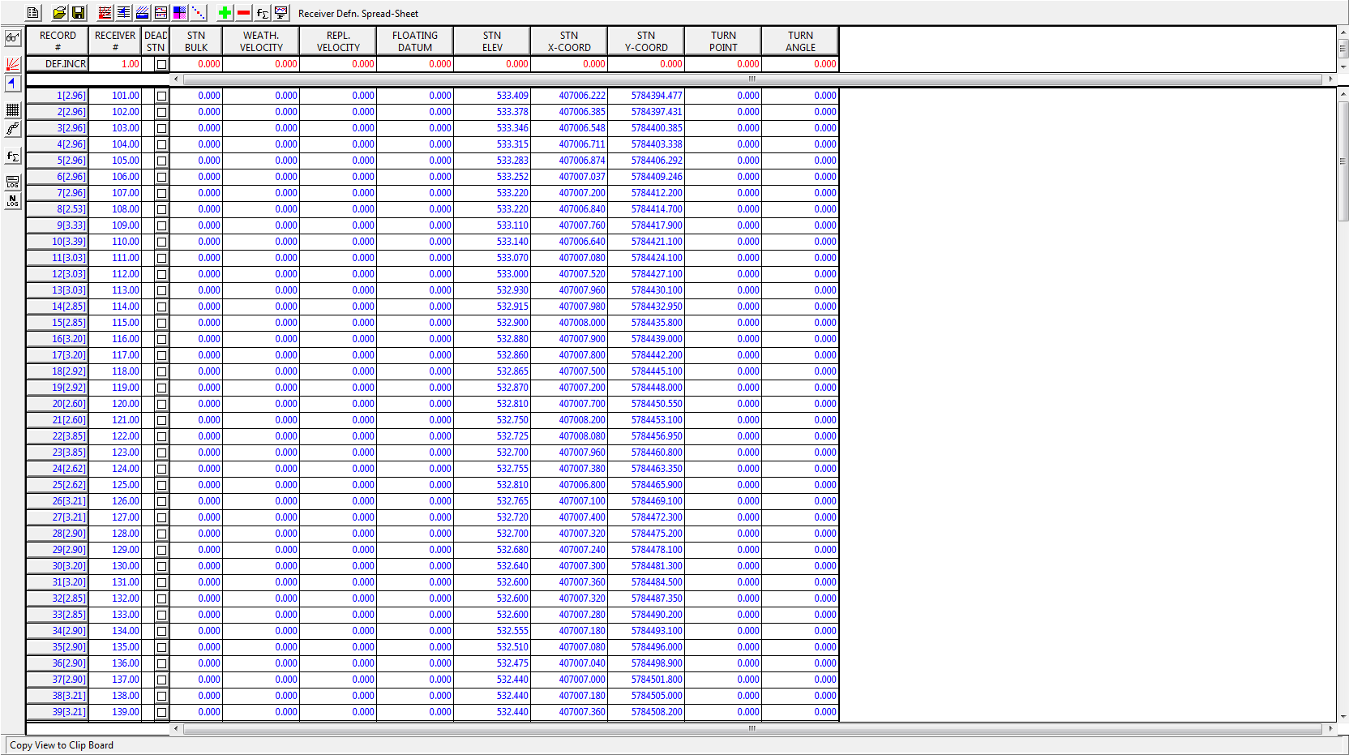
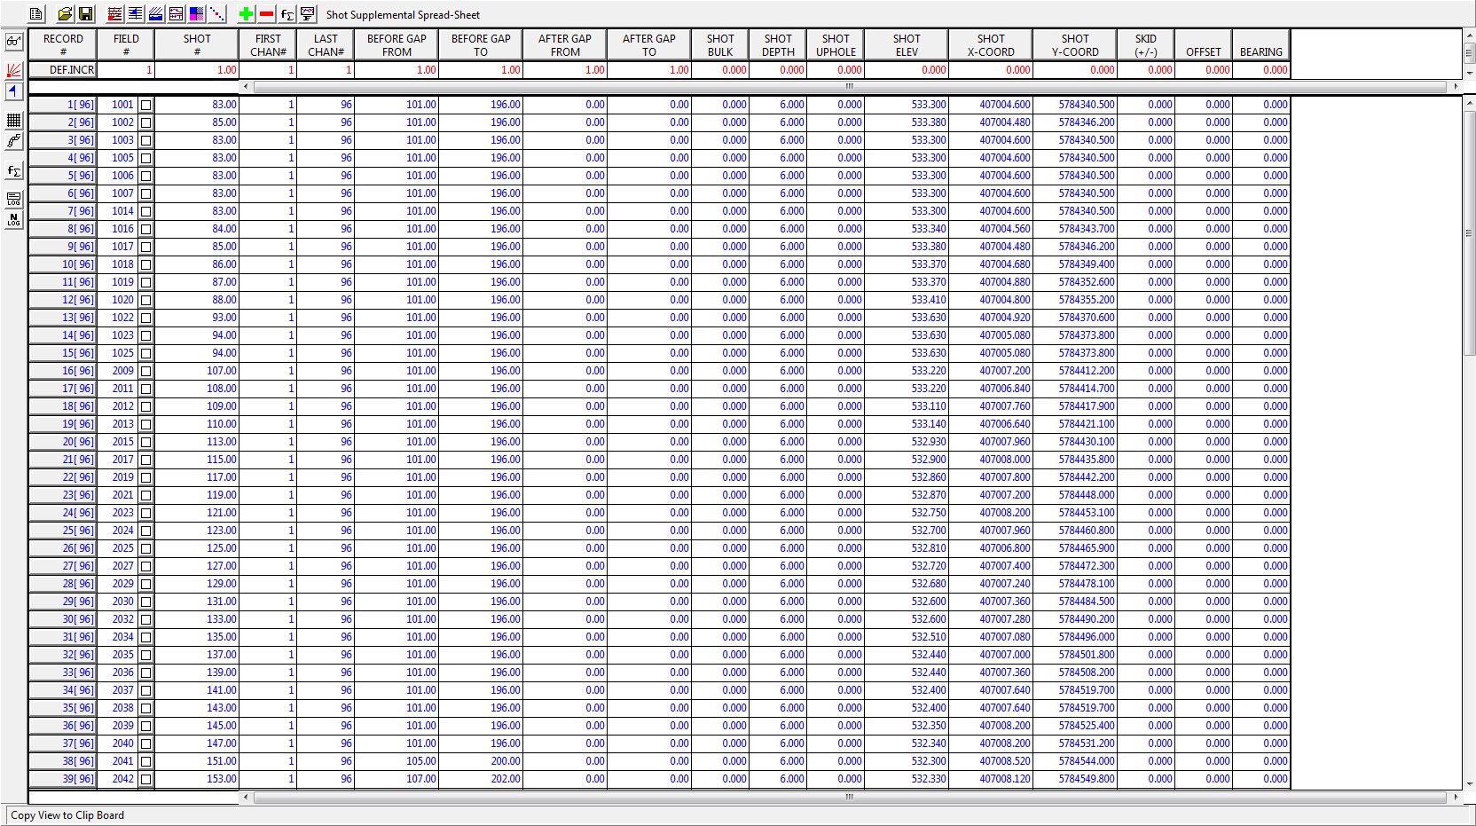
2. Seismic Processing Sequence
(1) Create and load geometry
Sources: Station number, X, Y, Elevation, FFID, Uphole, Offset, Skid et al. in shot spread sheet.
Receivers: Station number, X, Y, Elevation et al.
For Vista, assigning geometry to seismic data means that for each trace a number of values are determined, which are saved in the specified project database and then can be loaded to trace headers.

Slide 7
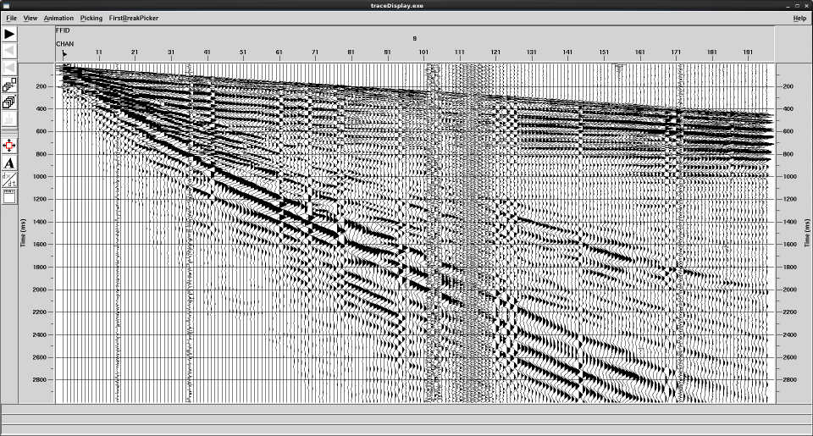
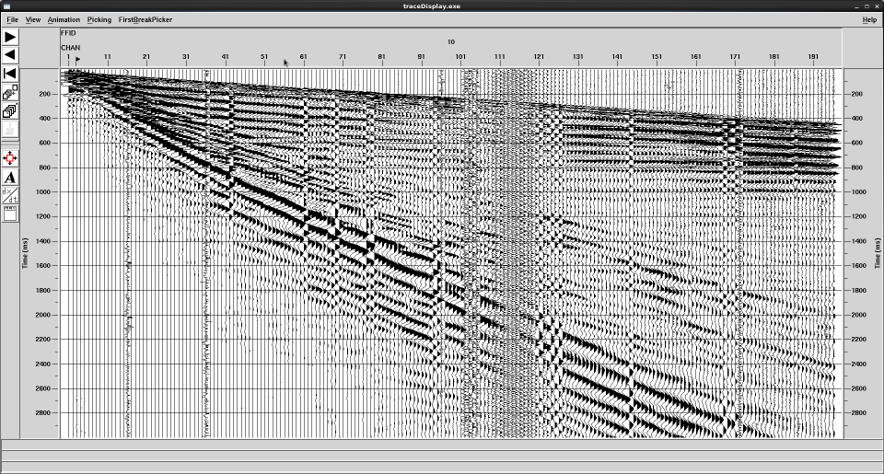
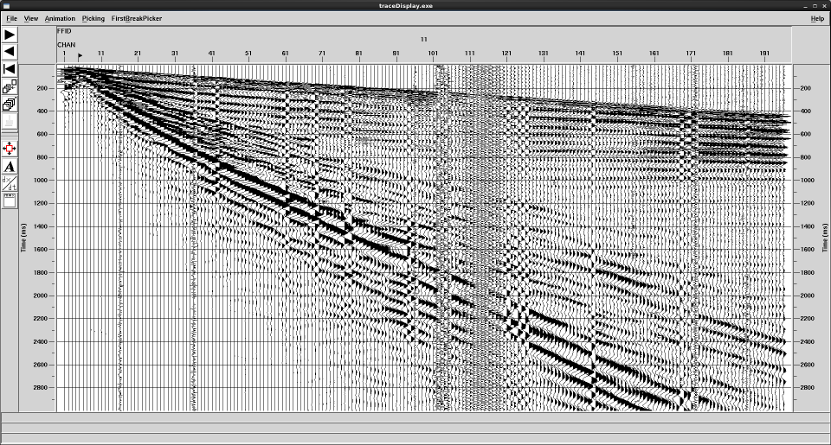
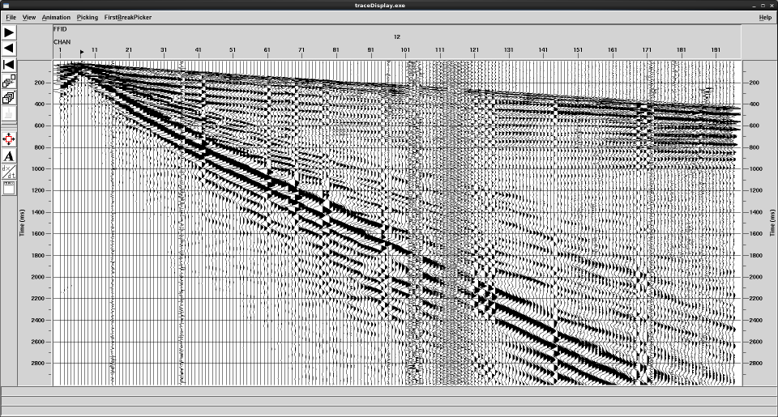
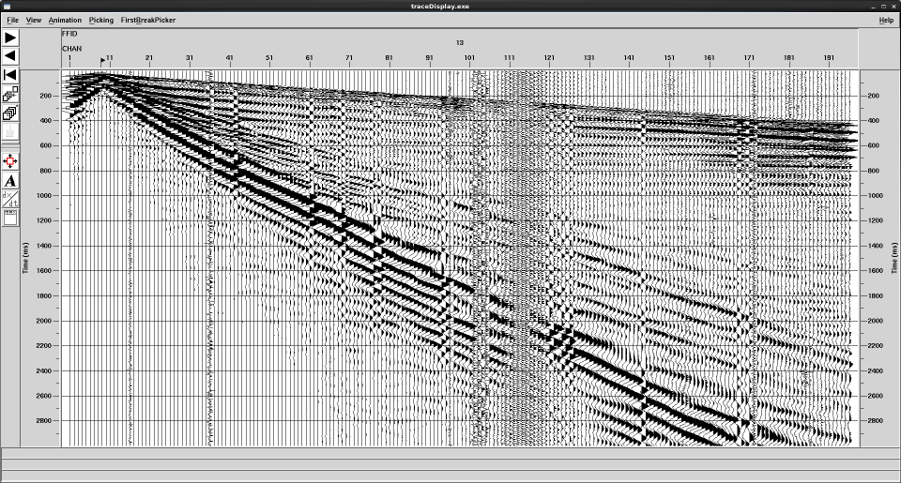
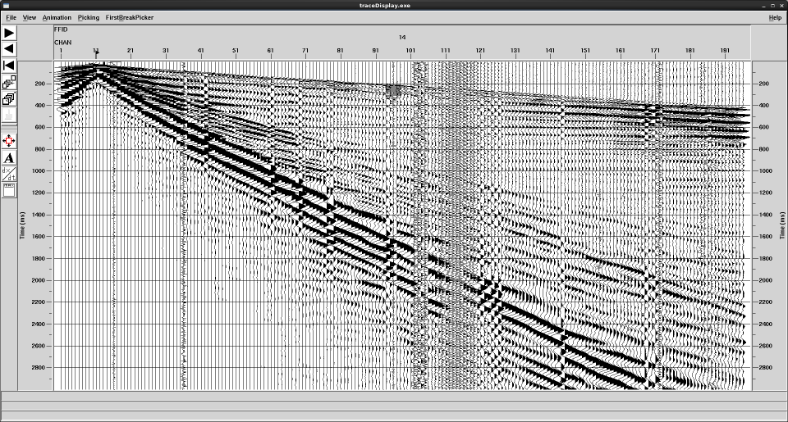

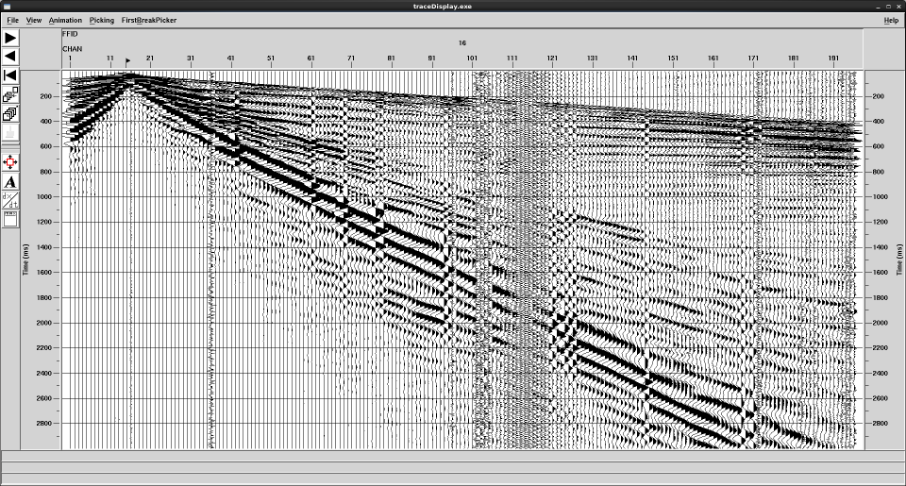
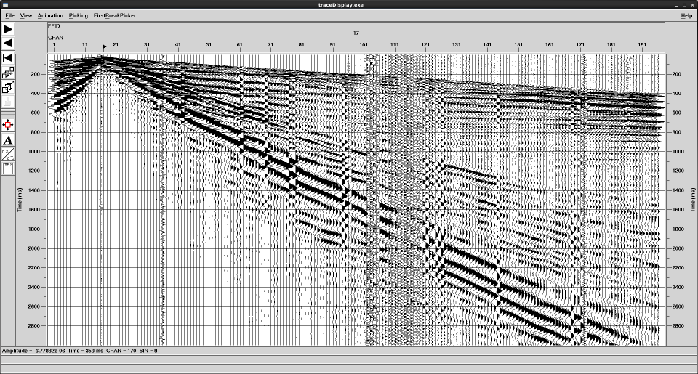
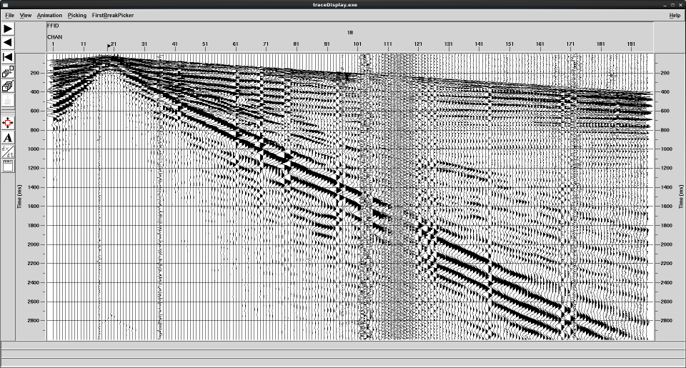
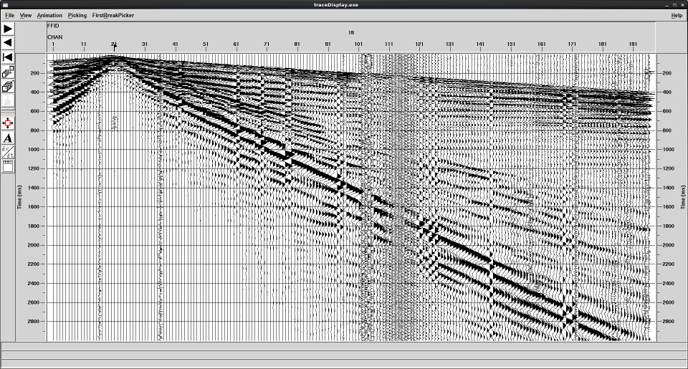
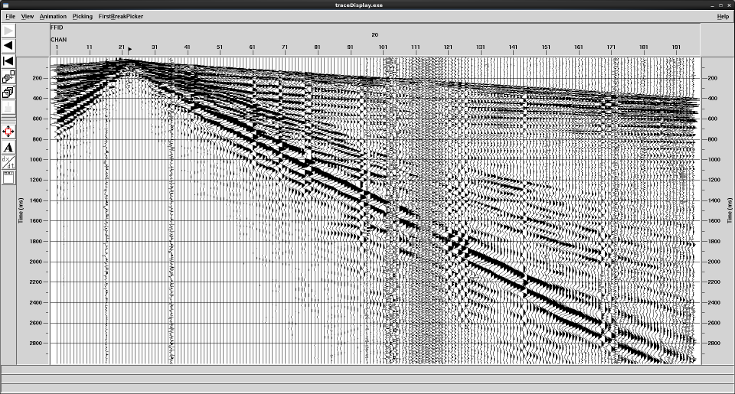

Slide 8
2. Seismic Processing Sequence
(2) Trace edit
Bad traces removal (noisy channels, poorly planted geophones, channels contaminated by power line noise, et al.)
Polarity reversal

Slide 9
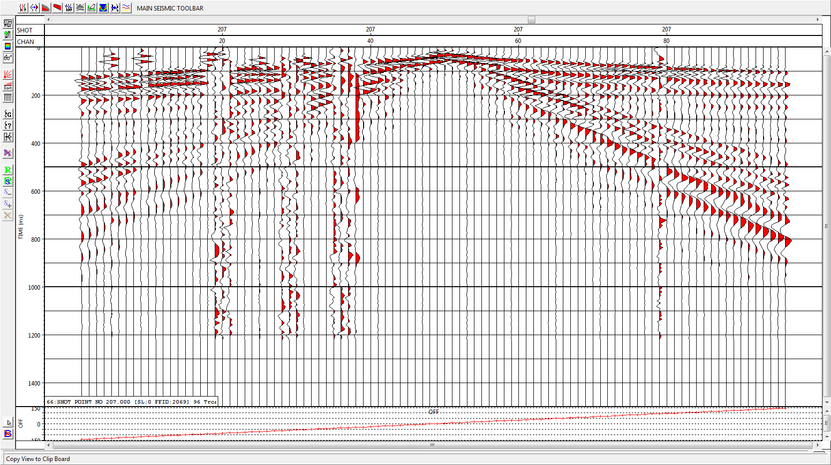
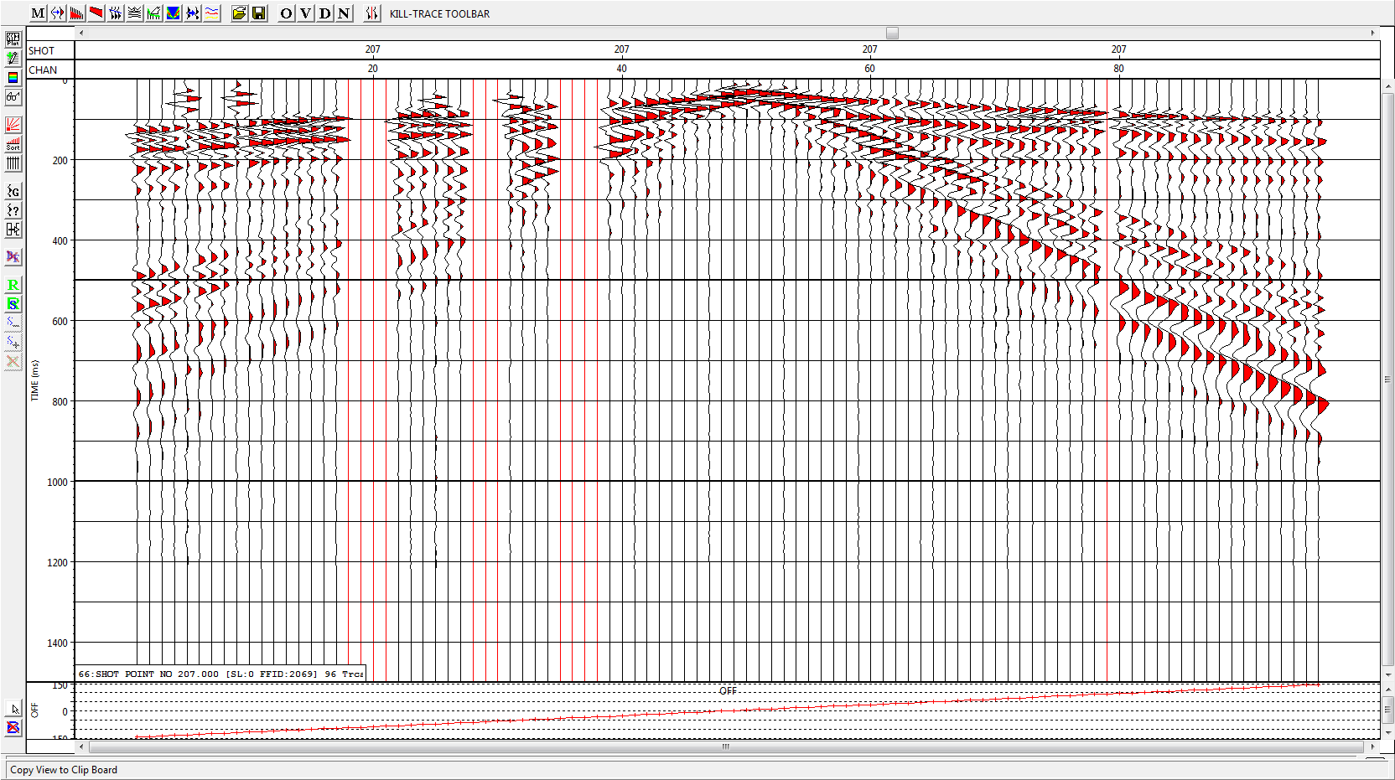
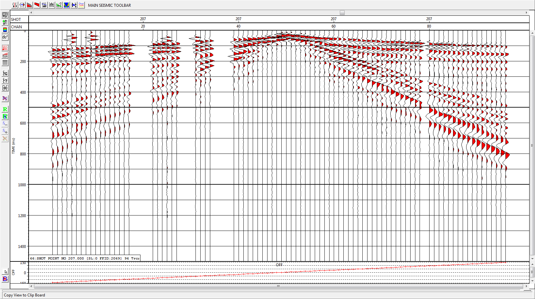

Slide 10
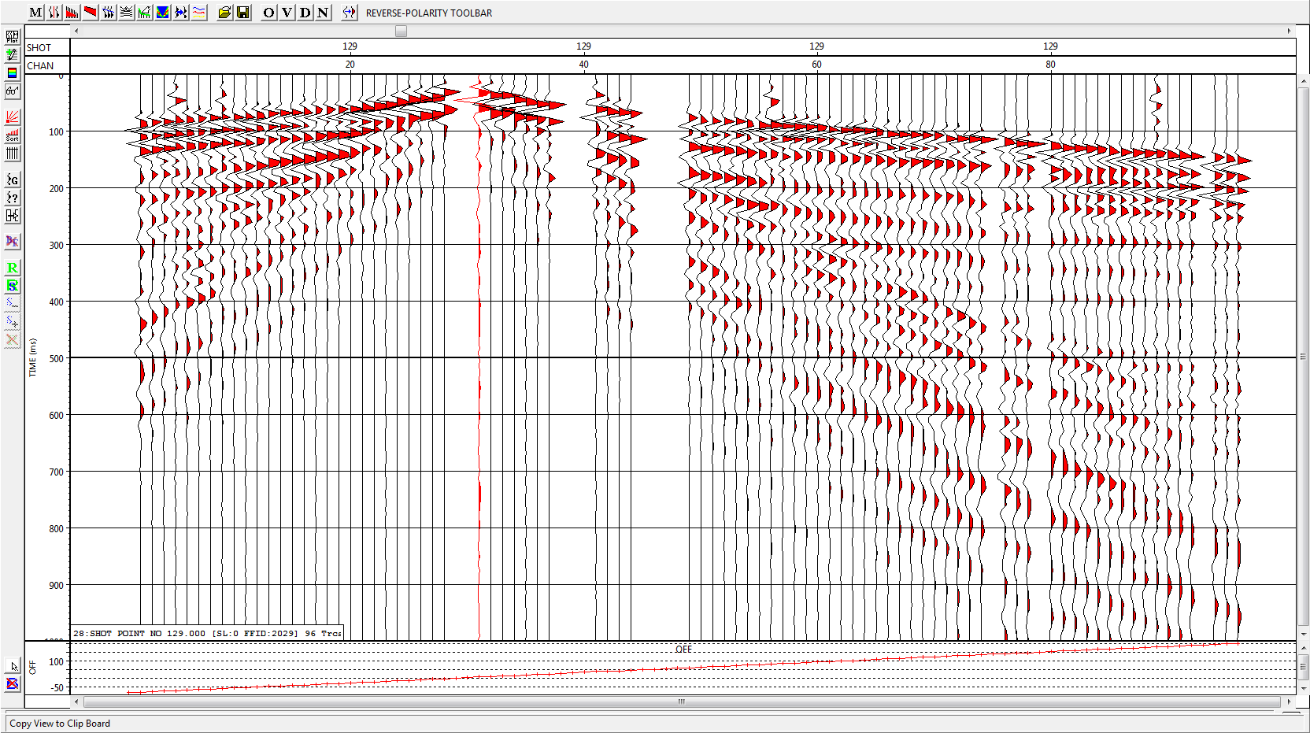
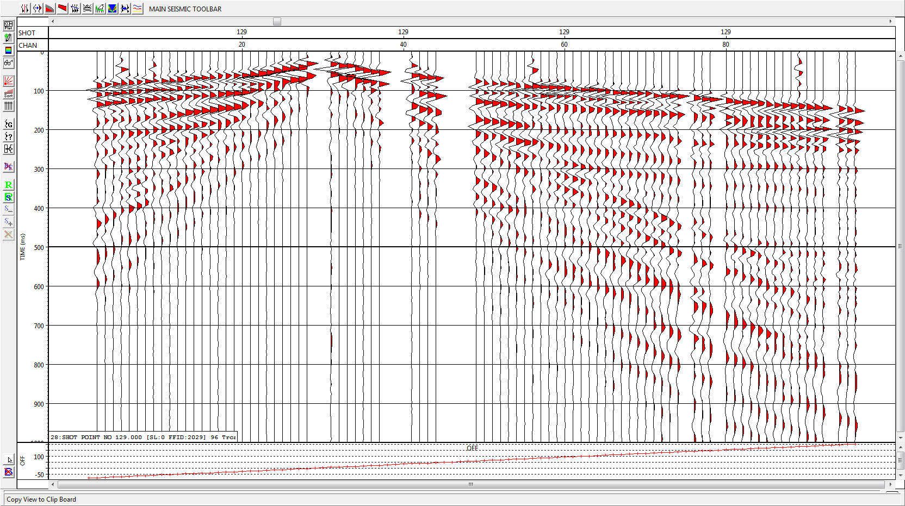


Slide 11
2. Seismic Processing Sequence
(3) First arrival picking
Identification of the direct waves or refracted waves and measure their travel-times.
First arrival picking is the prerequisite for the the calculation of refraction statics.

Slide 12
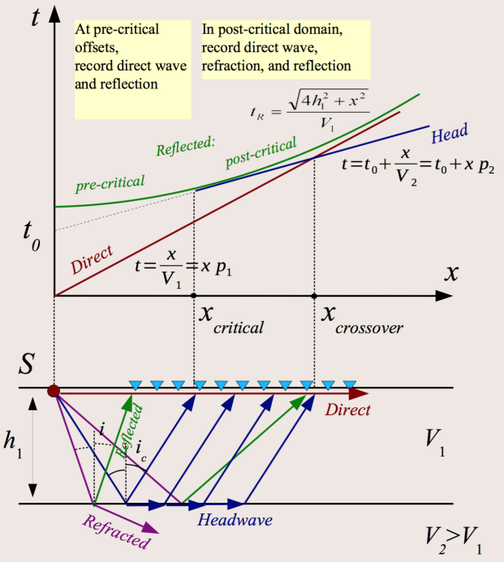

Slide 13
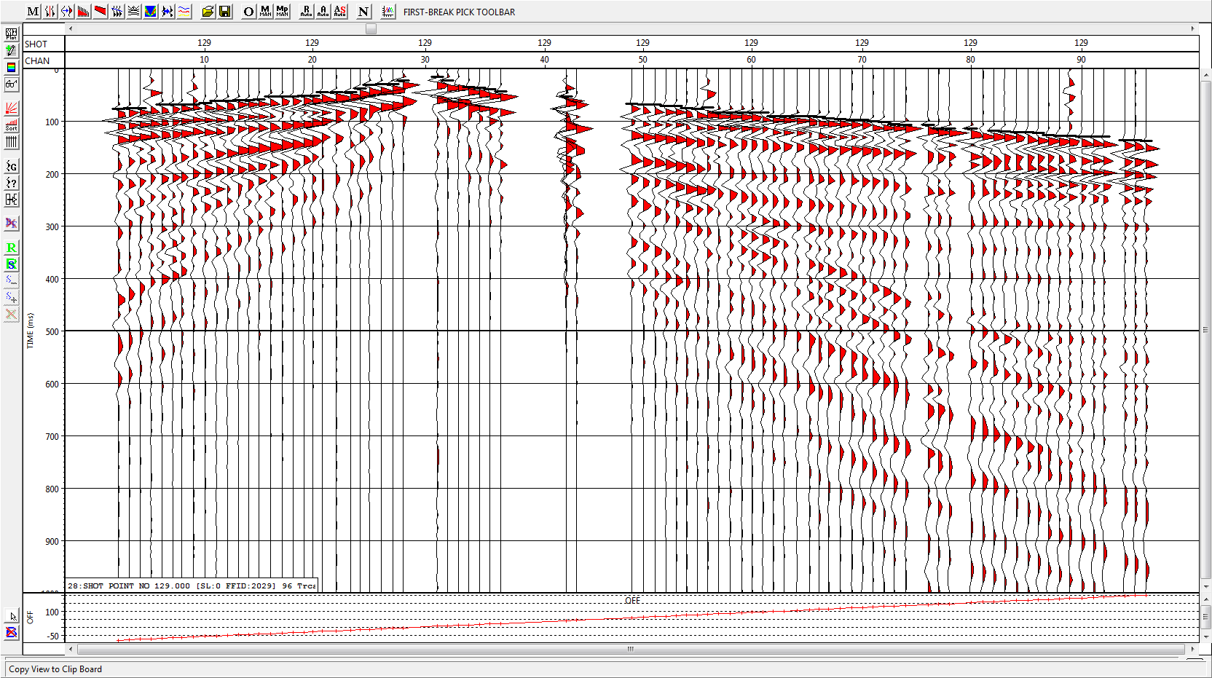
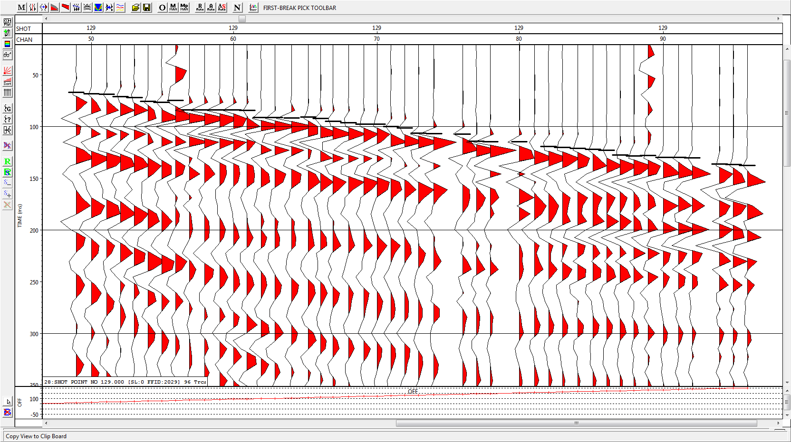

Slide 14
2. Seismic Processing Sequence
(4) Elevation and refraction statics
Statics are time shifts in the records.
Elevation statics
Refraction statics
irregular topography
near-surface weathering zone
(before NMO)
Statics
Residual statics
misalignment of the wavelet
(after NMO)

Slide 15
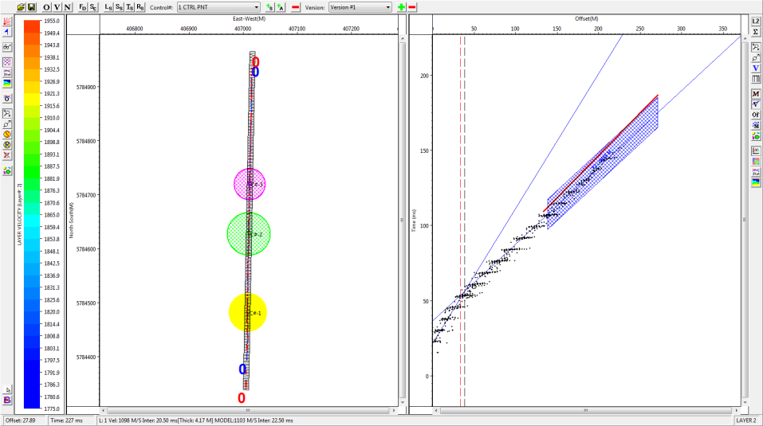
Head wave
Direct wave

Slide 16
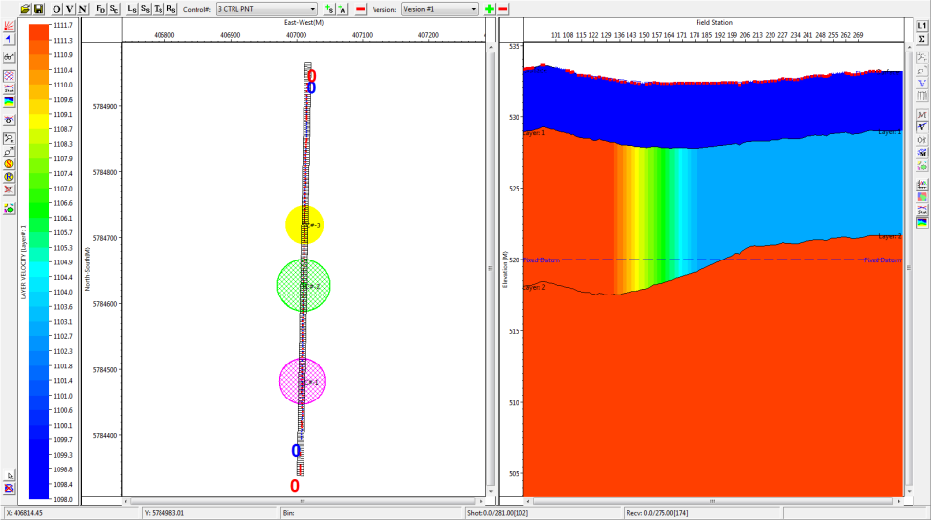
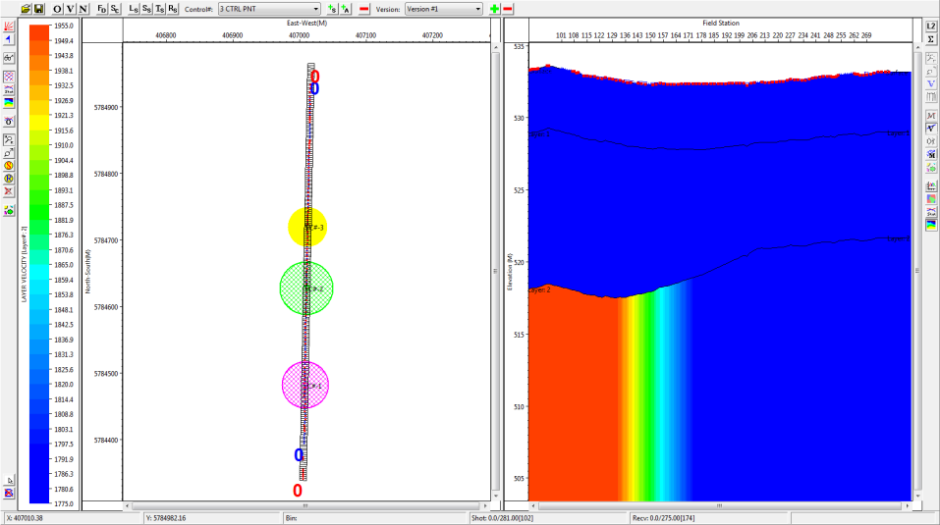

Slide 17
2. Seismic Processing Sequence
(5) Muting
Eliminates the signals of time intervals where strong noise is present.

Slide 18
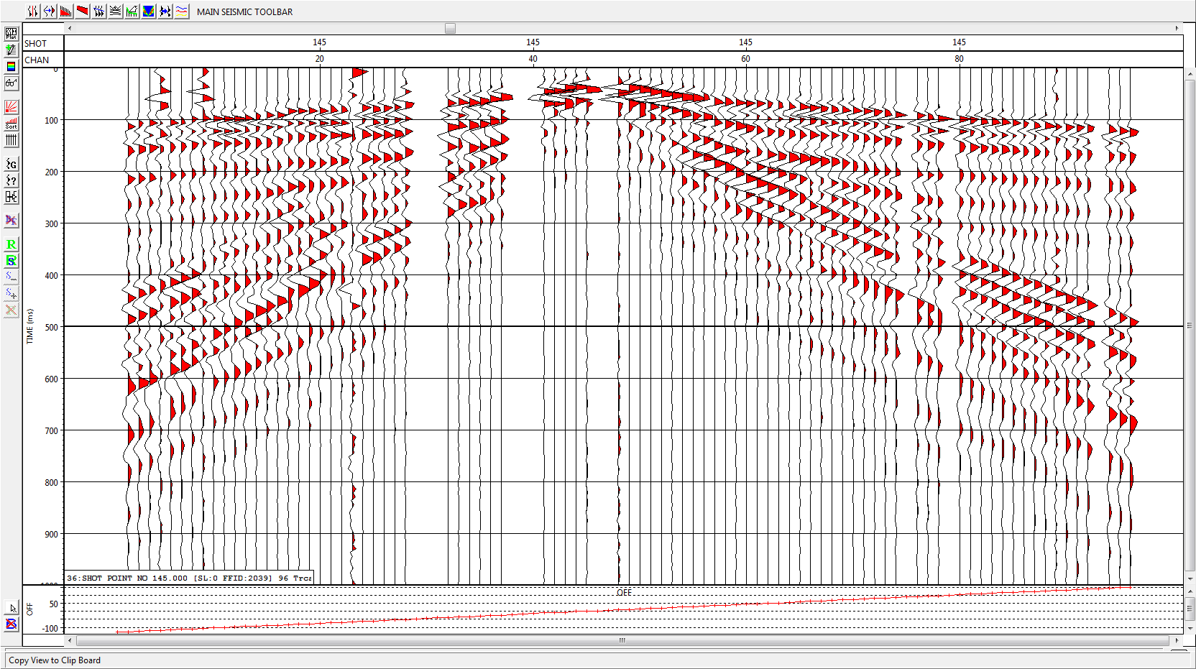
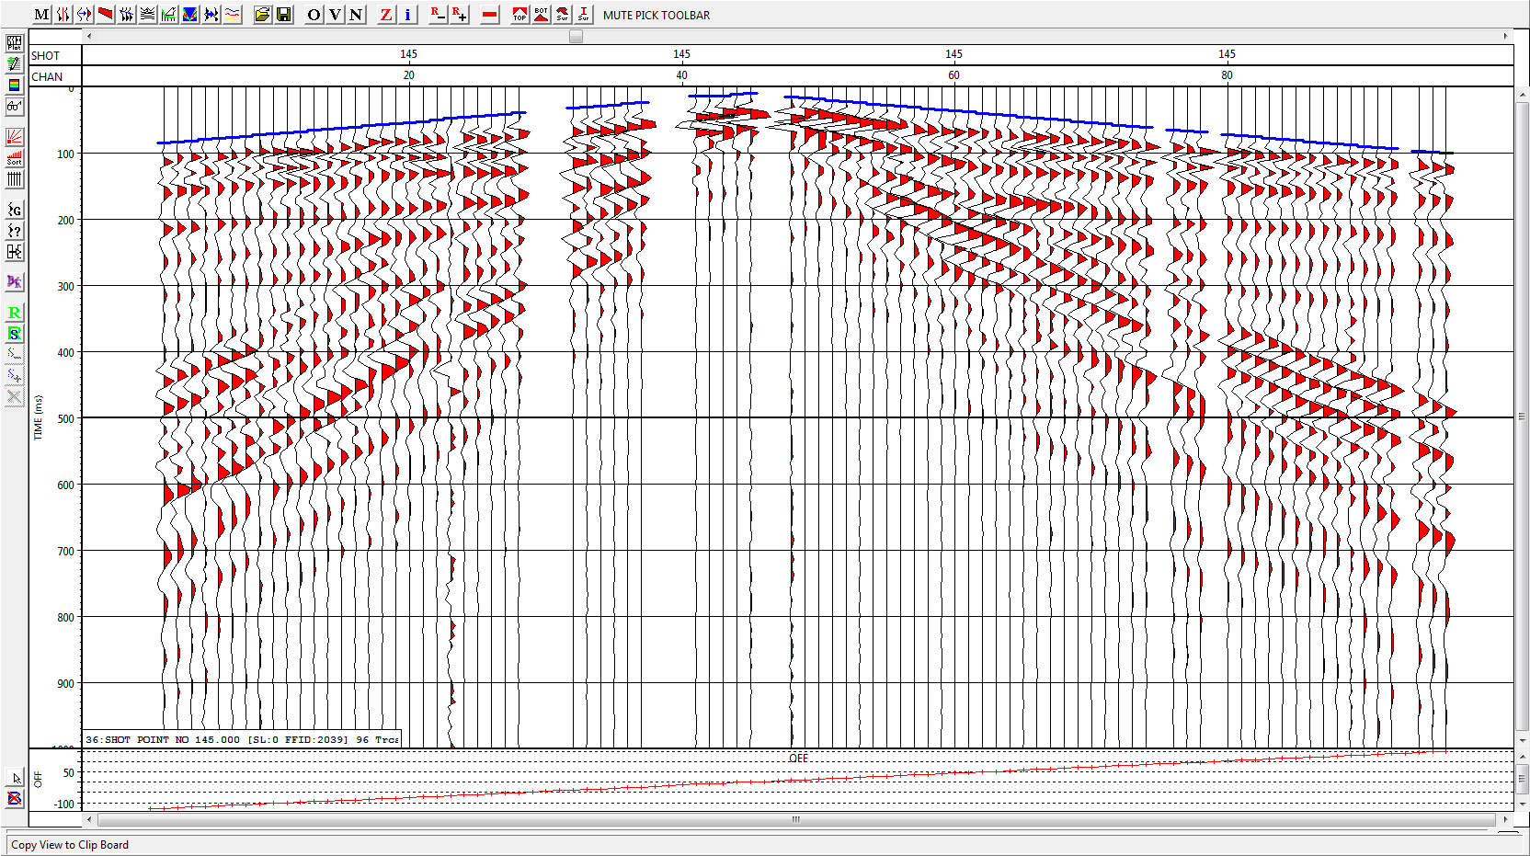

Slide 19
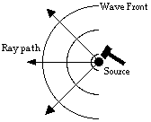
2. Seismic Processing Sequence
(6) Amplitude correction
The correction for the loss in amplitude of a signal as it travels through the earth and spreads its energy over a larger surface area.

Slide 20
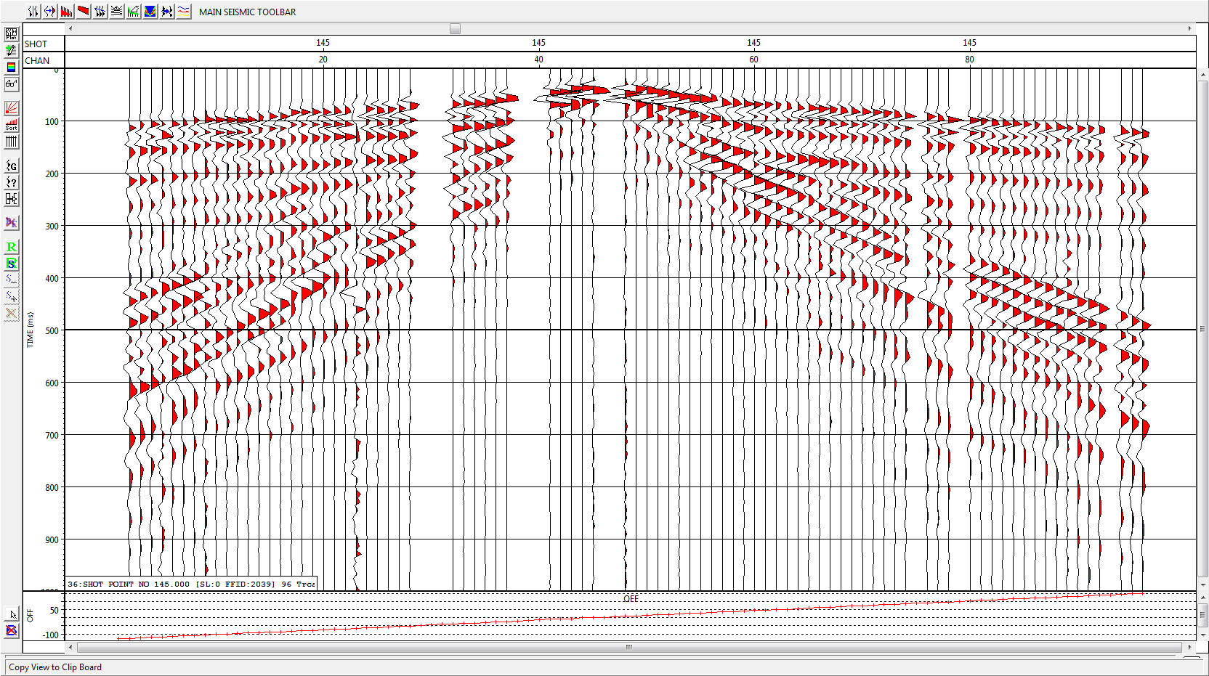
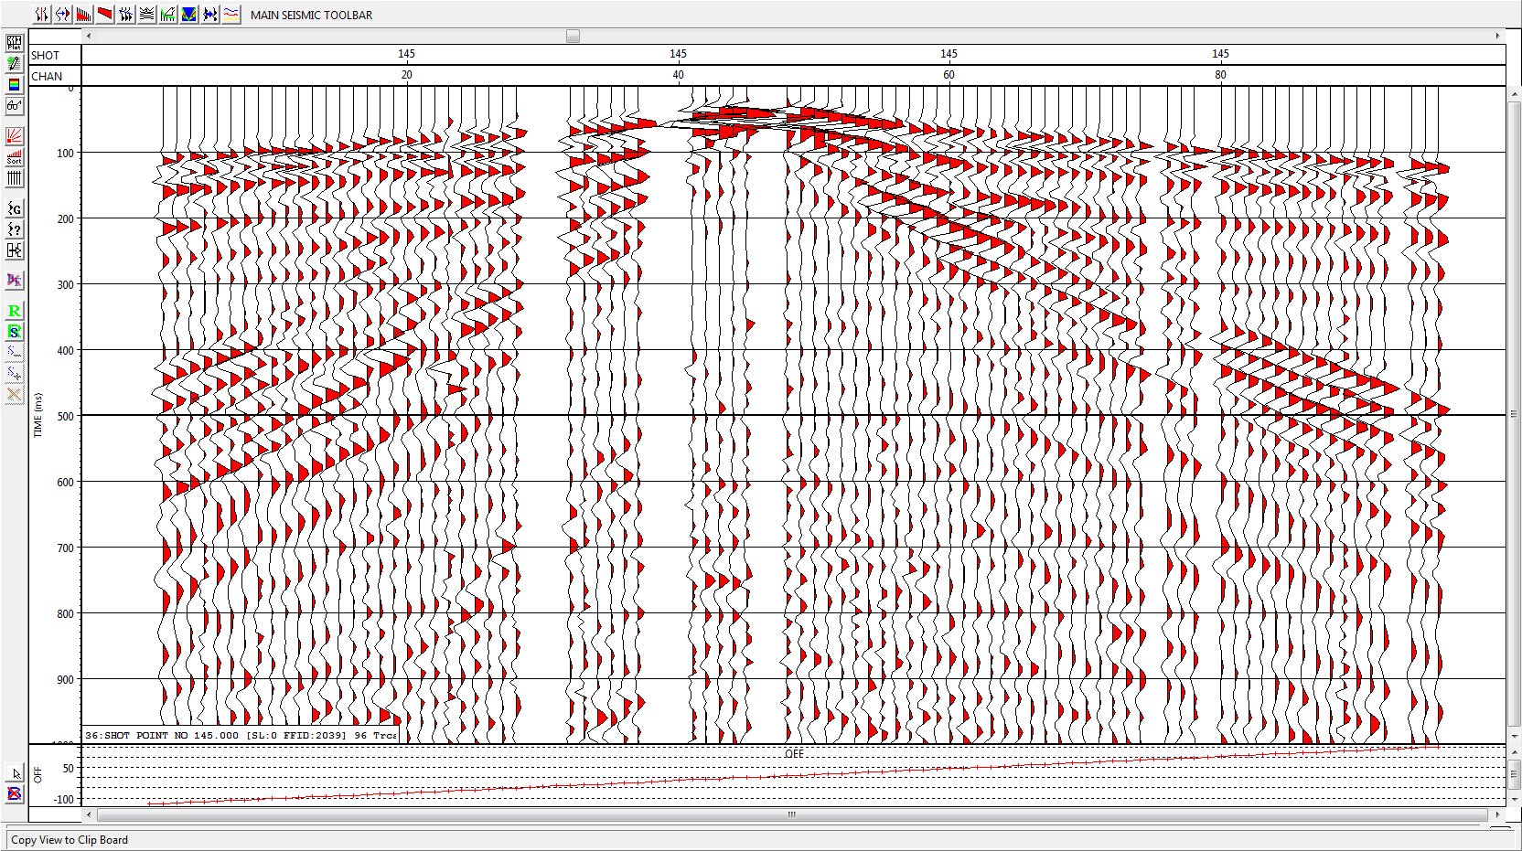

Slide 21
2. Seismic Processing Sequence
(7) Band-pass filter and f-k filter
Band-pass filter: It reduces or enhances the signals of certain frequency.
f-k filter: It reduces or enhances the signals of certain velocities.
They are effective ways to eliminate the coherent noise.

Slide 22
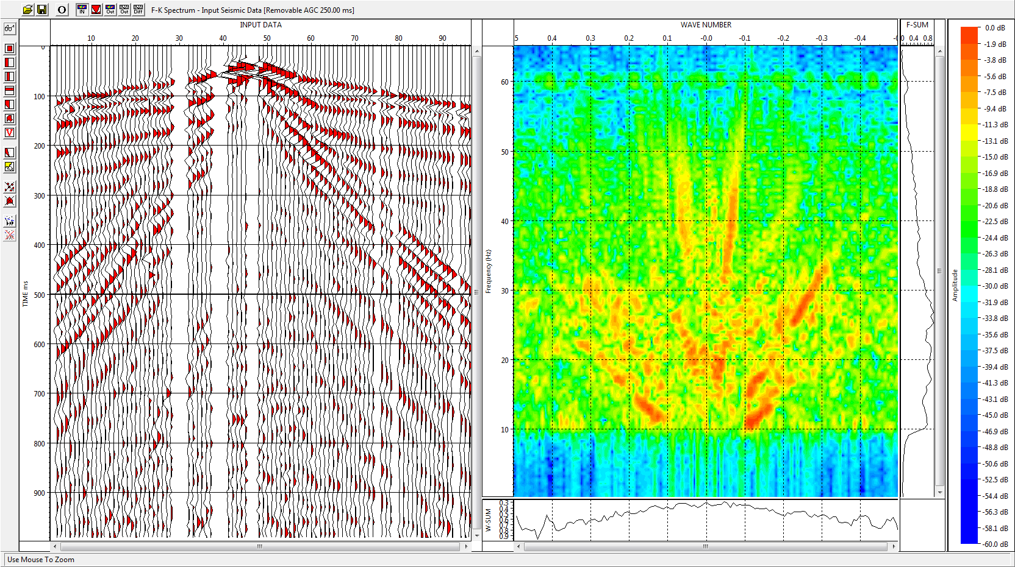
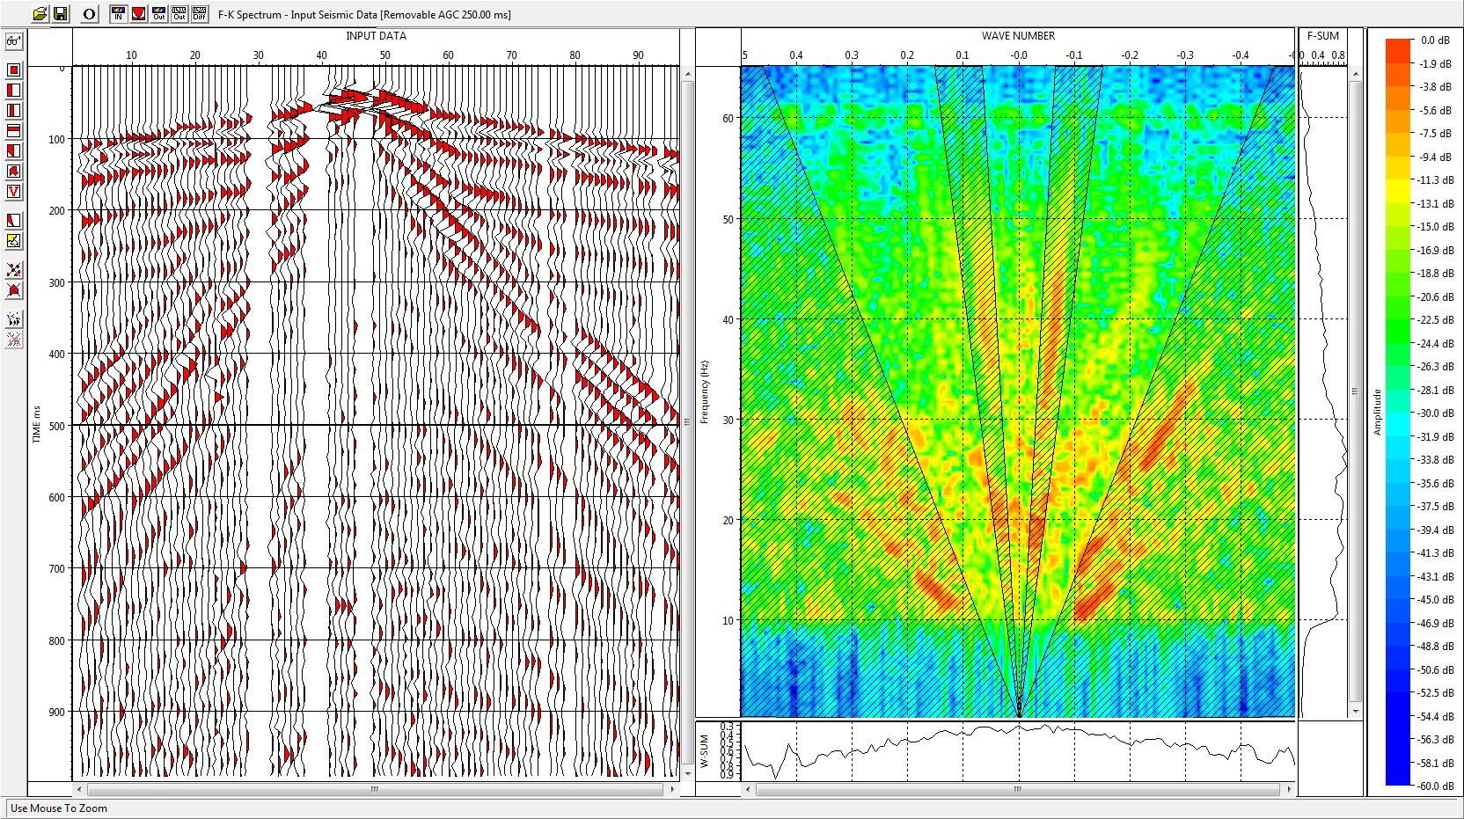
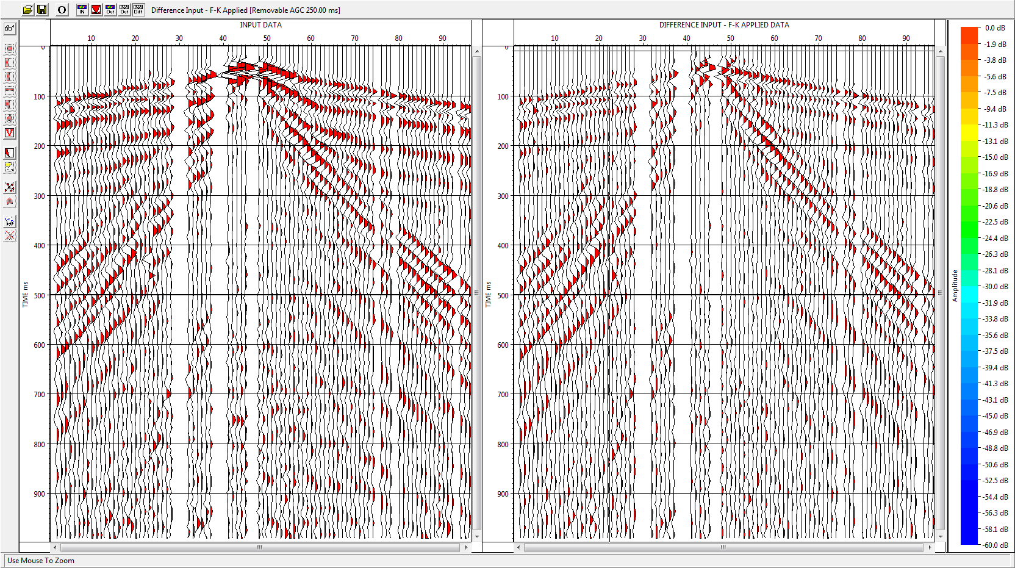

Slide 23

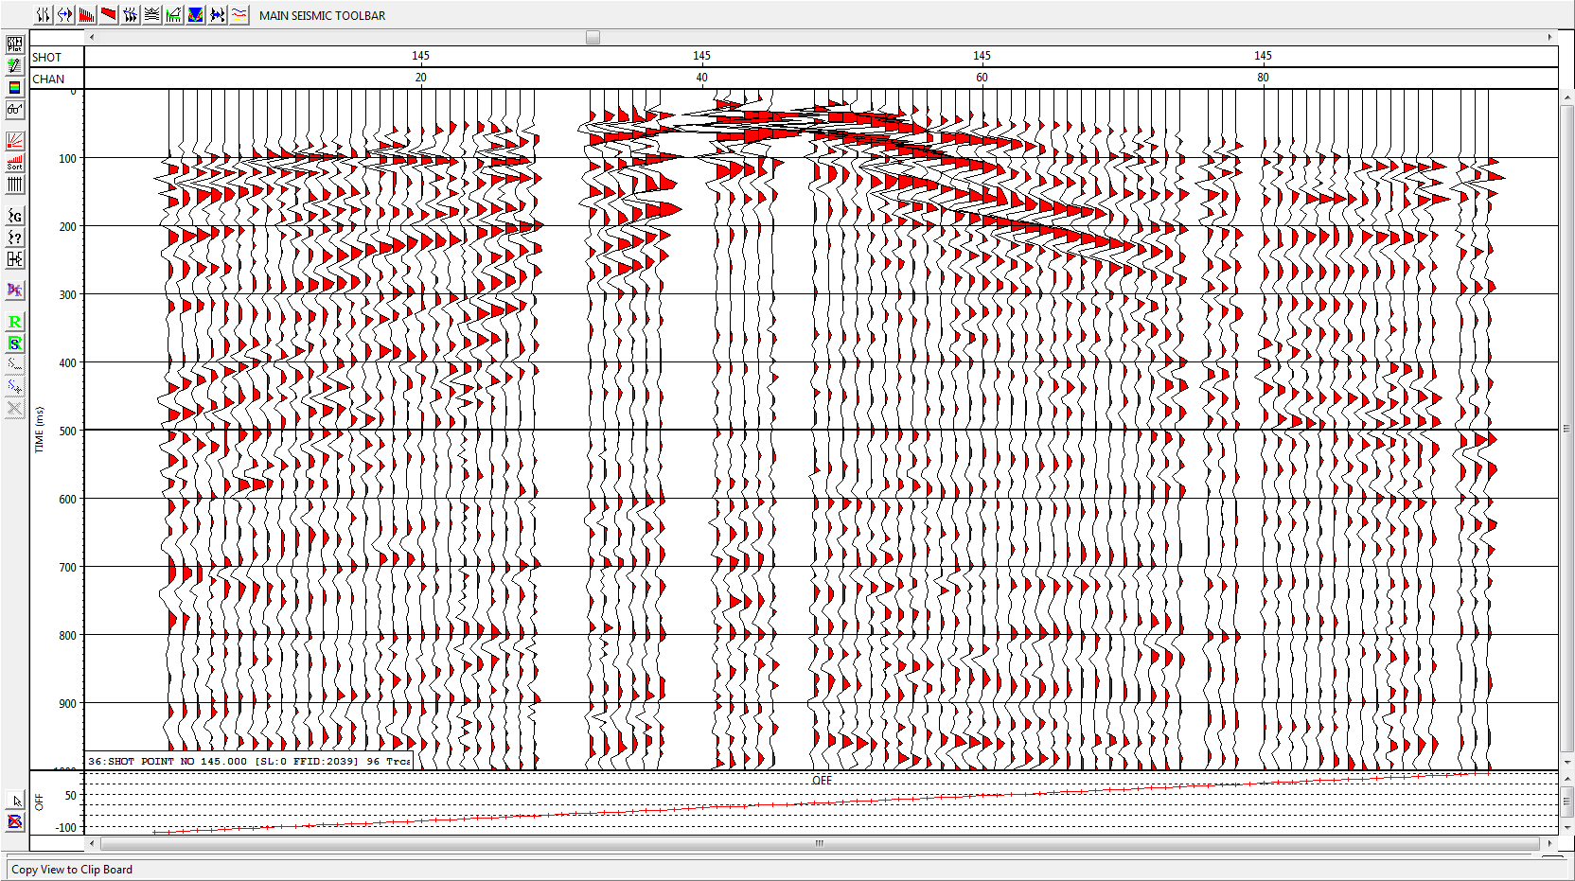

Slide 24
2. Seismic Processing Sequence
(8) Velocity analysis
The objective of velocity analysis is to determine the seismic velocities of layers in the subsurface.
There are different types of seismic velocities. We are going to work with stacking velocities which will be used afterwards for NMO correction of our data.

Slide 25
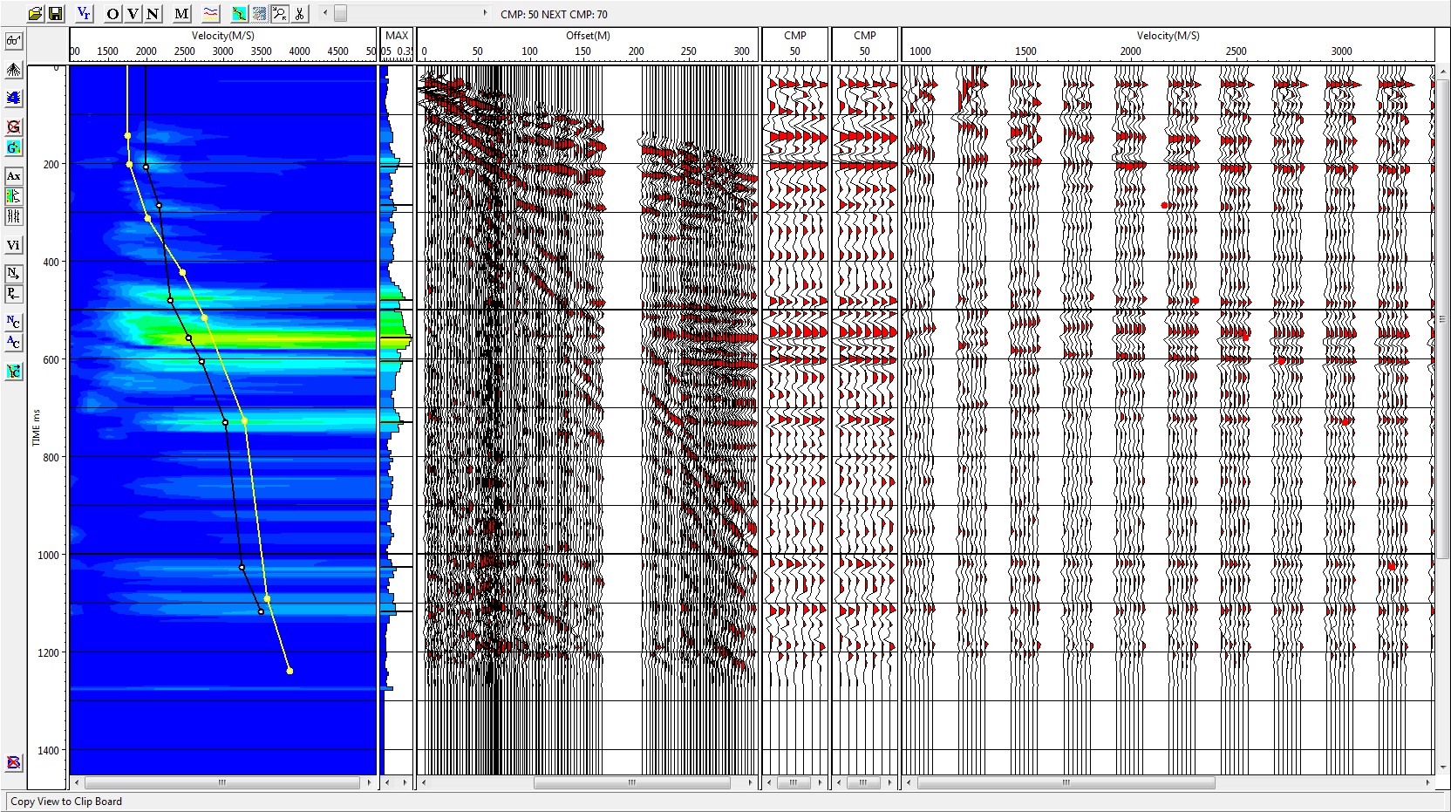
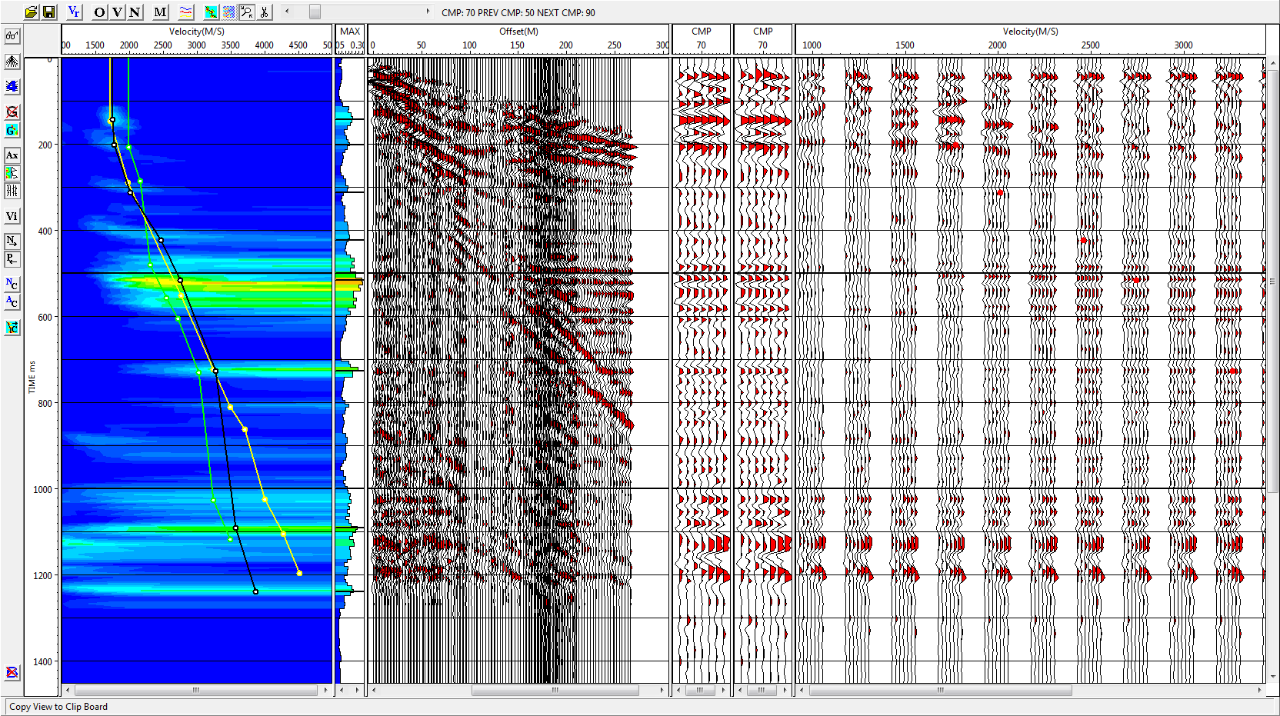
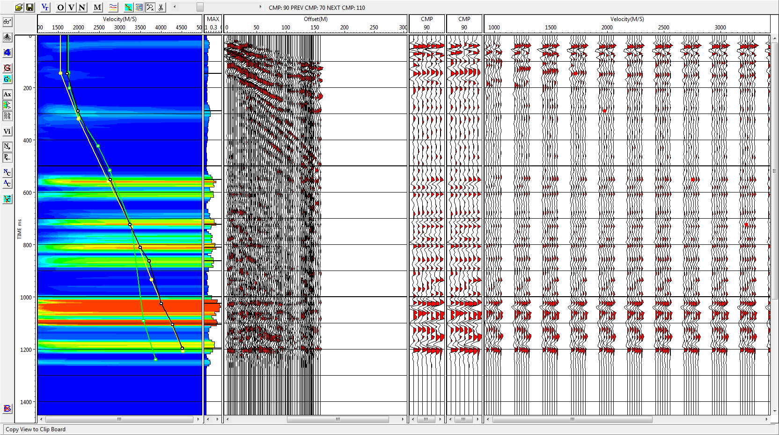

Slide 26
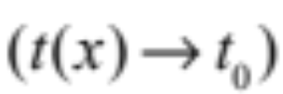
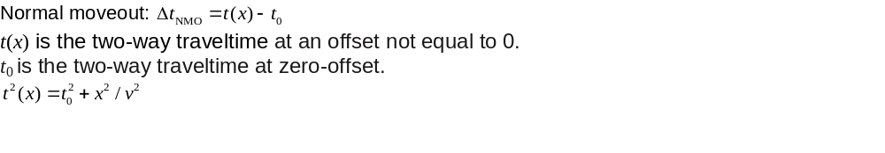
2. Seismic Processing Sequence
(9) Normal moveout (NMO) correction
NMO correction removes the time shift of the reflections caused by non-zero offset.

Slide 27
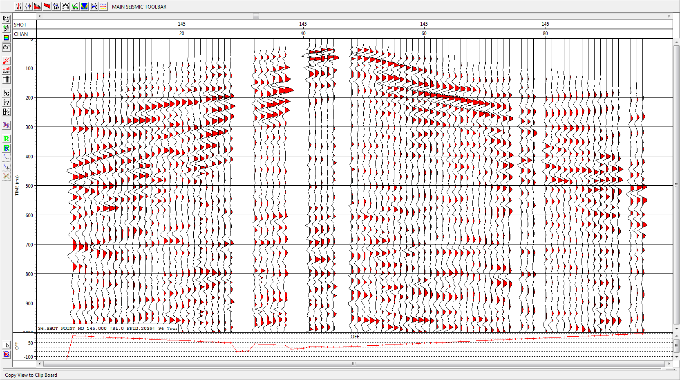

Slide 28
2. Seismic Processing Sequence
(10) Residual statics
Removal of any time shift remaining after the NMO correction.

Slide 29
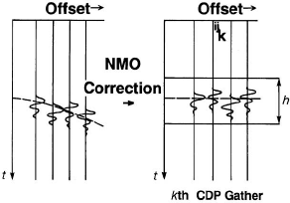

Slide 30
2. Seismic Processing Sequence
(11) Stack
The traces in the NMO-corrected CMP gather are stacked (summed up) to produce one stacked trace that represents that CMP.
The resulting stacked traces represent a zero-offset recording.

Slide 31
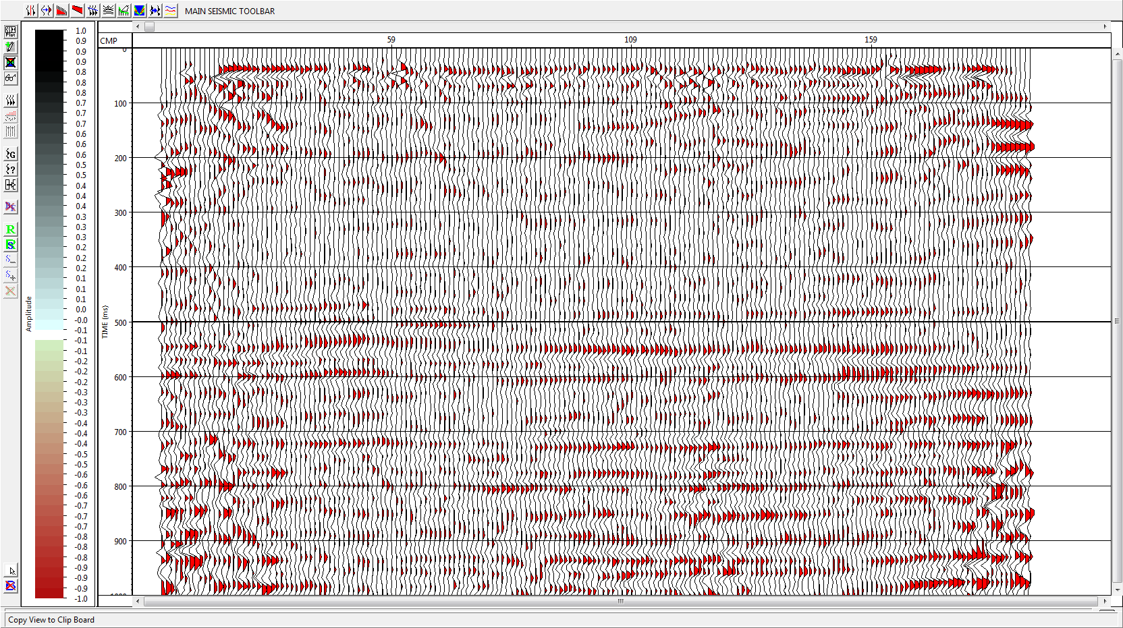
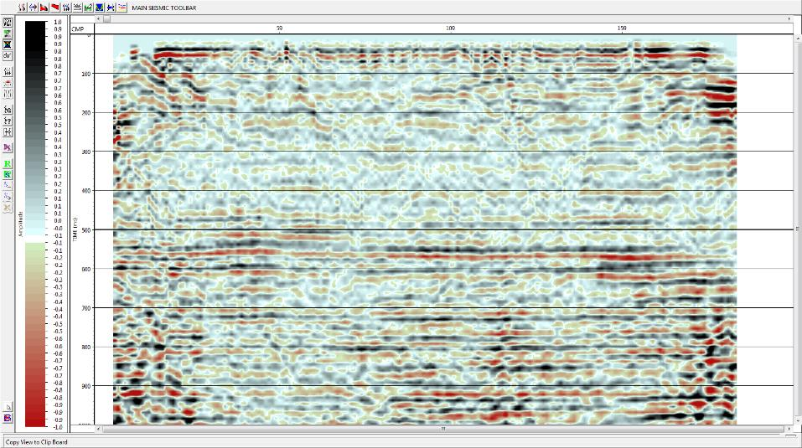

Slide 32
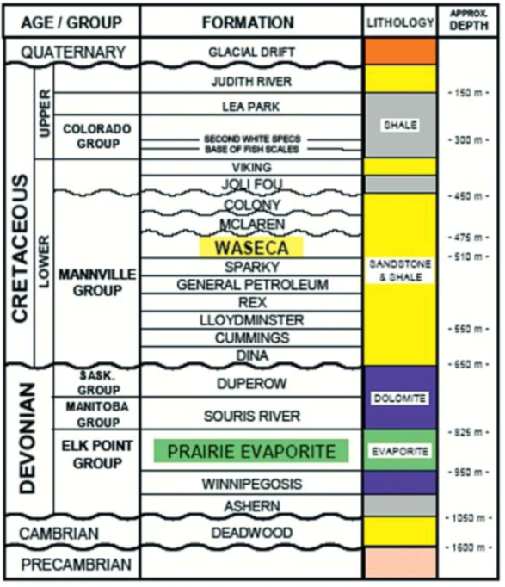

Slide 33
Mannville Group
Sask & Manitoba Group
Elk Point group

Slide 34
3. Summary
Create and load geometry
Residual statics
Stack
Trace edit
Normal moveout
Geological Interpretation
First arrival picking
Velocity analysis
Elevation and refraction statics
Filter
Muting
Amplitude recovery
Deconvolution

