Slide 1
Analysis of Shallow Refraction Seismic Dataset from Geological Engineering Field School 2025
(25 August 2025, area near Peturrson’s ravine)

Slide 2
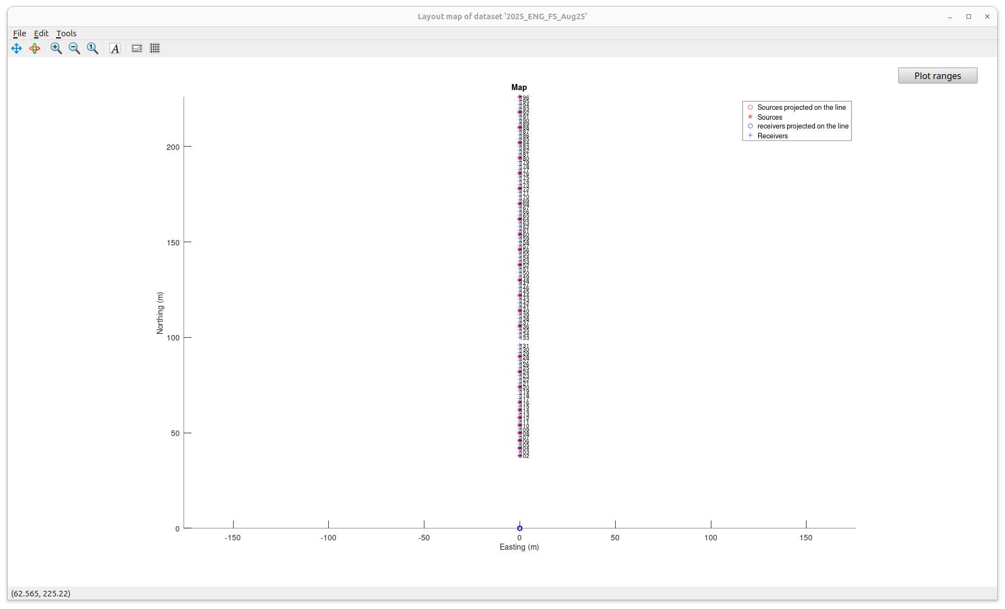
Map
First step of data analysis always consists of setting up and checking geometry of the survey.
This was a simple “fixed-spread” line of 96 geophones spaced at 2 m intervals. One location in the map is missing due to a bad channel in the recorder.
Sources were spaced at 3-4 geophone intervals (red).
Sensors were 28-Hz vertical-component geophones.
Source was 4-lb (?) slide hammer .

Slide 3
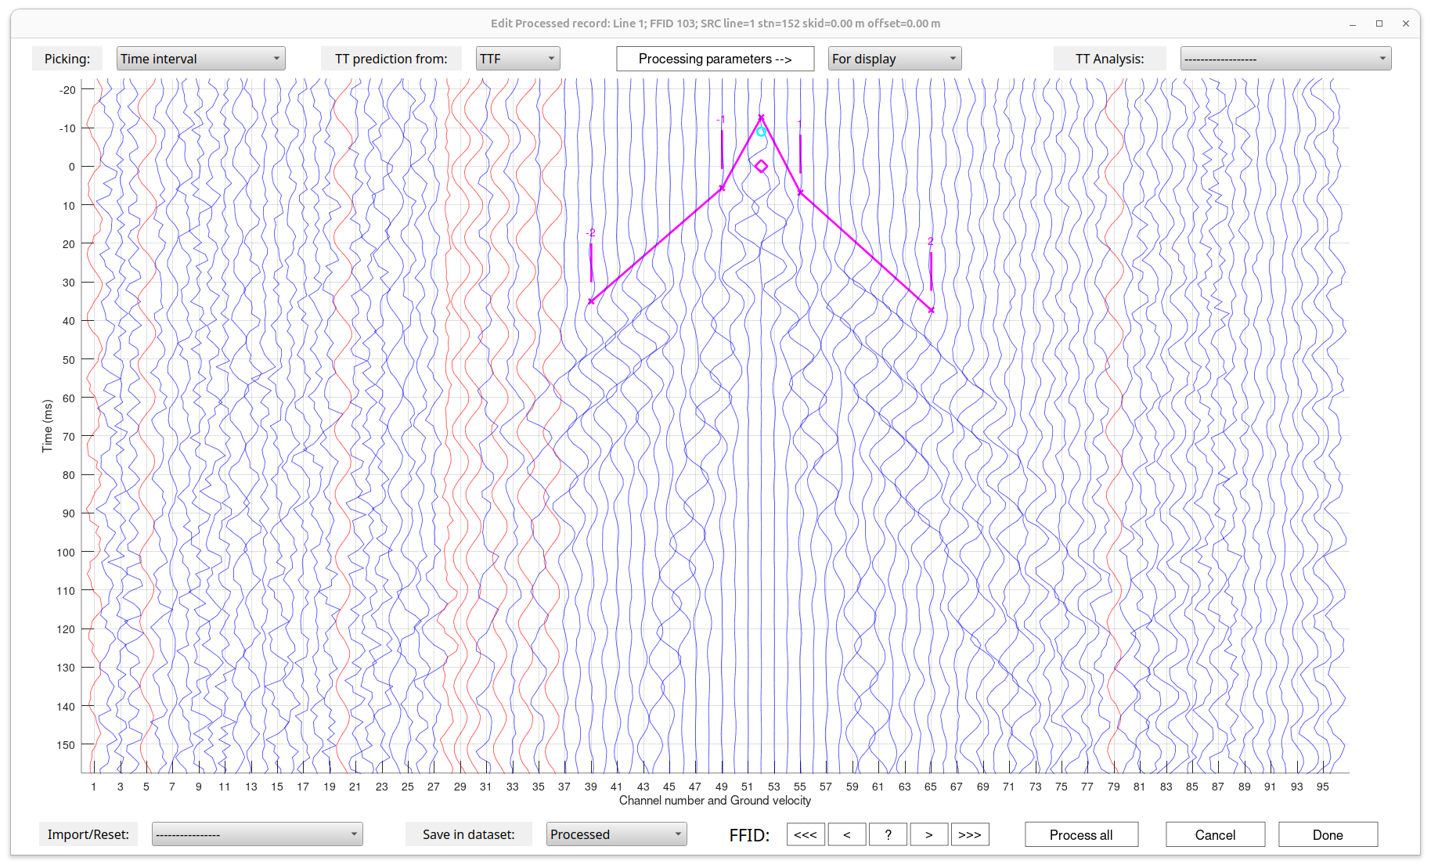
Example of Interactive identification of arrivals and travel-time picking.
We do this picking in a simplified way, only picking segments of direct-wave and refraction arrivals. The arrivals are differentiated by distinct slopes in the (distance,time) plane. These slopes are called “moveouts” (or “ray parameters”, inverse wave velocities).
This was done for many shots by Calla Henry (Geophys. Student).
See next slide.
Direct waves (travelling above the boundary)
Refracted waves (travelling below the boundary)
These waves appear to be shallow S-waves because:
1) They are very slow (velocities shown at the end of this presentation);
2) At such short distances, P-waves have near-horizontal ground motions which are not sensed by the vertical-component geophones.

Slide 4
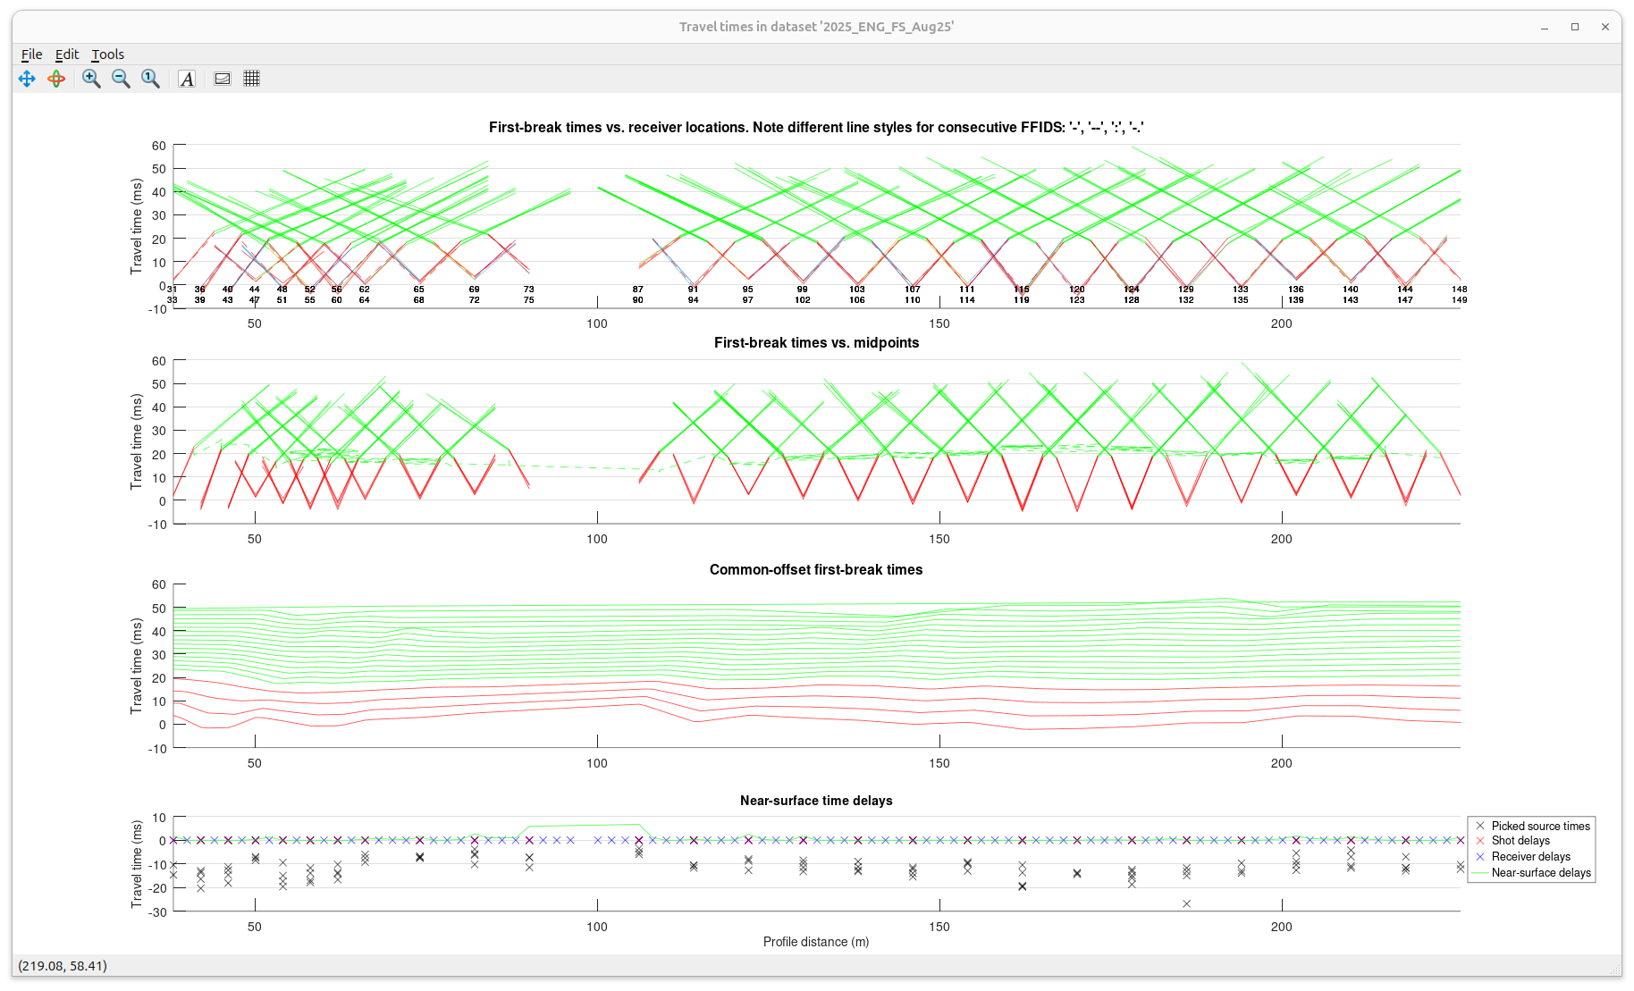
These plots show all travel times picked from the records.
Red colours show direct waves, and green are refractions
Travel times vs. receiver locations.
Numbers indicate different hammer strikes conducted at the same points
The same travel times vs. MIDPOINT locations
The same travel times sampled at a grid of offsets *source-receiver distances”
Picked source delay times and corrections derived from reciprocal travel-time analysis (next slide)

Slide 5
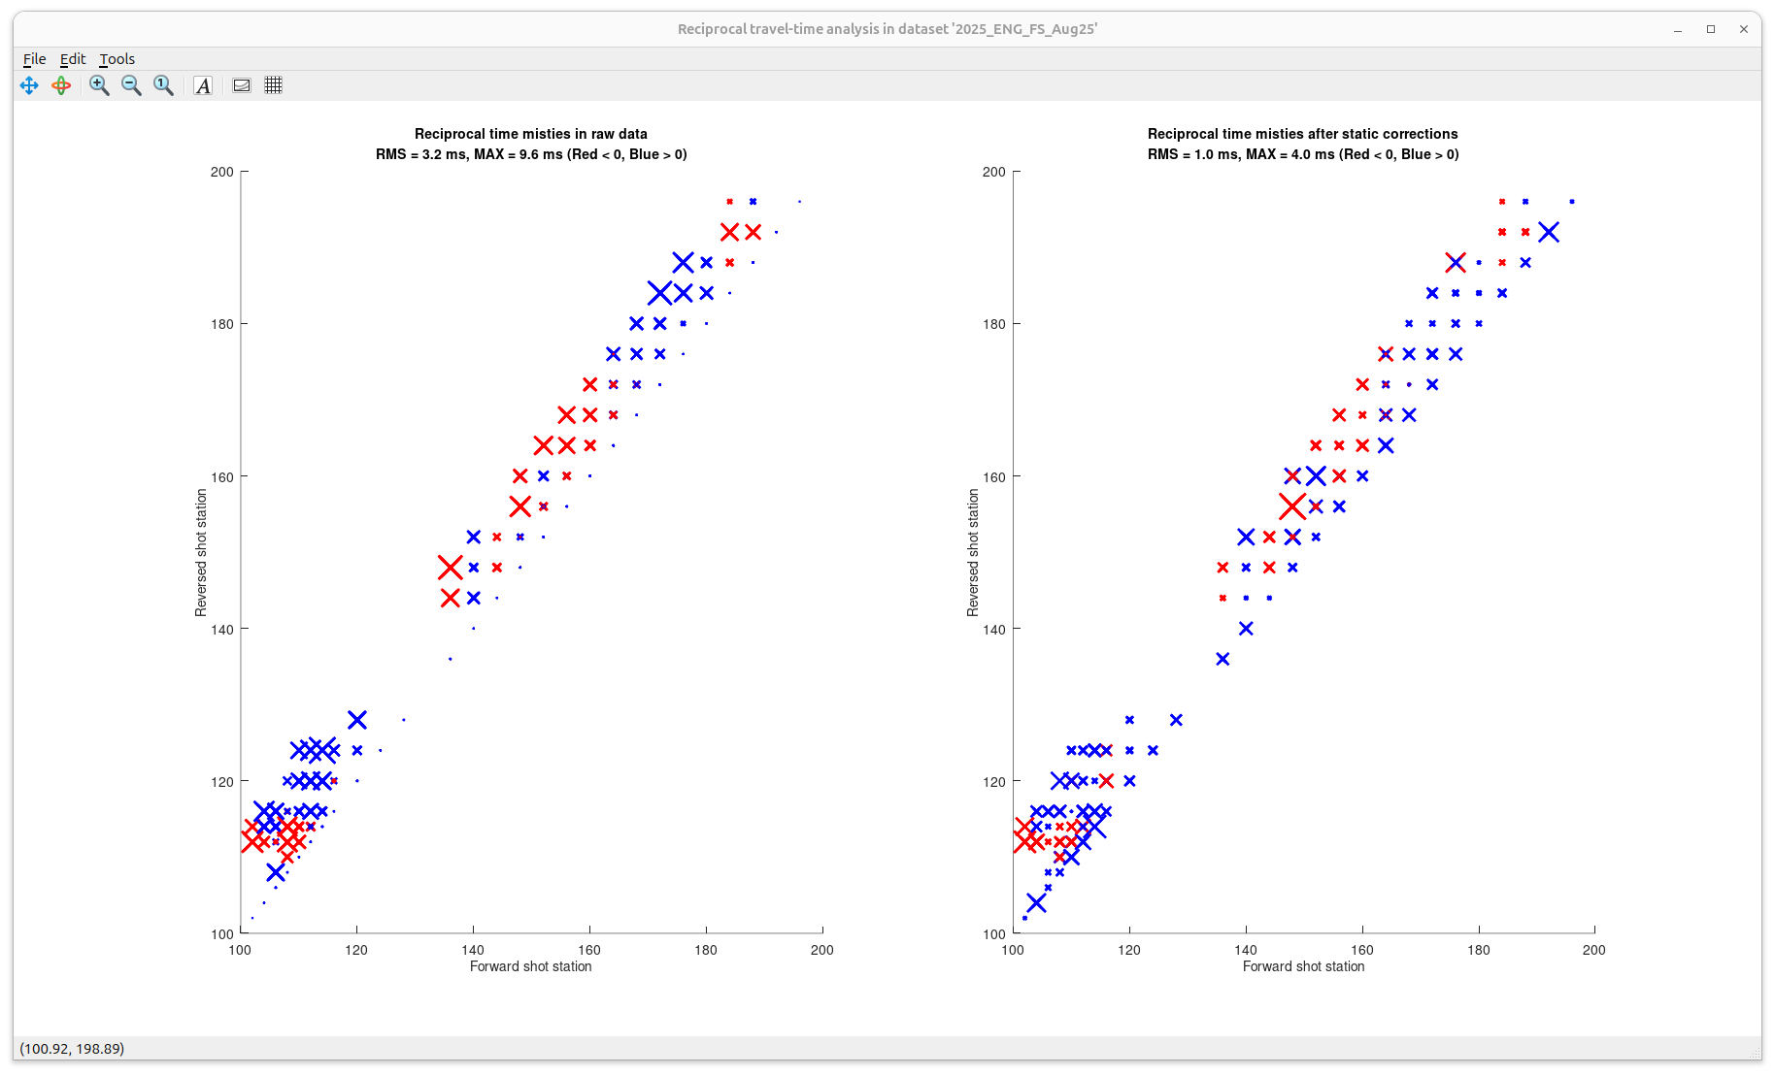
Reciprocal travel-time analysis
When picked from records, travel times measured in opposite directions between source-point locations are generally different.
These differences are due to different near-surface conditions near sources and receivers, and uncertainties in phase picking.
These differences are analysed and corrected for as shown in this slide.
Reciprocal travel-time differences between source points in raw data (shown by sizes and colours of crosses)
Note the 3.2 ms RMS value
Reciprocal travel-time differences after corrections of source times.
Note the smaller 1.0 ms RMS value

Slide 6
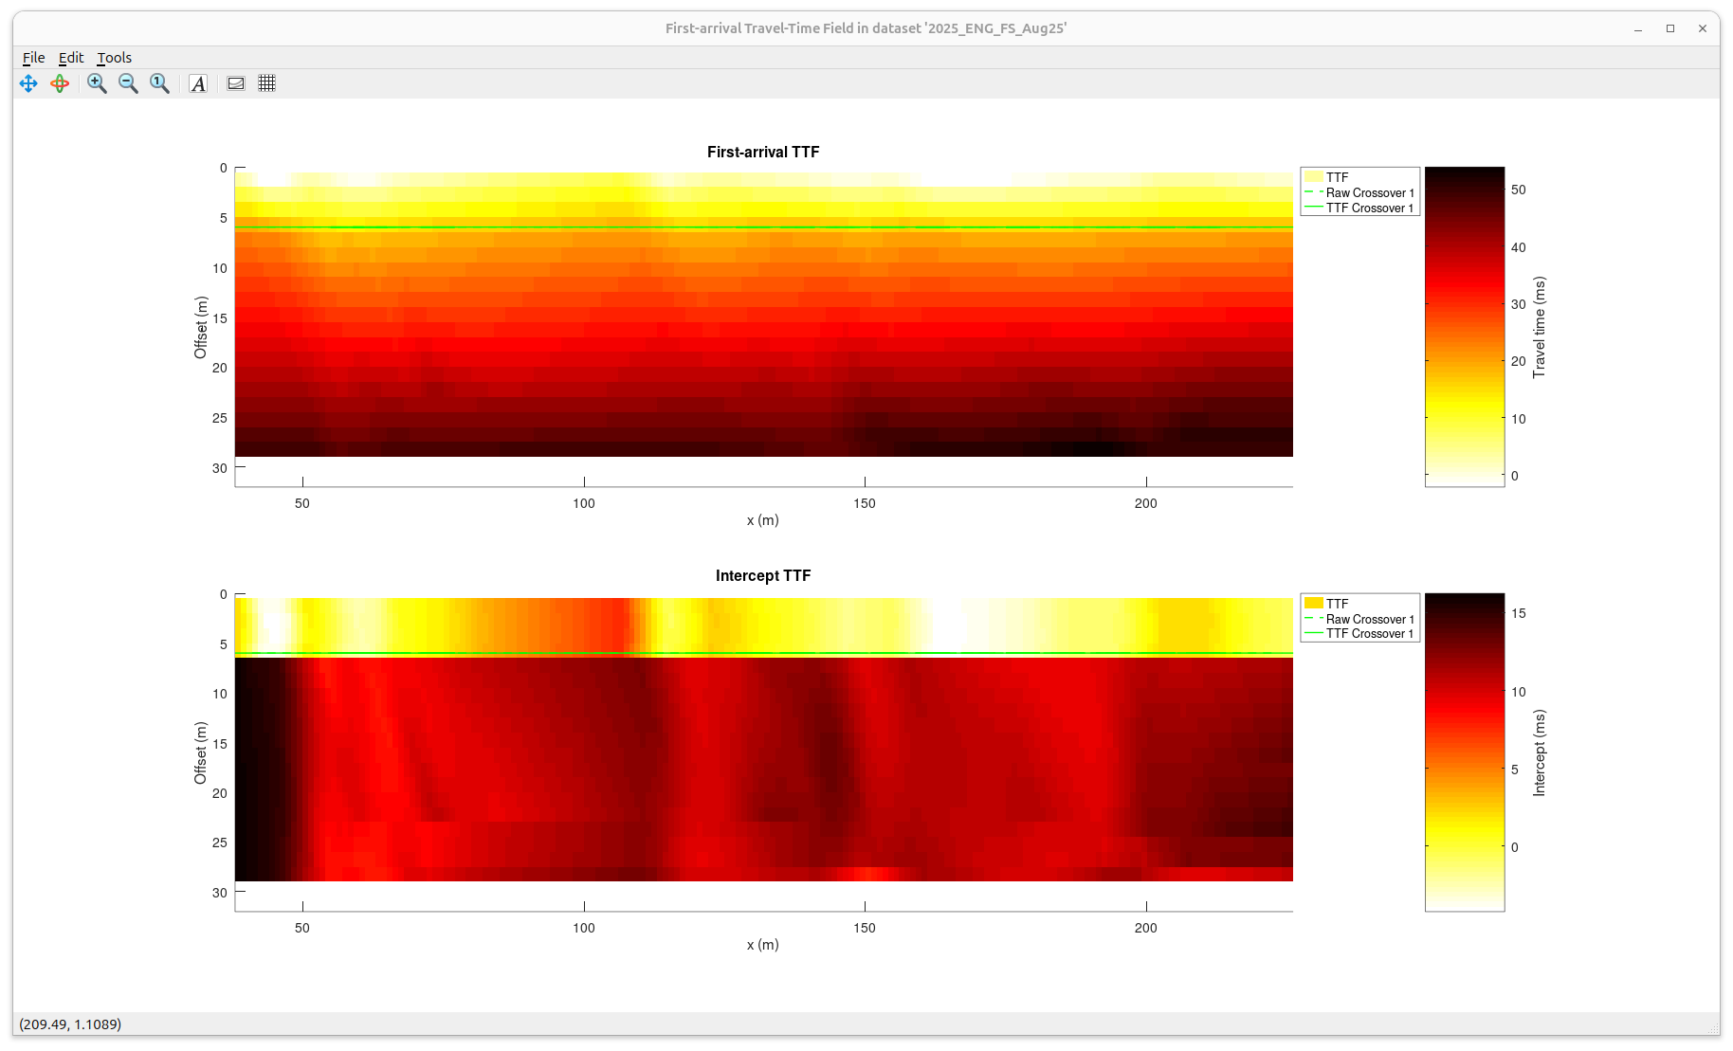
Taken together, all travel times in slide 4 represent sampling of a continuous function in the (midpoint,offset) space, called the “Travel-Time Field” (TTF)
This plot shows the interpolated continuous TTF.
Note the change of colour with offset (downward), which represents increasing travel times. This increase is called “moveout”.
Green line is the “crossover” separating direct waves from refractions
This plot shows “reduced” TTF, in which the moveouts within the direct and refracted waves are subtracted.
The resulting near-constant values are the “intercept times” for the direct and refracted waves.

Slide 7
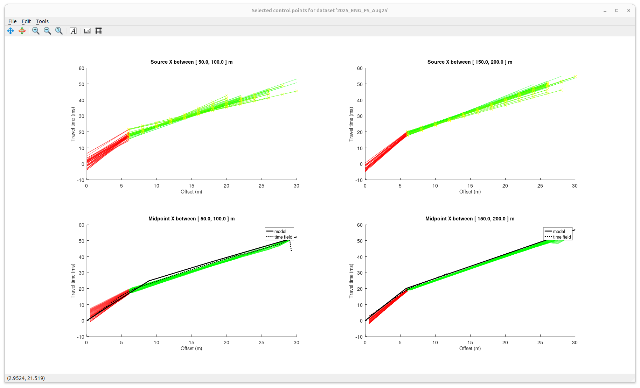
Another way to look at the picked travel times – select travel times within ranges of source or midpoint positions. Such ranges are called “control points” and used to construct starting models for inversion.
Note that the common-midpoint time(offset) dependence derived from the TTF (dotted black line) matches the travel times well.

Slide 8
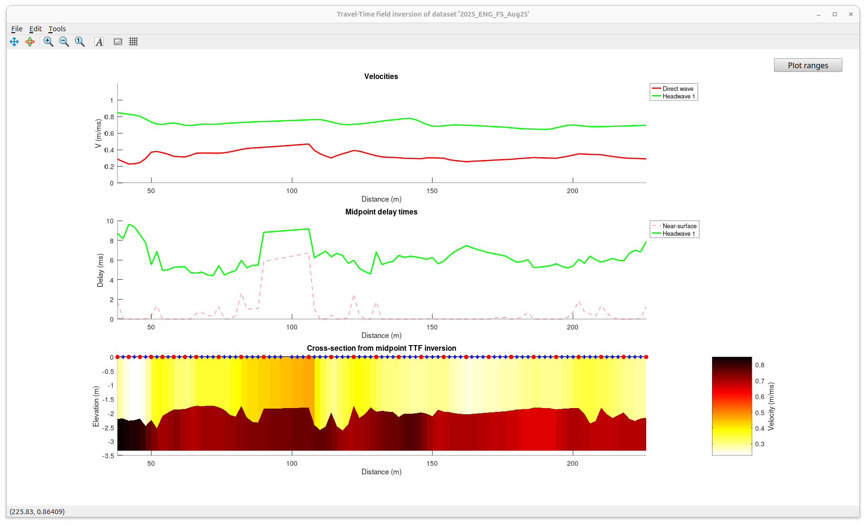
Travel-Time Field inversion
The interpolated TTF can be inverted as 1-D travel time curves (preceding slide) at each midpoint location.
This inversion requires no complex algorithms and gives a fairly accurate depth-velocity model .
TTF-inverted velocities of layers
Disregard the delay-time “bump” near 90-105 m distances. Unfortunately, It is produced by missing recordings in this interval.
Refraction delay times from TTF inversion
Depth-velocity model .
Note the strong velocity contrast near 2-m depth.

Slide 9
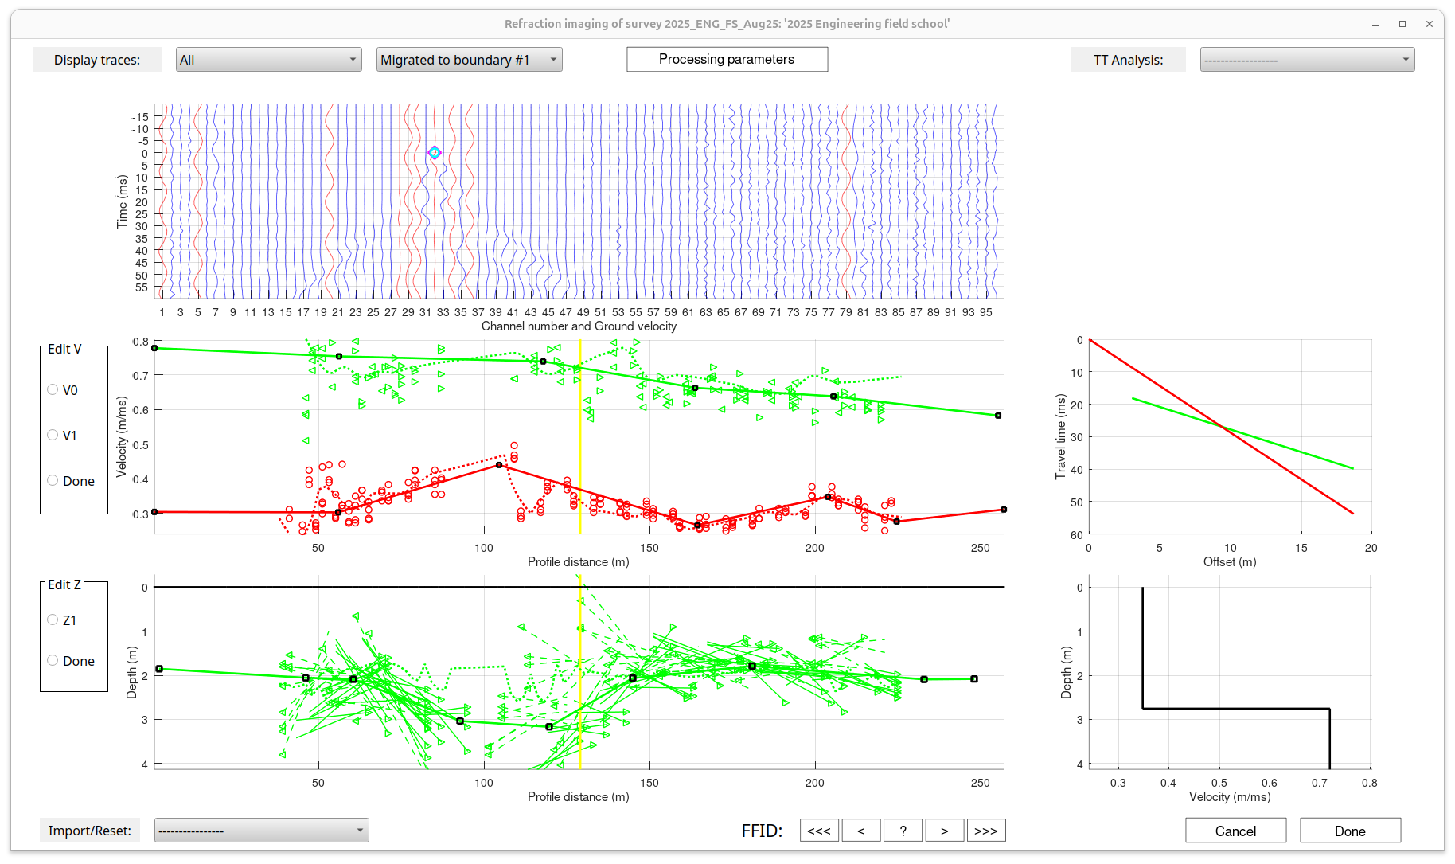
Interactive inversion
Final inversions are typically obtained by interactive modelling using ray tracing. This is a tedious procedure relying on elaborate interactive software. However, the TTF inversion gives as a good starting model (dashed lines) making this task much easier.
This image is not completely implemented but is supposed to show seismic records migrated (overlaid) onto the position of the boundary in depth.
Travel times at the position of yellow cross-section line on the left
Velocity editor
Boundary depth editor
Velocity model at the position of yellow cross-section line on the left

Slide 10
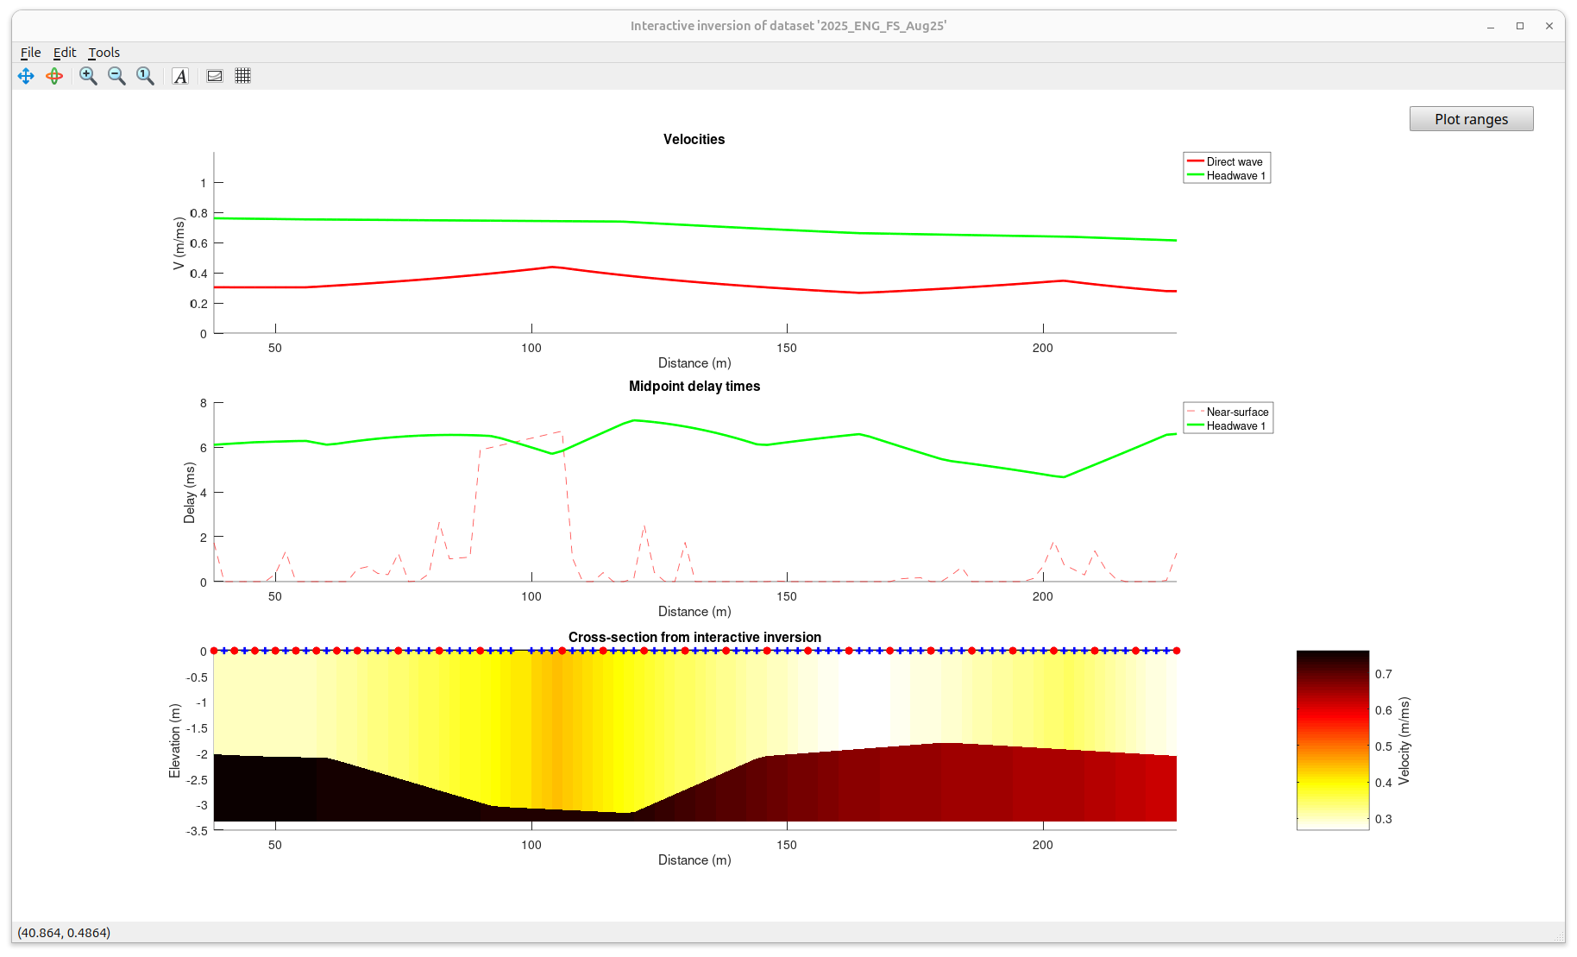
This is the final (so far)result of the interactive inversion.
Note that the inversion still suggests a deeper boundary in the area of our data gap (100-120 m )

