Slide 1
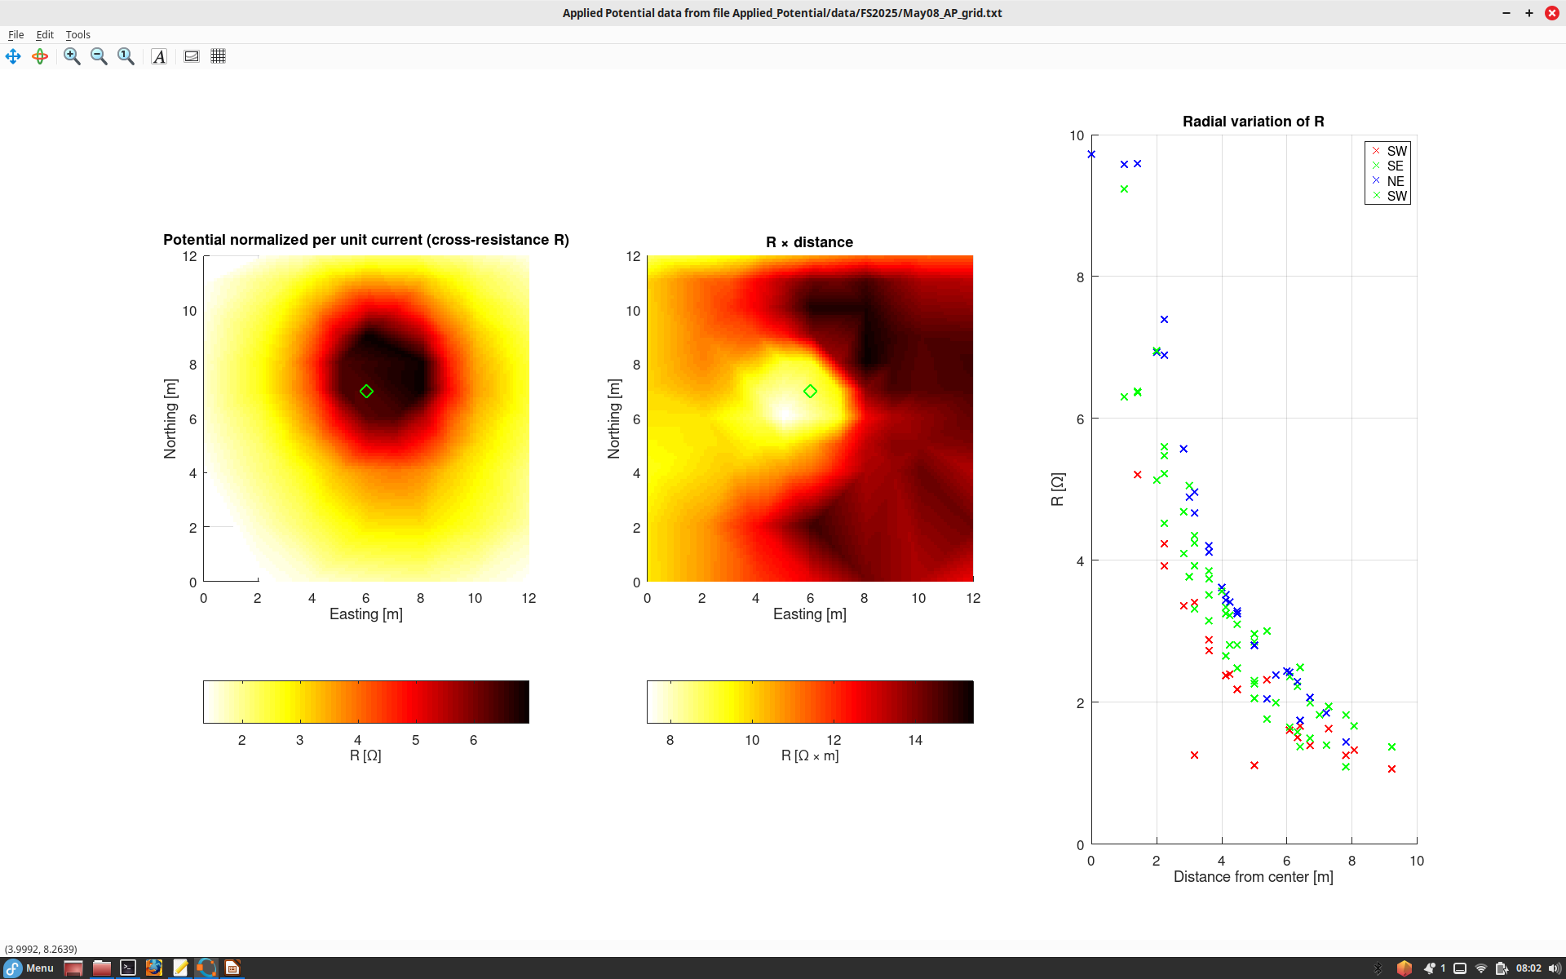
Quick analysis of Applied Potential grid data.
This panel shows the measured potential (voltage relative to infinity) divided by current. Note that this ratio is the resistance R. Note that the resistance between a point near target and infinity is about 10 Ohm.
Green diamond is the location of highest potential (top of target).
Scaled potential R = V/I vs. distance from the source, in four directions from the source.
Note that potentials decrease quicker to the SW.
This is because of the shape of the target and the effect of fence.
In this panel, the normalized potential is multiplied by distance from the source point. This corrects for the 1/distance decrease of potential and emphasizes the effect of the shape of the target.
Note that the target is oriented NW-SE and seems dipping toward NE.
Also note the increase of potential to the east because of the (unfortunate) effect of the wire fence.

