Slide 1
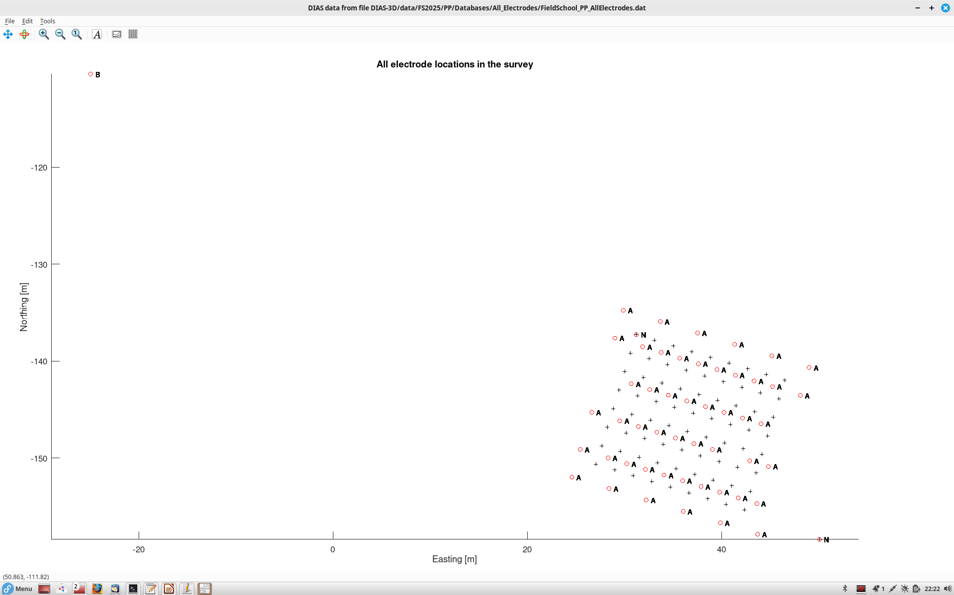
All electrodes in our survey
Locations A (red circles) are current injection points
B is the remote current electrode common to all injections
Unlabelled pluses are electrodes M (measuring voltages relative to N)
N is the reference potential electrode common to all recordings. For some reason, point N was switched between the SE and NW positions after a part of injections was done.
<number>
Coordinates are relative to the GNSS pier near the vault

Slide 2
DIAS (Charlotte Thibaud) applied two types of imaging to this dataset:
1) Using the “pseudo-pole-pole” geometry of the recorded dataset (roaming A and M electrodes with fixed B and N);
2) Combining the recorded V/I ratios to produce a pole-dipole dataset (with roaming A, M and N electrodes and fixed B).
For each of these geometries, two imaging procedures were performed:
a) apparent resistivity volumes constructed by geometric rules;
b) inversion for true subsurface resistivity performed by solving equations of electric current propagation in 3D.
Below, I show results from both of these procedures plus some additional comments about imaging of a single point A.
Finally, most procedures for DC resistivity imaging can be applied to chargeability (Induced Polarization, IP). This is illustrated at the end of this document.
<number>

Slide 3
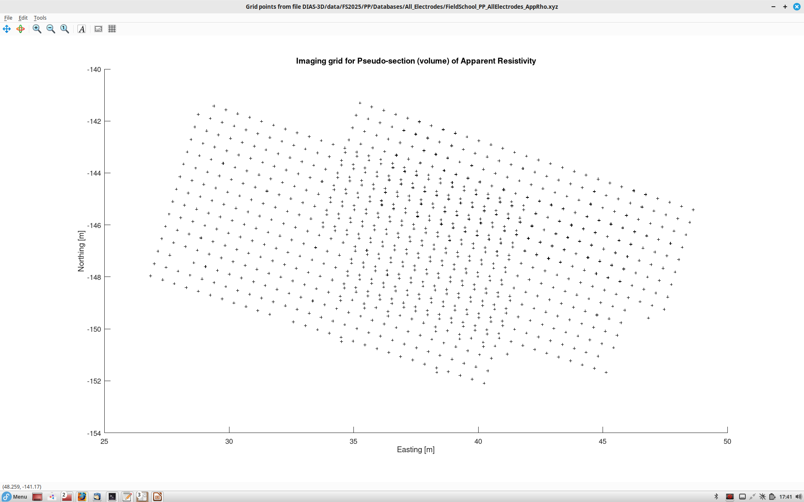
Grid of pseudo-locations (midpoints) for the recorded pole-pole array.
The reference electrode N was changed once during recording, and hence the distribution of imaging locations looks like two sub-grids.
<number>

Slide 4
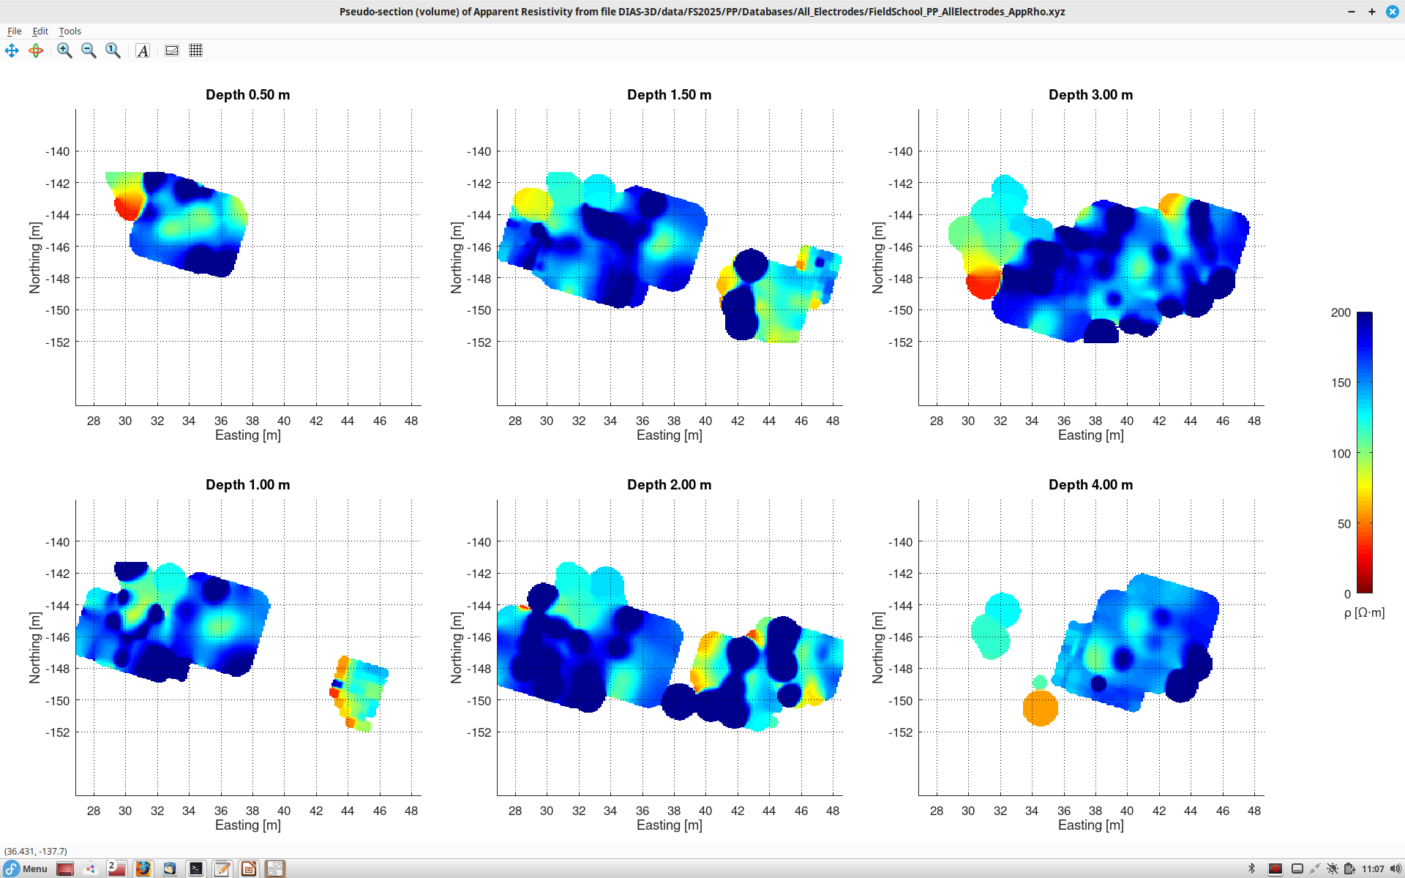
Apparent resistivity from the pole-pole array (as recorded). For each source-receiver pair, the resistivity is obtained at pseudo-depth beneath the midpoint shown in the preceding slide, and averaged using a spatial filter. This gives slices of apparent resistivity at Z = const
<number>

Slide 5
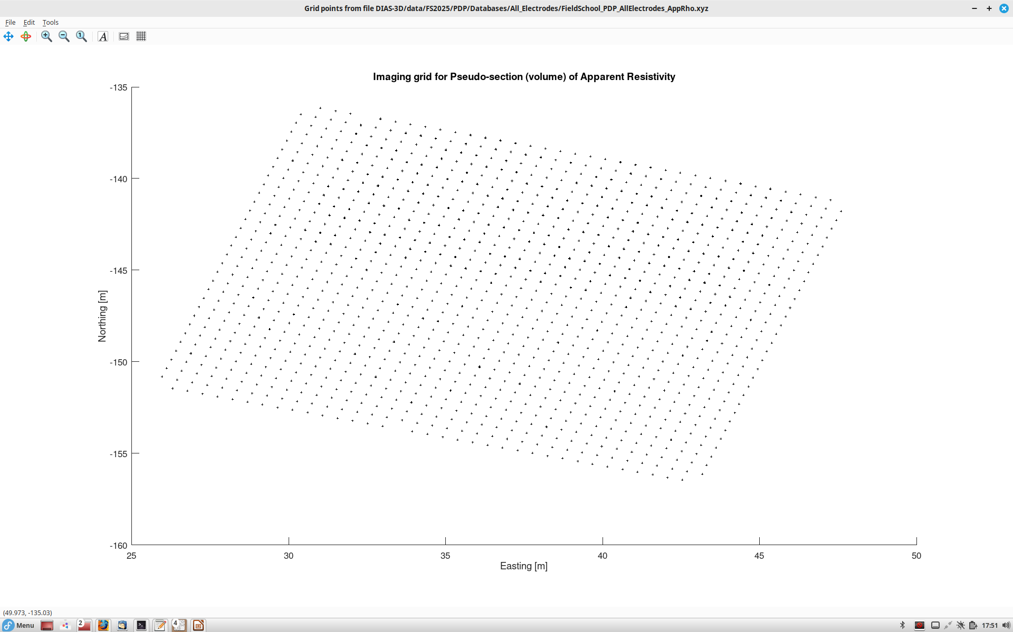
By taking various combinations of data to simulate sampling by the “virtual” pole-dipole electrode arrays.
This image shows pseudo-locations of these arrays. There are roughly 9 times more of V/I ratios here than in the original dataset (preceding slides).
<number>

Slide 6
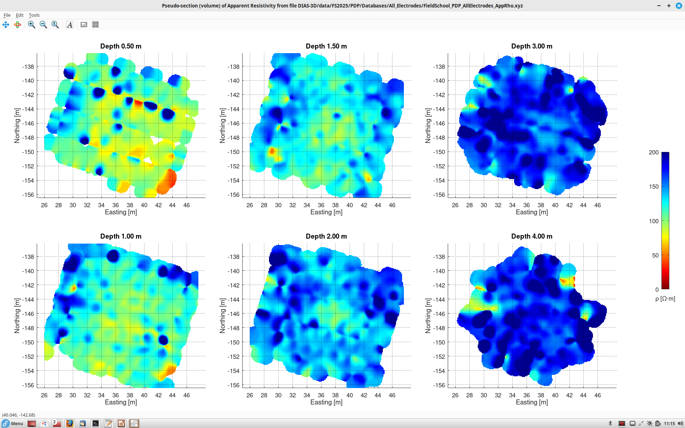
Apparent resistivity by using the virtual pole-dipole like arrays. The apparent resistivities at (midpoint, pseudo-depth) locations are also spatially averaged and shown as slices Z = const
This seems to be our conductive target!
<number>

Slide 7
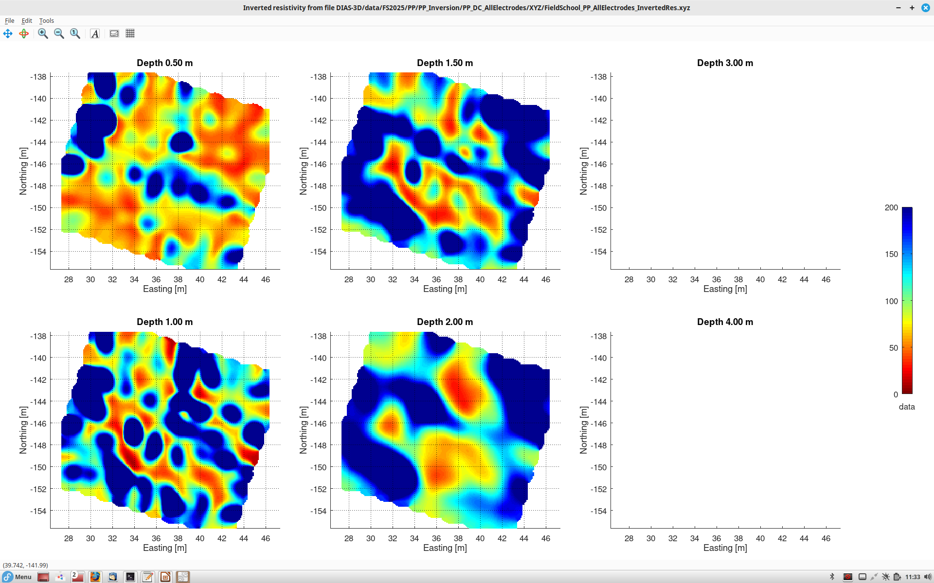
Resistivity inversion using pole-pole geometry (as recorded). Inversion by Charlotte Thibaud (DIAS)
Deeper slices won’t plot for some reason…
<number>

Slide 8
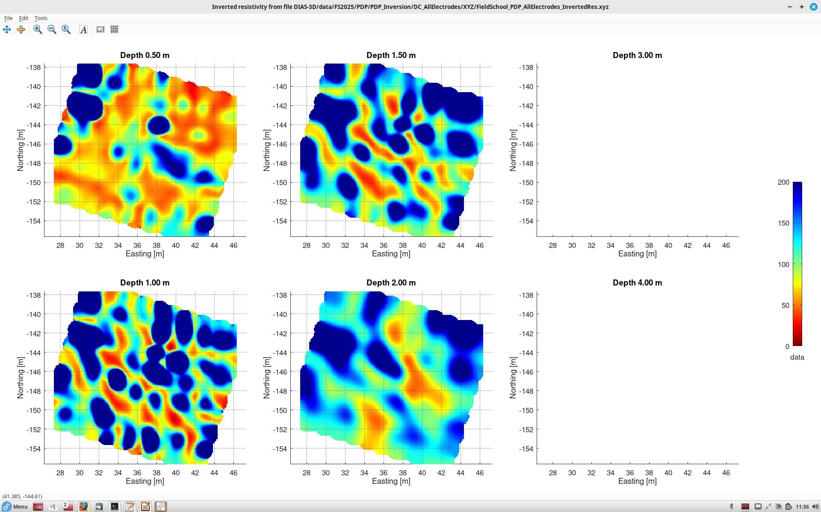
Subsurface resistivity model by constructing numerous pole-dipole electrode arrays and inverting them
<number>

Slide 9
On the following slides, I show a detailed analysis of one current-source injection.
An arbitrary location of electrode A near (easting = 38 m, northing = -145 m) was selected.
These slides also summarize the general procedure of resistivity imaging and illustrate the concept of “resistance matrix” (slide 12)
<number>

Slide 10
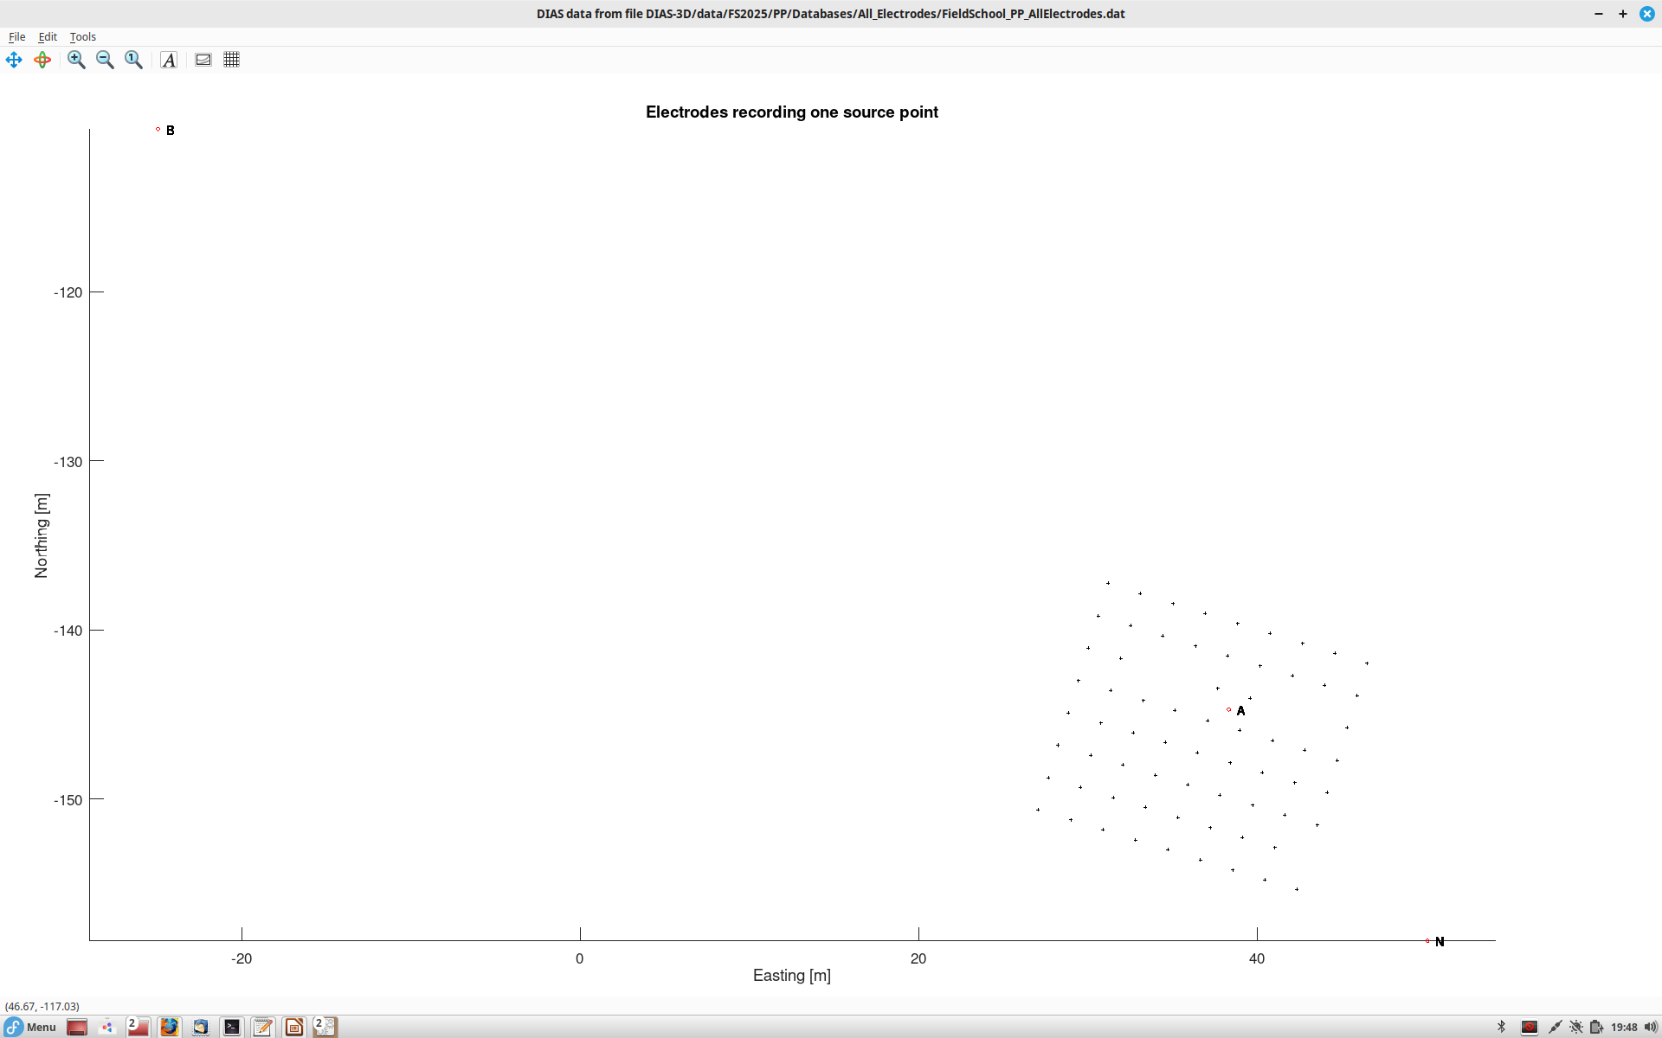
This slide shows the geometry of recording, and the measured potentials are shown in the next slides.
A is the selected current-injection point,
B (northwest corner of this image) is the remote current return point.
Voltage is measured between points M (unlabelled crosses) and reference electrode N (southeast of the swath of electrodes).
For true “pole-pole” electric recording, reference electrodes would be placed at “infinity”, i.e. distances much larger than the size of the study area. However, DIAS uses nearer placement of reference electrodes (“pseudo-pole pole array”) for efficiency of data acquisition.
<number>

Slide 11
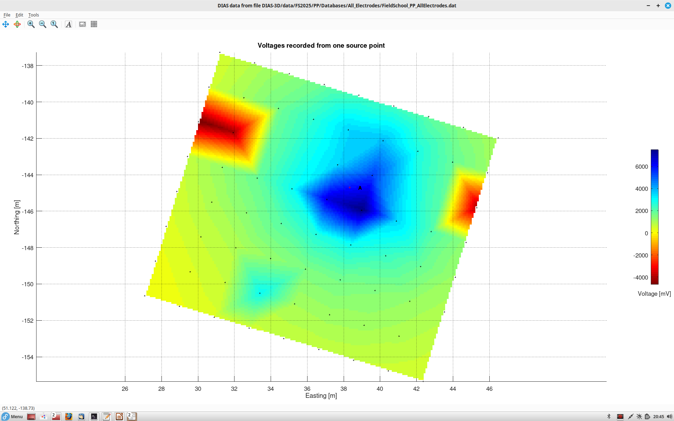
Interpolated map of voltages recorded from this source point.
The voltage should generally decrease as 1/distance away from the current injection point.
This is generally what we see; however, note several electrodes with negative voltages. These are likely due to topography and self-potentials
<number>

Slide 12
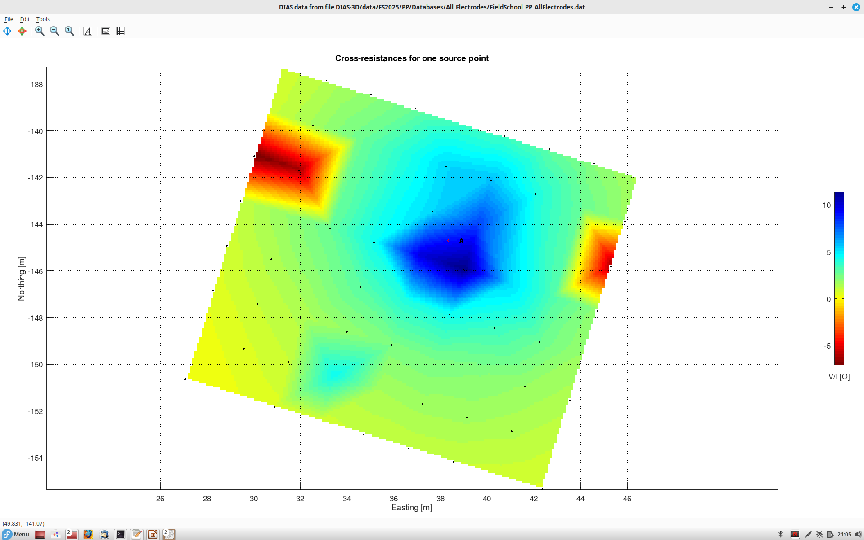
Dividing V by the injection current (I = const), a map of cross-resistances for the array is obtained.
This image represents one row of the resistance matrix R which we also tried measuring with SYSCAL.
To complete the resistance-matrix row, we need to measure the voltage at the current electrode A.
Unfortunately, this voltage is not provided in DIAS data, and we also could not measure it in our SYSCAL test.
Note that R = V/I tends to zero at the infinity and is about 10 Ohm near the source (at about 1 m from electrode A)
<number>

Slide 13
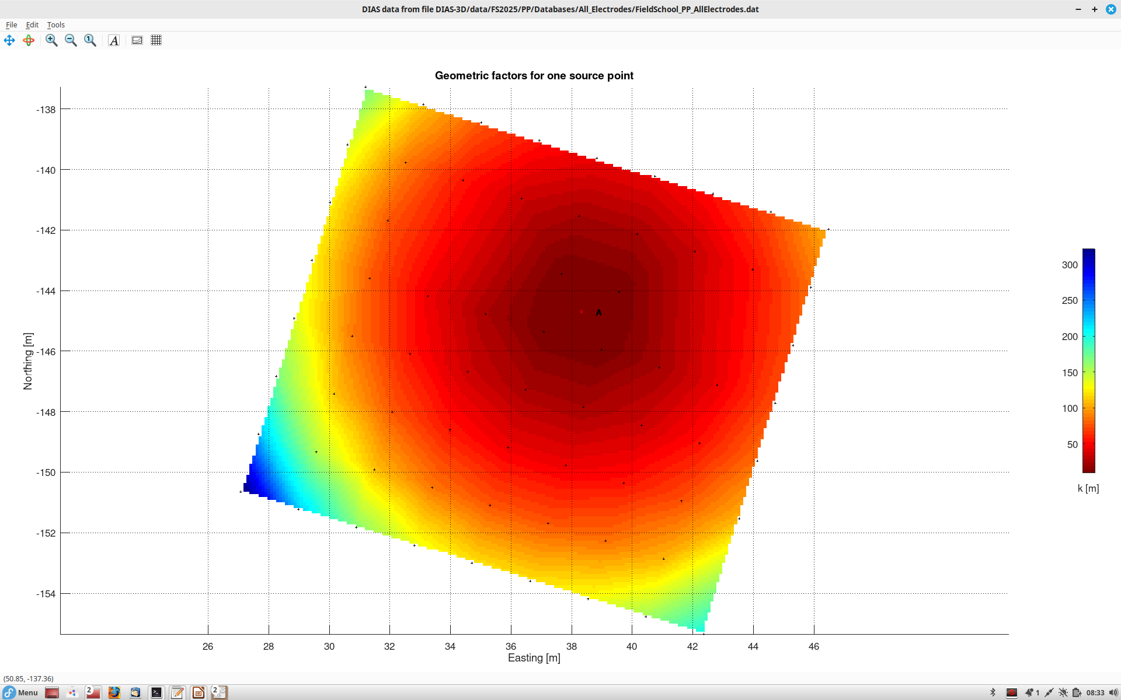
With different positions of potential electrode M (pluses below), geometric factors (k) of the A-B-M-N array vary as shown . Note that geometric factors increase proportionally to the A-M distance near source A.
<number>

Slide 14
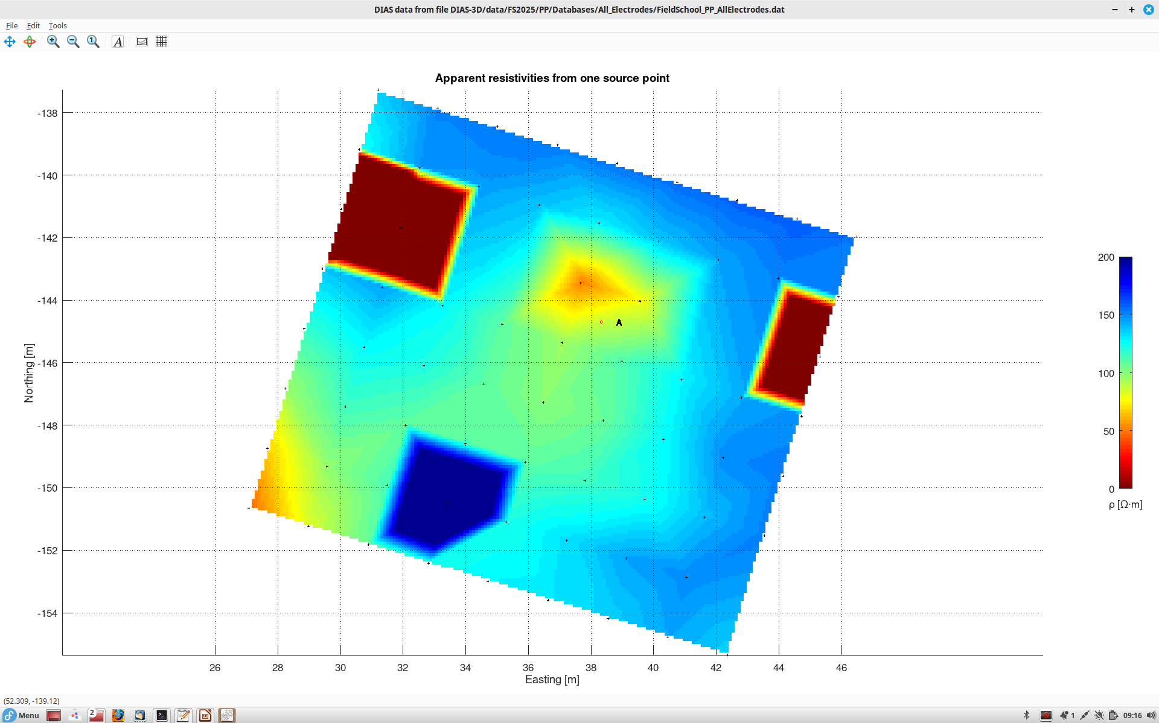
Multiplying the resistance V/I by the geometric factor k gives the apparent resistivity.
(ignore the three anomalous readings)
Near source point A, the apparent resistivity is close to the near-surface resistivity (about 80 Ohm.m, fairly low!)
At larger distances, it comes from a deeper layer (about 150 Ohm.m)
<number>

Slide 15
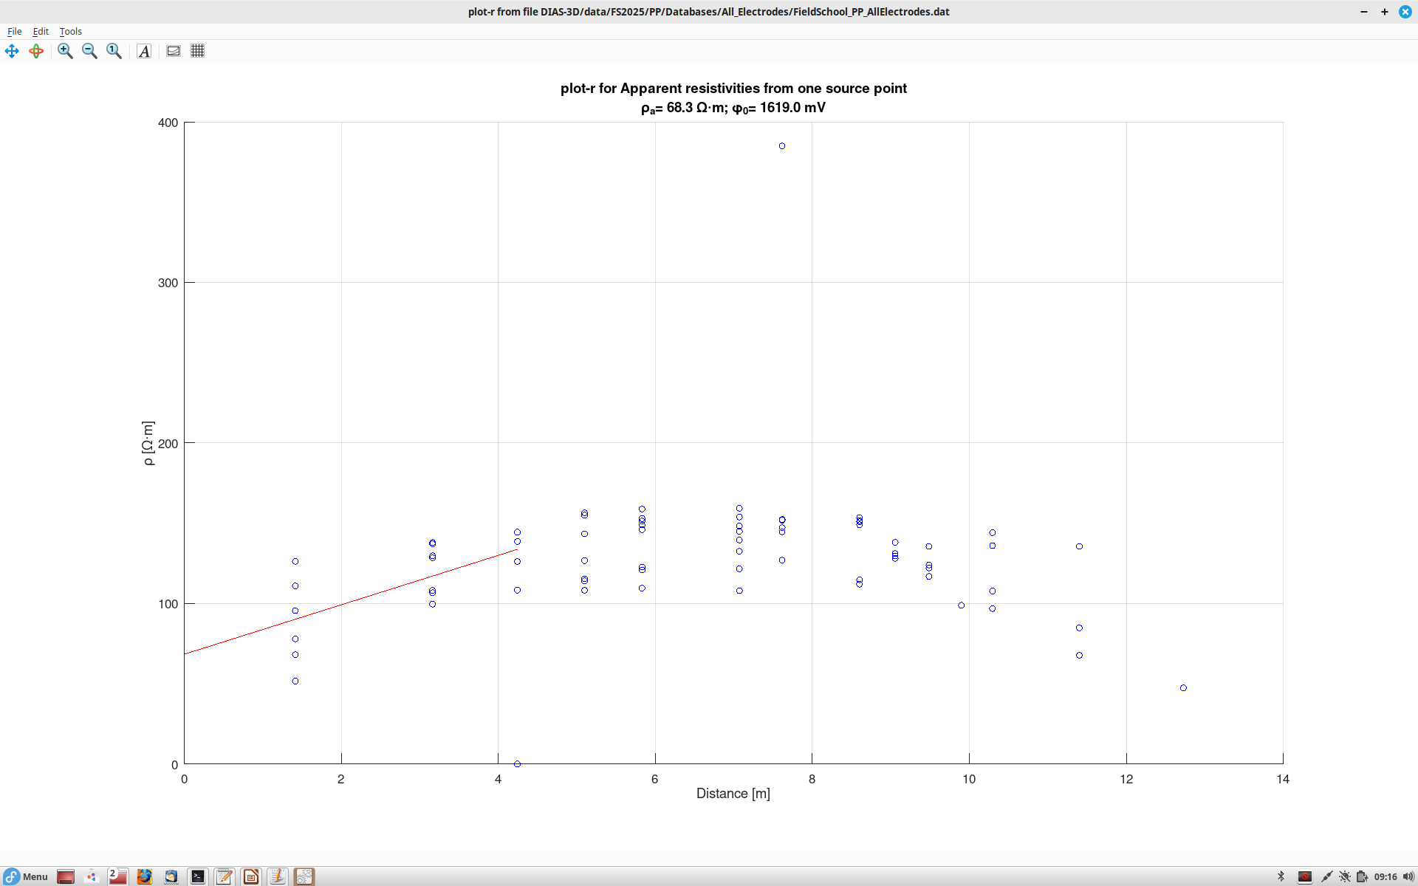
Here, apparent resistivities from the preceding plot are plotted vs, distances from electrode A (injection point)
Note that the apparent resistivity increases with distance (red line). This is because of an additional potential gets developed across a very thin near-surface layer.
This potential is analogous to “static times” in seismics.
Slope of the red line is due to the additional potential at point A. This potential can be calculated from this slope and equals 1.62 V (see plot title)
This decrease of apparent resistivity with distance is due to sampling deeper layers (less resistive)
The intercept at r = 0 is the actual resistivity near point A
(68 Ohm.m)
<number>

Slide 16
Most images obtained for DC resistivity can also be produced for chargeability (usually denoted M, but this is not electrode M!).
DC resistivity characterizes the ability of the medium to conduct current,
whereas chargeability measures the ability of the medium to polarize itself (produce time-variant “displacement current”).
The following slides show chargeability plots similar to resistivity results above.
<number>

Slide 17
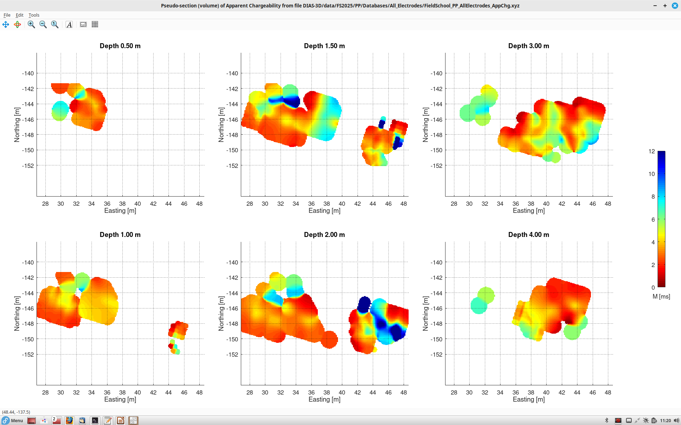
Apparent chargeability from the pole-pole array (as recorded).
<number>

Slide 18
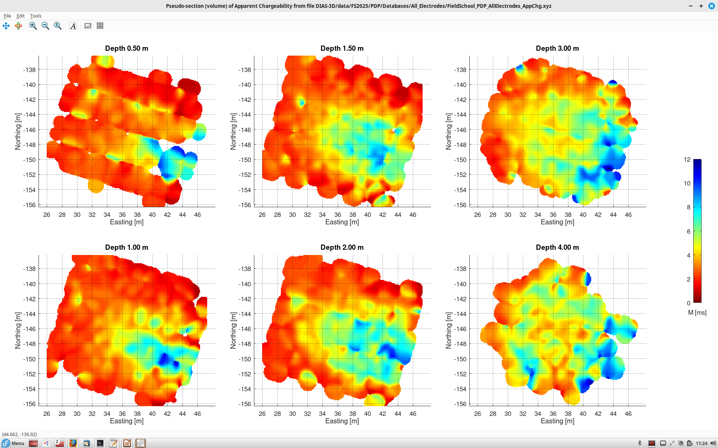
Apparent chargeability from the virtual pole-dipole arrays. Note that after transformation, coverage and consistency of the image are improved.
Also a strong expression of the target. However, it may also be related to surface topography (?).
A surface low may cause increased apparent resistivity and chargeability.
<number>

Slide 19
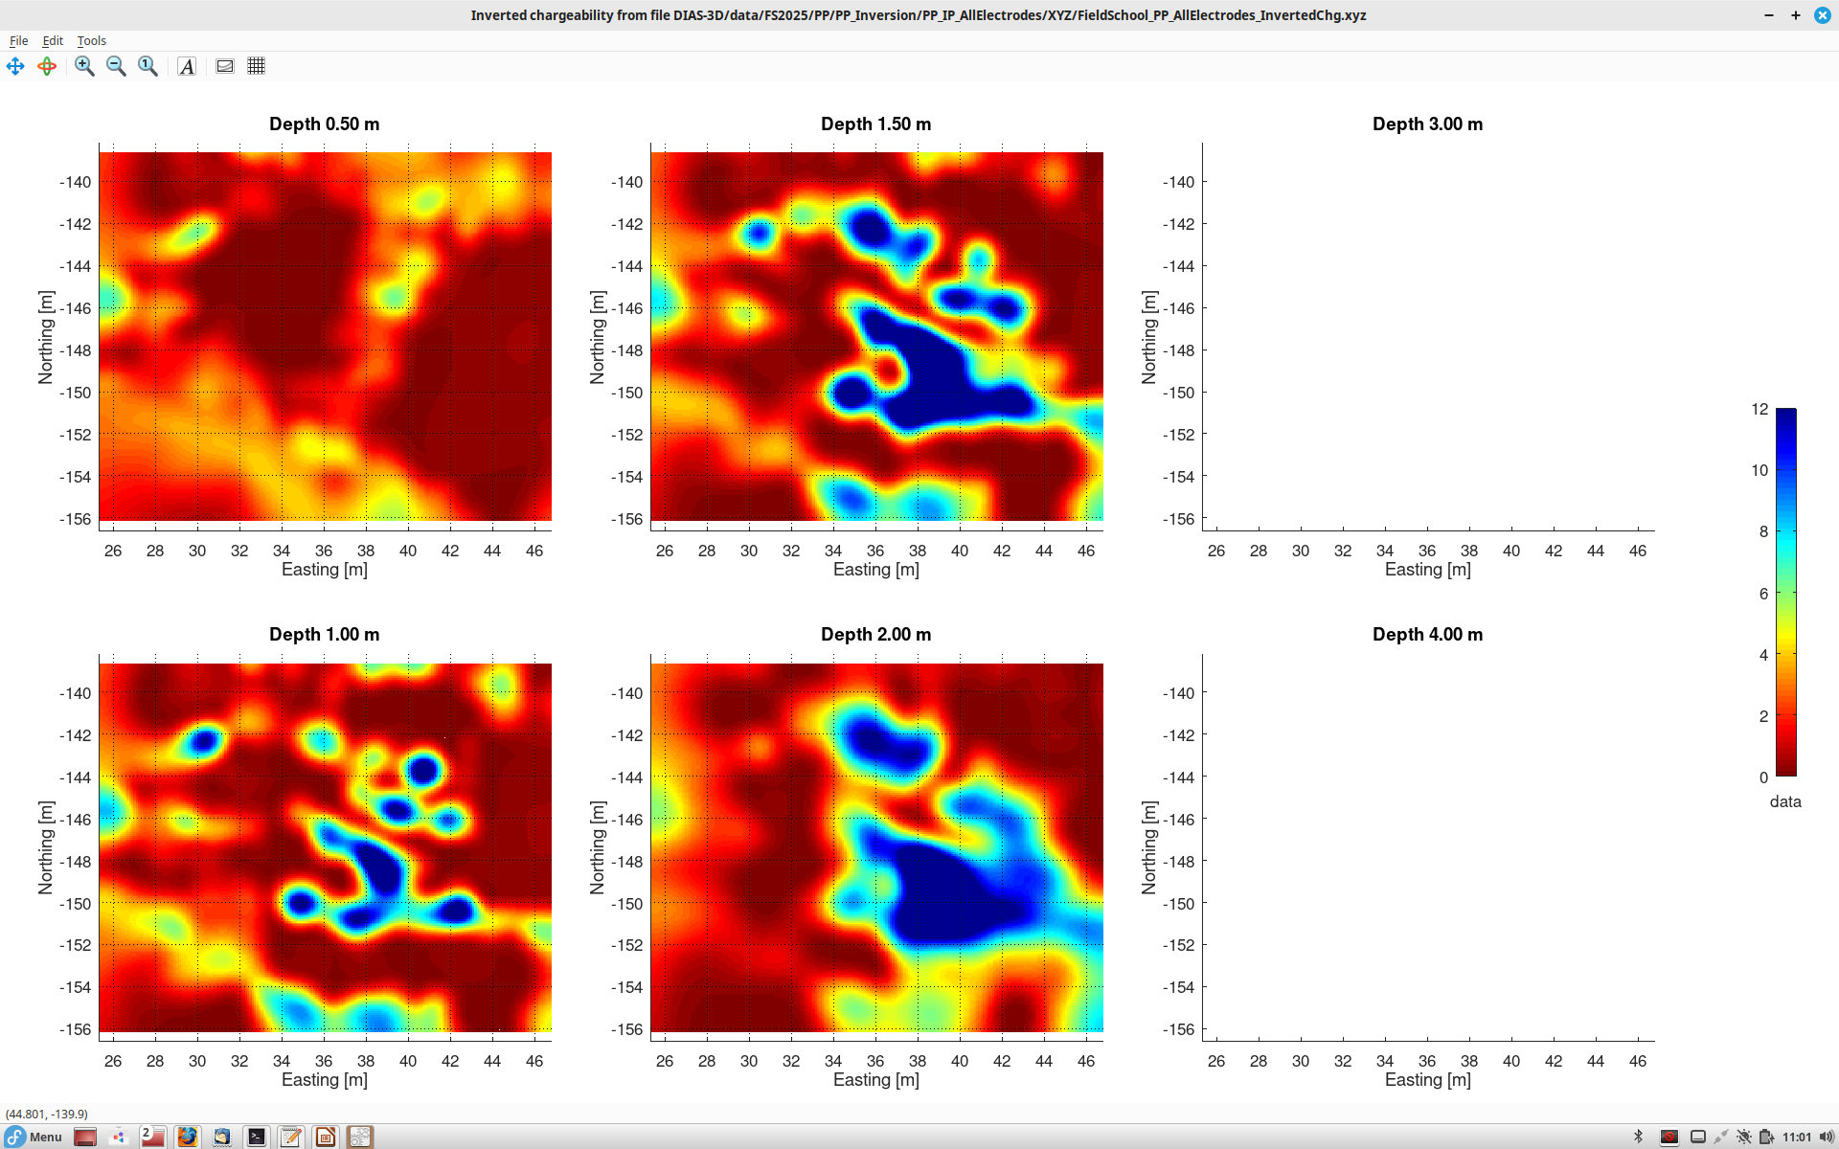
Subsurface chargeability model by inverting recorded pole-pole data
<number>

Slide 20
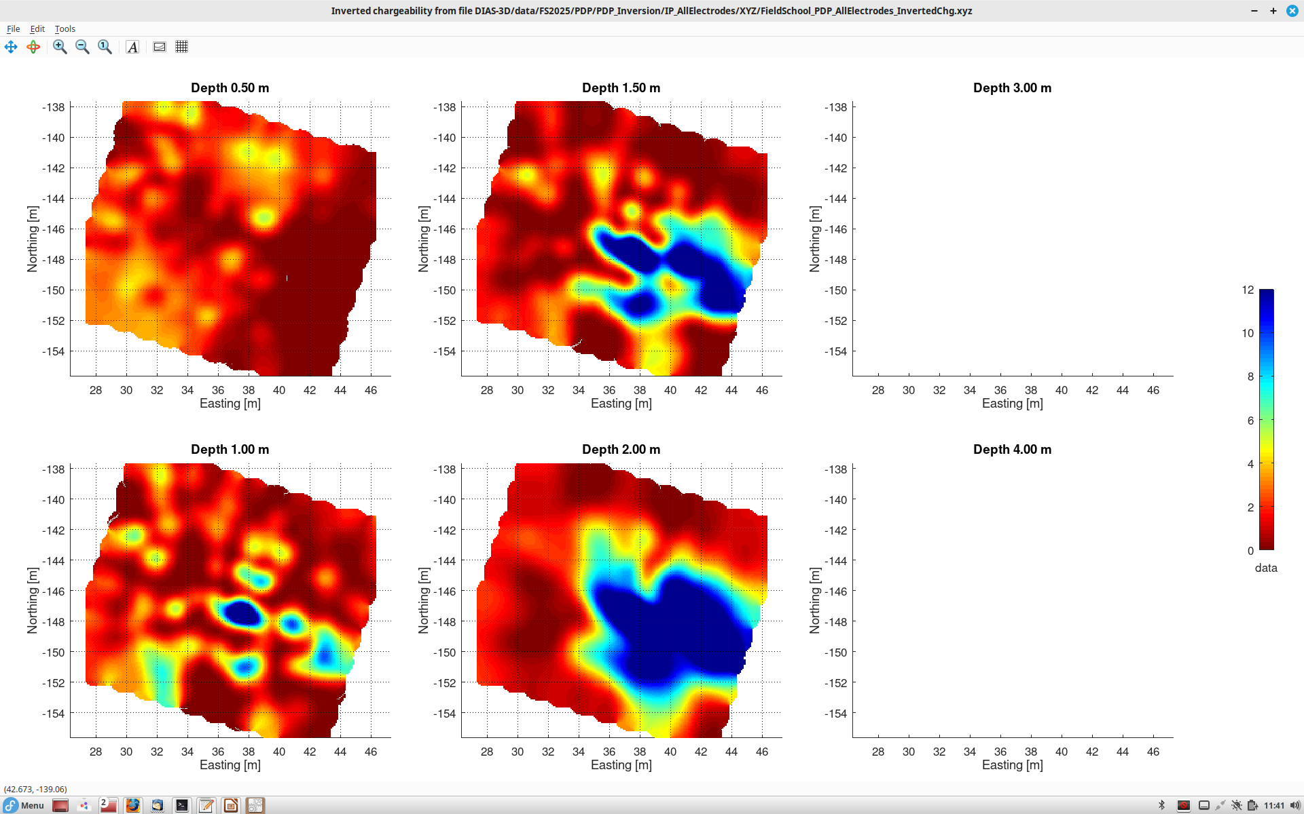
Subsurface chargeability model by constructing pole-dipole electrode arrays and inverting them
<number>

