Slide 1
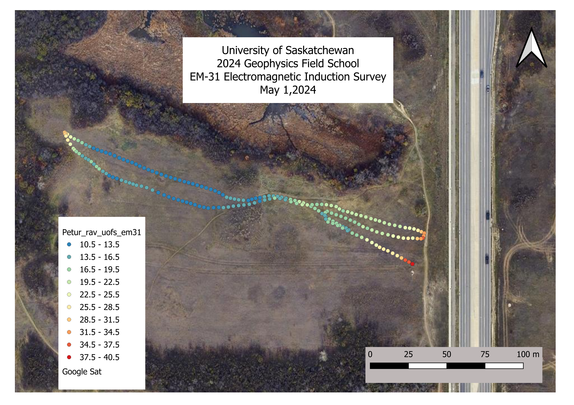
EM31 did not work well on May 9. Randy Brehm repeated the survey on June 12and these results are shown at the end of this document.
Here, I show Randy Brehm’s results from last year instead (Peturrson’s ravine off Central Ave).
This is Randy’s image showing apparent conductivity along the track of the instrument.

Slide 2
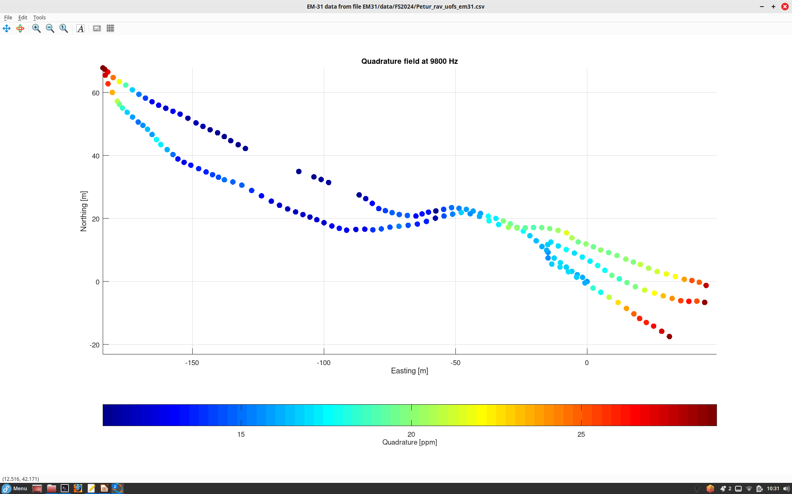
The traditional way to display such data is to plot a colored dot at each reading along instrument track.
This plot shows quadrature (90-degree phase shifted) component of the induced field.
High quadrature values correspond to high conductivity of soil.

Slide 3
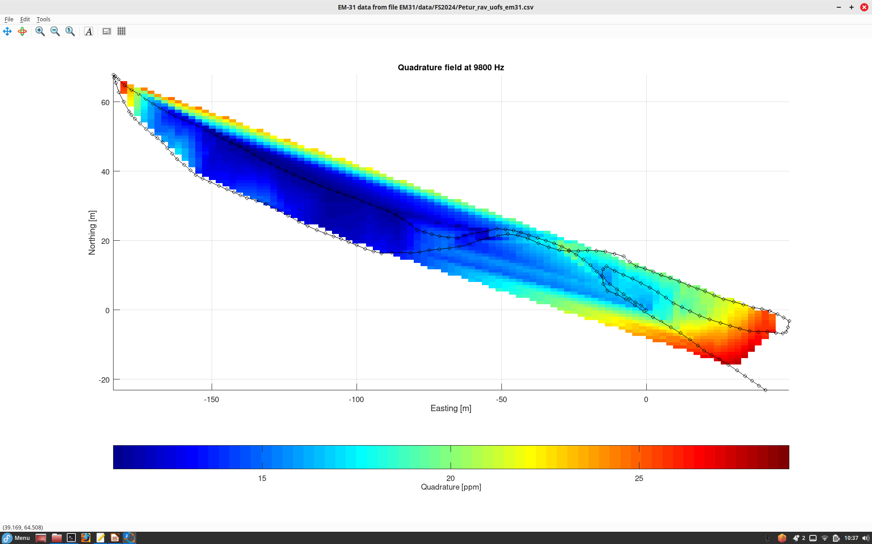
The same data interpolated into a spatial grid. High quadrature values correspond to high conductivity of soil.

Slide 4
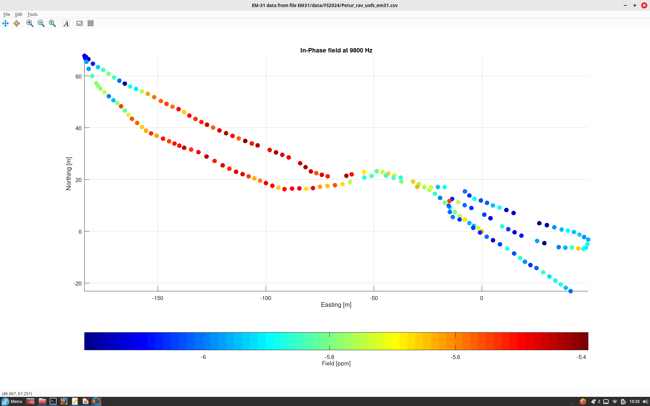
In-phase component of induced field

Slide 5
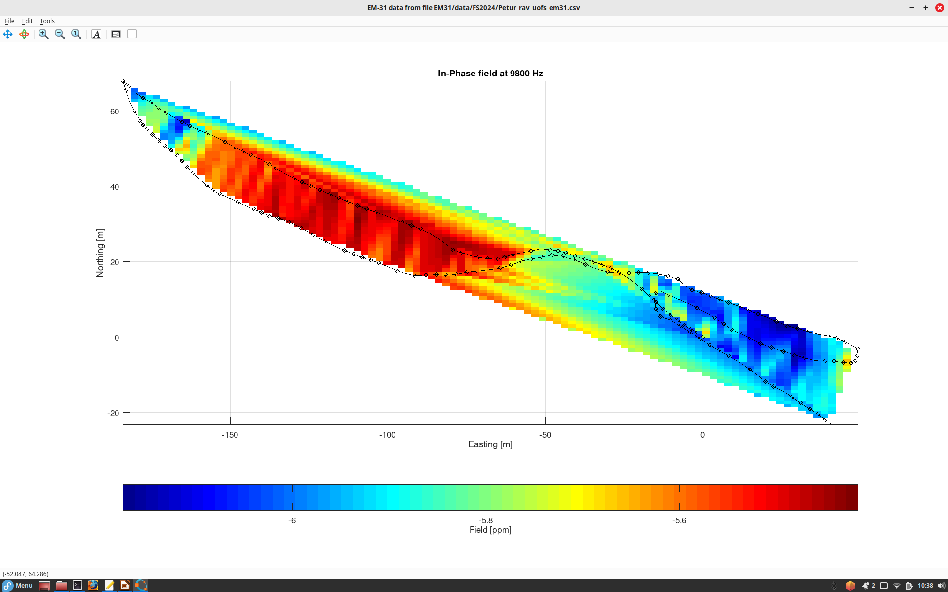
Gridded In-phase component

Slide 6
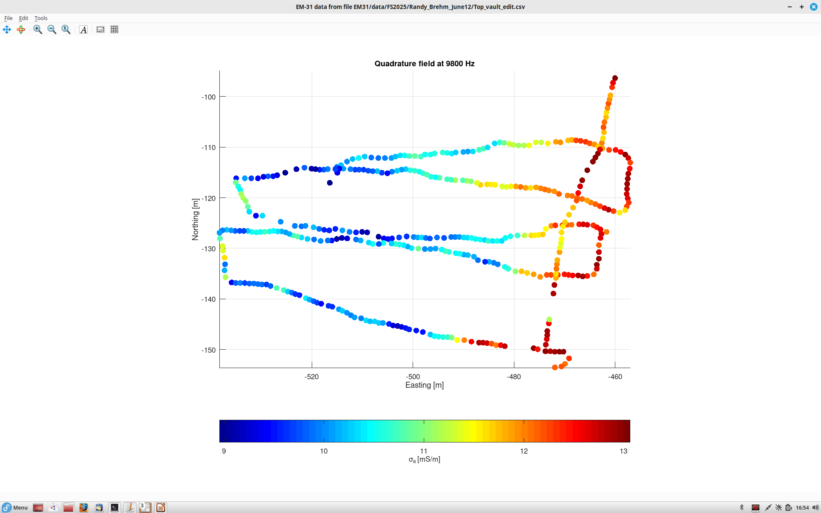
Repeated EM31 survey on June 12 in the area of Applied Potential target in the SE corner of Geophysical test Site.

Slide 7
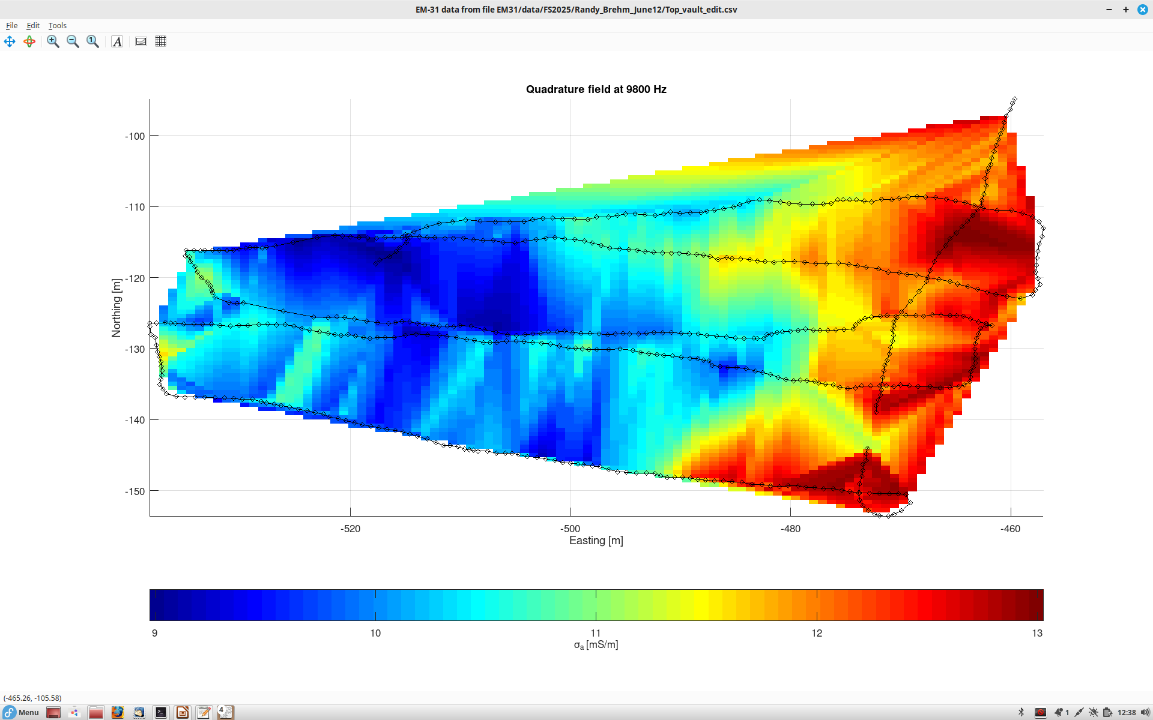
Gridded quadrature field
These appear to be our targets pointed out in GEM-2 report
Fence fence fence fence
Still a significant east-west variation which may be caused by the fence (?).
Randy suggests that this trend may also be due to an increase of soil conductivity with silt/clay content increasing to the east.

Slide 8
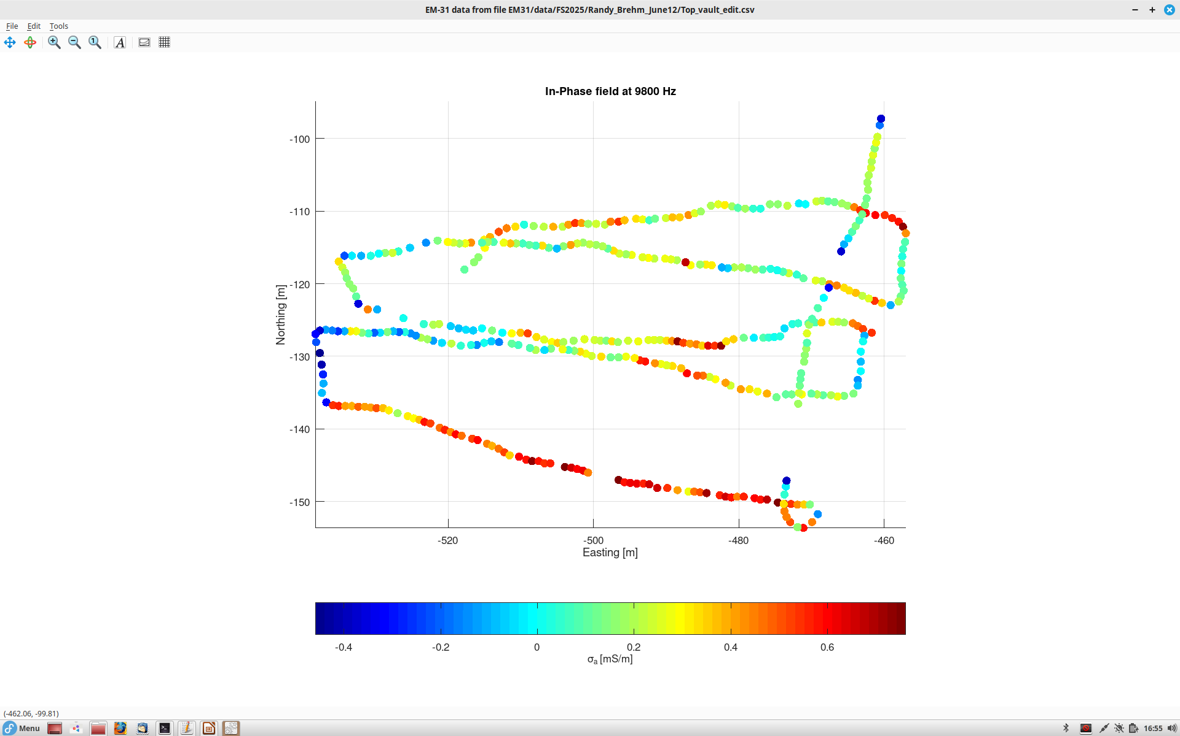
In-phase field recordings

Slide 9
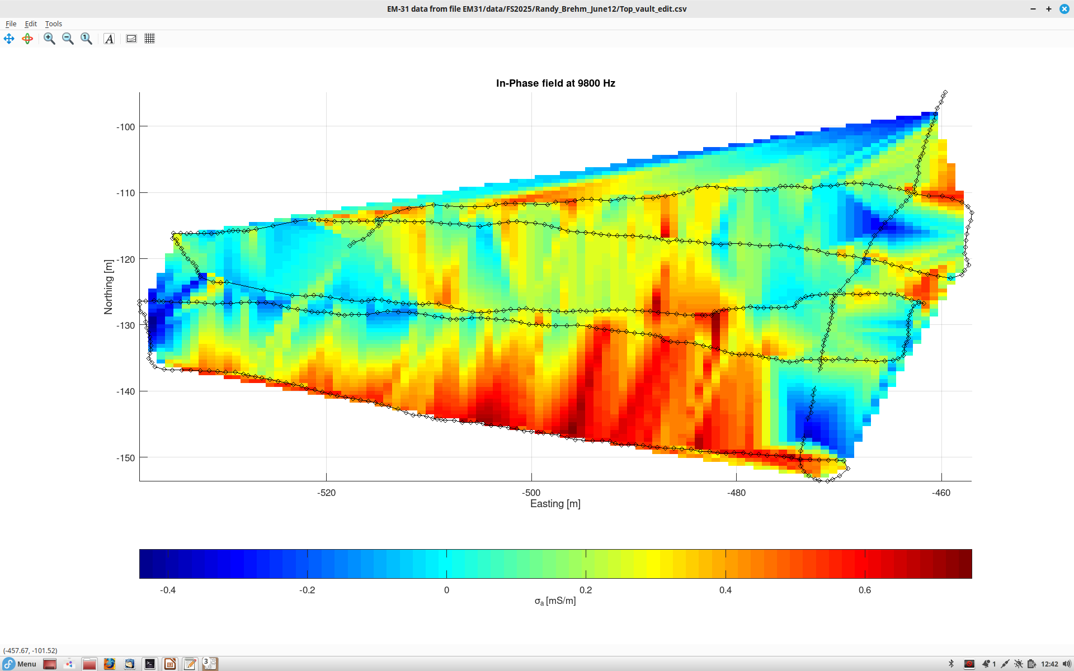
Gridded In-phase field
Note that the in-phase field is not so much affected by the fence on the east but may show an effect of topography along the southern edge.

Slide 10
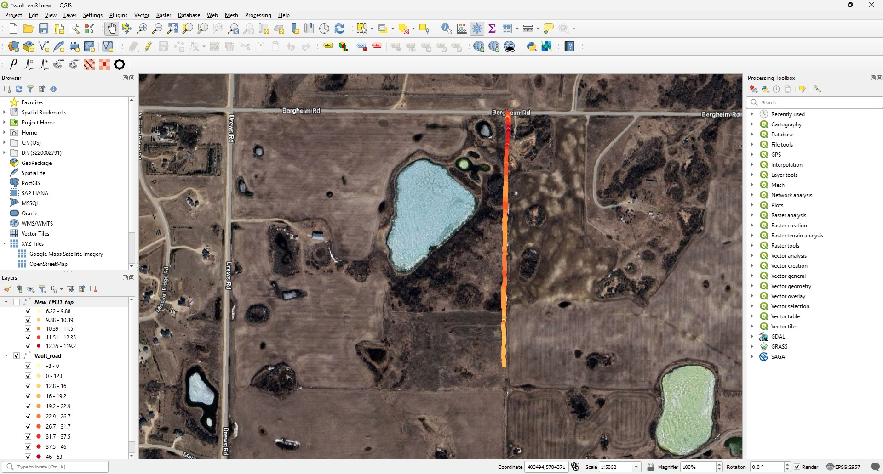
Randy did another survey along the access road to vault property. This map shows a track of quadrature data.

Slide 11
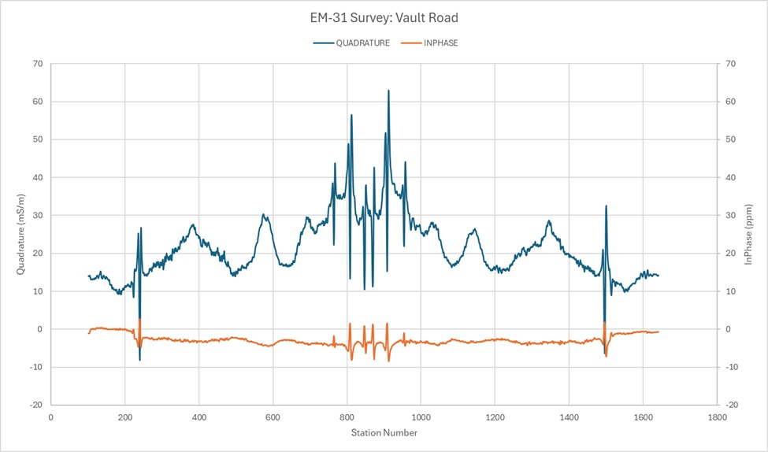
Graphs of data vs. station number. The route starts at the hill, descends north to Bergheim road, and then returns back. Hence each anomaly is covered twice, and the graph looks symmetrical.
Note:
1) higher conductivity as the traverse descends down the hill;
2) lower conductivities at elevation highs along the road (due to drier sand and gravel);
3) Four strong anomalies due to underground lines (electrical, natural gas?) crossing the road

Slide 12
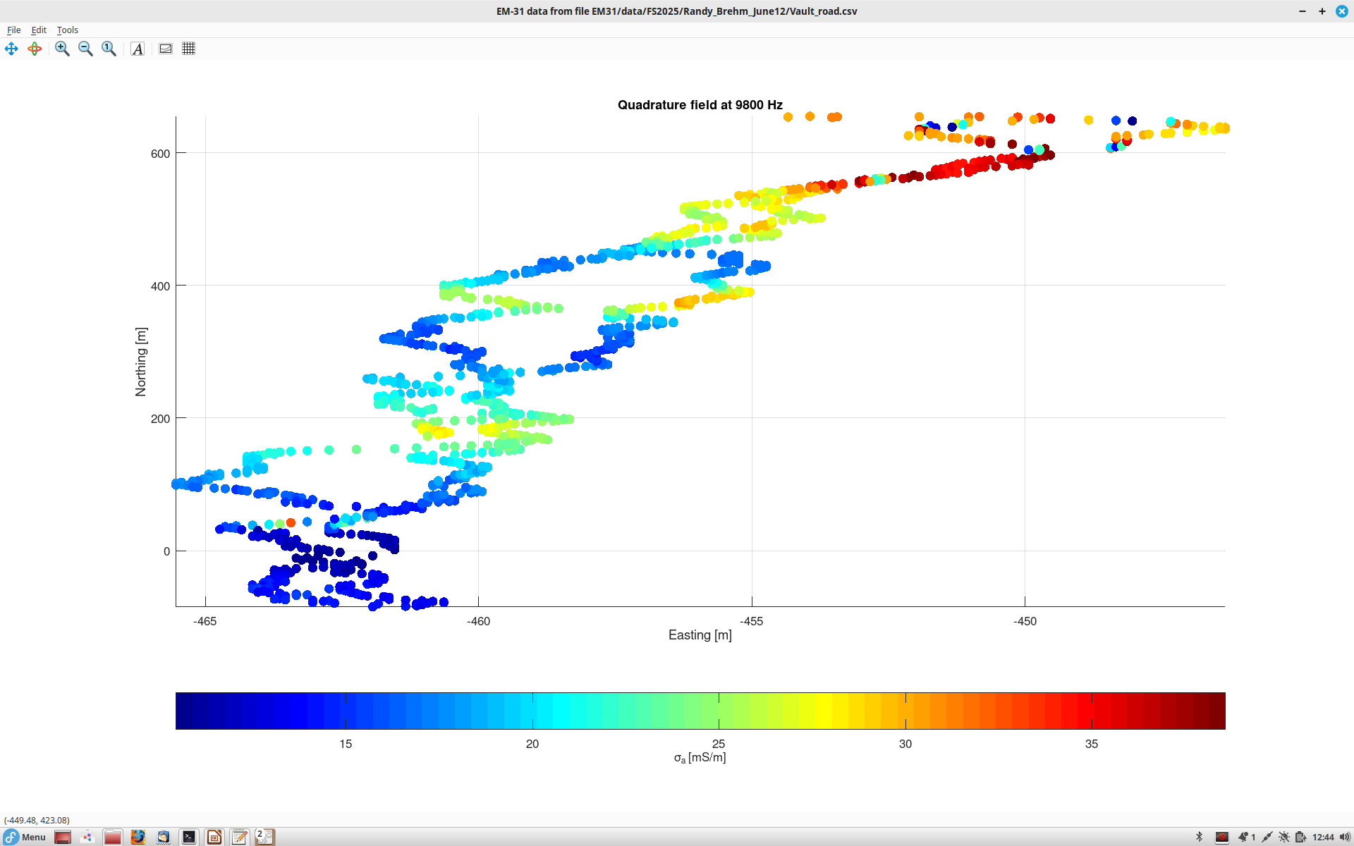
The same track of quadrature from my Octave program
Note that the east-west scale in this plot is much larger than the north-south one, to see detail.

Slide 13
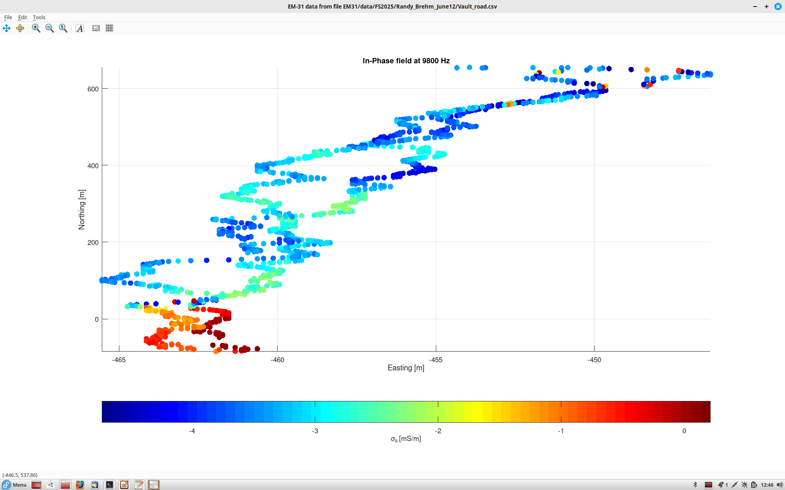
Measured in-phase field

Slide 14
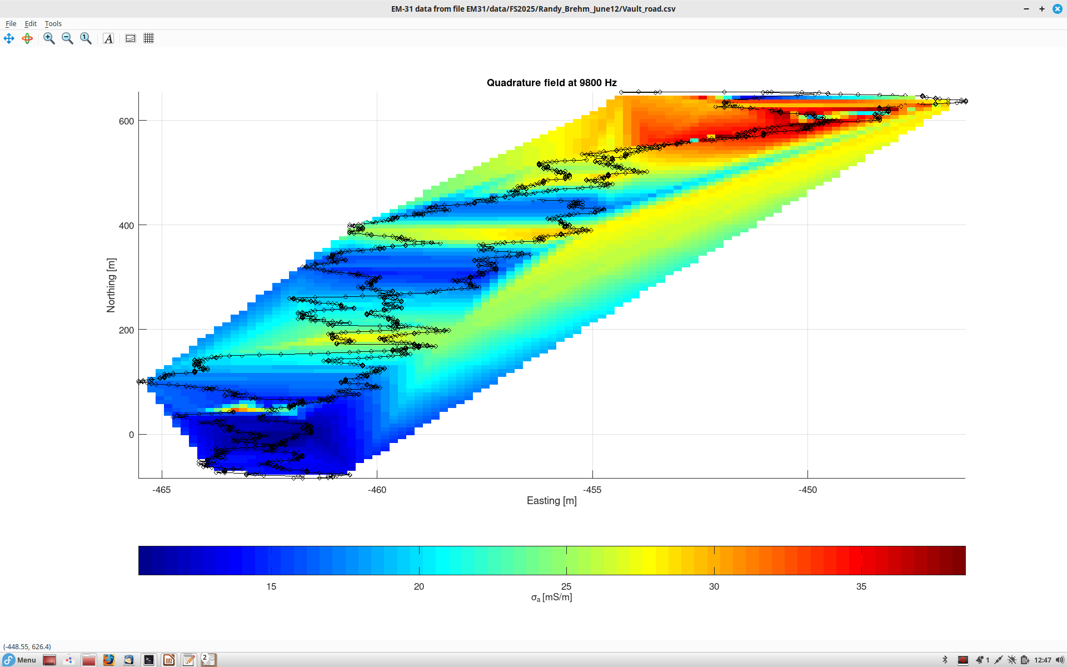
Gridded quadrature
Again note the high conductivity in the northern part (lower elevation and underground lines) and a sharp anomaly in the south (electrical power cable for the vault)

Slide 15
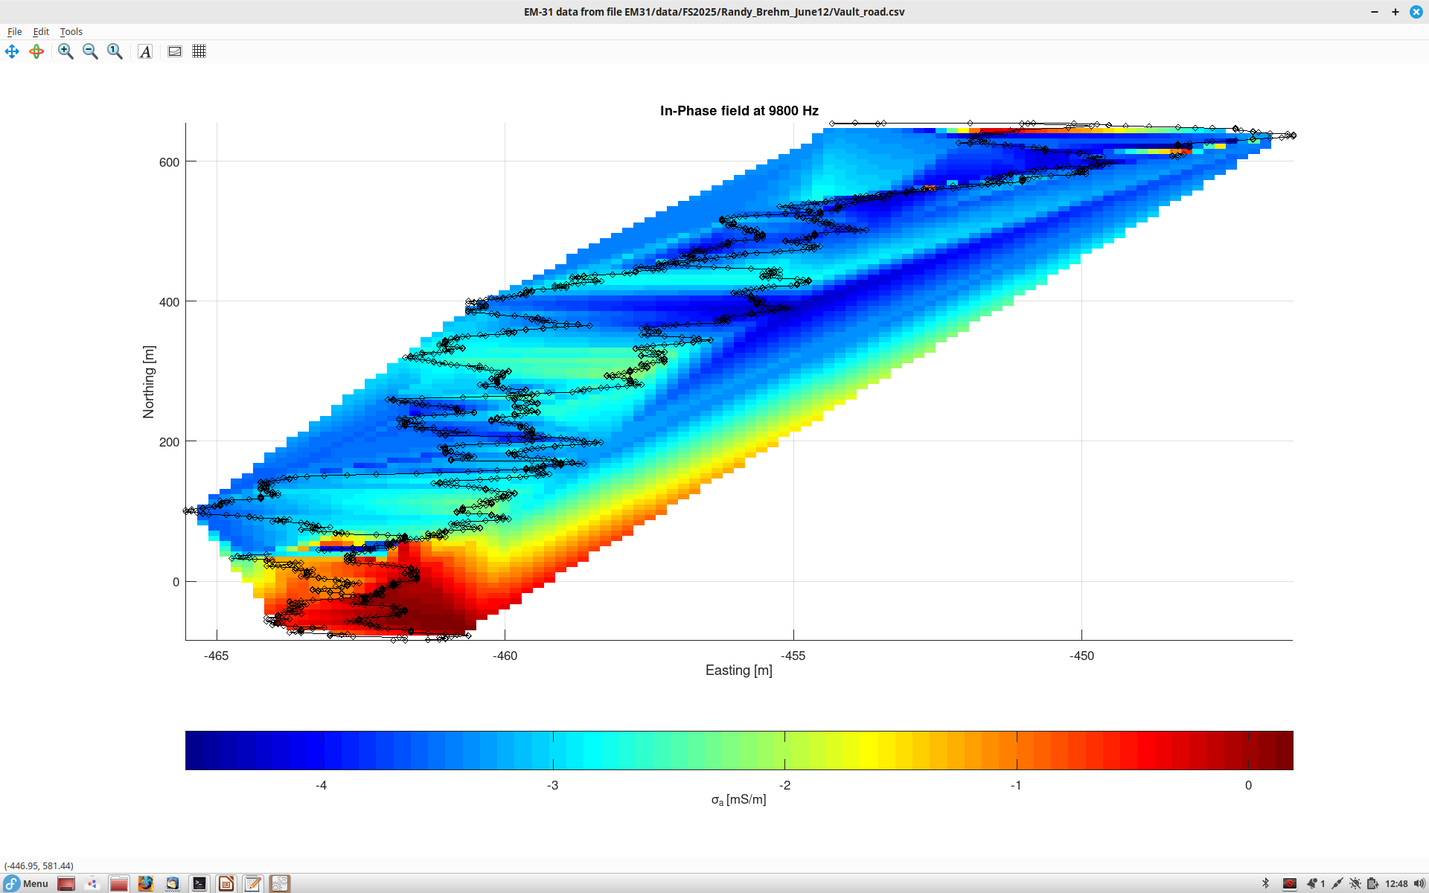
Gridded in-phase

