Slide 1
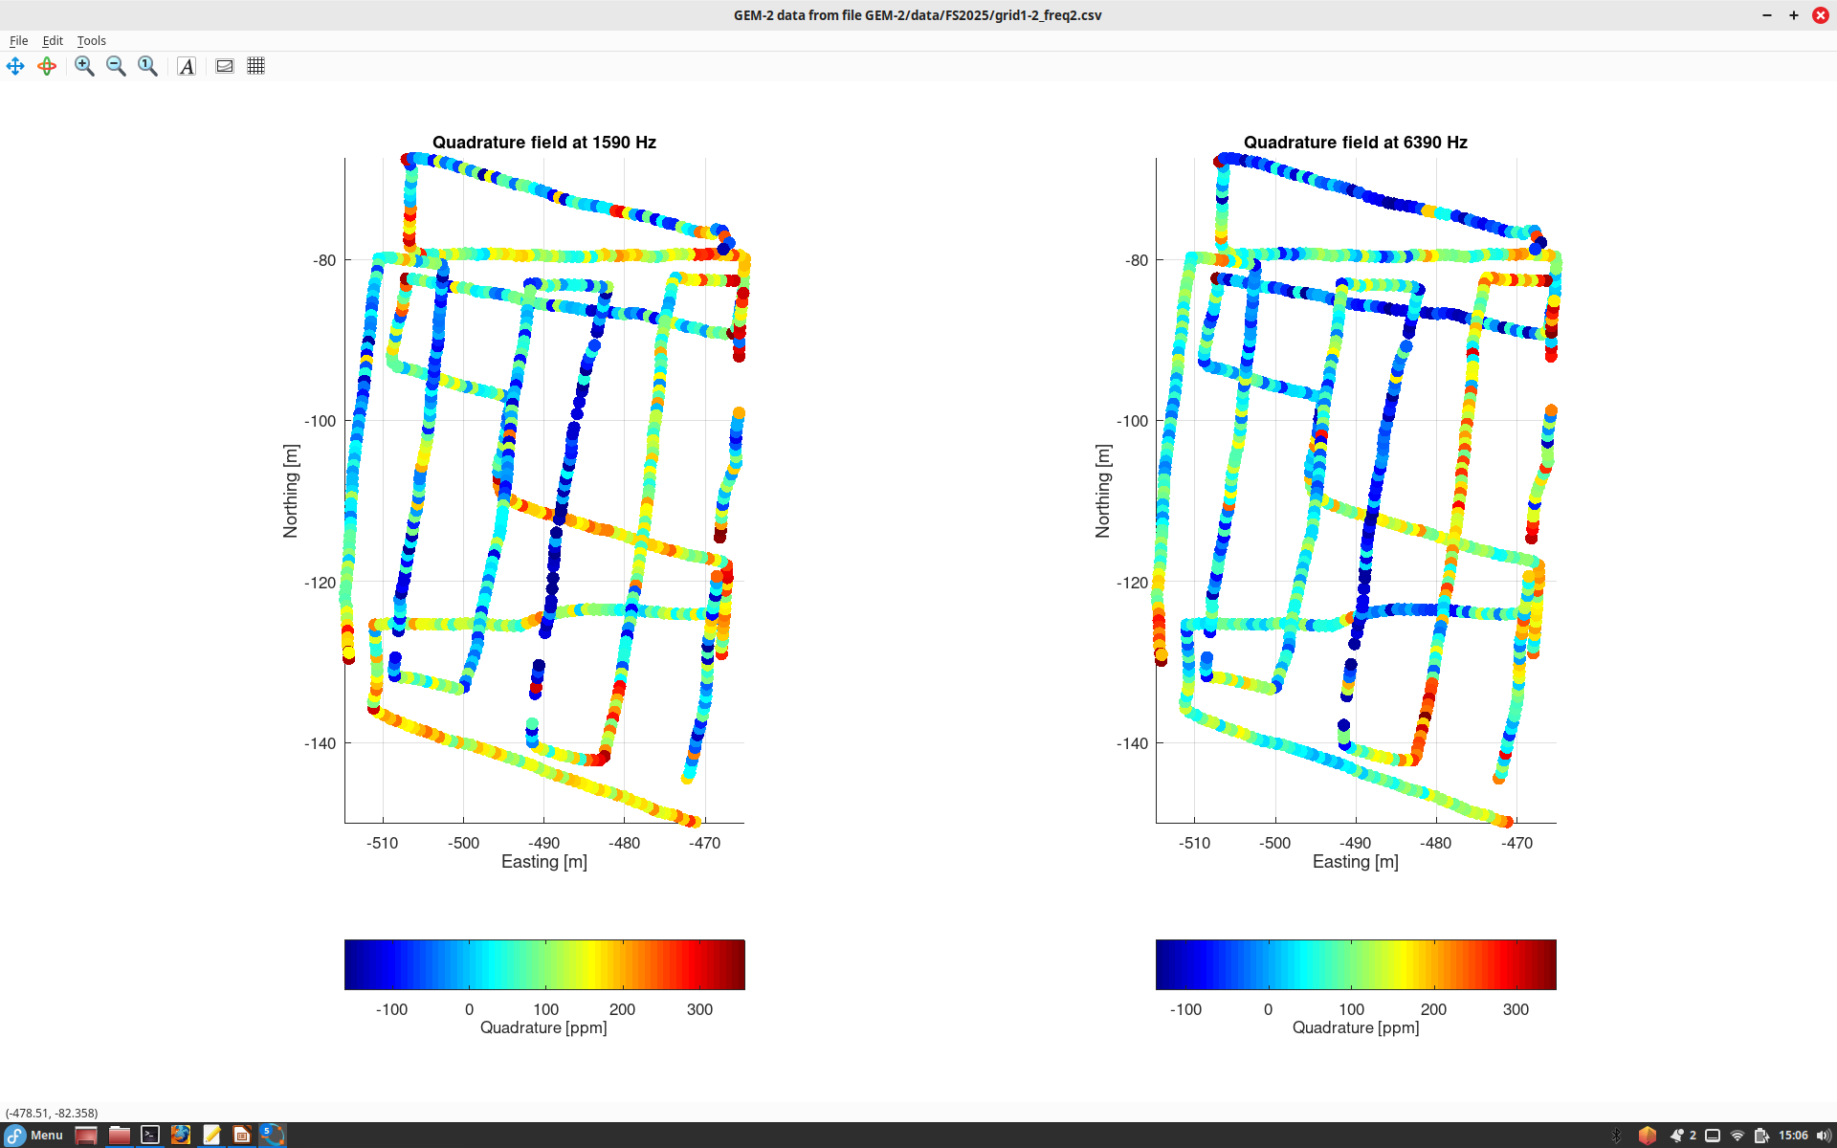
Imaging was done at two frequencies as shown
The following plots show several data readings.
The instrument makes readings at each about 10-20 cm intervals, but only points separated by more than 75 cm are shown here for clarity.

Slide 2
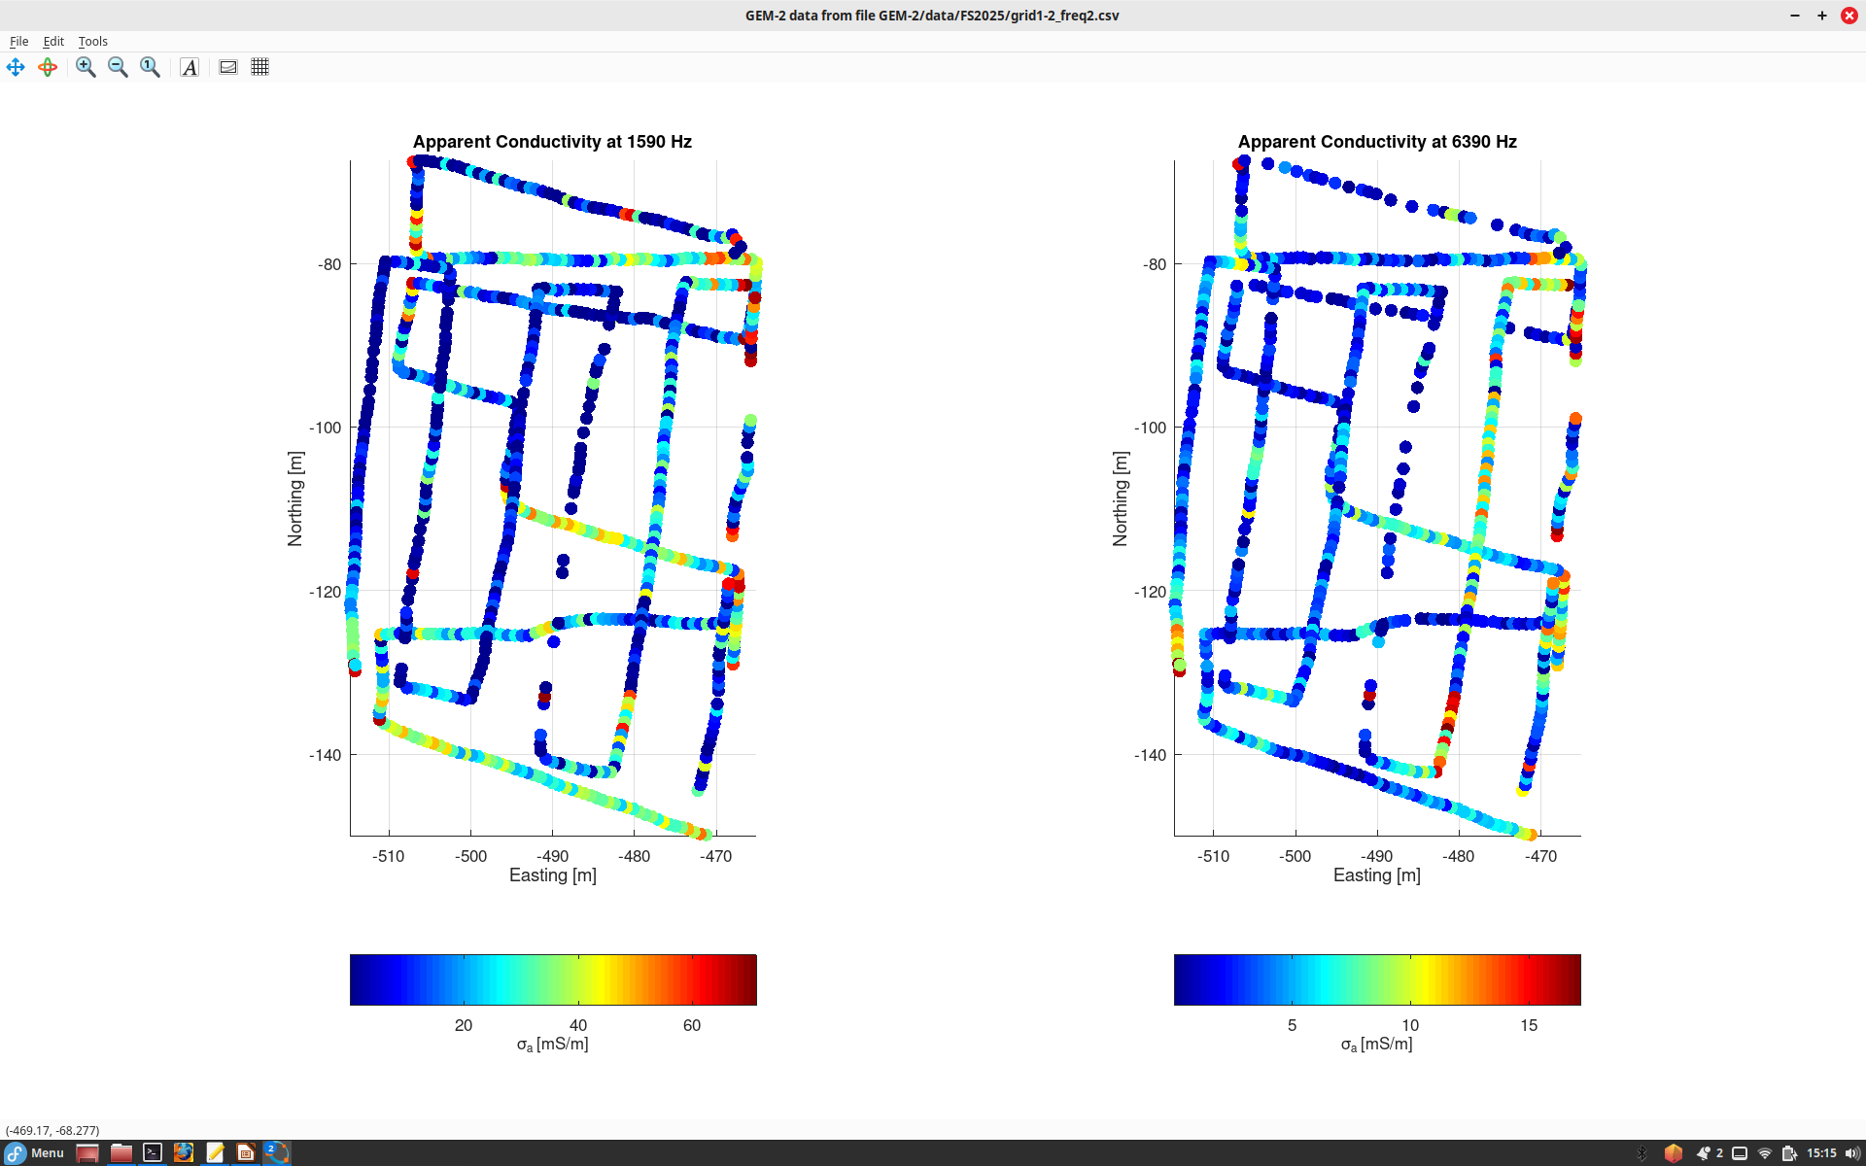

Slide 3
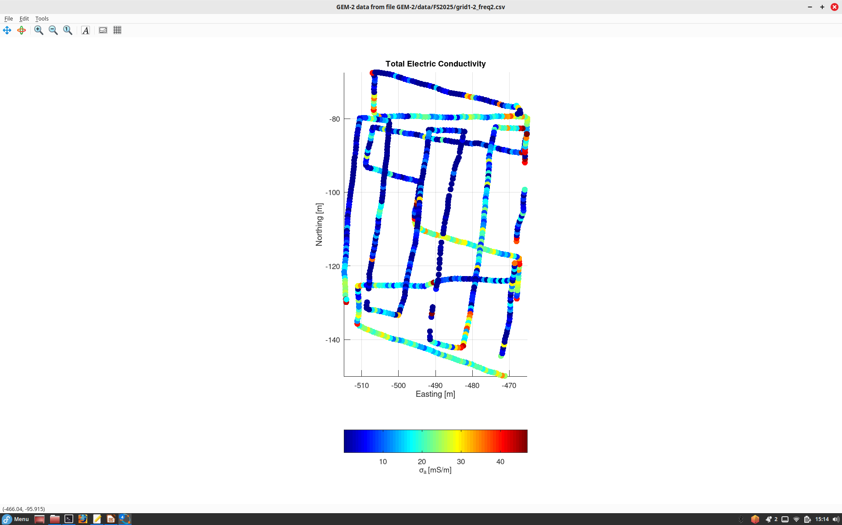

Slide 4
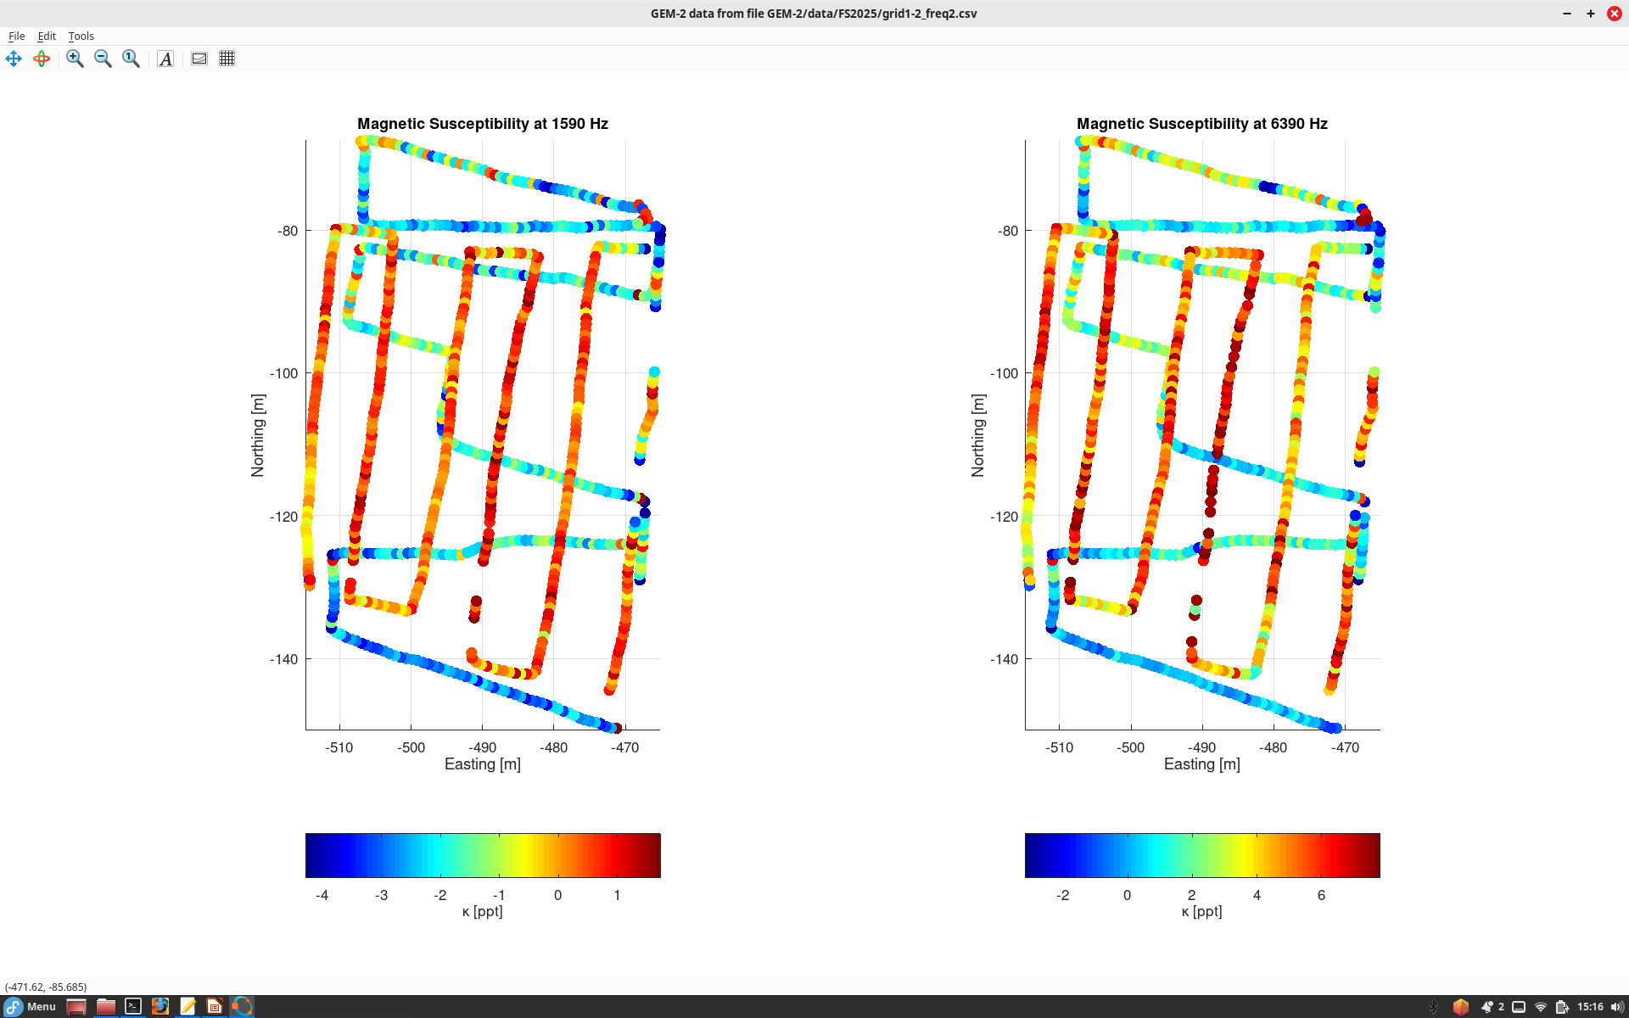

Slide 5
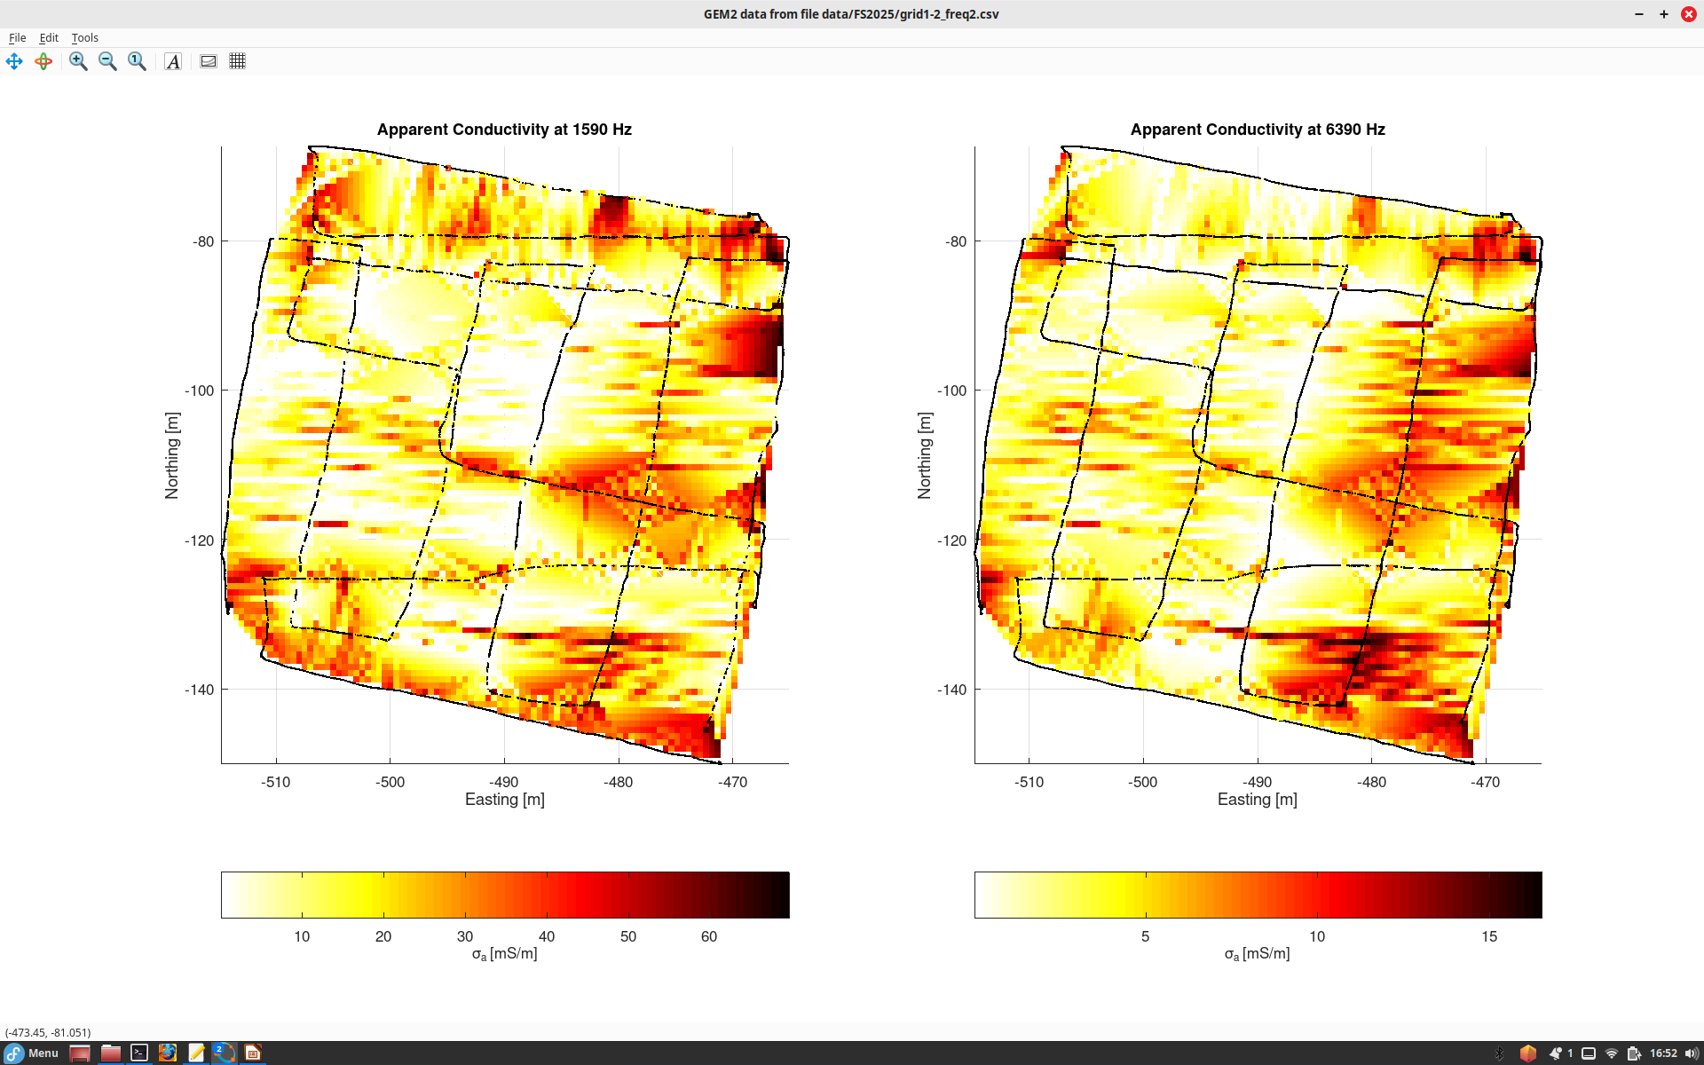
Gridding of the data by “Delaunay triangulation” produces maps of the respective properties .
This is the main display – apparent resistivity at the different frequencies.
Using “hot” color map here
Note our Applied Potential test target and something else?
The target stands out particularly well at 6390 Hz
On the East side, some anomalies from barbwire fence

Slide 6
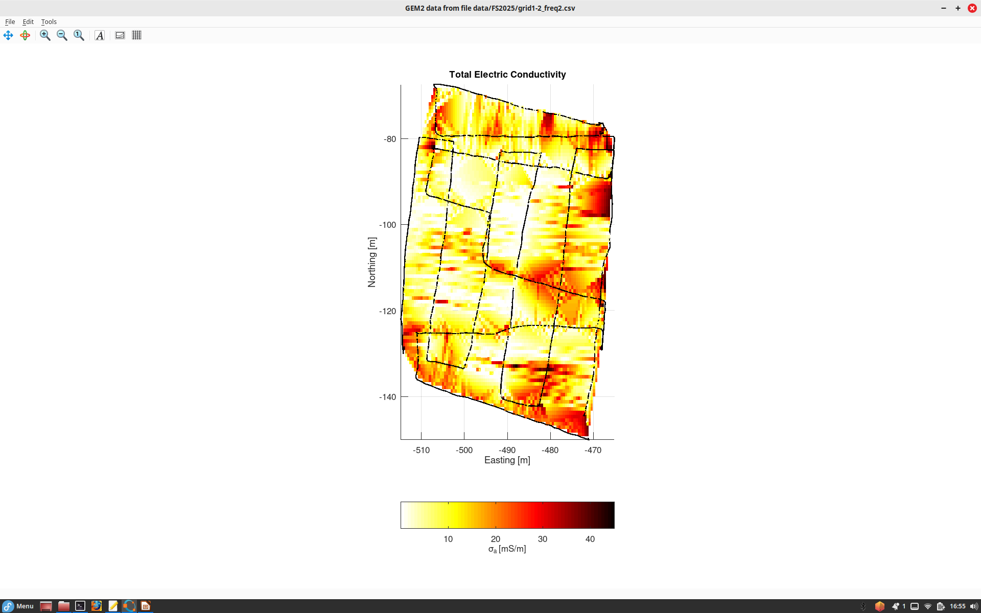
Total electric conductivity derived by combining the two frequencies

Slide 7
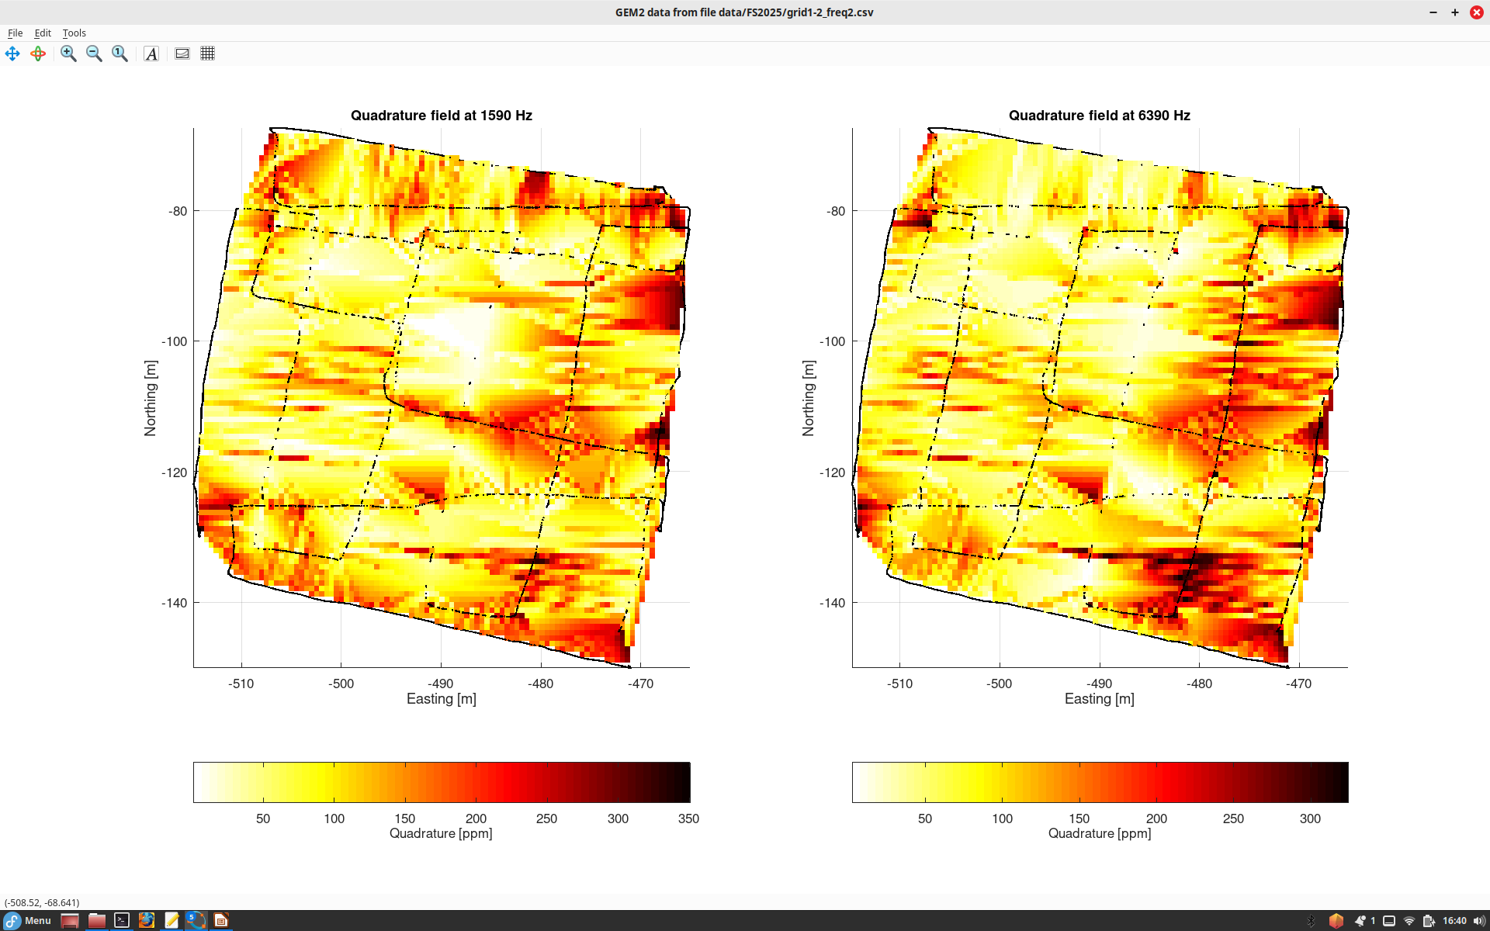
Imaging was done at two frequencies as shown
”Quadrature” is basically induced field at 90-degree phase shift from the primary one
Note our Applied Potential test target and something else?
On the East side, some anomalies from barbwire fence

Slide 8
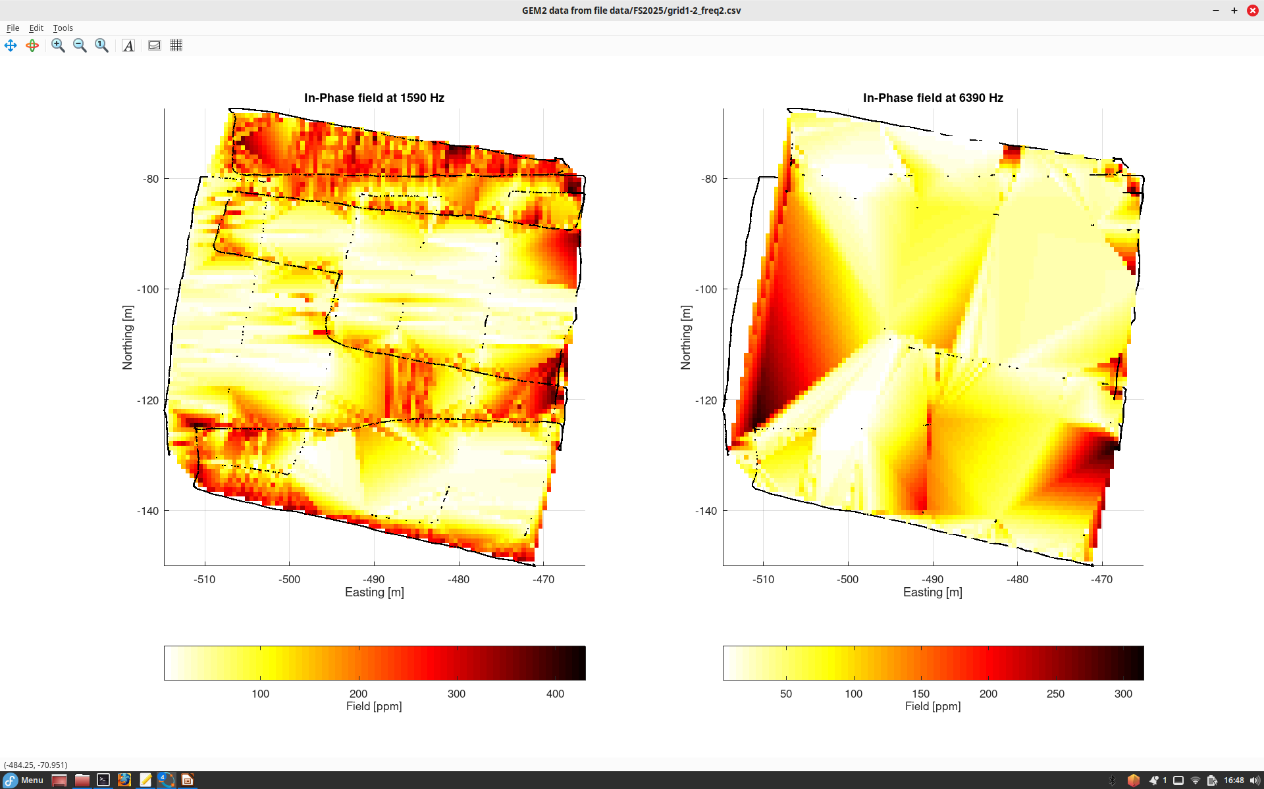
In-phase field (with the primary one) is more difficult to interpret

Slide 9
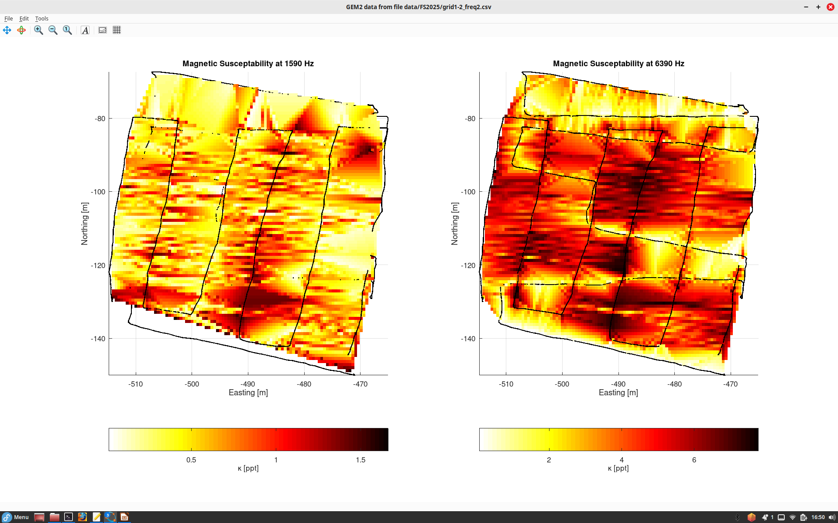
Magnetic susceptibility is also estimated by the instrument

Slide 10
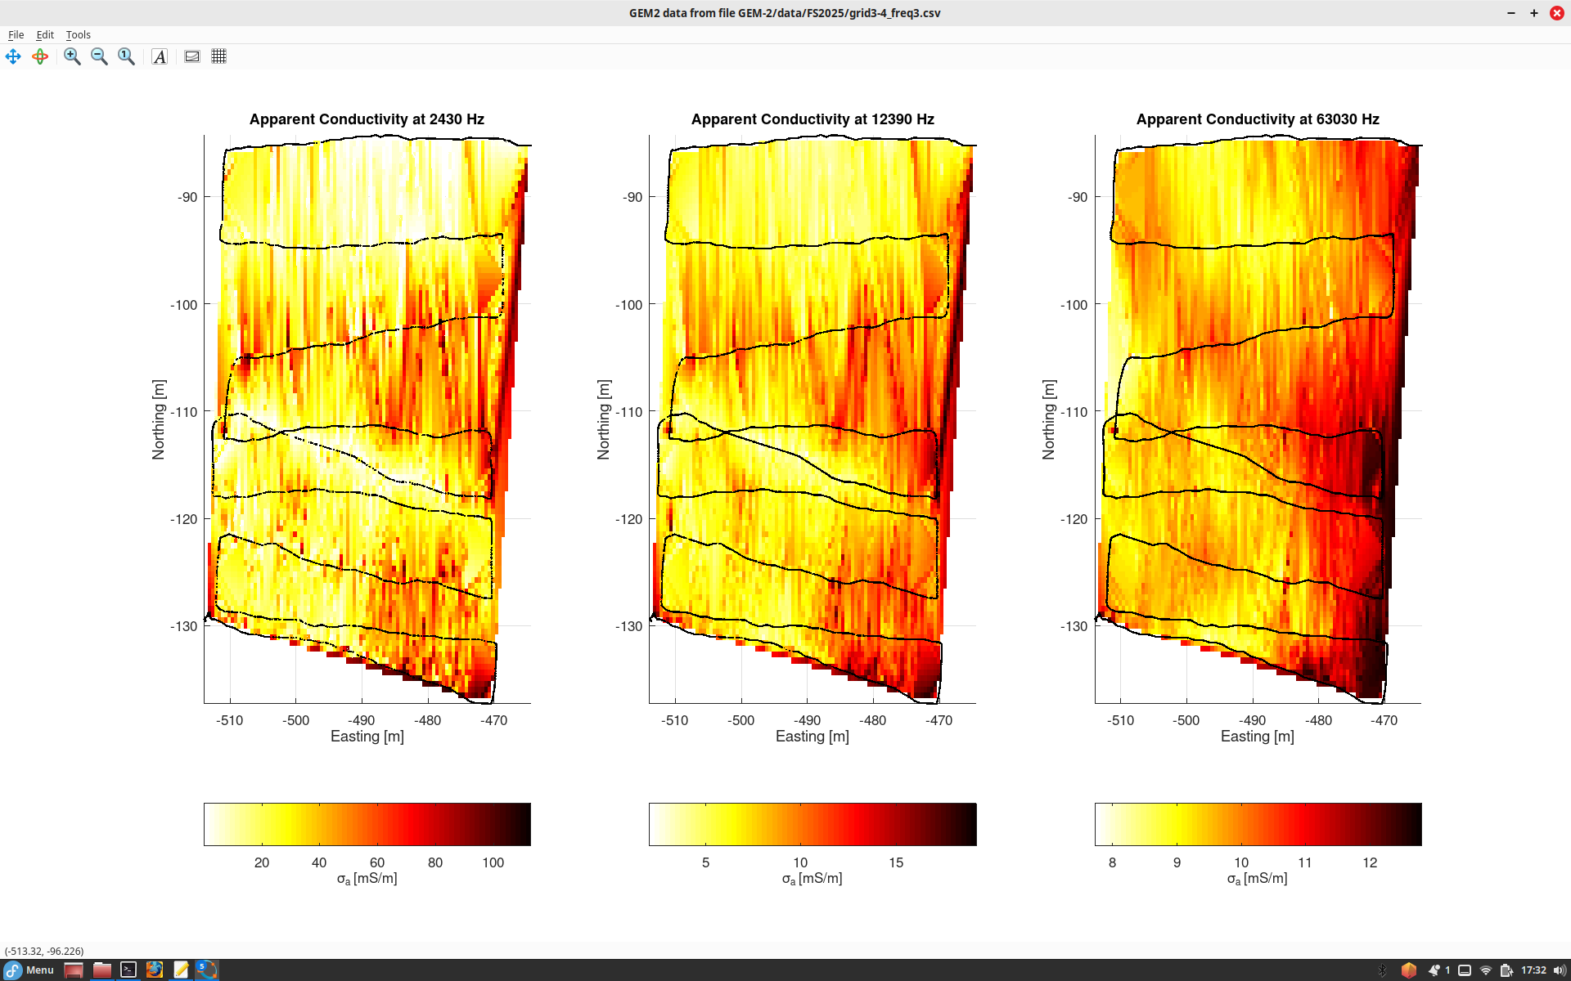
Todd also ran tests using three higher frequencies.
They seem to be more affected by the fence.

Slide 11
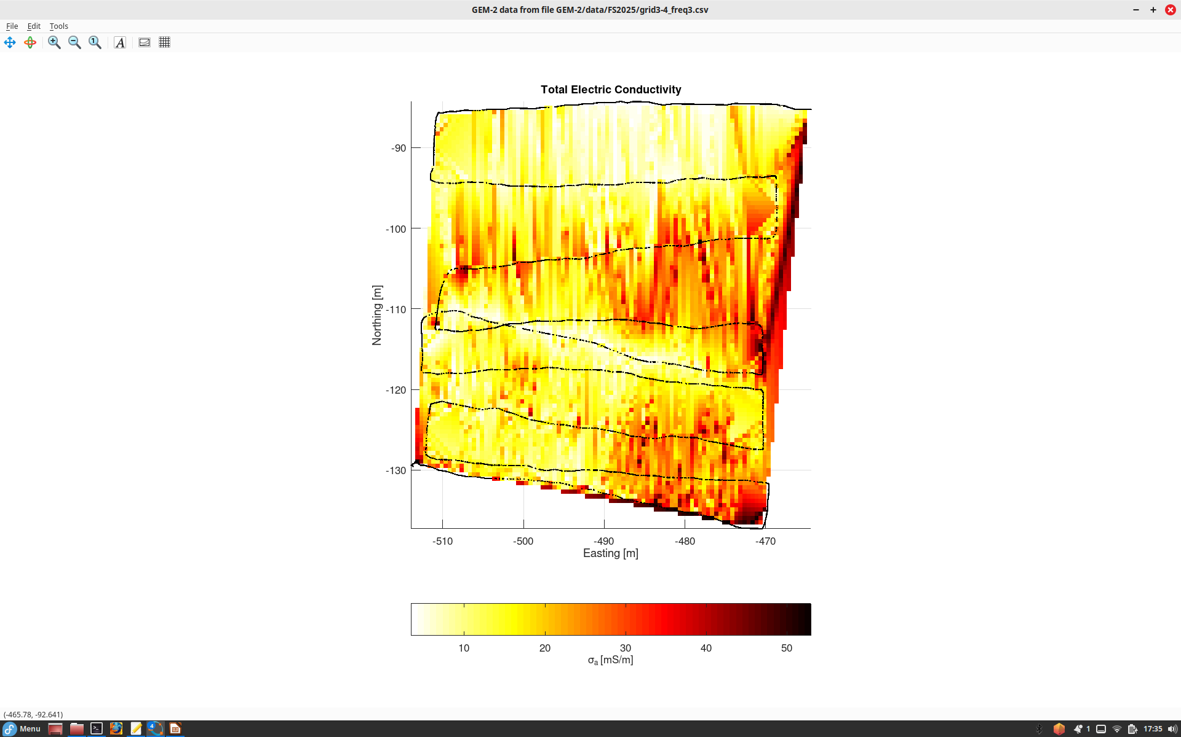
An interesting E-W channel of low conductivity here

