Slide 1
Randy Brehm’s Images from GPR lines in the Bowl (May 5) are in folder May05_GPR_Bowl

Slide 2
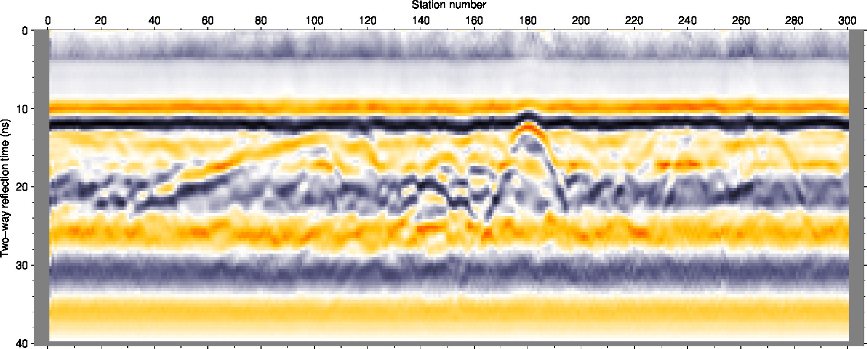
GPR record along the seismic line near the vault (May 8).
Power cable
Crossing access road

Slide 3
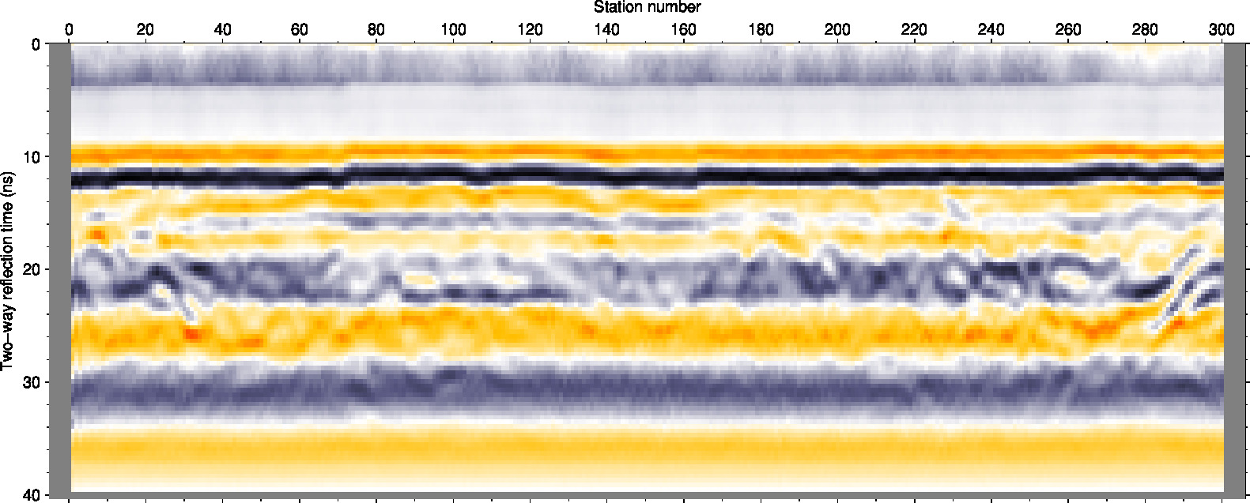
Line along the access road

Slide 4
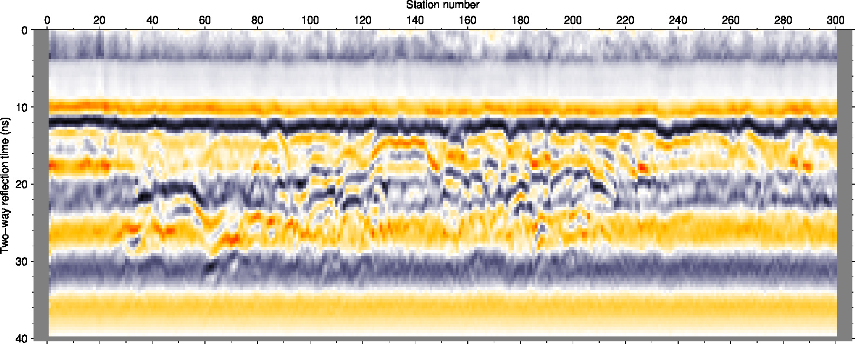
I am not sure where this line was, but should be near the Applied-Potential target
Note strong scattering between stations 30 and 220

