Slide 1
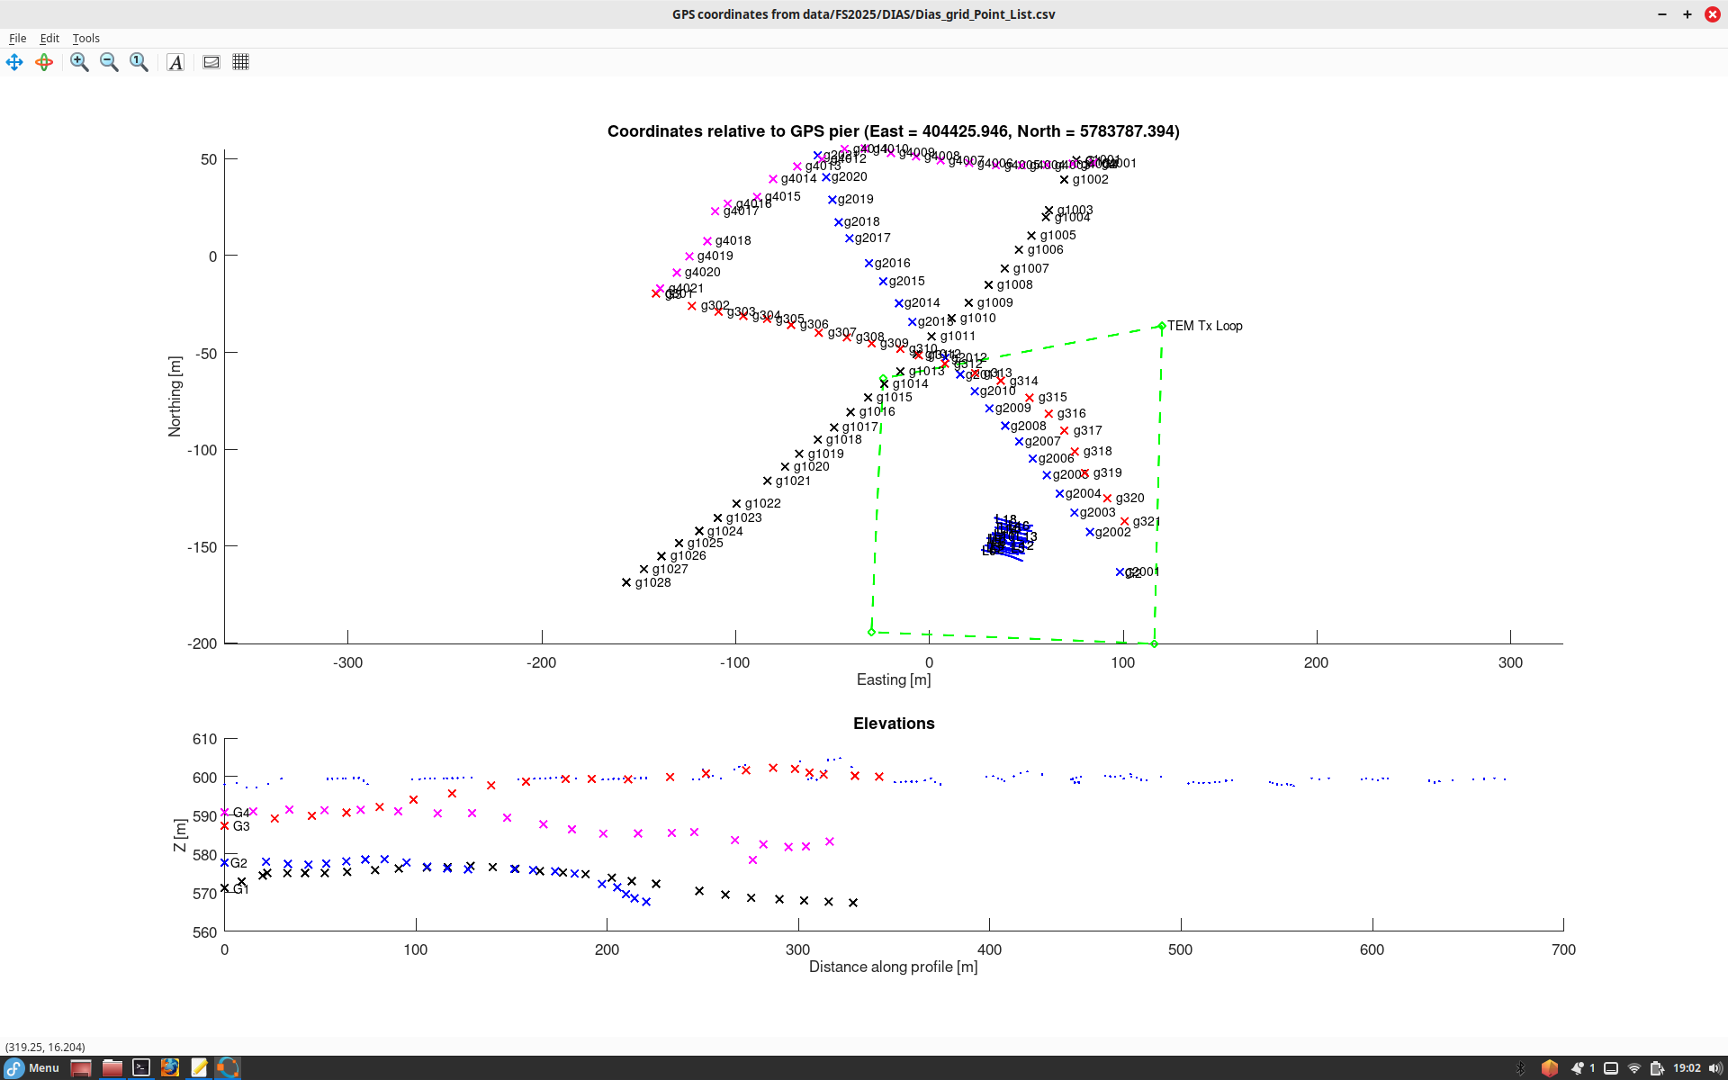
Coordinates of most of our surveys
Elevations are shown vs. distance along each individual profile.
(Dots are from the 3-D DIAS grid and give weird distance of nearly 700 m)

