Slide 1
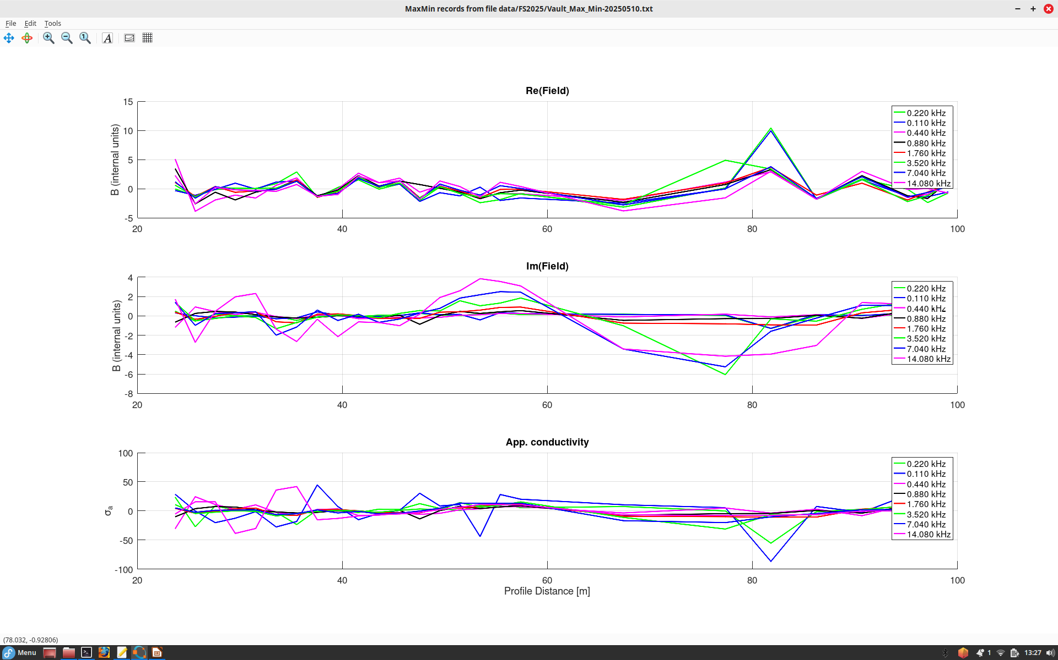
MaxMin profiles along the long diagonal line G1 at the vault (May 10). Note that MaxMin operates at 8 frequencies.
Distance is measured from the NE end of the line.
These peaks separated by 25 m (Tx – Rx cable length)
look like related to Rx or Tx passing over target (power cable)

