Slide 1
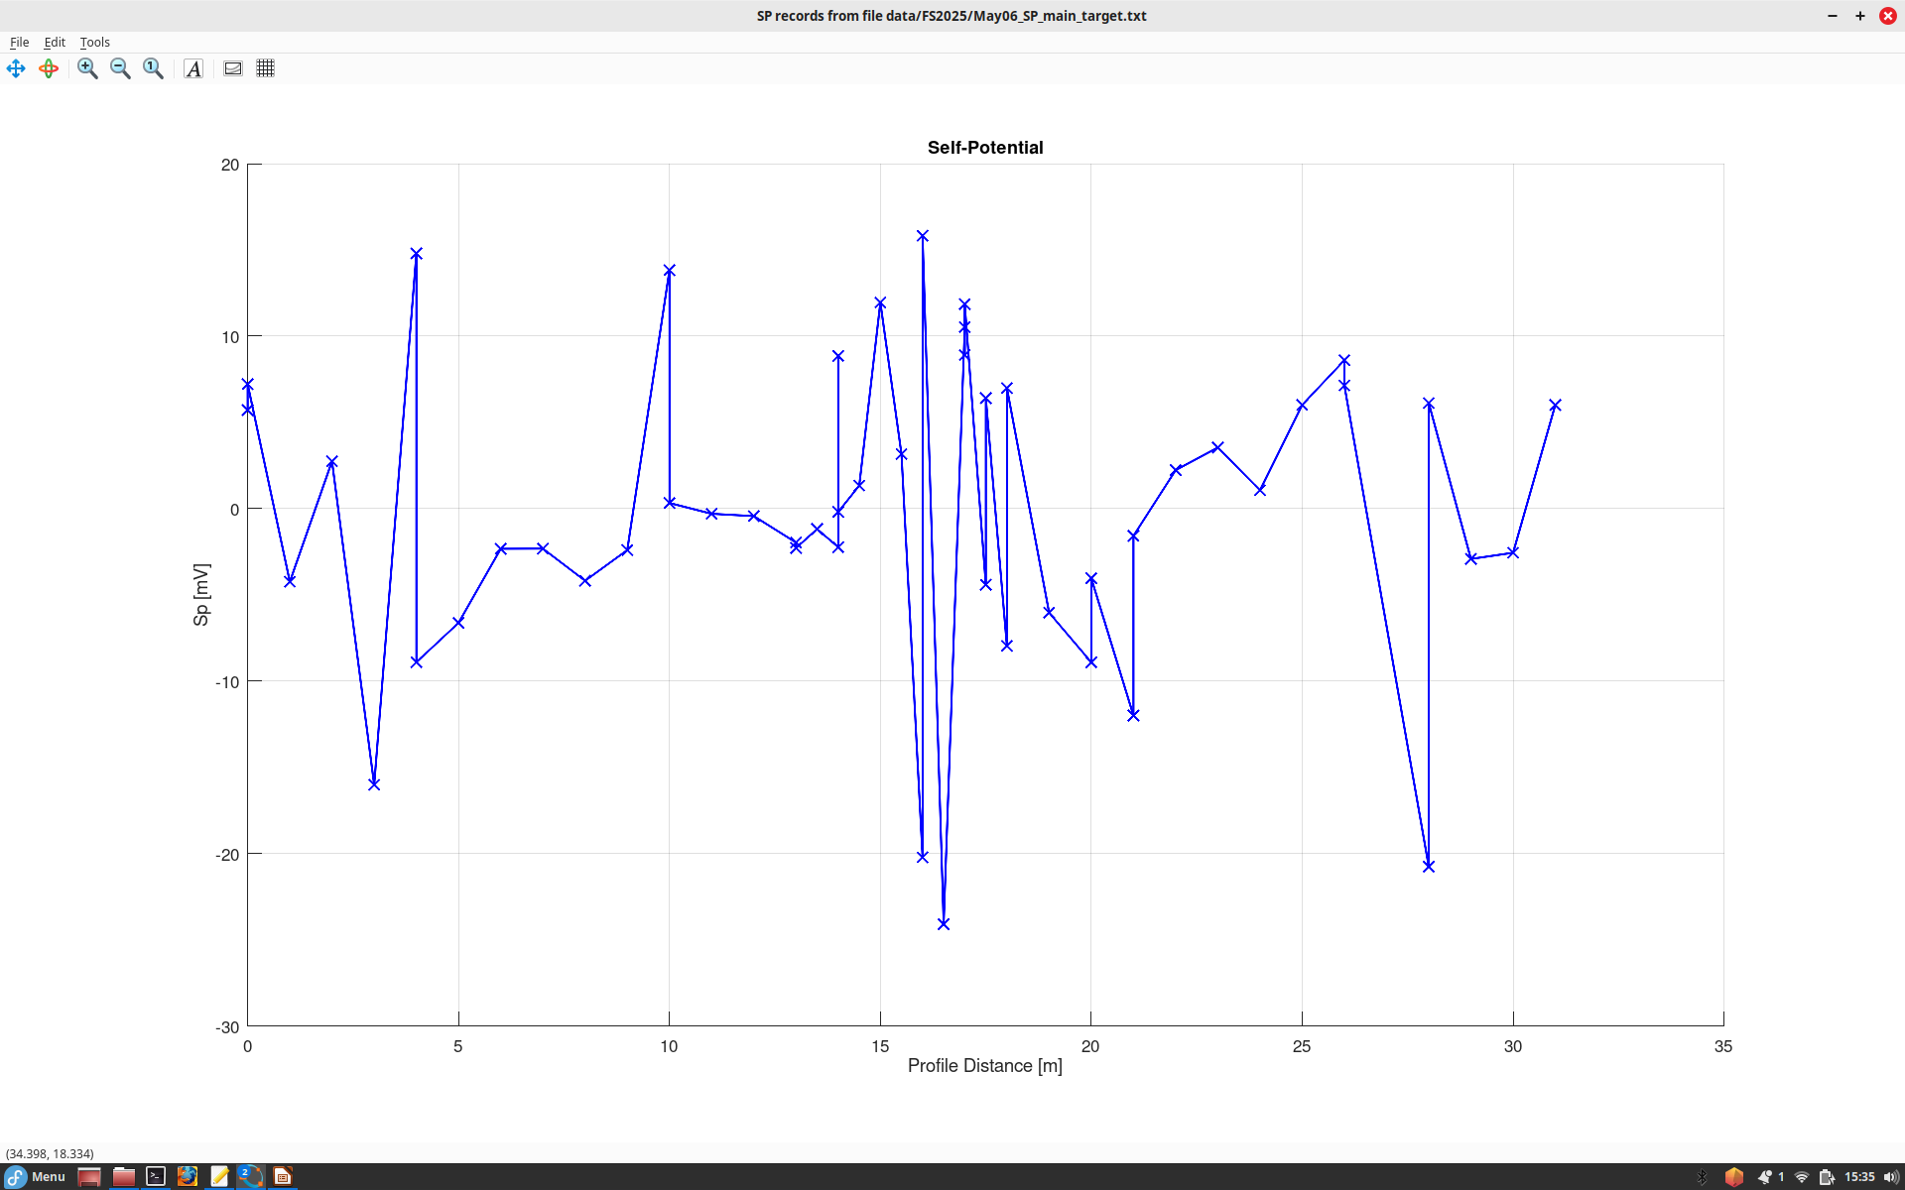
Self-Potential profile across the main magnetic target near Vault (May 5).
SP voltages are relatively weak (about +/-10 mV) and affected by surface topography and vegetation
Some points need to be retaken or
verified
Target is here.
Near the target, we have an SP low but also strong variations

