Slide 1
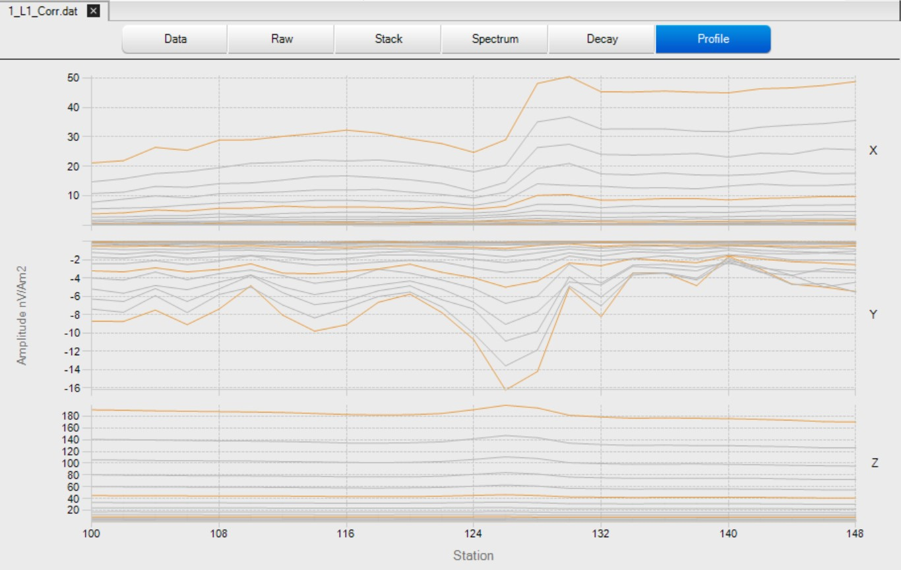
These Images are by Joel Grunerud. I will later try drawing more images.
TEM line 1 across the main target (May 10). The anomaly (iron sheet) is at near station 126.

Slide 2
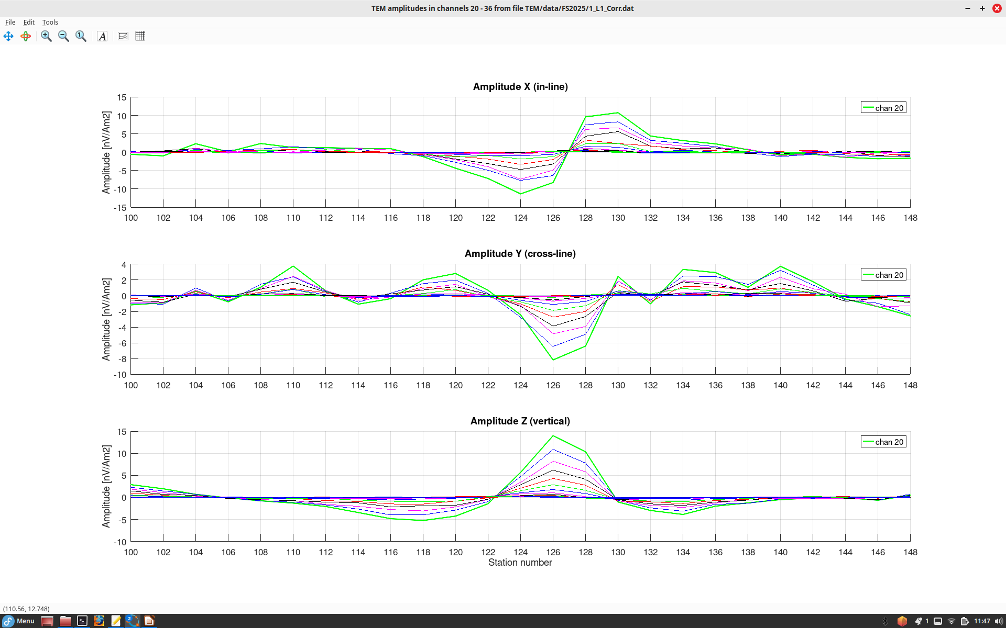
Improved images of channels 20-36 from Line 1 after removal of the regional trends of responses
The target is near the peaks of responses in components Z and Y, and zero cross-over in component X
Such shapes of X and Z responses suggest a channel induced current flowing around the target
Y response is weak (note axis labels) and is likely due to the westward plunge of the target

Slide 3
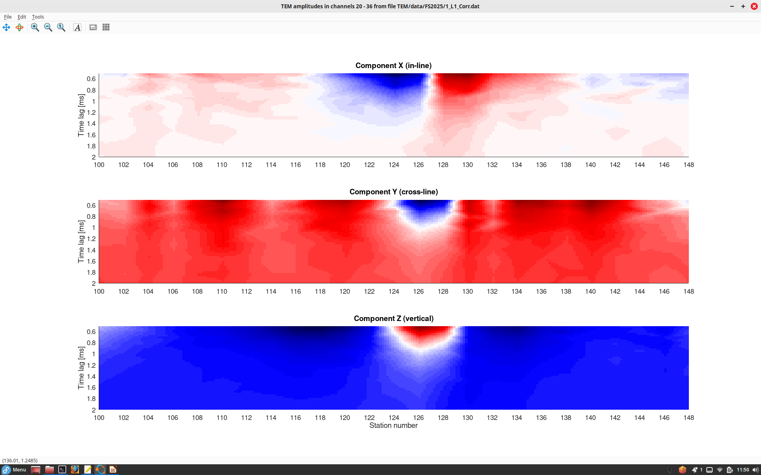
In these images, the amplitudes are shown by color (negative – blue, positive – red), and vertical axes show the time delays of current induced in the ground by stopping the primary current in the transmitter loop.
Note that the currents near target continue flowing for about 1 ms.

Slide 4

Similar results for TEM Line 2 (a couple meters west of Line 1)

Slide 5
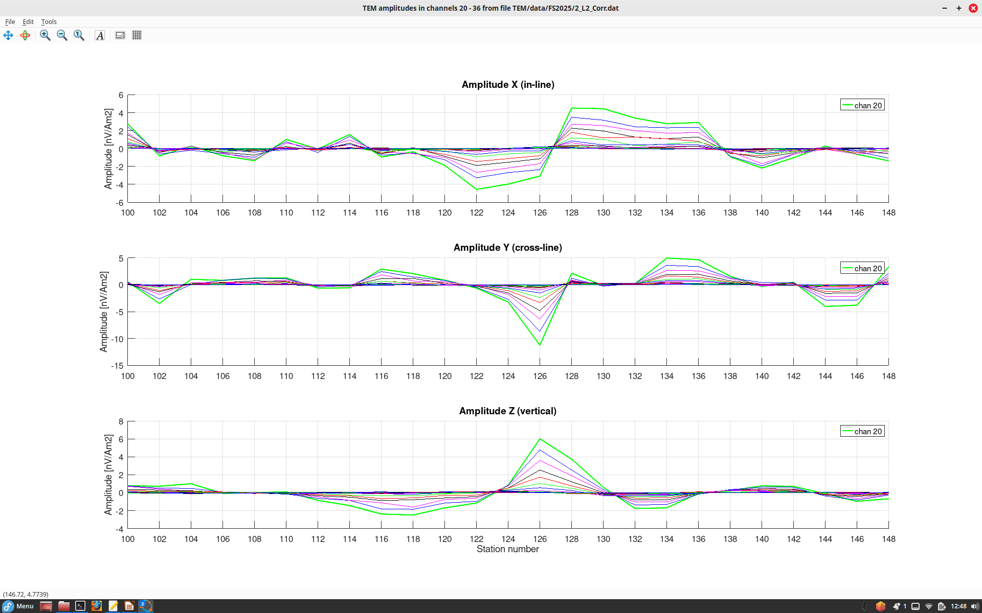

Slide 6
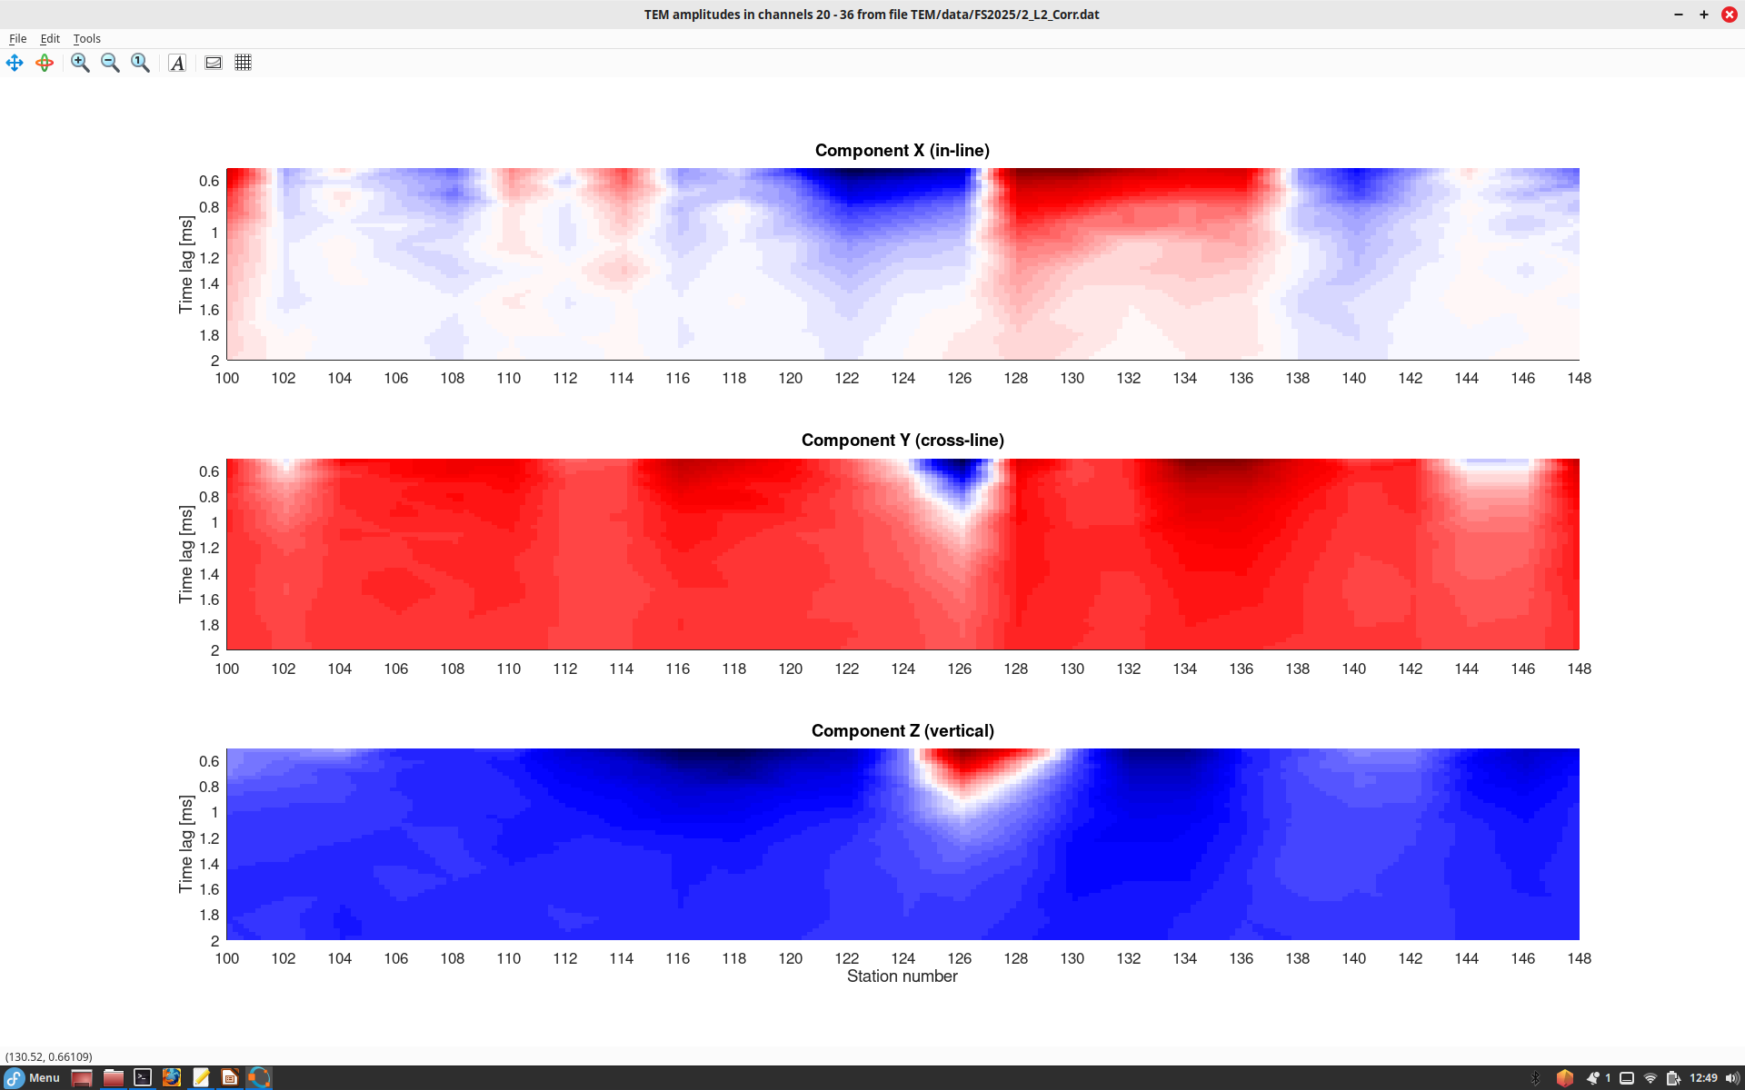
Responses are slightly shorter and weaker at this location, likely because the target is plunging and is located deeper here.

