Slide 1
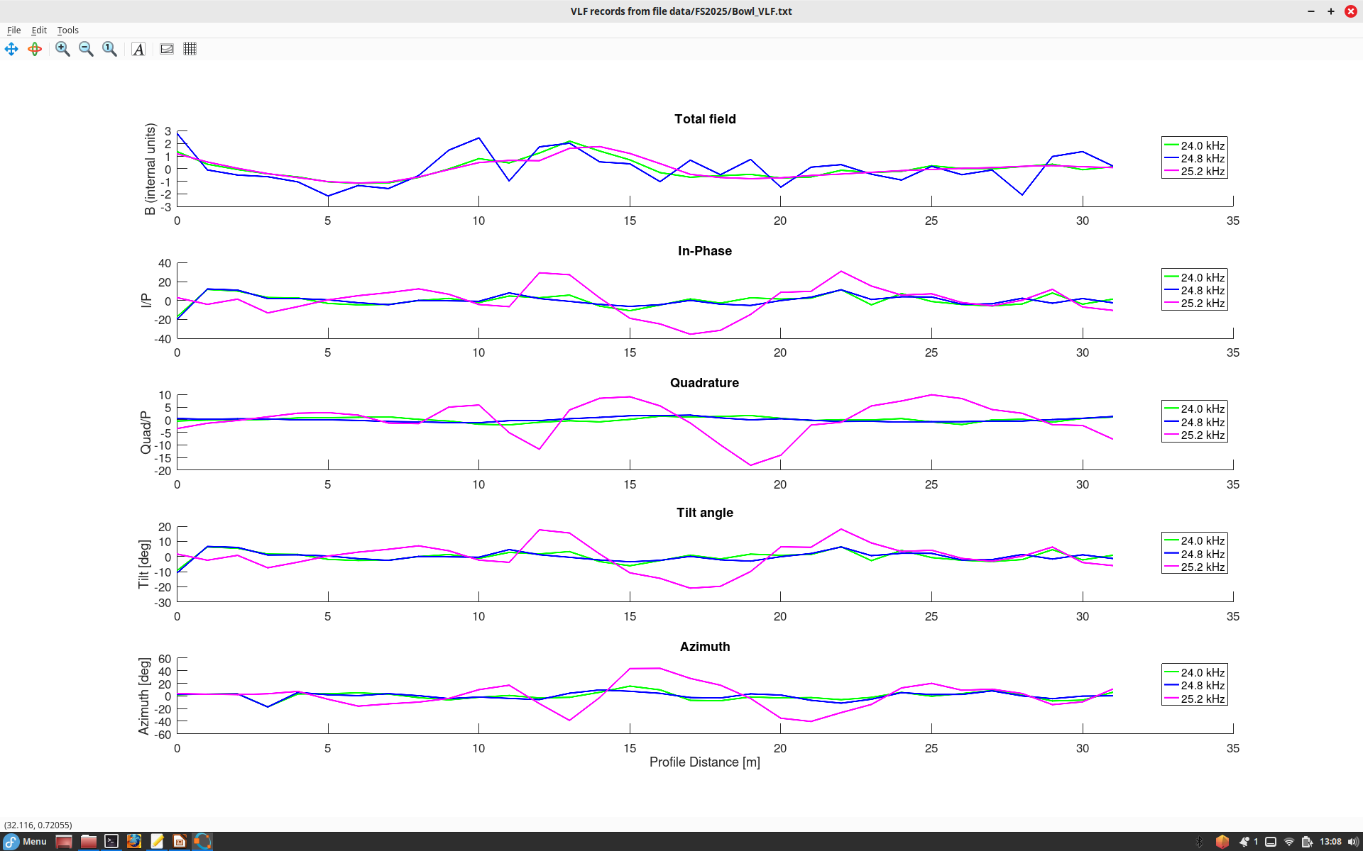
Frequencies show different transnmitters:
24 kHz ==> Cutler, Maine
24.8 kHz ==> Jim Creek, Washington state
25.2 kHz ==> La Moure, North Dakota
VLF profile in The Bowl (May 6).
The target (cable) seems to be best seen at 25.2 kHz (purple)
Peaks of the In-Phase and tilt angle (of recorded magnetic field) shows the conductor (cable)
Quadrature
has a cross-over at this point
There also seems to be something here where we saw GPR reflections

Slide 2
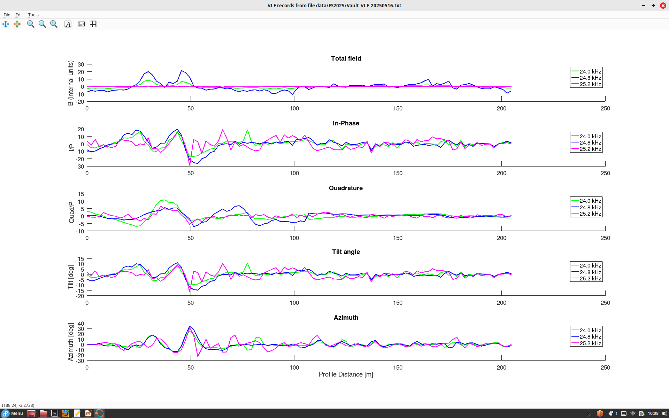
VLF profile at the vault site (May 9).
Interesting peak of Quadrature at ~70 m may be due to topography?
Cables

