Slide 1
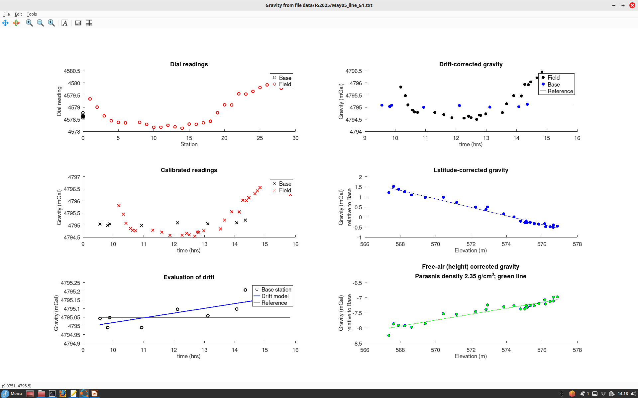
Line G1 looks good (station 28 was redone)
Note the instrument drift model from repeated measurements at base station
Note gravity reducing with elevation (“free-air” effect)
After correction for the free-air effect, gravity increases with elevation.
This gives a good estimate of subsurface density

Slide 2
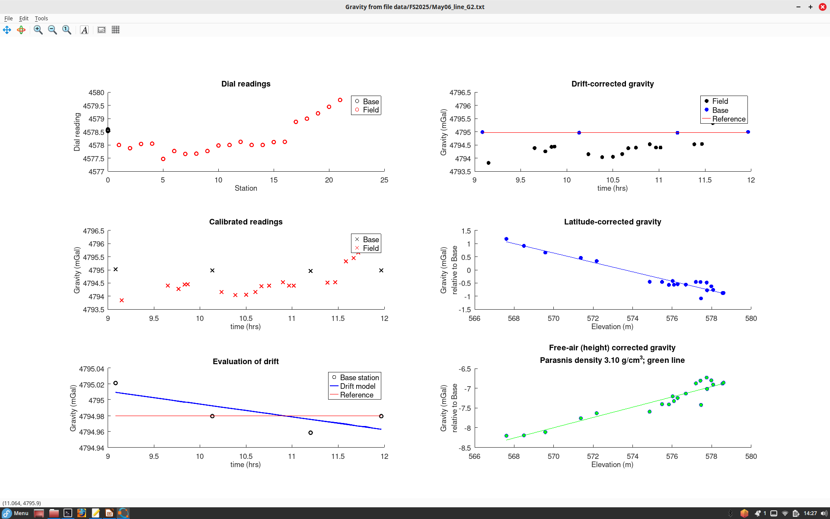
Line G2
Parasnis density looks too high in this line

Slide 3
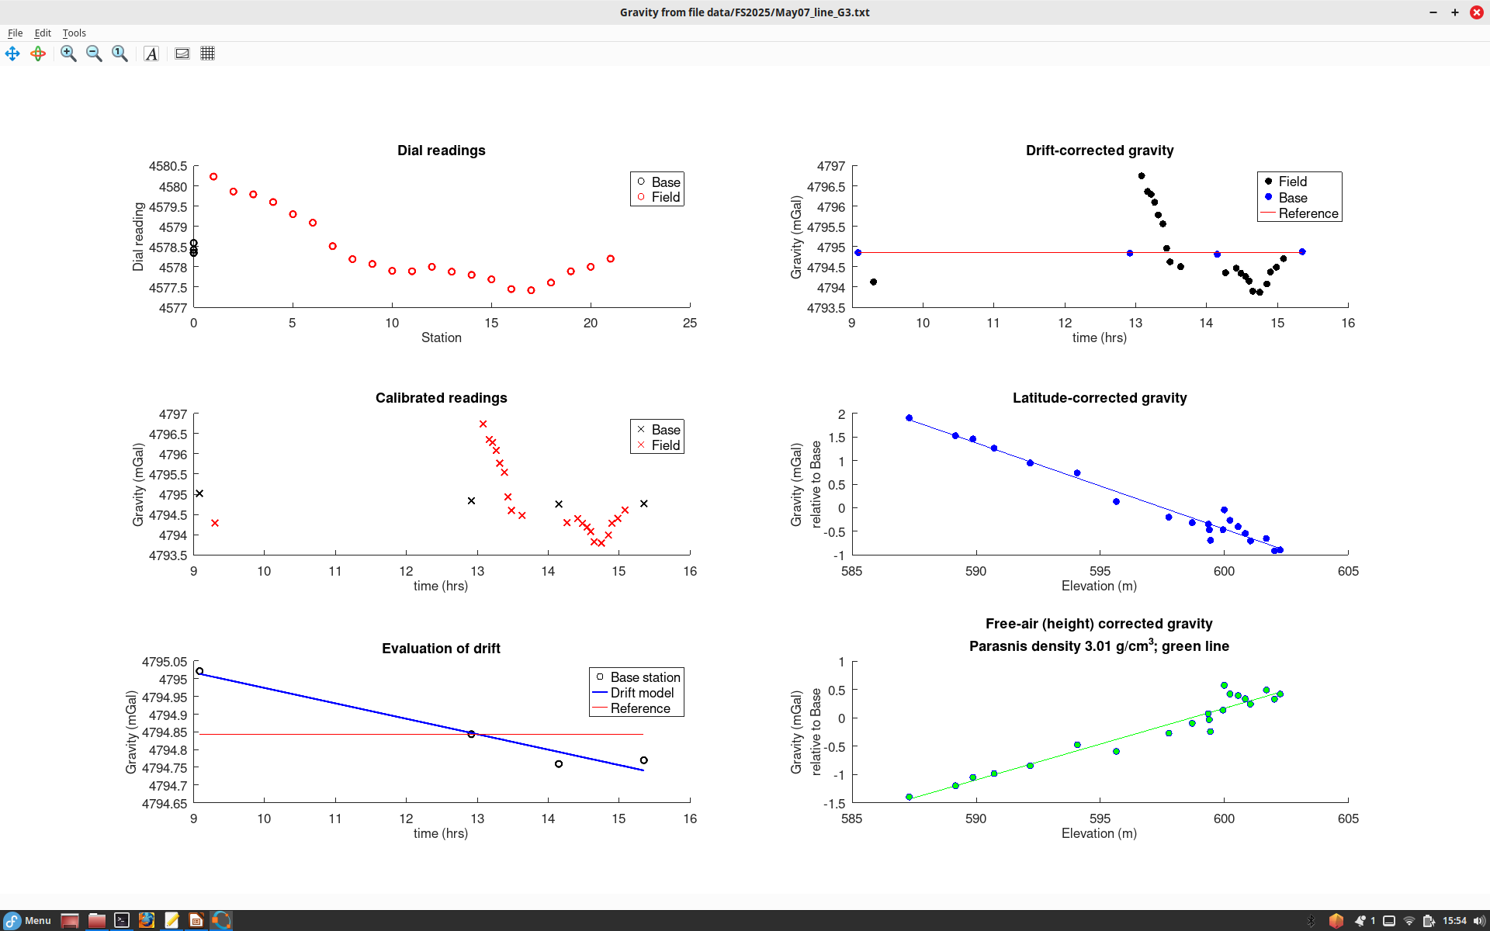
Line G3 (Station 11 redone)
high Parasnis density is a mystery

Slide 4
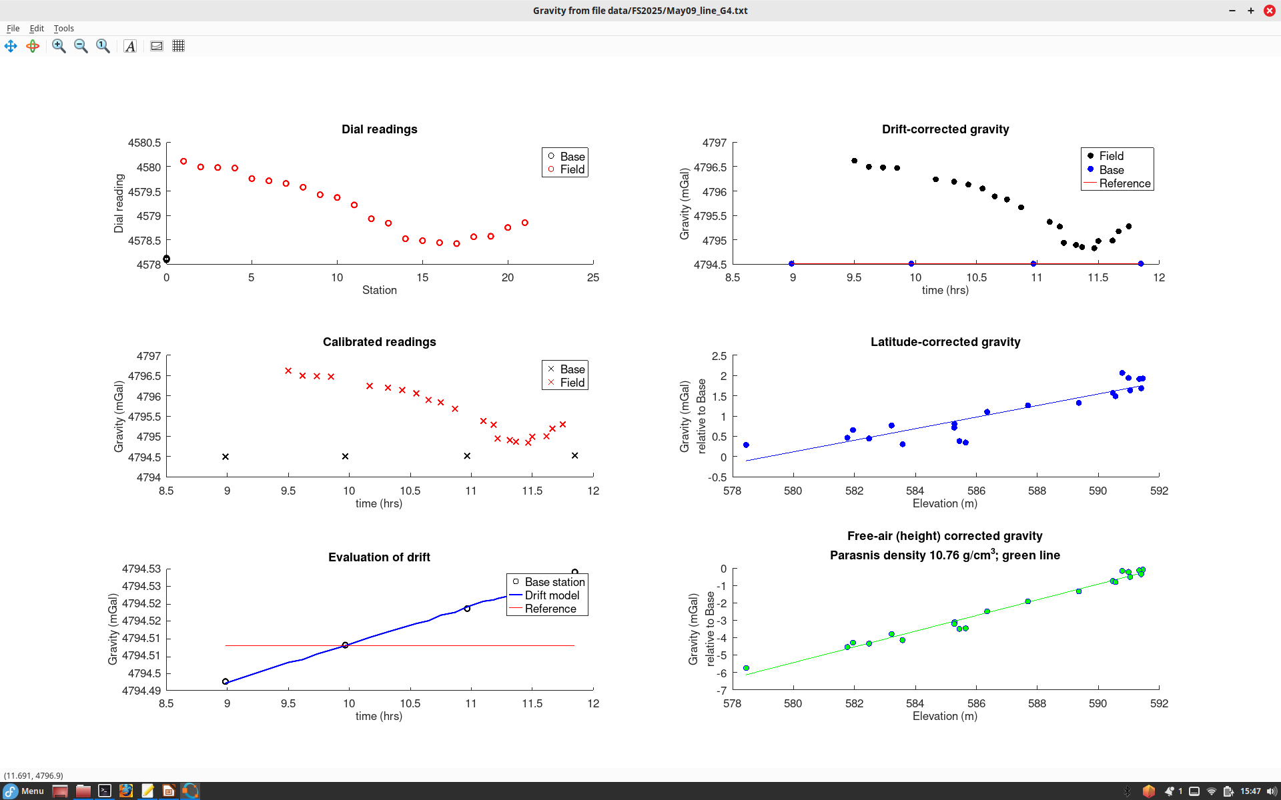
Line G4
Parasnis density should be poorly resolved here because of nearly-horizontal line at low elevation

