Slide 1
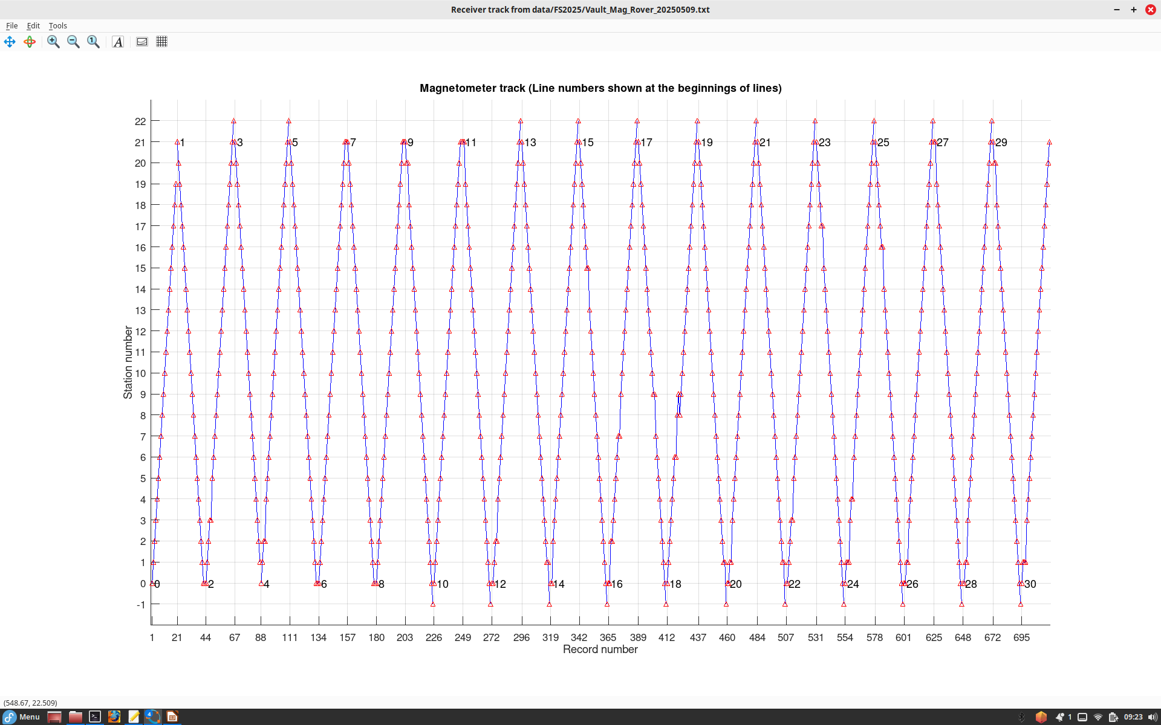
Magnetomter grid over AP target at vault site on May 9. This graph shows station numbers for the 717 records we made. Line numbers are labelled. There were many operator errors (stations skipped, track directions set wrong). I tried correcting these errors but apparently not very successfully

Slide 2
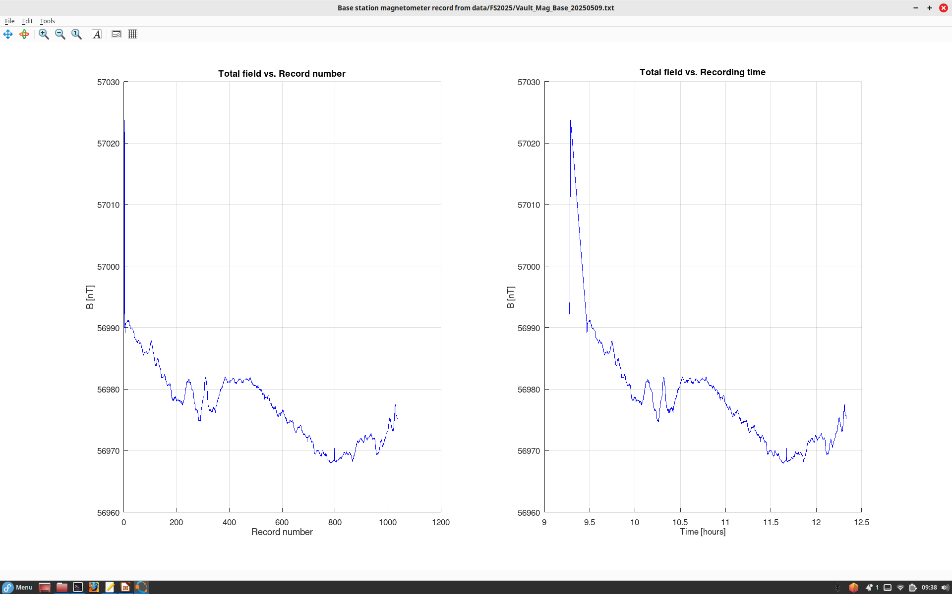
Base station magnetic record from May 9 at the vault.
Note the variability of magnetic field after 9:30 (before 9:30, the big spike is during set-up)

Slide 3
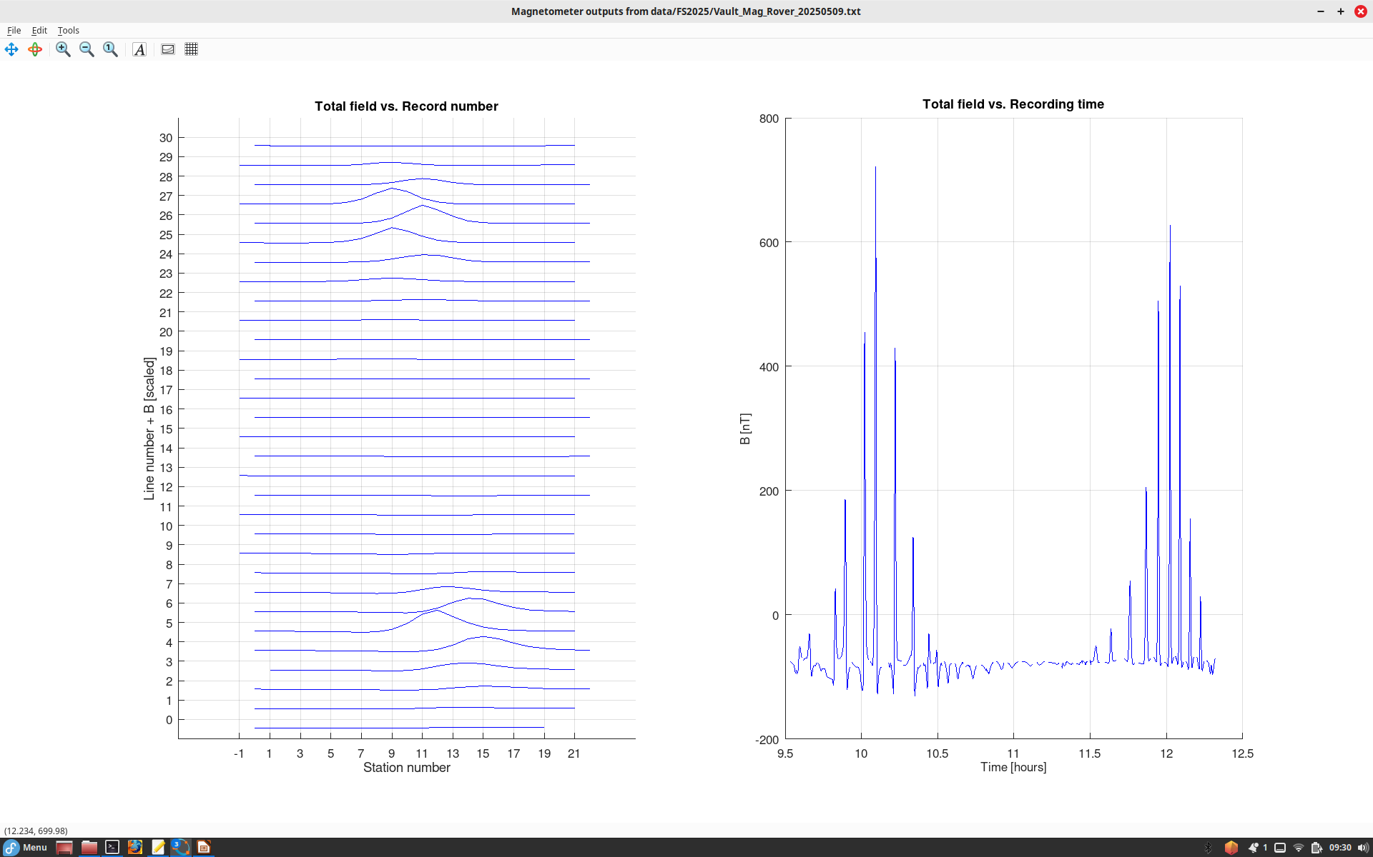
Magnetic anomalies shown as graphs vs. station numbers (left) and as a function of time during the whole survey (right).
This time dependence is used to subtract (in the following plot) the reference magnetic field recorded at the base station
Note two clear magnetic anomalies.
However, these anomalies appear misaligned and shifted due to positioning errors.

Slide 4
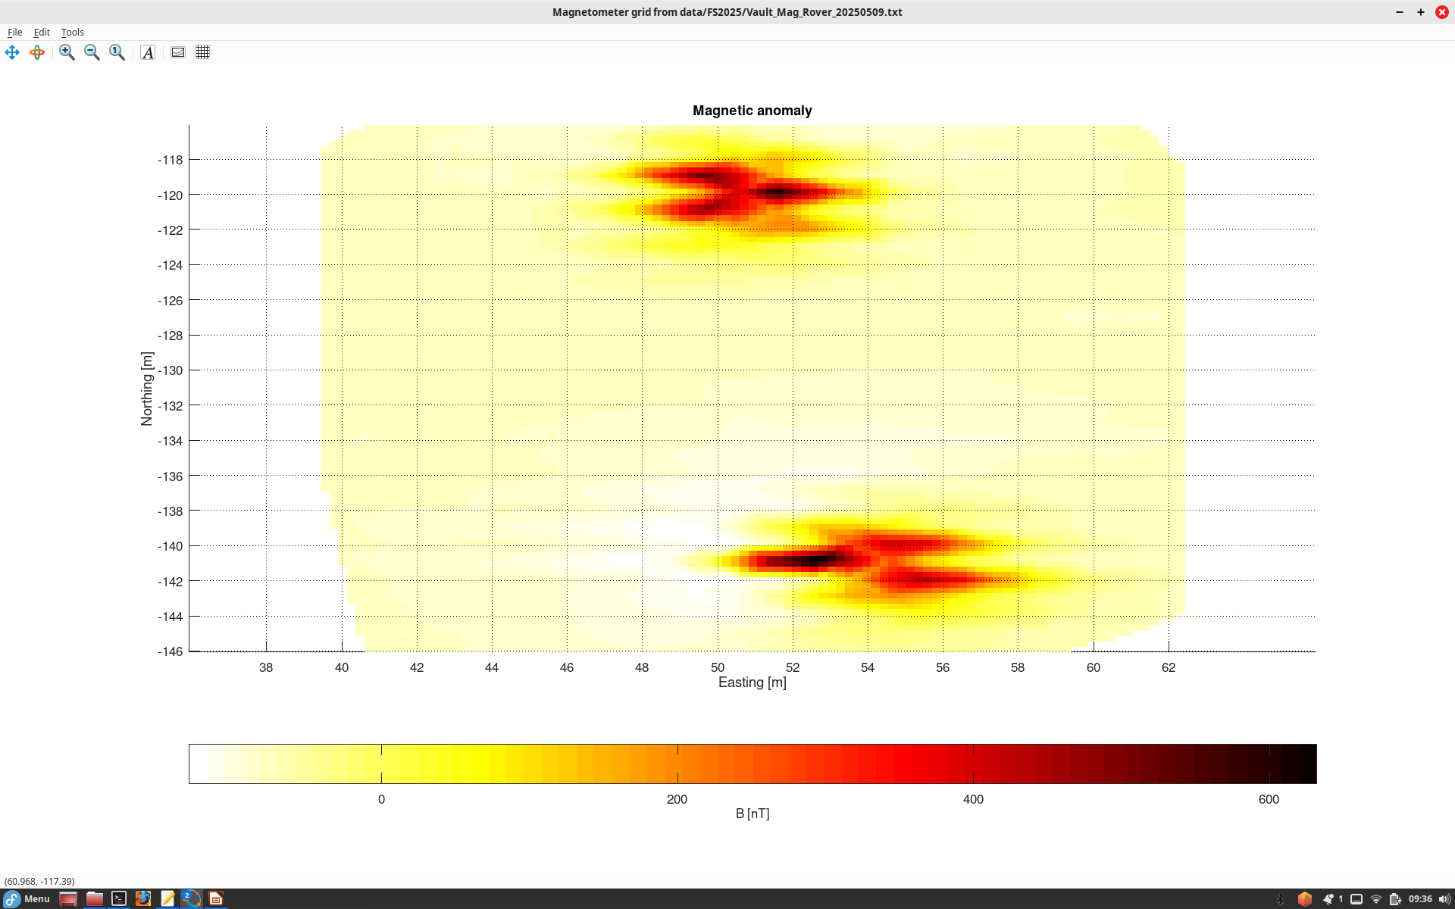
Magnetic anomalies gridded on map.
Misaligned, apparently due to positioning errors, but generally look correct

Slide 5
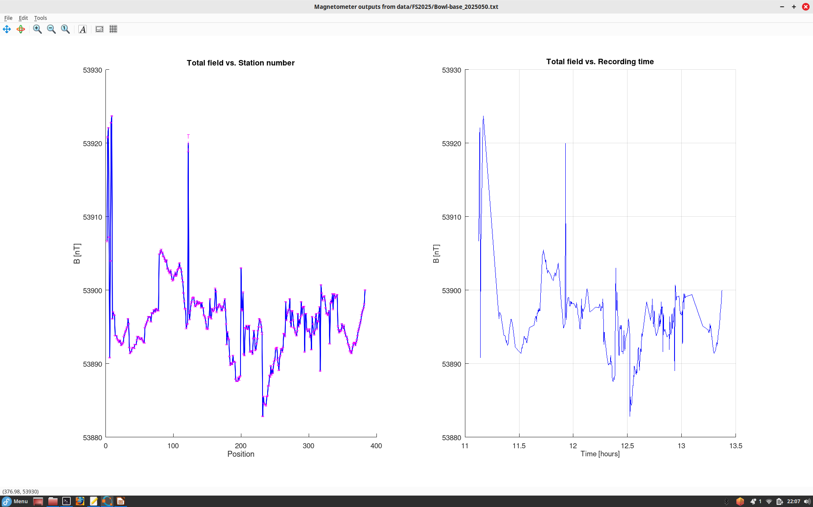
For magnetic grid at the Bowl (May 3), there were also a few positioning errors (all of us learning!), and the same procedure gave good results. Hers are the variations of magnetic field at the base station.
In this instrument (OMNI), “position” means record number.
We (Quin) ran the base station manually, and so its data are not so densely sampled as in the Vault test.

Slide 6
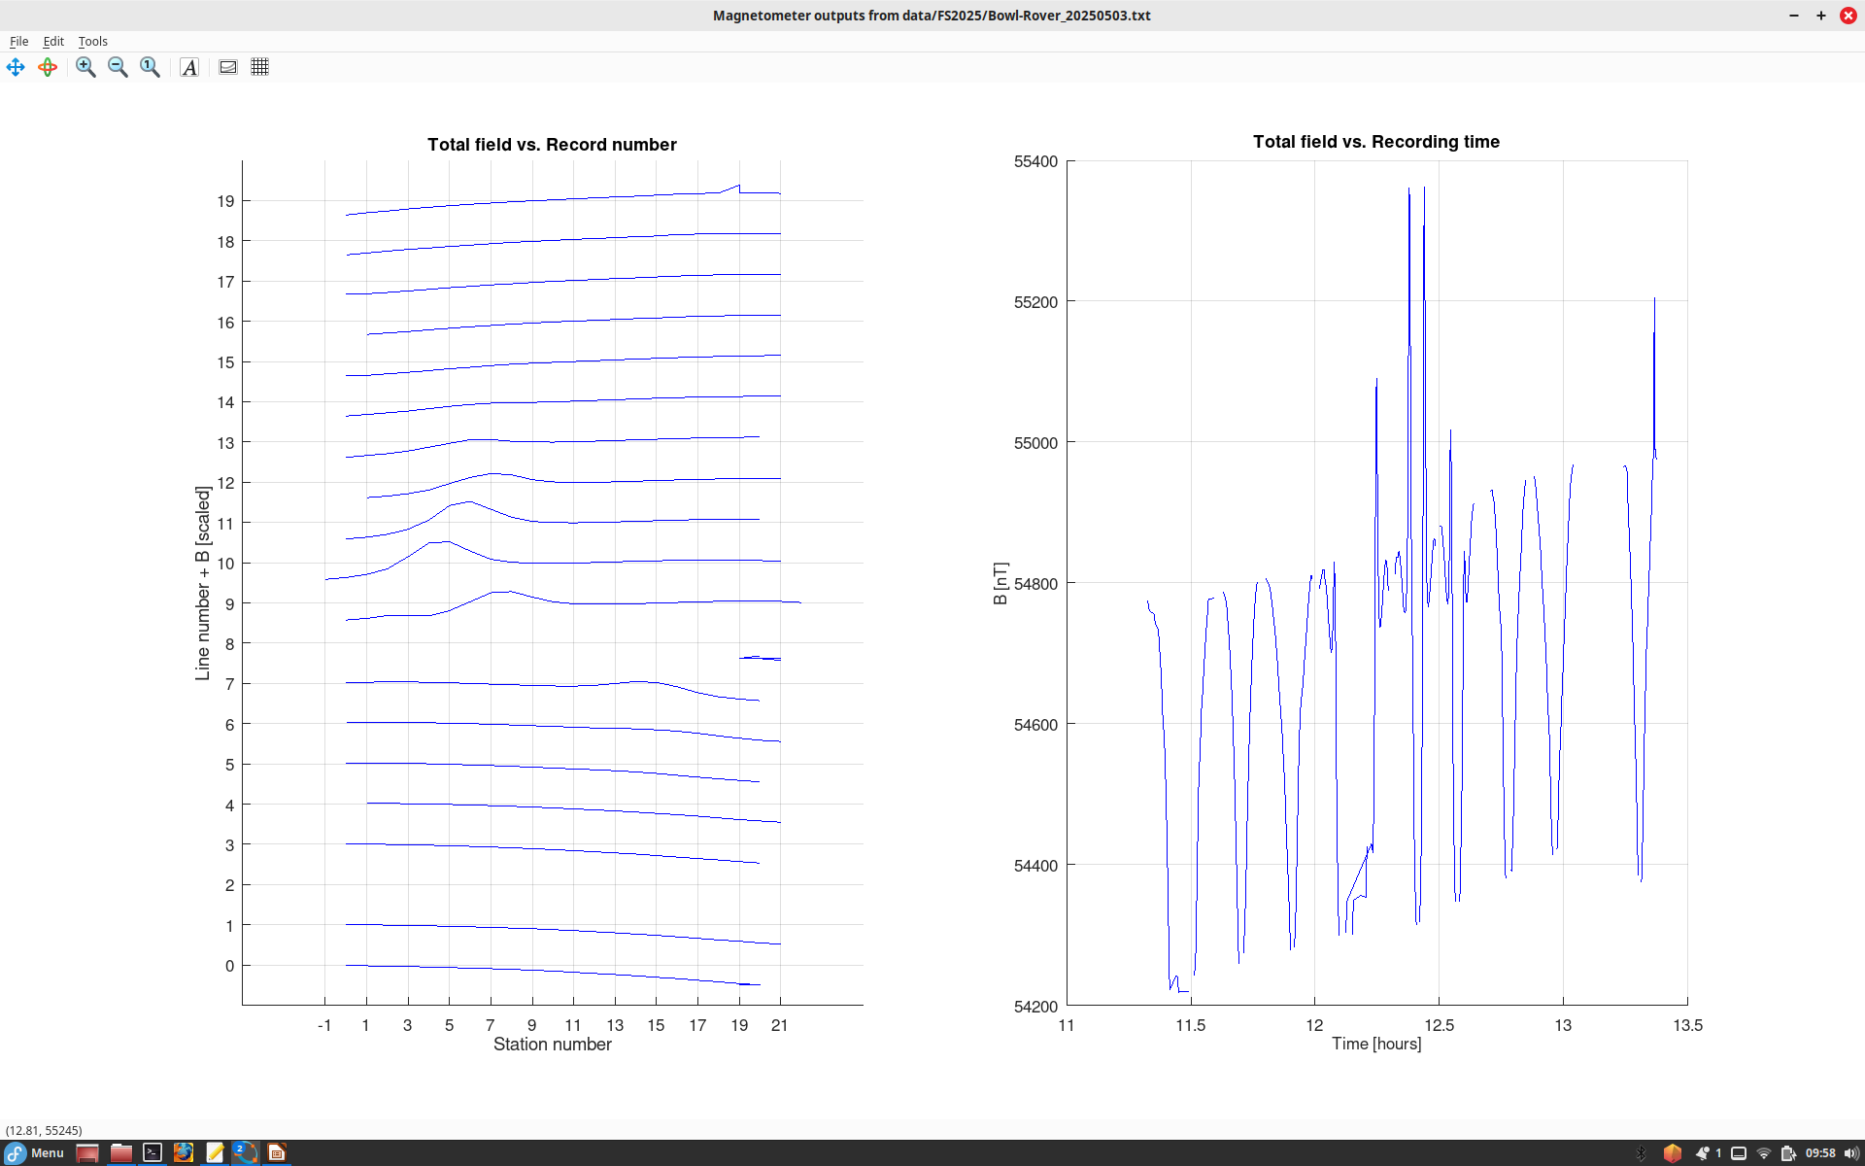
Recorded ragnetic field vs. line/station numbers and time

Slide 7
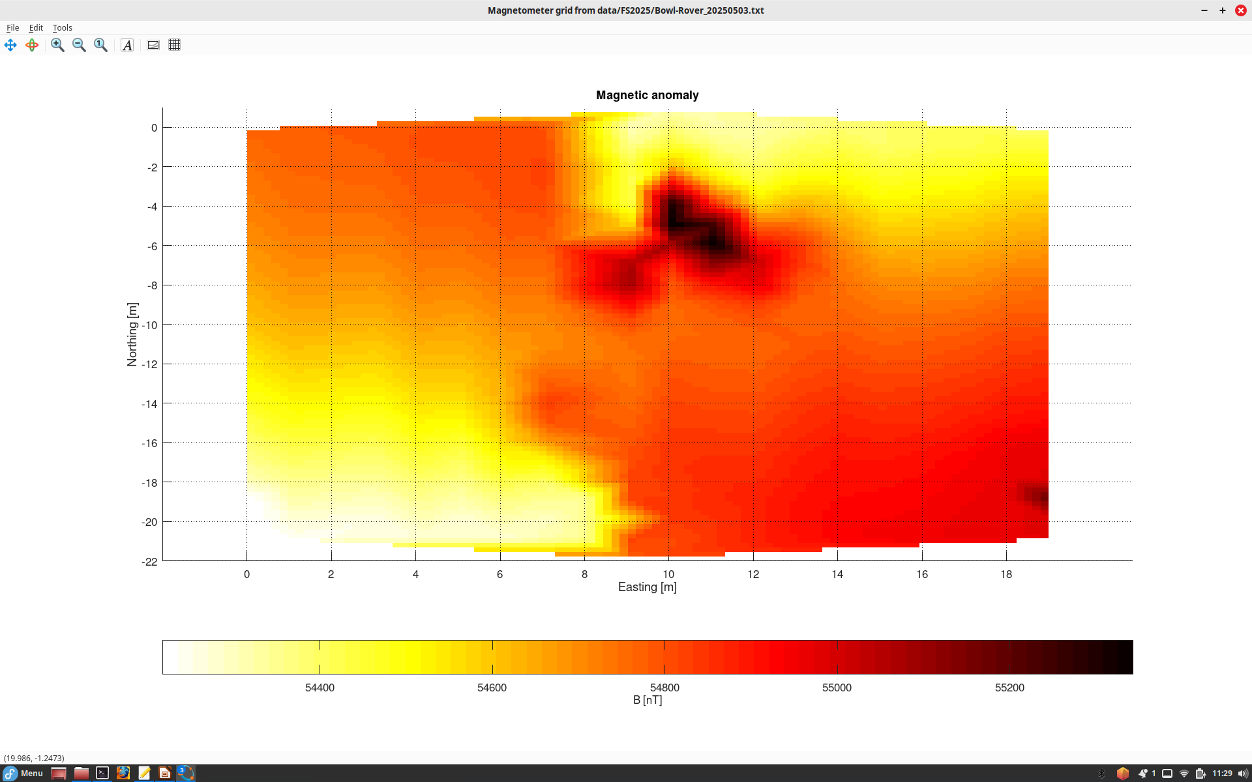
We need to check which of these dark anomalies is rs the iron rod and which are the manhole covers...

