Slide 1
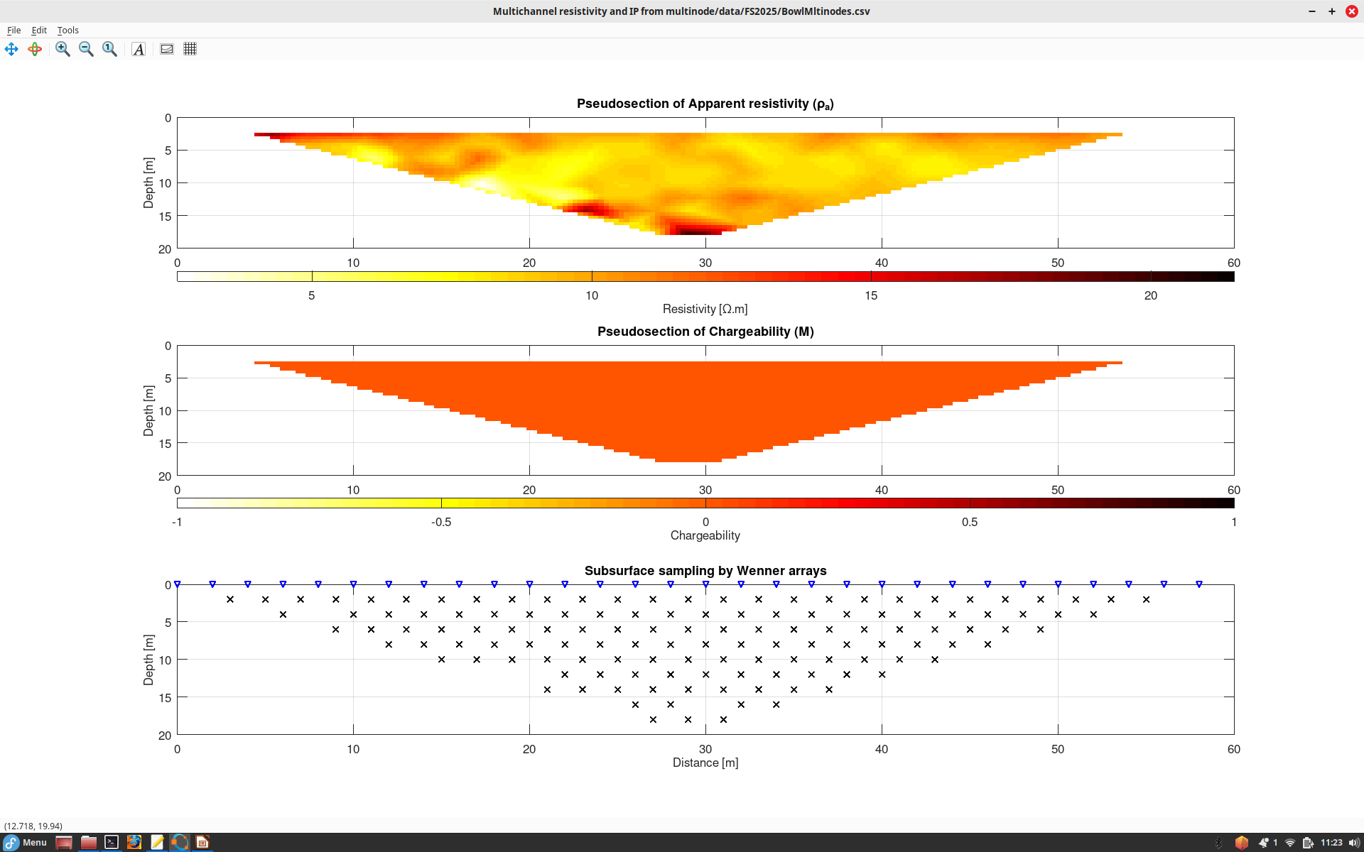
Multinode resistivity line across Bowl on May 03 after removal of bad readings. Low values ~10 Ohm.m may be due to clay.
Some variations of resistivity. Maybe a resistive body at depth, but still not sure.
M values we did not record, and so M=0 is shown
Note this map of depth coverage by different Wenner arrays formed from the 3-channel spread

Slide 2
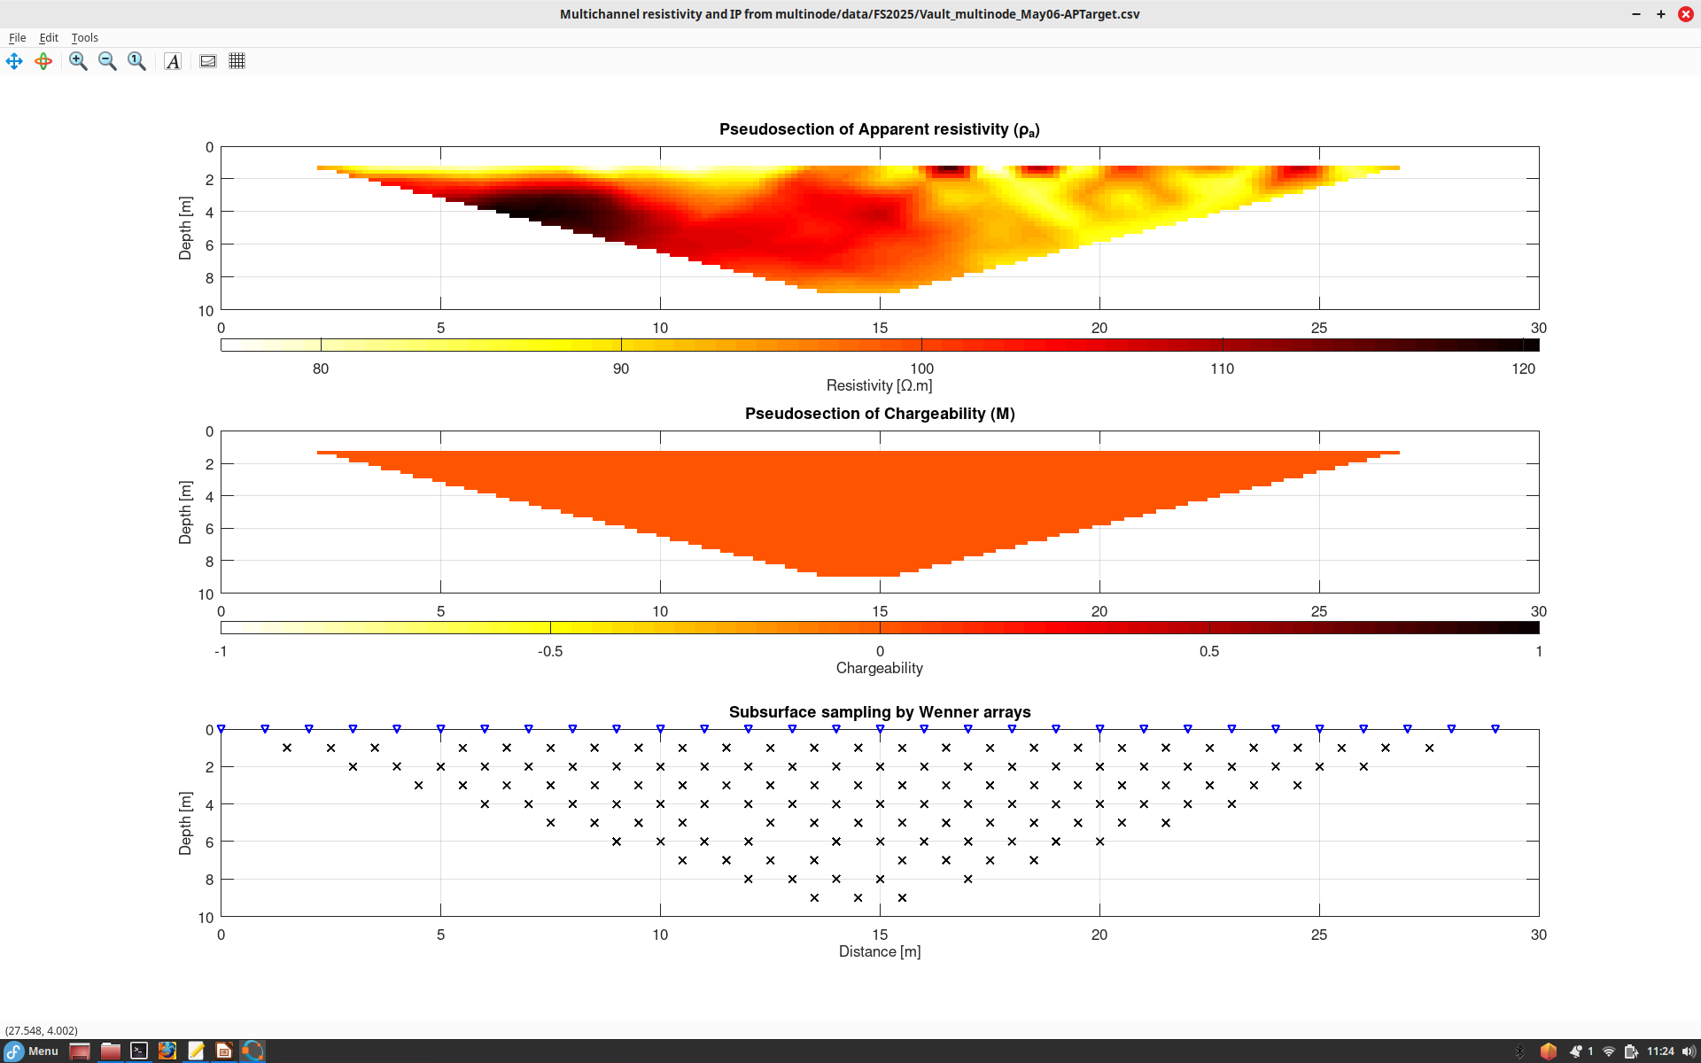
Multinode resistivity line along AP target near vault (May 6). Looks not very successful. Several electrodes seem poorly connected (black areas om the right) and a strange “resistive” anomaly on the left. May need to redo with shorter spacings or a different line direction.

