Slide 1
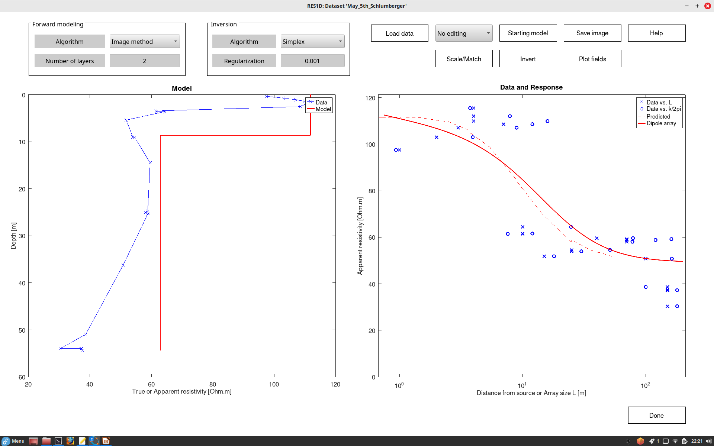
Resistivity interpretation for a layered 1-D model.
Here, blue line is the apparent resistivity (calculated from data) vs. pseudo-depth.
Red line is the true resistivity model which I adjust interactively to fit data on the right (the two red curves)
In this panel, blue symbols are apparent resistivity data plotted vs. “array size” estimated by different methods.
Dashed red line is the apparent resistivity for an equivalent pole-pole array (with one A and one M electrodes, and B and N at infinity)
Note in the model:
A clearly more conductive layer below about 10-m depth (clayey til below sand?)
Generally low resistivities in the area, below 120 Ohm.m
Solid red line is the modelled apparent resistivity for the pole-pole array. The objective of data fitting is to select the model so that the solid red lines matches the dashed one (and the blue markers).

