Slide 1
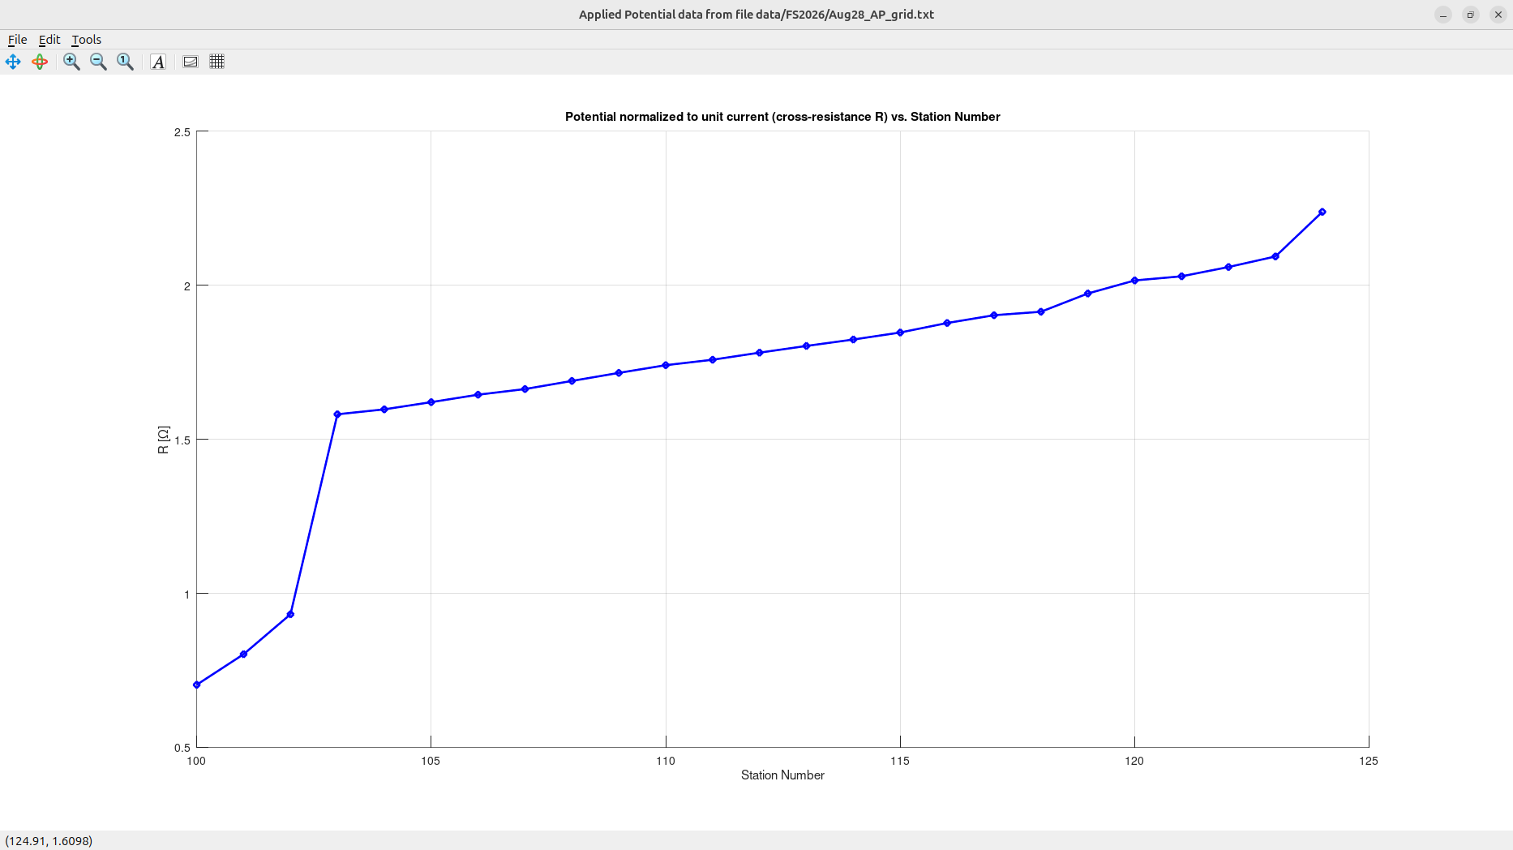
Applied Potential (“Equipotential”, or “Mise-a-la-Masse”) line over target 5A (4 by 8 ft iron sheet dipping North).
It appears that the resistivity meter (SYSCAL Junior) did not work well after the first rainy day of the field school. The cross-resistance (Voltage-to-Current ratio) measured between pairs of MN and AB electrodes in the AP line increased continuously to a large distance after the target.
The broad peak between stations 103 – 115 may still be related to the nearly flat-lying iron sheet dipping north, but the overall continuous trend looks suspicious.
S
N

Slide 2
To make it up for the failed AP survey, the next slide shows good results from the 2025 field school.
This survey was a 12 by 12-m grid over target “4D”, which is a nearly vertically placed 4 by 8 ft iron sheet (about 35 years ago!)

Slide 3
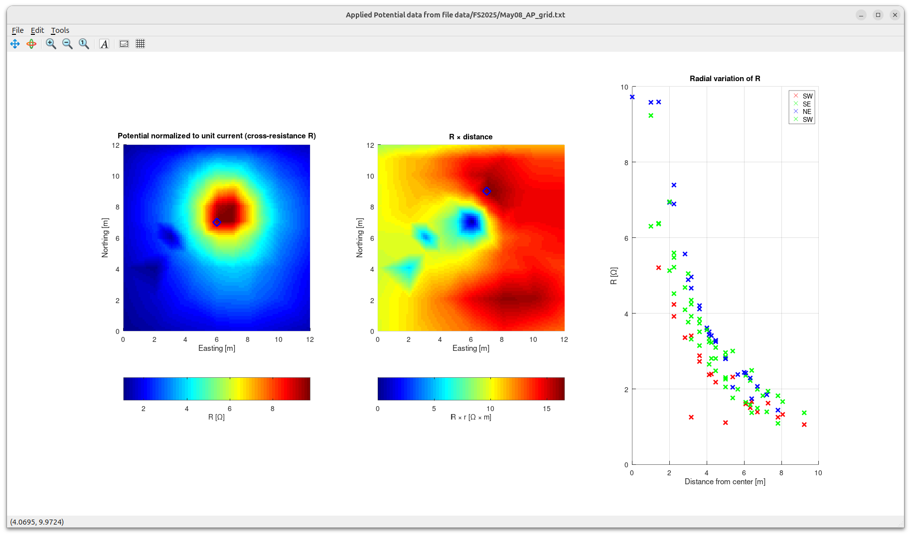
Quick analysis of Applied Potential grid data over the target in the SE corner of the test site
This panel shows the measured potential (voltage relative to infinity) divided by current. Note that this ratio is the cross-resistance R.
Note that the resistance between a point near target and infinity is about 10 Ohm.
Green diamond is the location of highest potential (top of target).
Scaled potential R = V/I vs. distance from the source, in four directions from the source.
Note that potentials decrease quicker to the SW.
This is because of the shape of the target and the effect of fence.
In the panel above, the current-normalized potential is multiplied by the distance from the source point. This corrects for the 1/distance decrease of potential and emphasizes the effect of the shape of the target.
Note that the target is oriented SW-NE and seems dipping toward SW.
Also note the increase of potential to the east because of the (unfortunate) effect of the wire fence.
Diamond symbols in these plots indicate the peak values of the plotted quantities.

