Slide 1
Multi-source and multi-channel 3-D surveys (seismic, resistivity) are quite expensive and take an extensive effort and significant time to conduct. Therefore, they should be carefully designed to optimize subsurface coverage and field effort.
The following slides illustrate some steps of preliminary design and evaluation of the DIAS resistivity/IP survey on August 30-31, 2026 at the geophysical test site.

Slide 2
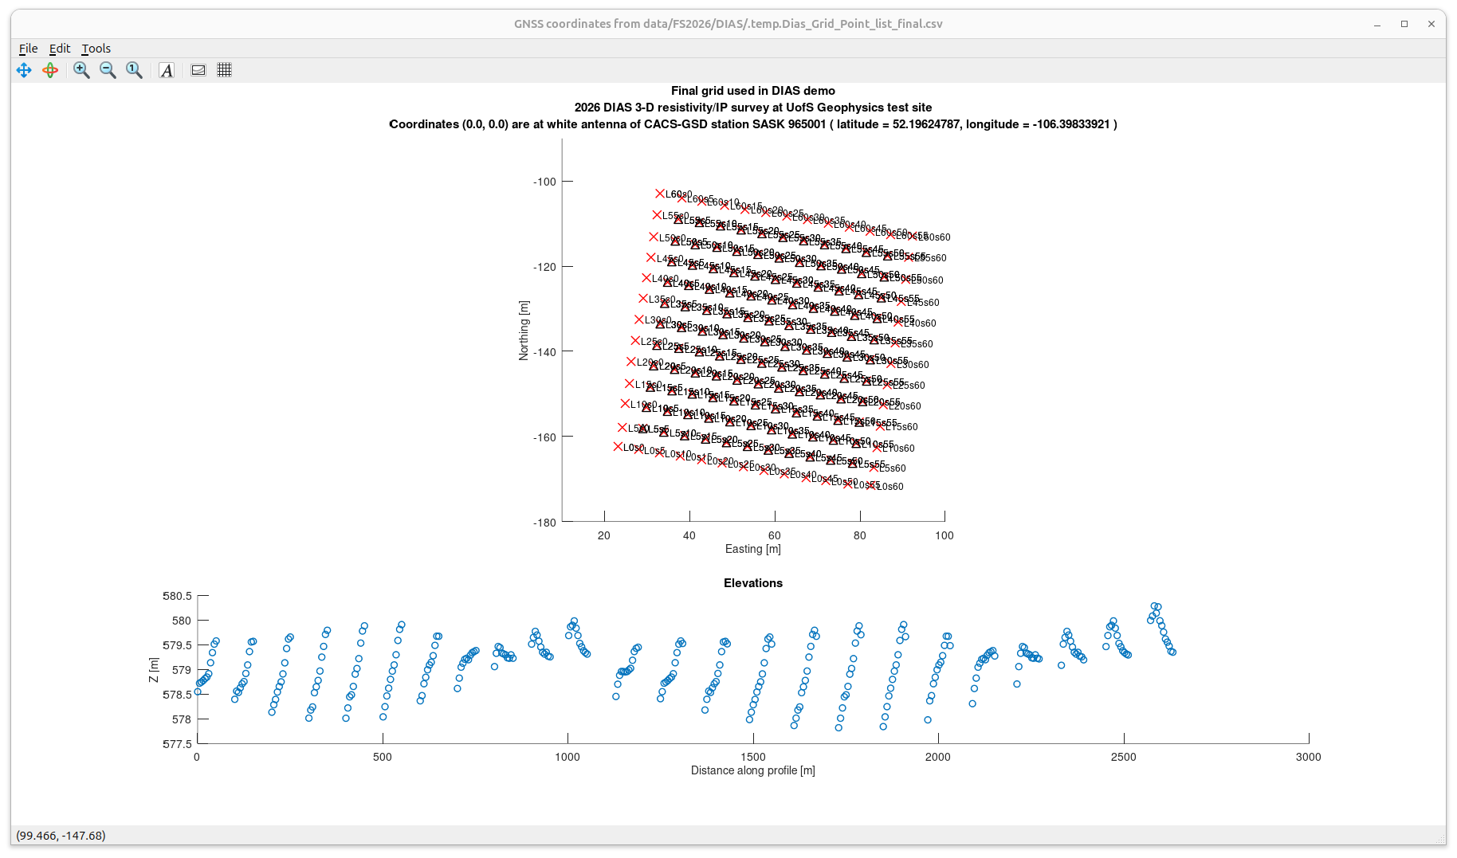
Surveyed DIAS grid
Red crosses are current injection points (electrodes A). Sources form a 13 ✕ 13 grid.
Triangles are potential measurement points (electrodes M). These electrodes occupy the inner 11 ✕ 11 grid
Electrodes B (current sink) and N (potential reference) are placed al large distance from the grid and not shown here.
As you remember, because of time constraints and weather, not all planned current-injection points were used for data acquisition.
Coordinates are in meters relative to the GNSS antenna pedestal near the vault
Plot below shows surface elevations along the lines of the grid, in scan order along lines
<number>

Slide 3
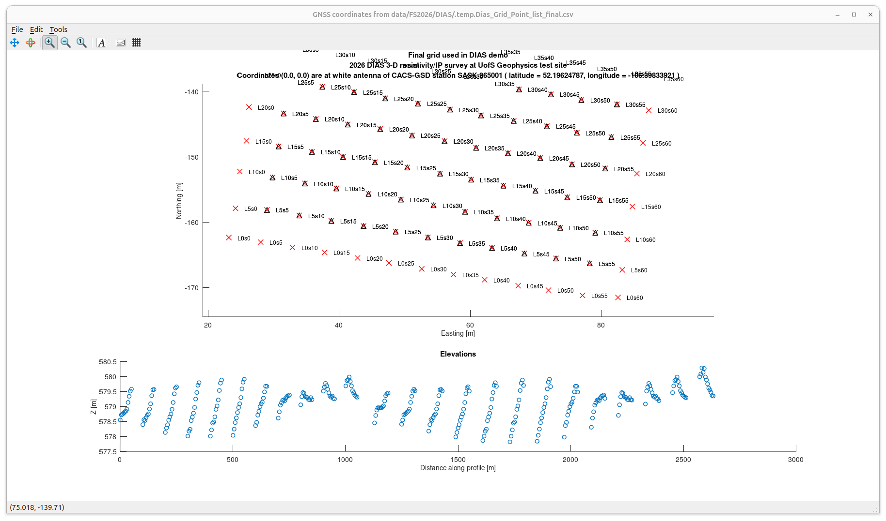
Zoom-in into the preceding plot showing the notation of line and station numbers (denoted by symbols ‘L’ and ‘s’)
Lines are oriented approximately West-East
Line numbers increase South to North
<number>

Slide 4
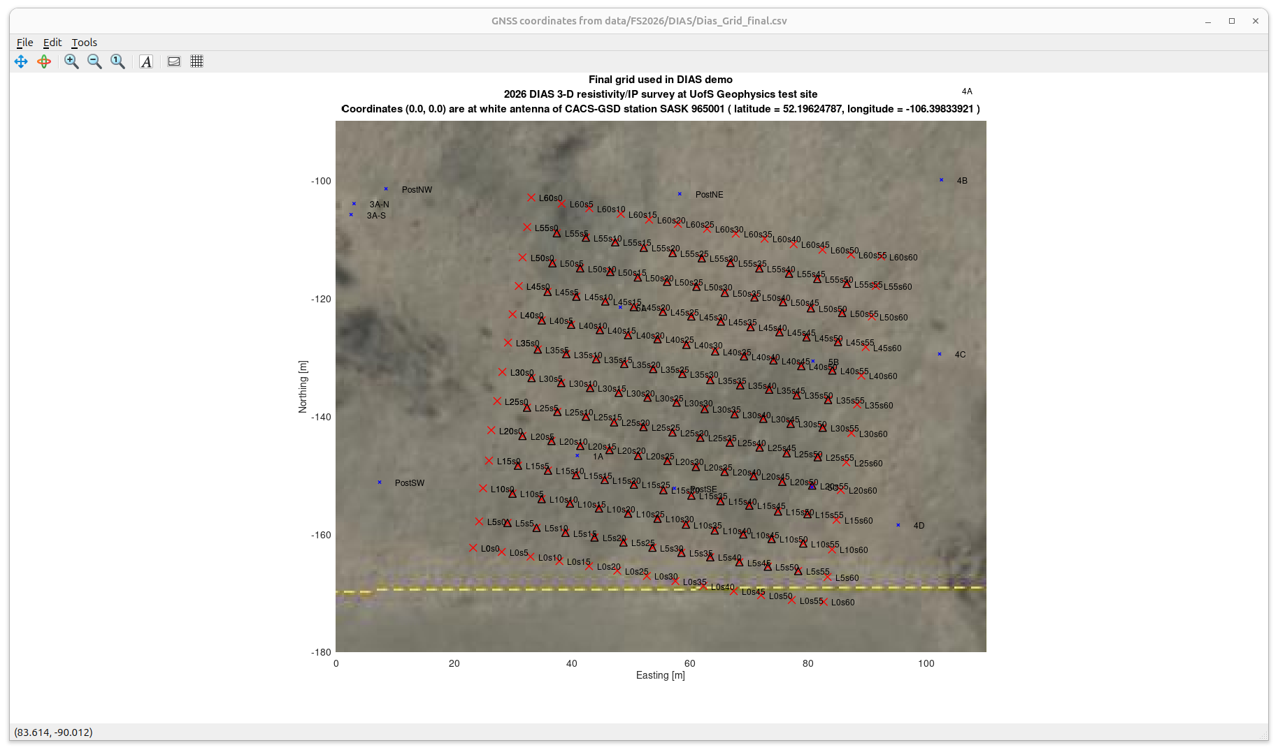
Zoom-in into the preceding plot showing the notation of line and station numbers (denoted by symbols ‘L’ and ‘s’)
Blue crosses show electrical/magnetic targets and other markers installed in the area
Note that targets 1A, 5A (4✕8 ft iron sheets) and 5B and 5C (smaller iron objects) lie within the grid.
<number>

Slide 5
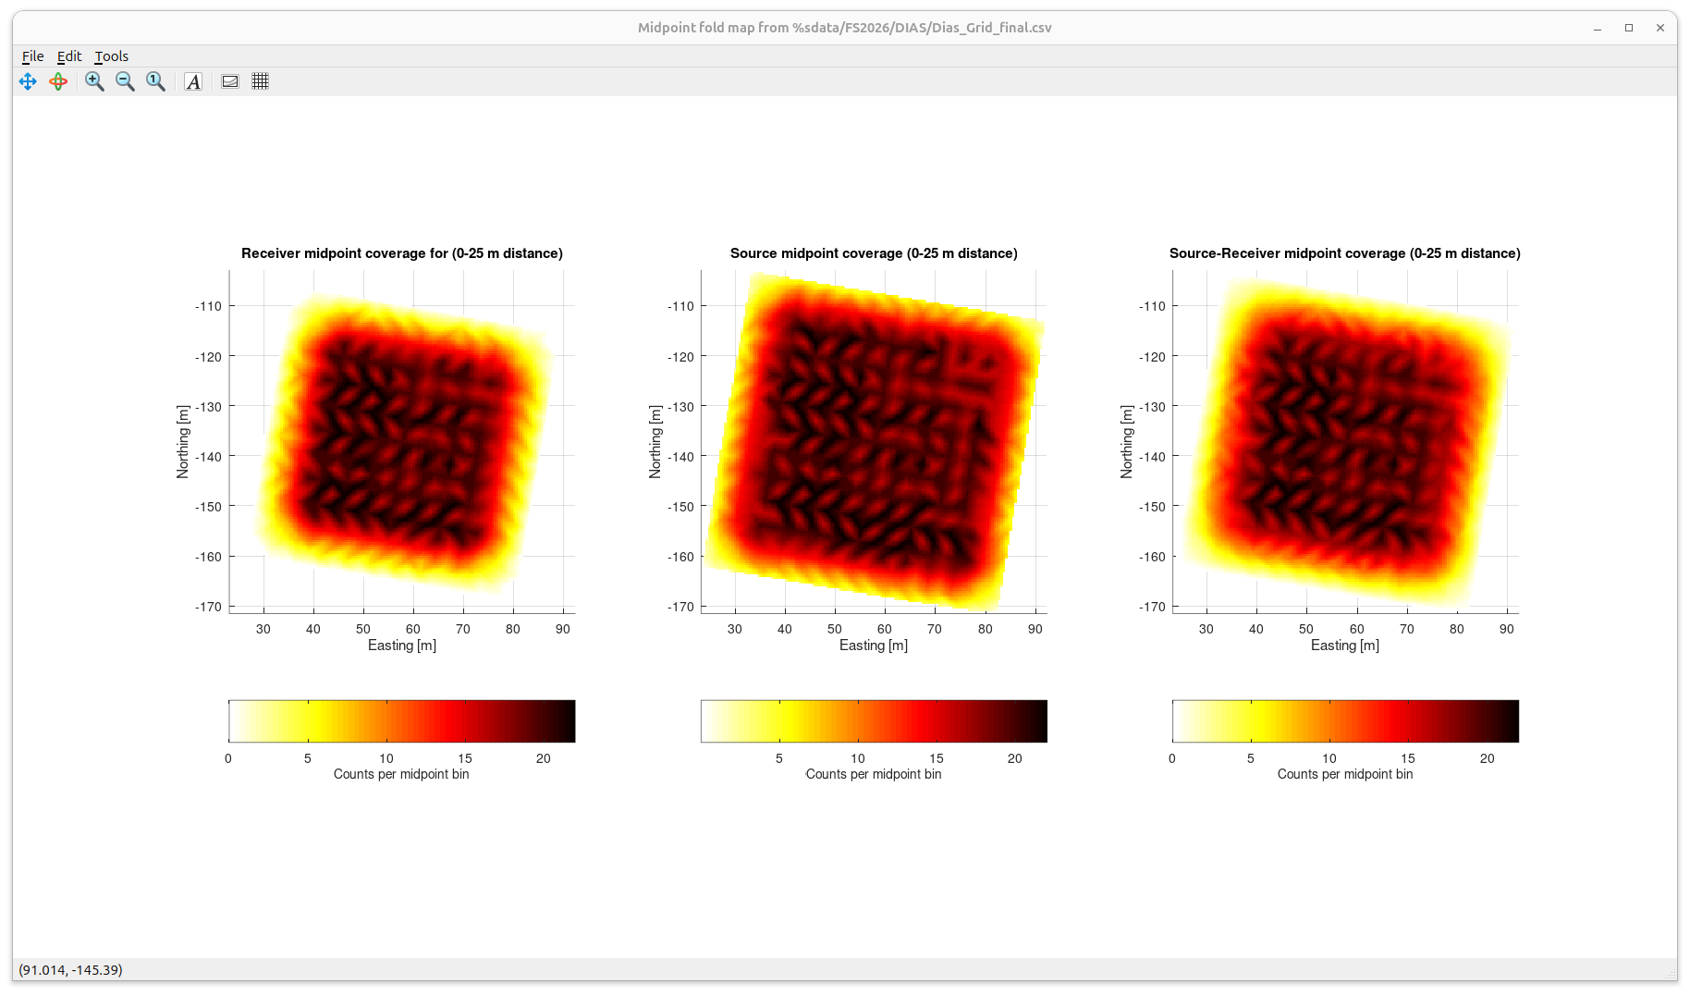
Prior to deploying a 3-D array, it is important to model and examine the extent and uniformity of its areal coverage, and also quality of the distance (depth) and azimuthal coverage.
Although we are limited to the selected design of the grid, it is still useful to analyze its properties.
Inversion of such “pseudo-pole pole” 3-D data is usually based on subtracting readings obtained from various pairs of electrodes. For example, subtracting the potentials read at electrodes M1 and M2 gives the result of a “gradient-array” experiment in which M1 would serve as electrode M and M2 – as electrode N.
Due to this differencing procedure, the zones of maximum sensitivity of the array is generally distributed close between the receiver-receiver, source-source, and source-receiver midpoints. Numbers of these midpoints falling within 2.5✕2.5 m (half station spacing) “common-midpoint bins” are shown in these plots. Spatial separations below 25 m are considered (i.e., maximum depth of imaging about 25 m).
NOTE from these plots:
1) The source- (current-) pair and source-receiver point coverages are significantly broader than that receiver (potential electrode) alone. This is why it is important to place additional current injection points around the receiver swath.
2) The subsurface coverages are significantly non-uniform and shows a strong “footprint” of the selected acquisition layout. This footprint is caused by using collocated current-injection and potential-electrode grids. undesirable.
3) The footprint could be reduced by placing the current injection points between the potential-electrode lines and stations. Probably the best strategy would be to use randomized injector and potential locations.
<number>

Slide 6
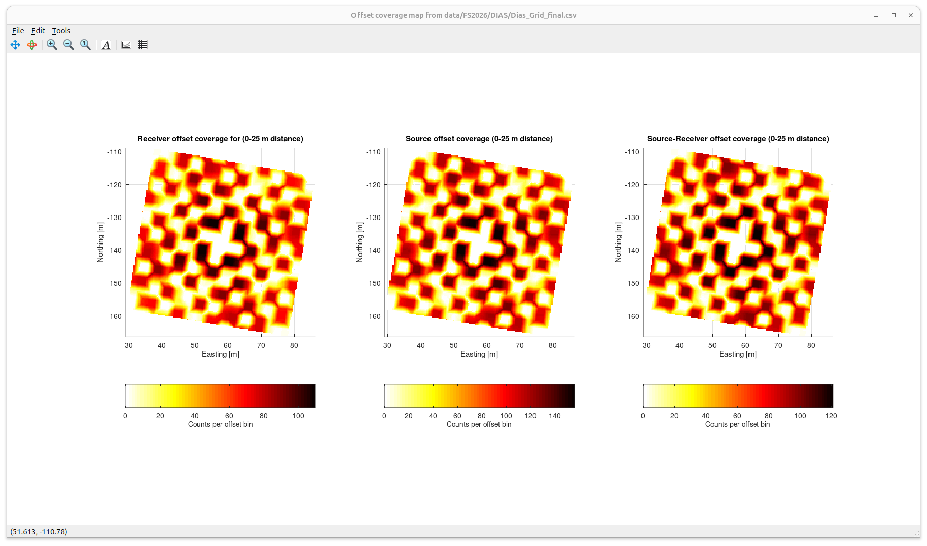
These images show the offset- (electrode separation) coverage maps evaluated between pairs of source (current injection), receiver (potential), and source-receiver electrodes.
The maps are plotted at the location and orientation of the grid. The zero-offset point (0,0) is at the centres of the images.
Note that with the collocated current-injection and potential electrodes, the offset coverage is nonuniform:
Small offsets are absent (gaps in the middle of the plots).
There is a strong “checker-board” pattern of alternating large and small densities of coverage. This pattern may be harmful during inversion, and it needs to be treated with care.
Similarly to the preceding slide, offsetting the injection points or using a pseudo-random electrode distribution would greatly reduce the non-uniformity of offset coverage.
<number>

