Slide 1
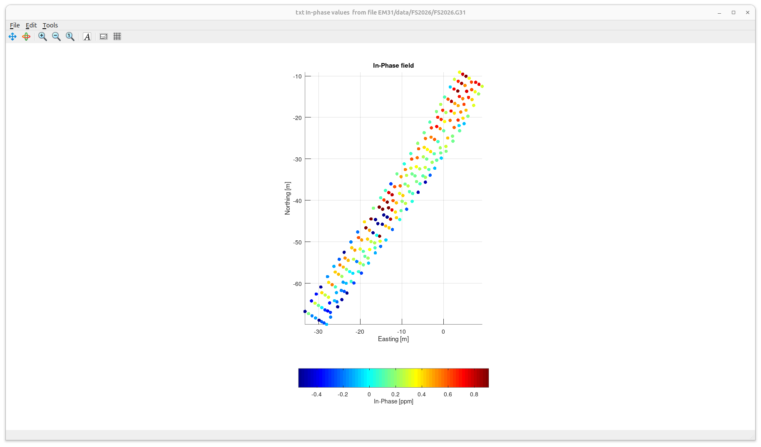
EM31 In-Phase response on the grid over target behind the vault
It appears that grid positioning errors may be present in this dataset
(it was not time-logged but based on following station-number sequences)
Another target is here (bundle of iron pipes and a copper pipe)
The strong negative anomaly at two points may be due to the target (iron water tank)

Slide 2
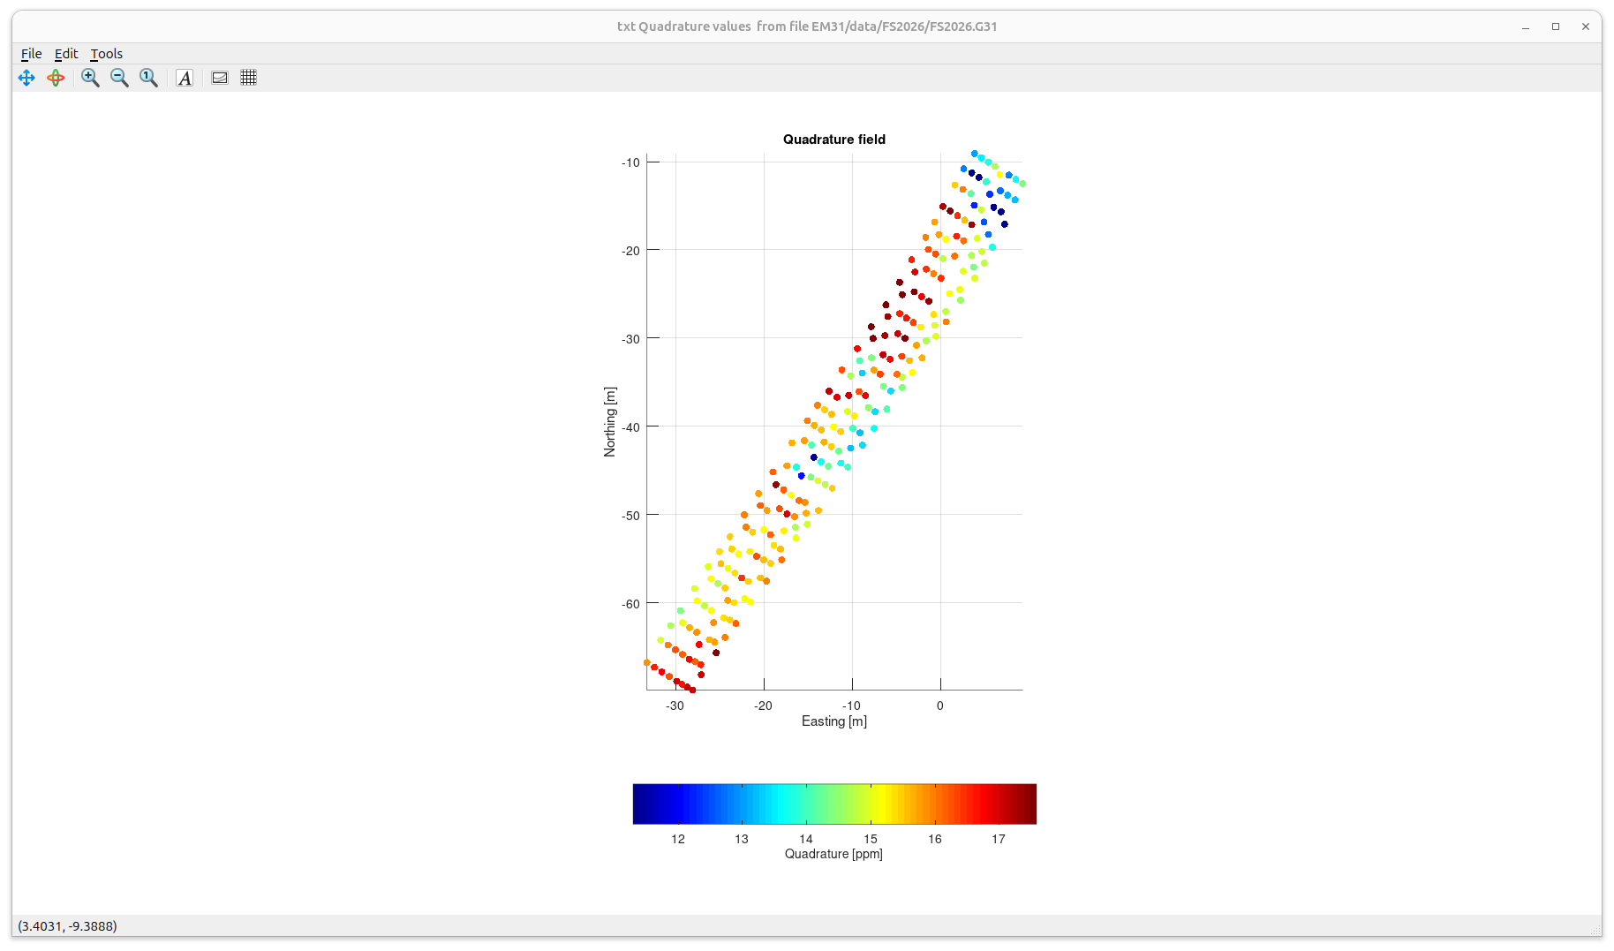
EM31 Quadrature response
Quadrature is also decreasing on top of the target

Slide 3
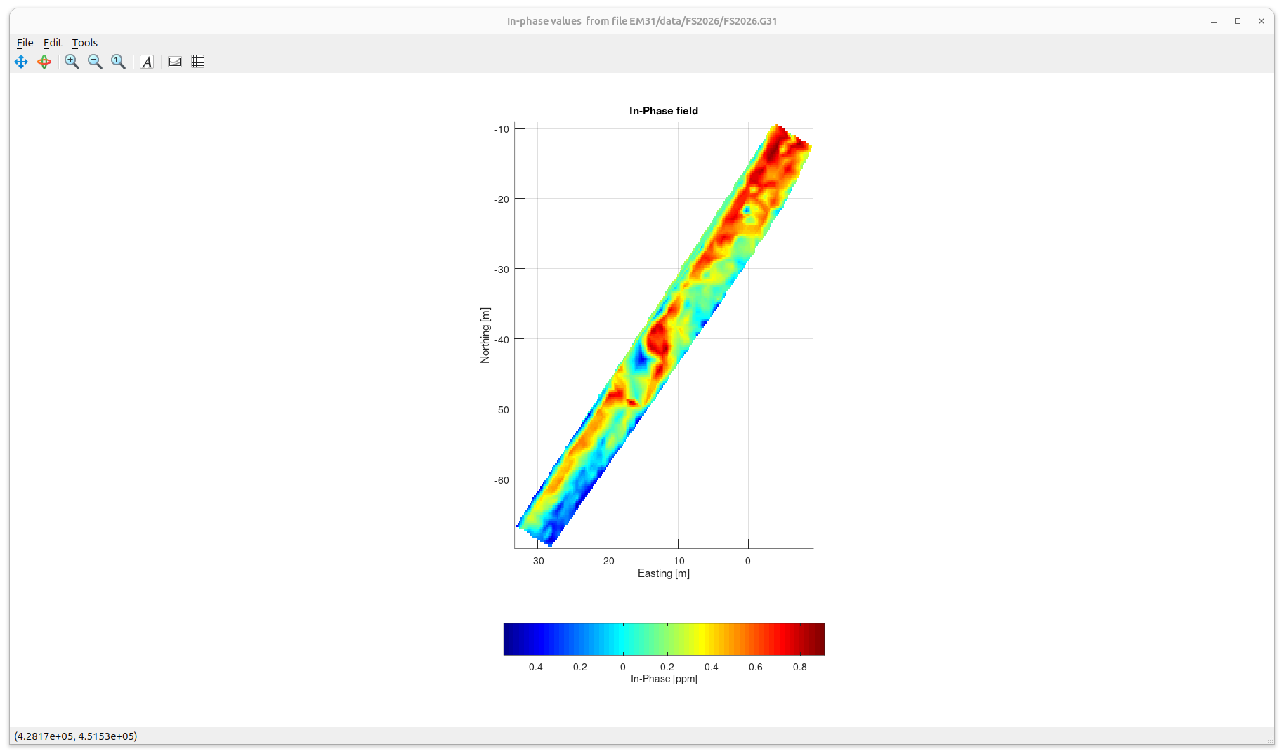
EM31 In-phase response gridded onto a continuous map
Target is here
... but the In-Phase also shows variations between different lines and areas (“acquisition footprint”)

Slide 4
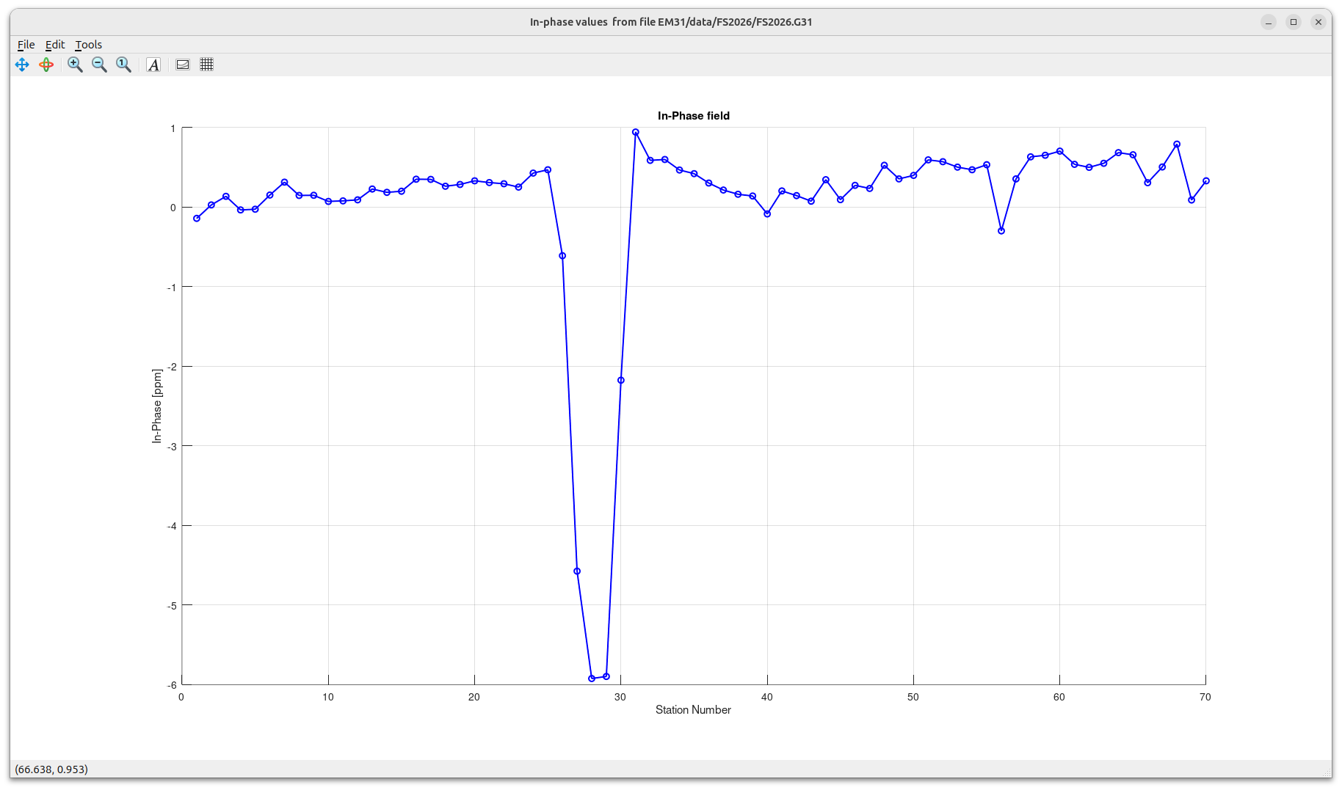
In-Phase response along line 5 of the grid
Strong negative anomaly over the target

Slide 5
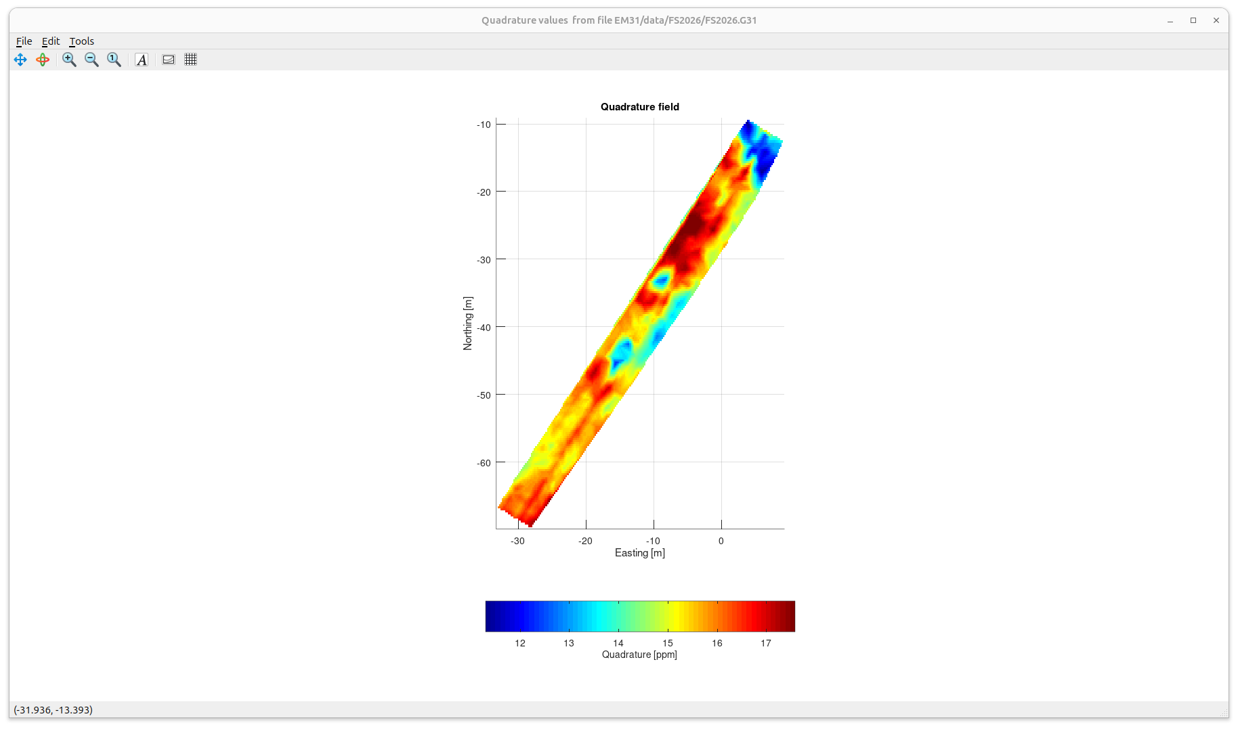
Gridded EM31 Quadrature response
?
The footprint is also strong but target is clearer in the Quadrature

Slide 6
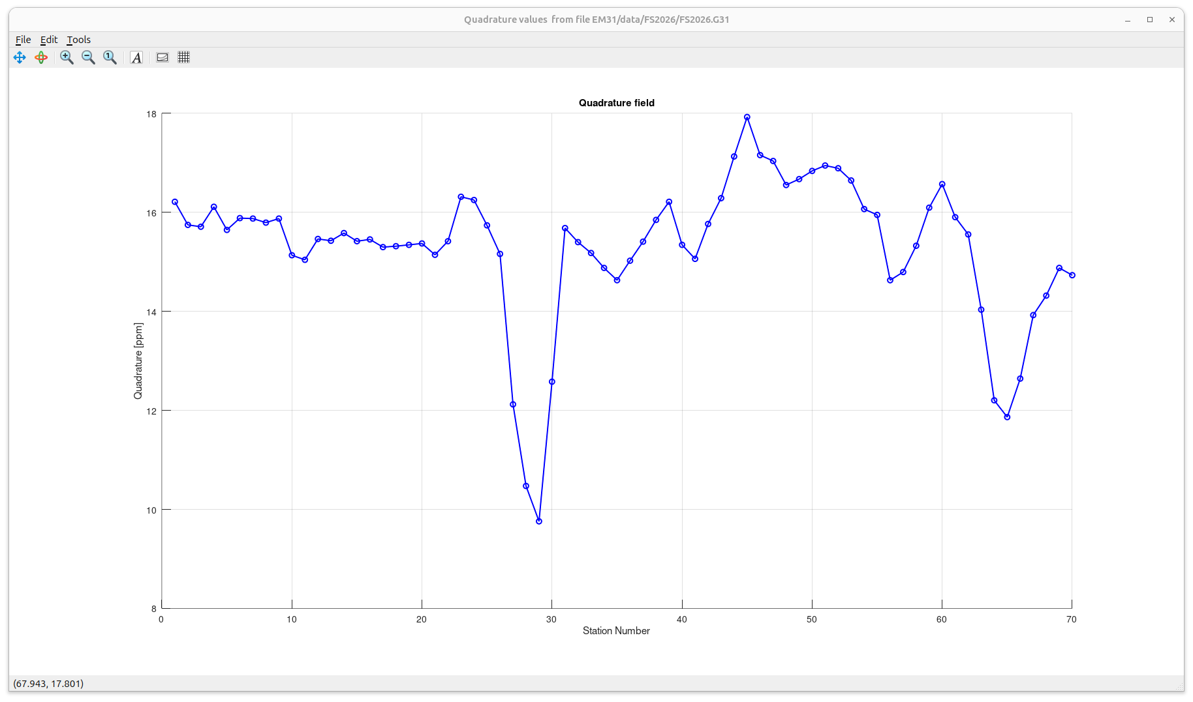
Quadrature response along line 5 of the grid
Strong negative response from the target

