Slide 1
Todd LeBlanc brought two GEM-2 instruments and did several tracks with them, using multiple frequencies measuring signal responses (In-Phase and Quadrature) and estimating physical properties of the subsurface (Electrical conductivity and Magnetic susceptibility)
The following slides show:
  Free-roaming tracks using instrument GEM-2 0460,
  Tracks by instrument 7047
  Grid survey behind the vault using GEM-2 0460
Note the large volumes of various types of data collected by such instruments
  2 to 6-7 frequencies collected simultaneously and continuously in space
  Due to recording accurate GPS times, the instruments can easily be used for small-scale gridding, like done in our survey
  Records show variations in soil type, some of our targets, and other anomalies (?)

Slide 2
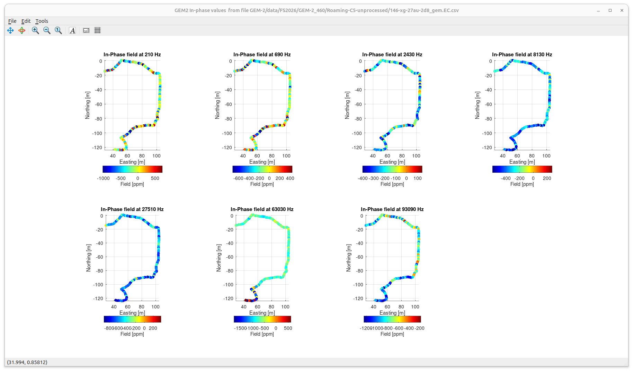
In-phase looks noisy

Slide 3
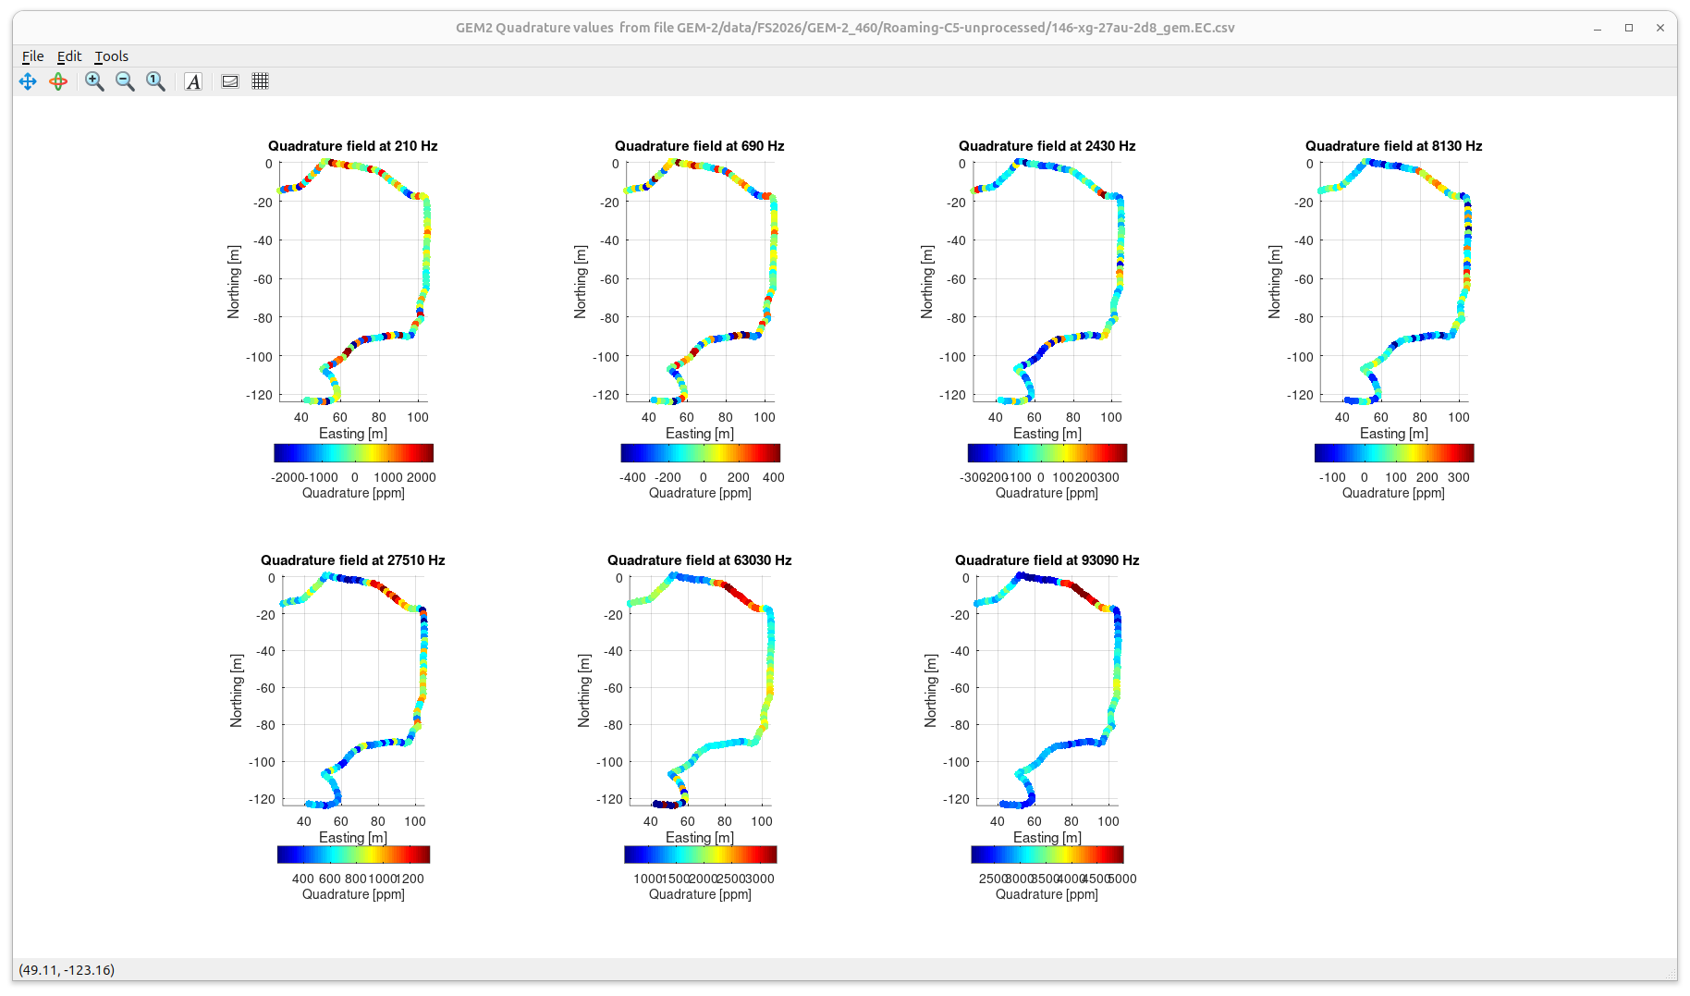
Quadrature is noisy at low frequencies but responds to targets at higher frequencies (NE part of the track)

Slide 4
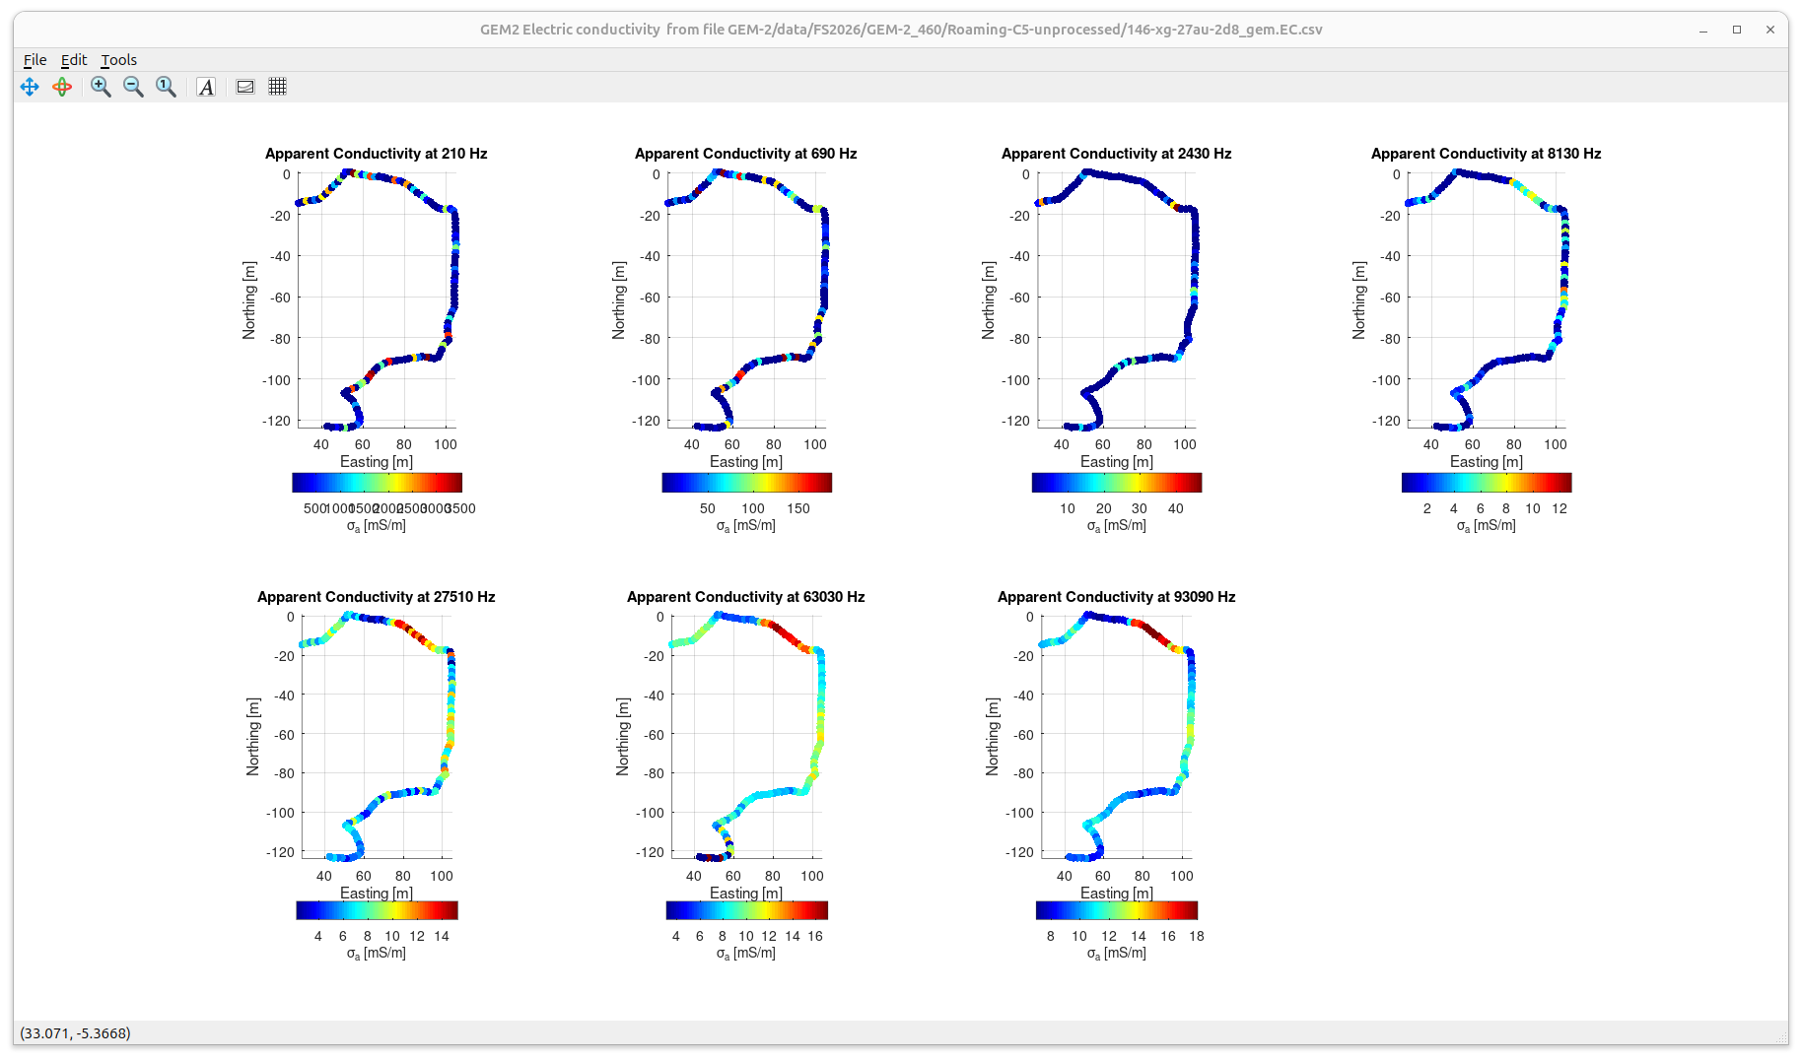
Point (0,0) on this map corresponds to the GPS pedestal near vault

Slide 5
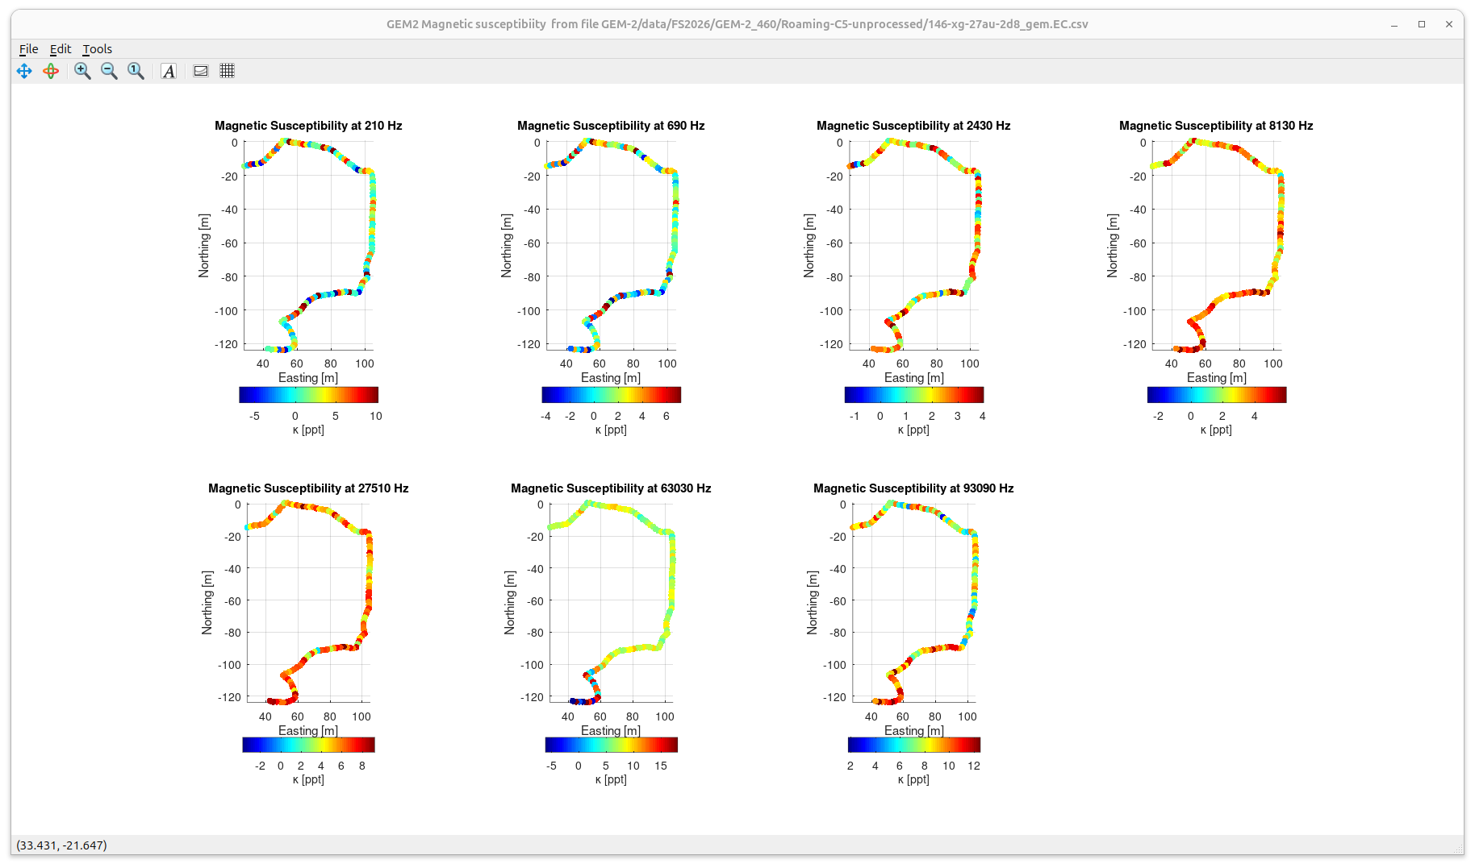
Quadrature is noisy at low frequencies but responds to targets at higher frequencies (NE part of the track)

Slide 6
The following slides show roaming tracks collected using instrument GEM-2 7027
These plots may be mostly useful for Todd and Ayshia (?)
  Some records seem to be all zeros, some show drift with acquisition time or different operators (?)
  I did not attempt removing the drift and gridding the track images

Slide 7
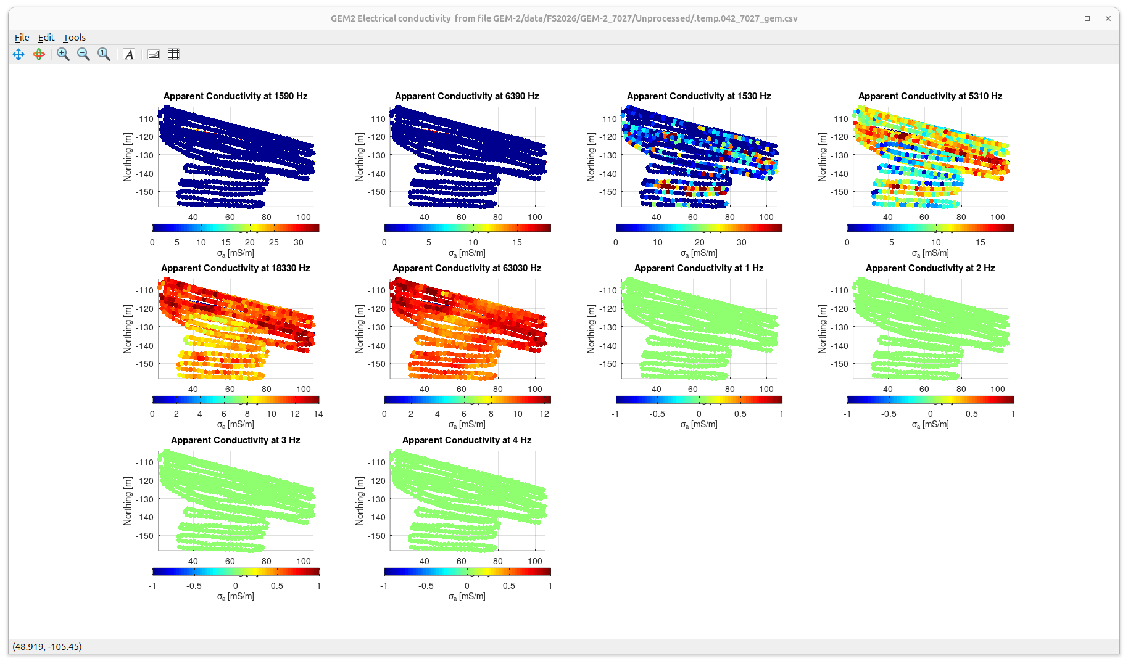

Slide 8
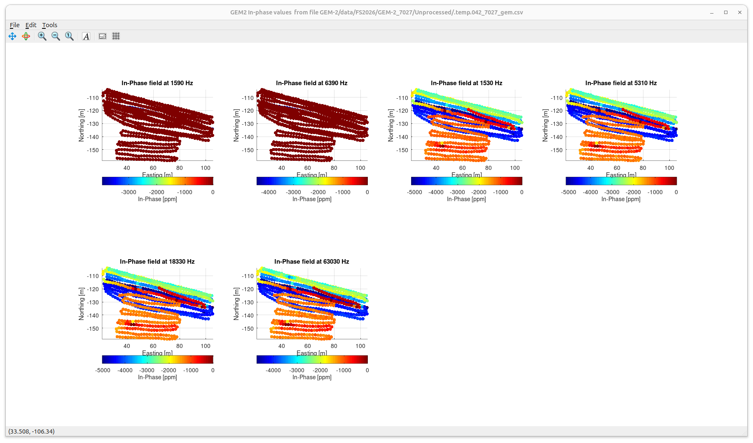

Slide 9
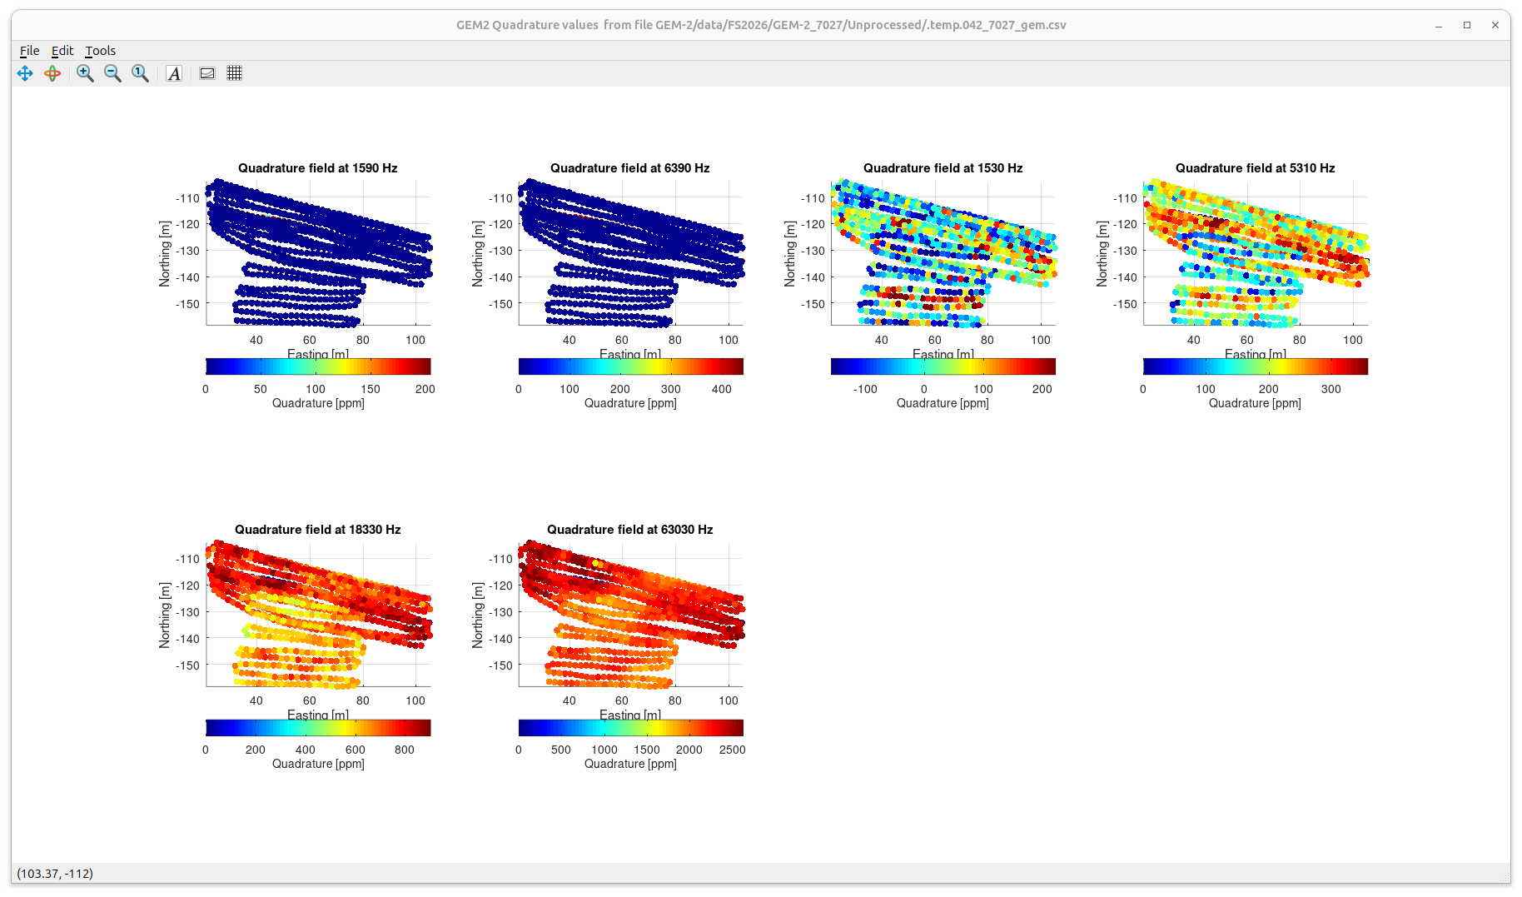

Slide 10
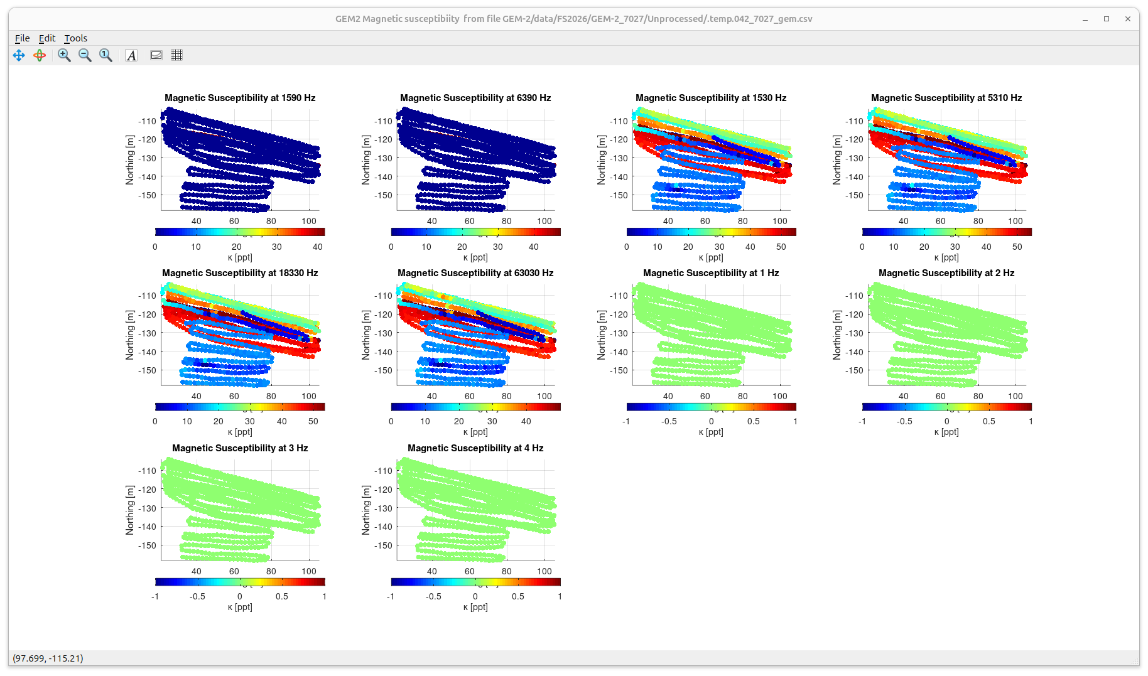

Slide 11
Next, look at the grid over targets behind the vault, GEM-2 460
The instrument was set up to operate at two frequencies: 1590 Hz and 6390 Hz
Note that the target was successfully detected
  However, it might have been useful to select smaller grid spacings (e.g., 0.5 m) in the vicinity of the target

Slide 12
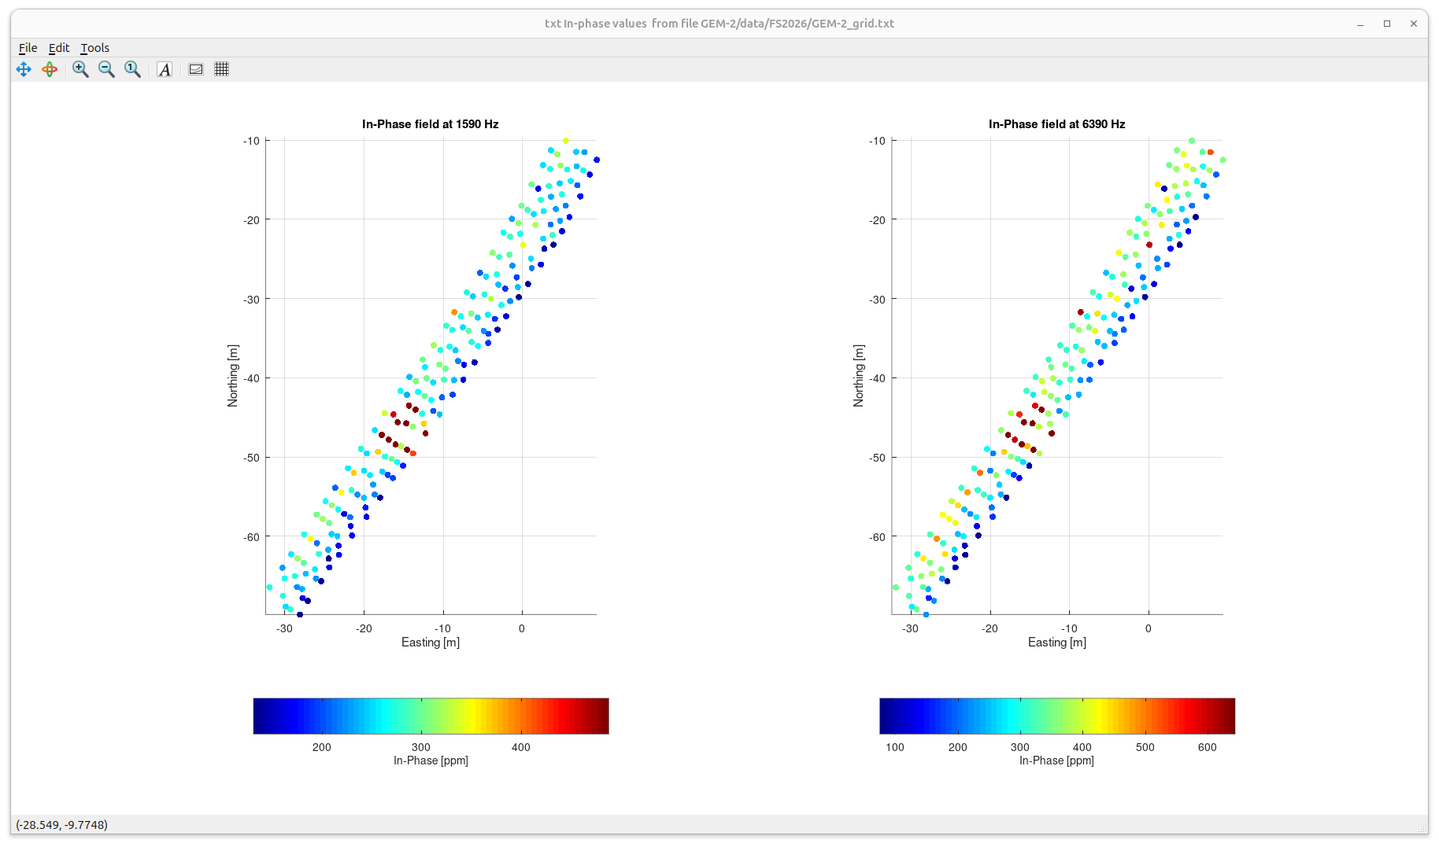
In-Phase response varies between lines.
Likely because of different heights of operators?
High In-Phase near target (iron water-heater tank)

Slide 13
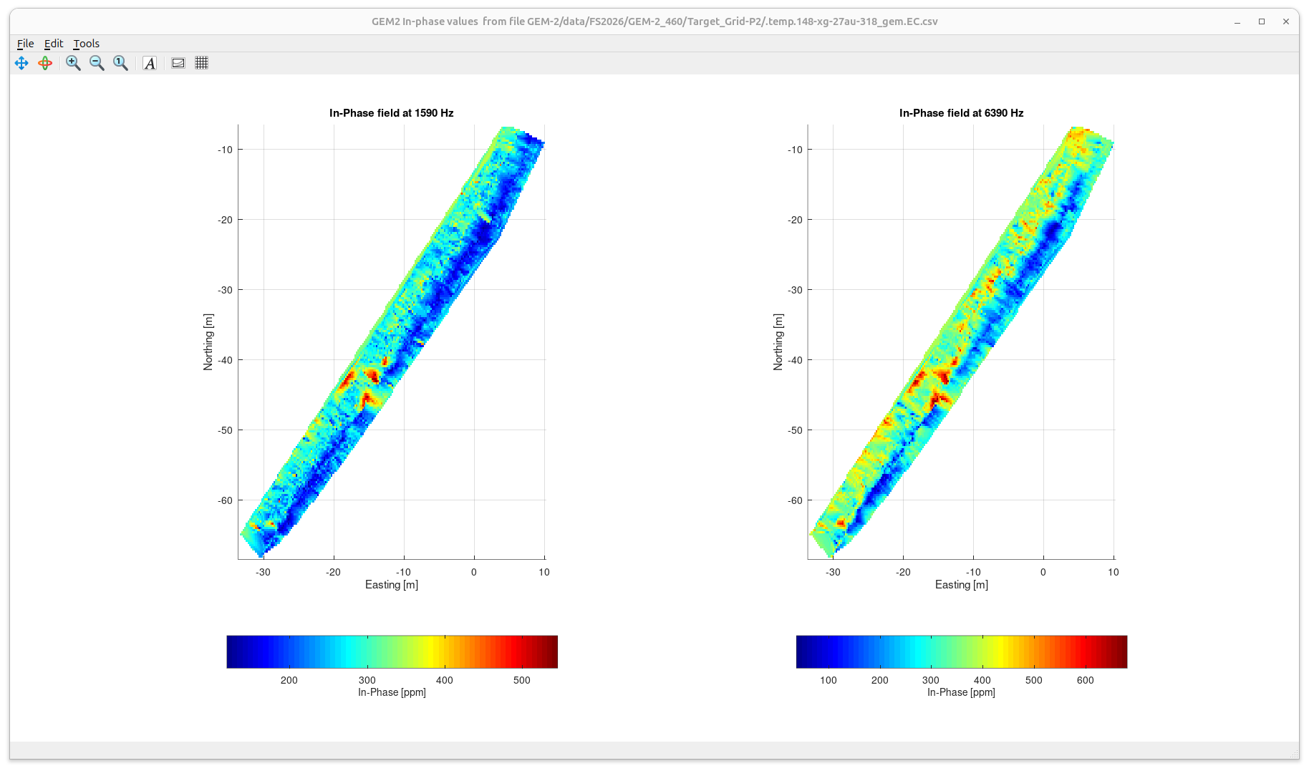
Gridded version of the preceding image

Slide 14
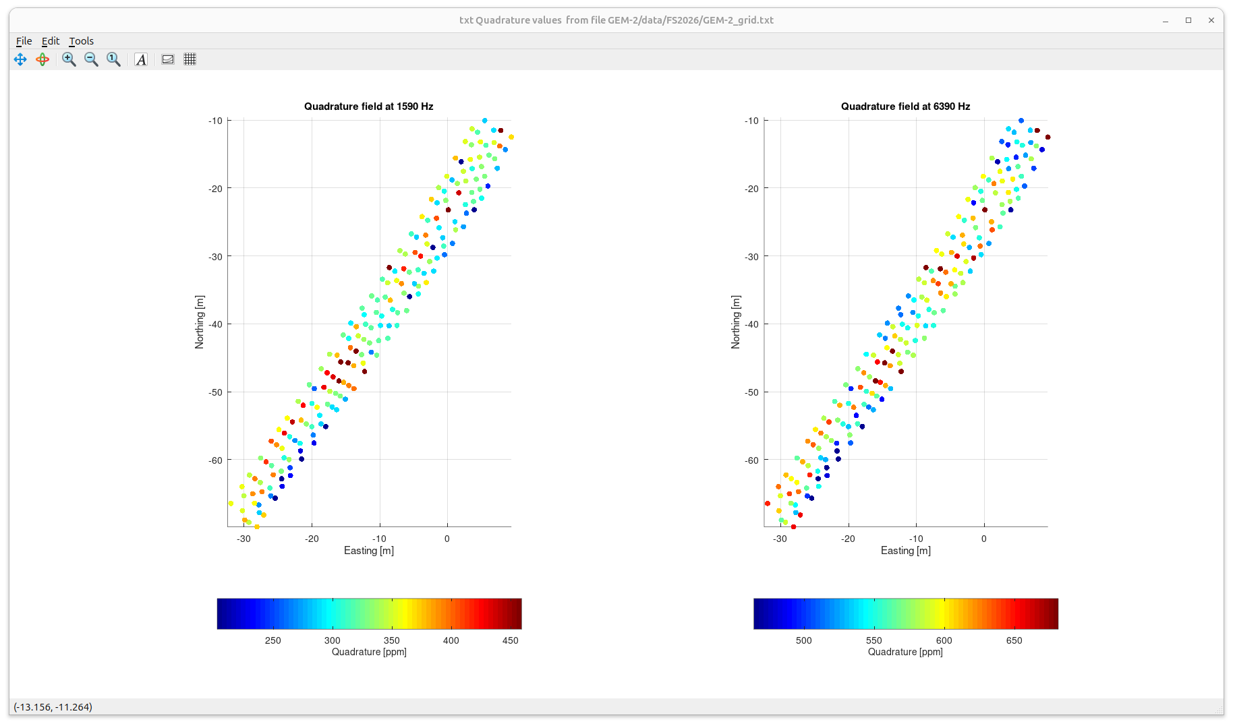
High Quadrature near target ?

Slide 15
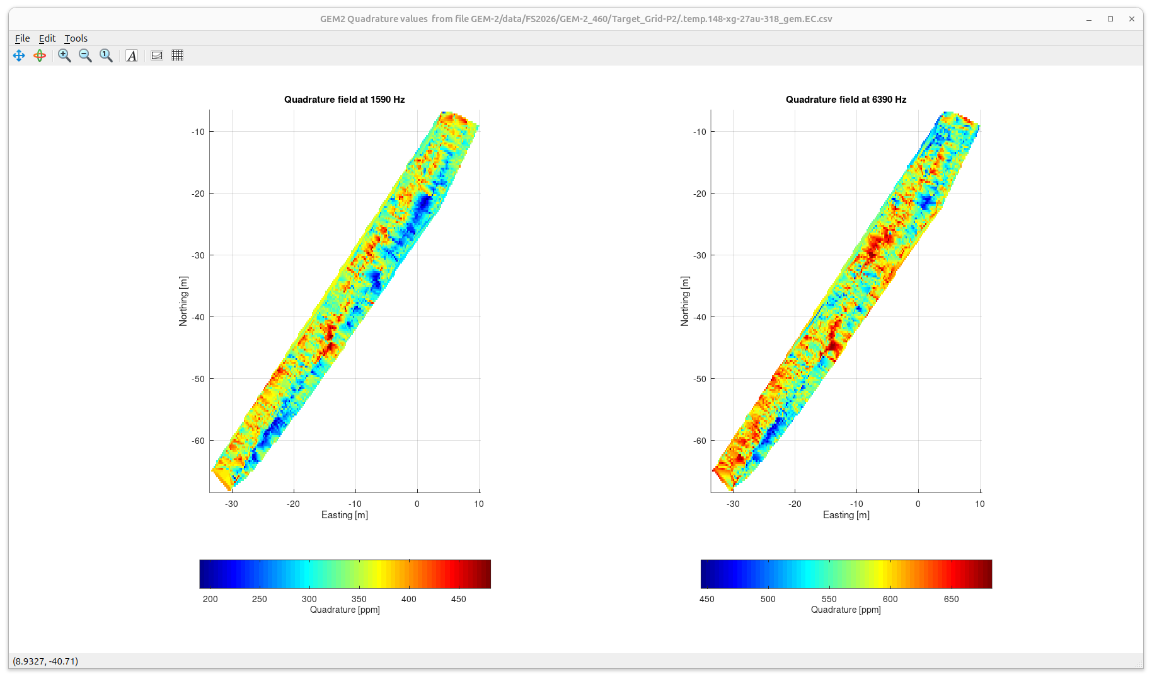
Gridded version of the preceding image

Slide 16
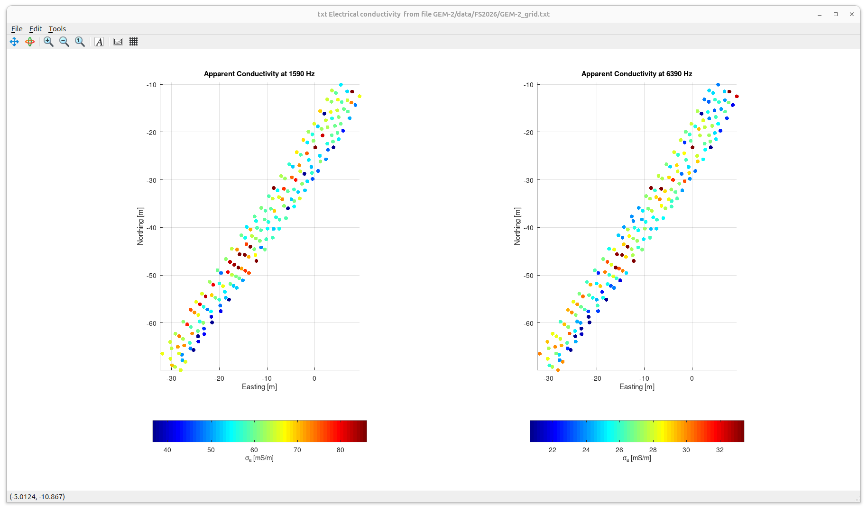
High (apparent) electrical conductivity over target

Slide 17
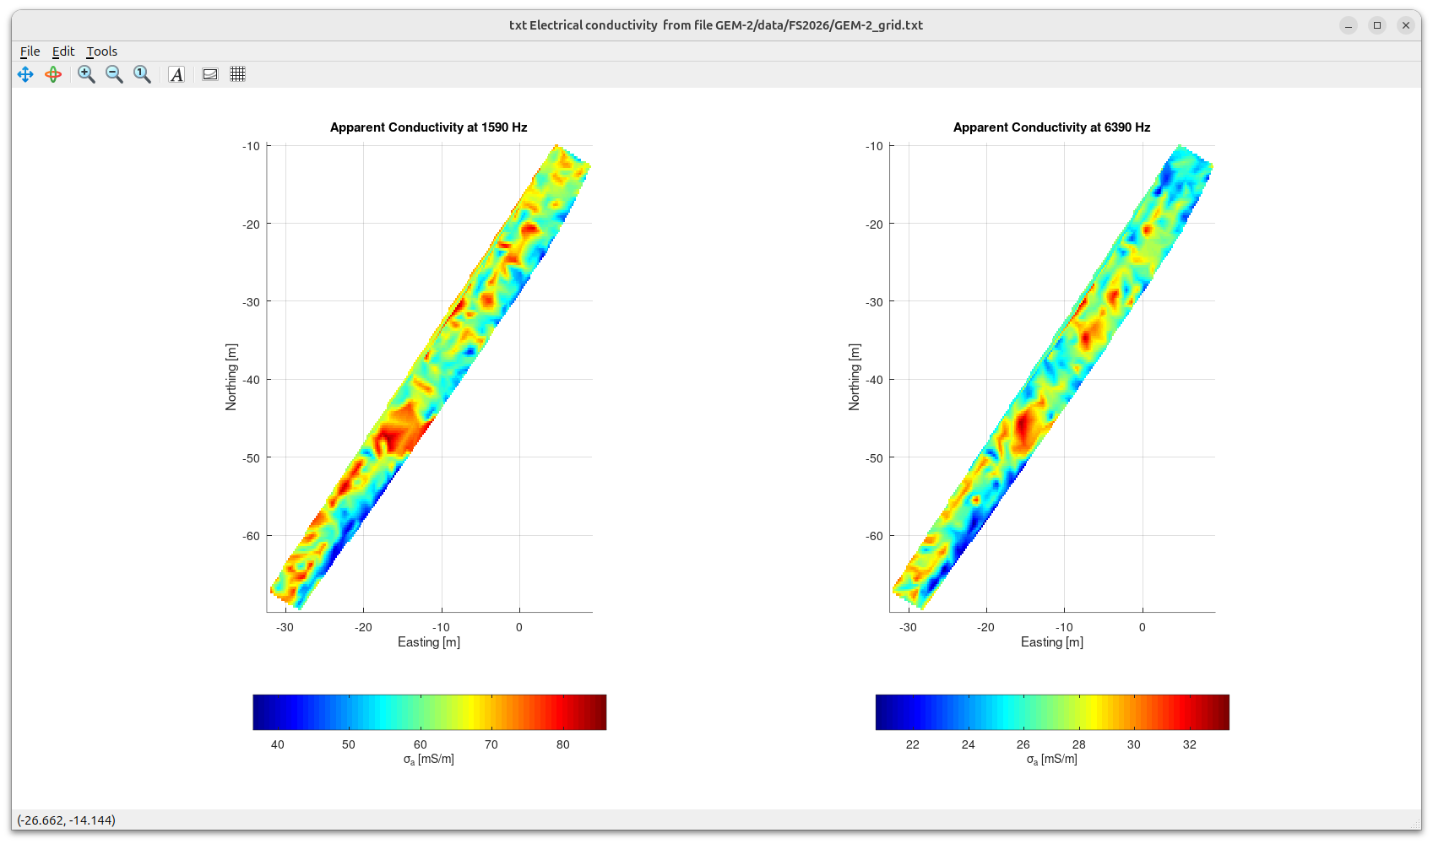
Gridded version of the preceding image

Slide 18
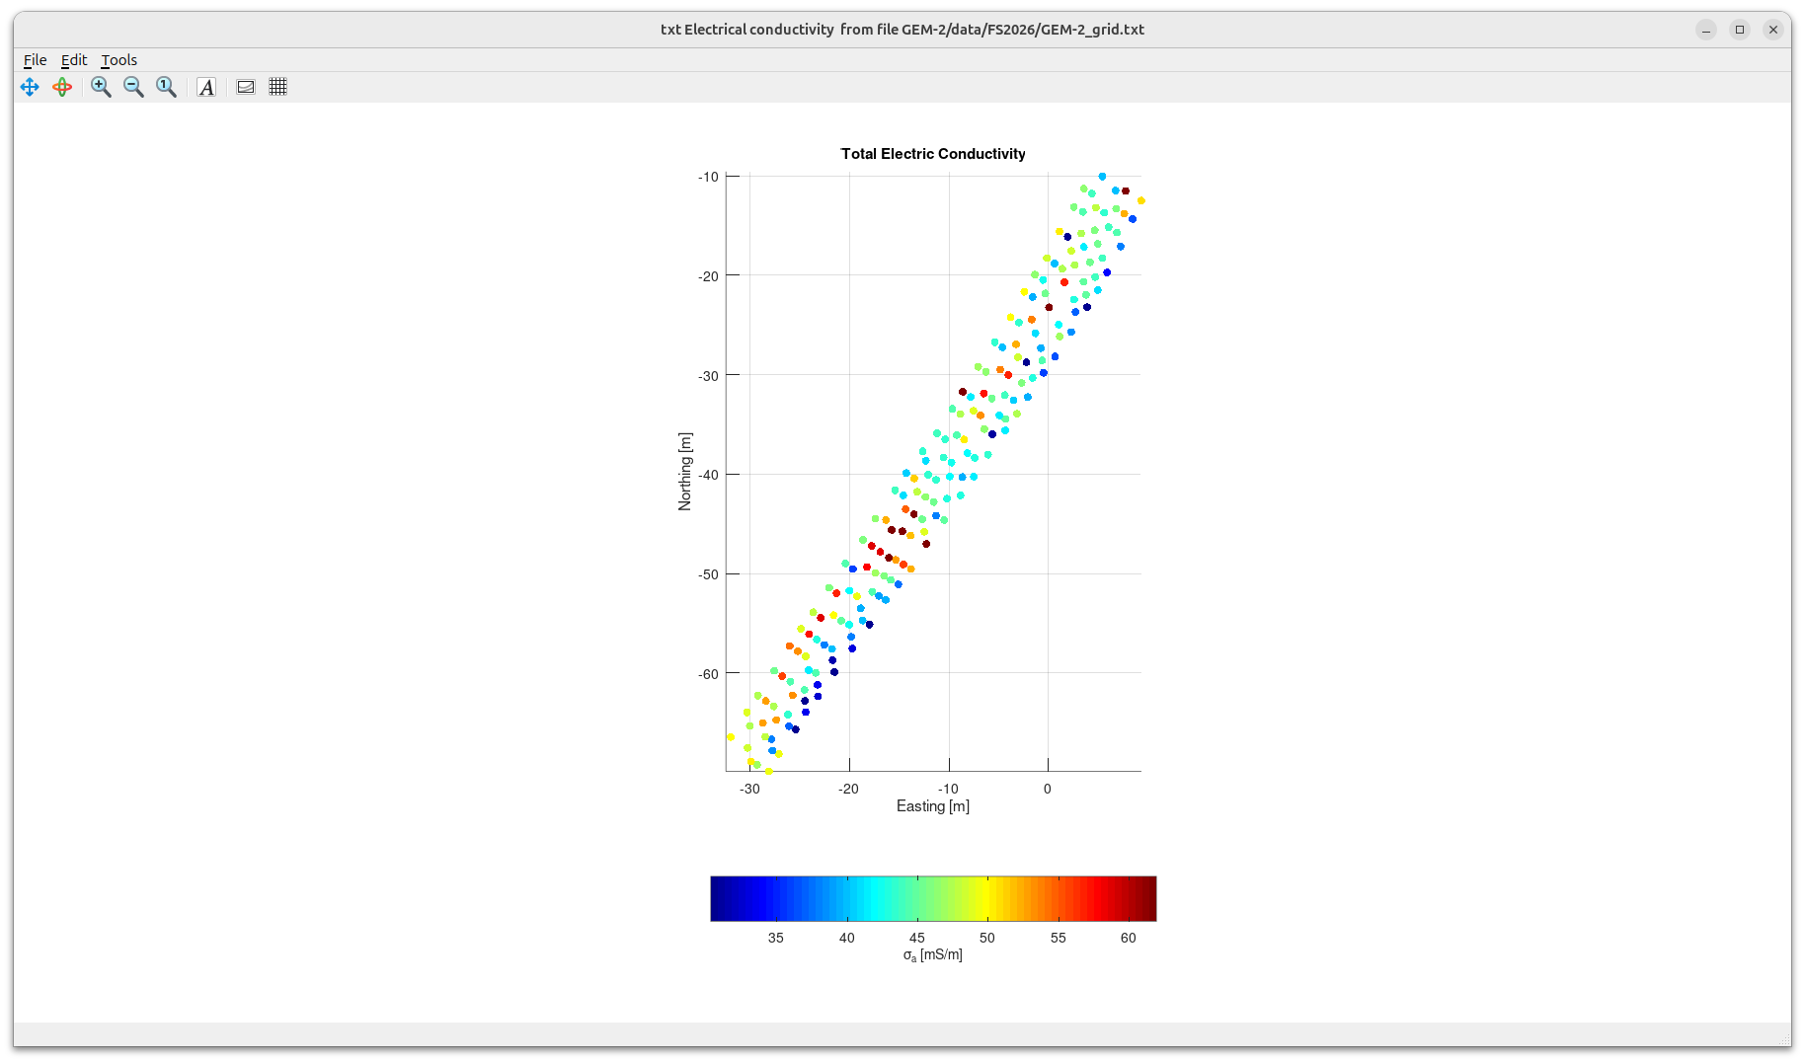
Total electrical conductivity estimated from both measurement frequencies
Clear positive response

Slide 19
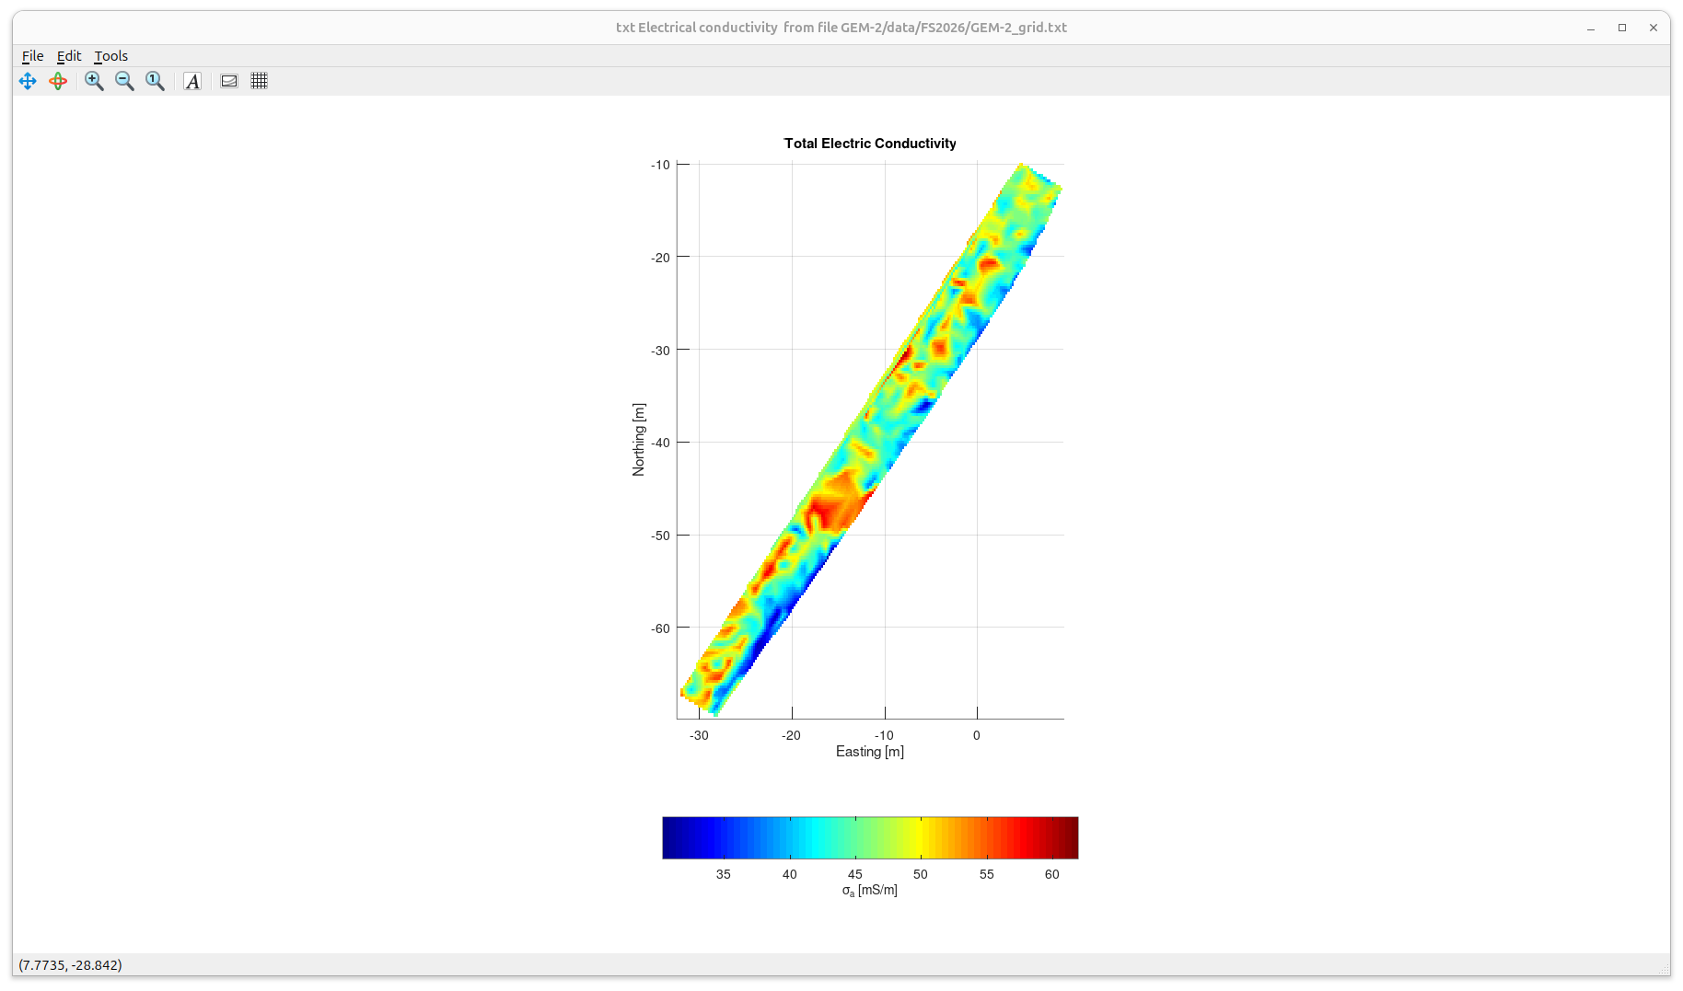
Gridded version of the preceding image

Slide 20
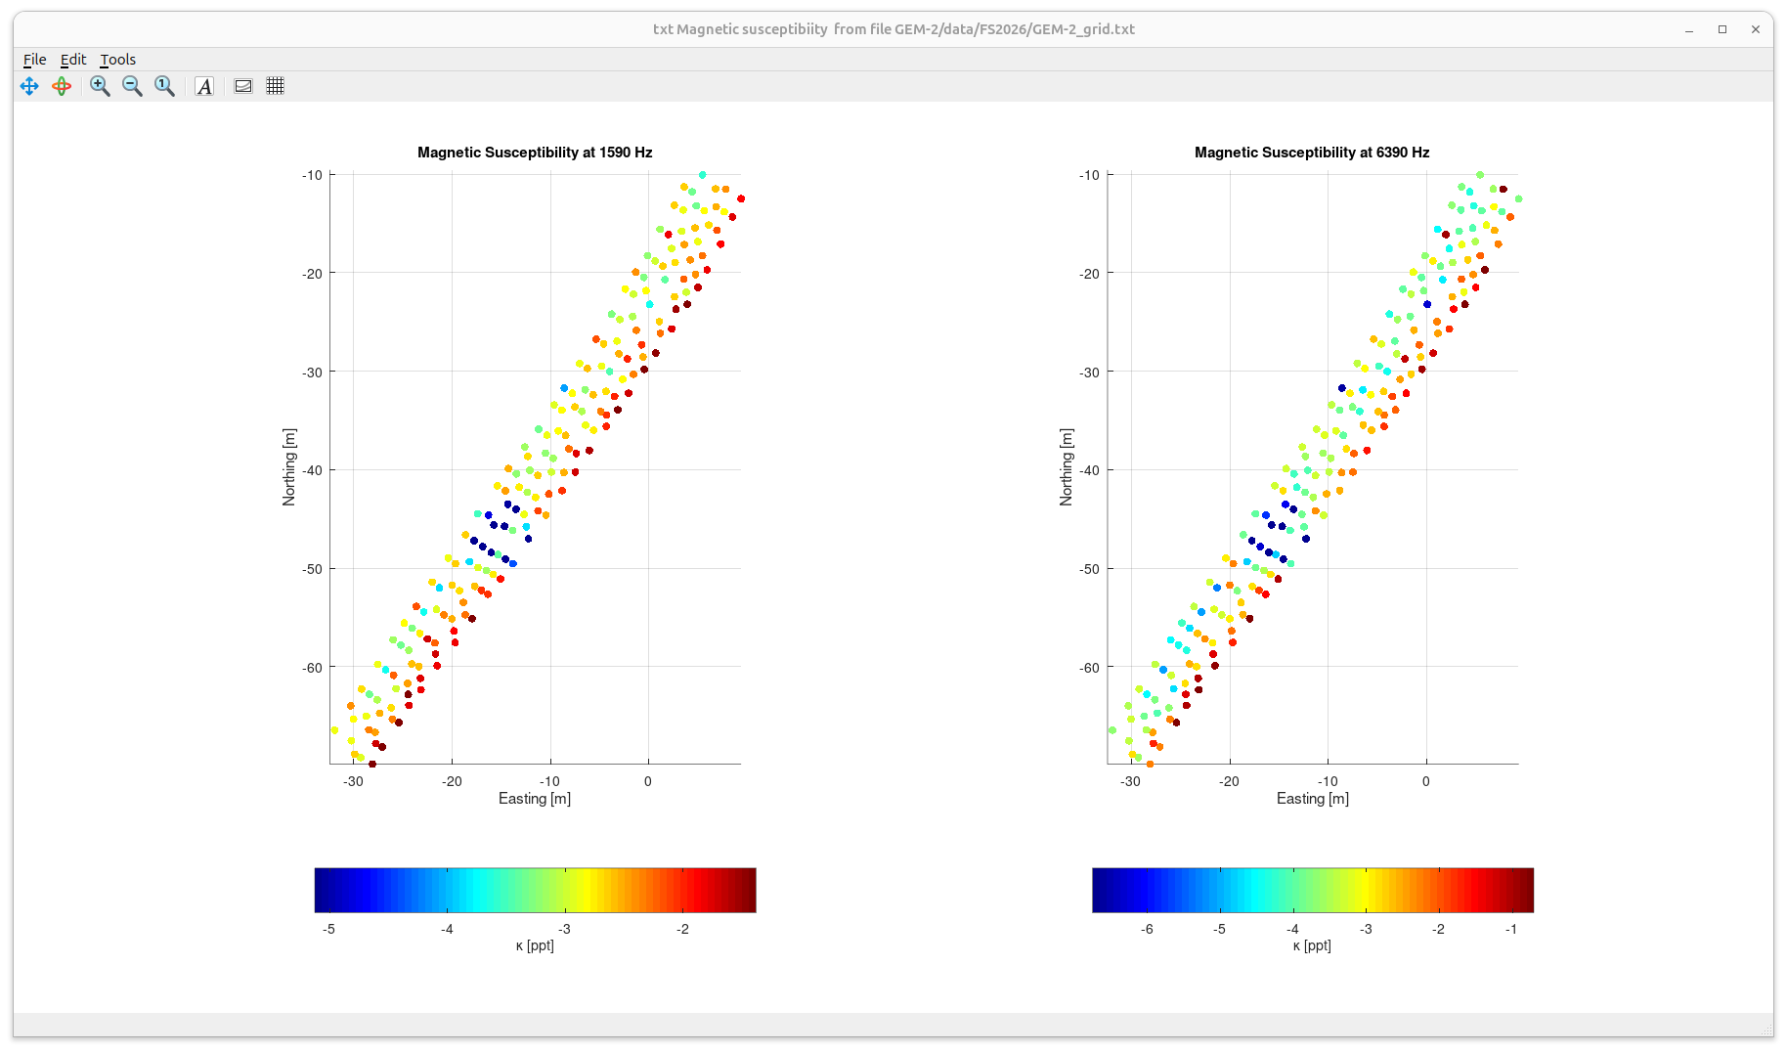
Very clear negative magnetic susceptibility anomaly measured over target

Slide 21
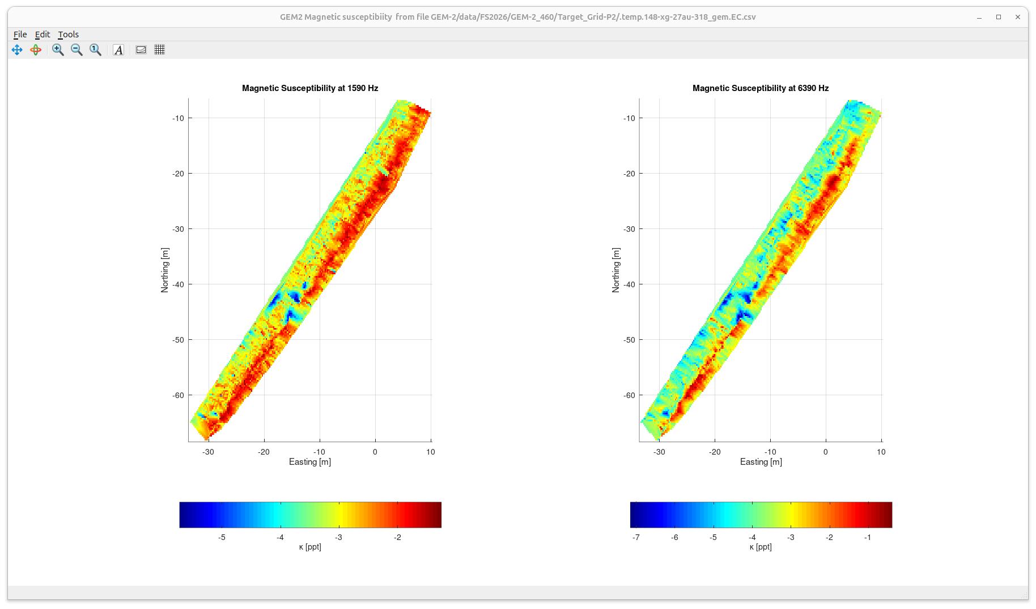
Gridded version of the preceding image

Slide 22
The following slides show line 5 of the grid from GEM-2 0460 in detail
Note the deep trough in magnetic susceptibility and strong peaks in all other quantities appearing over the target (shown by arrows)

Slide 23
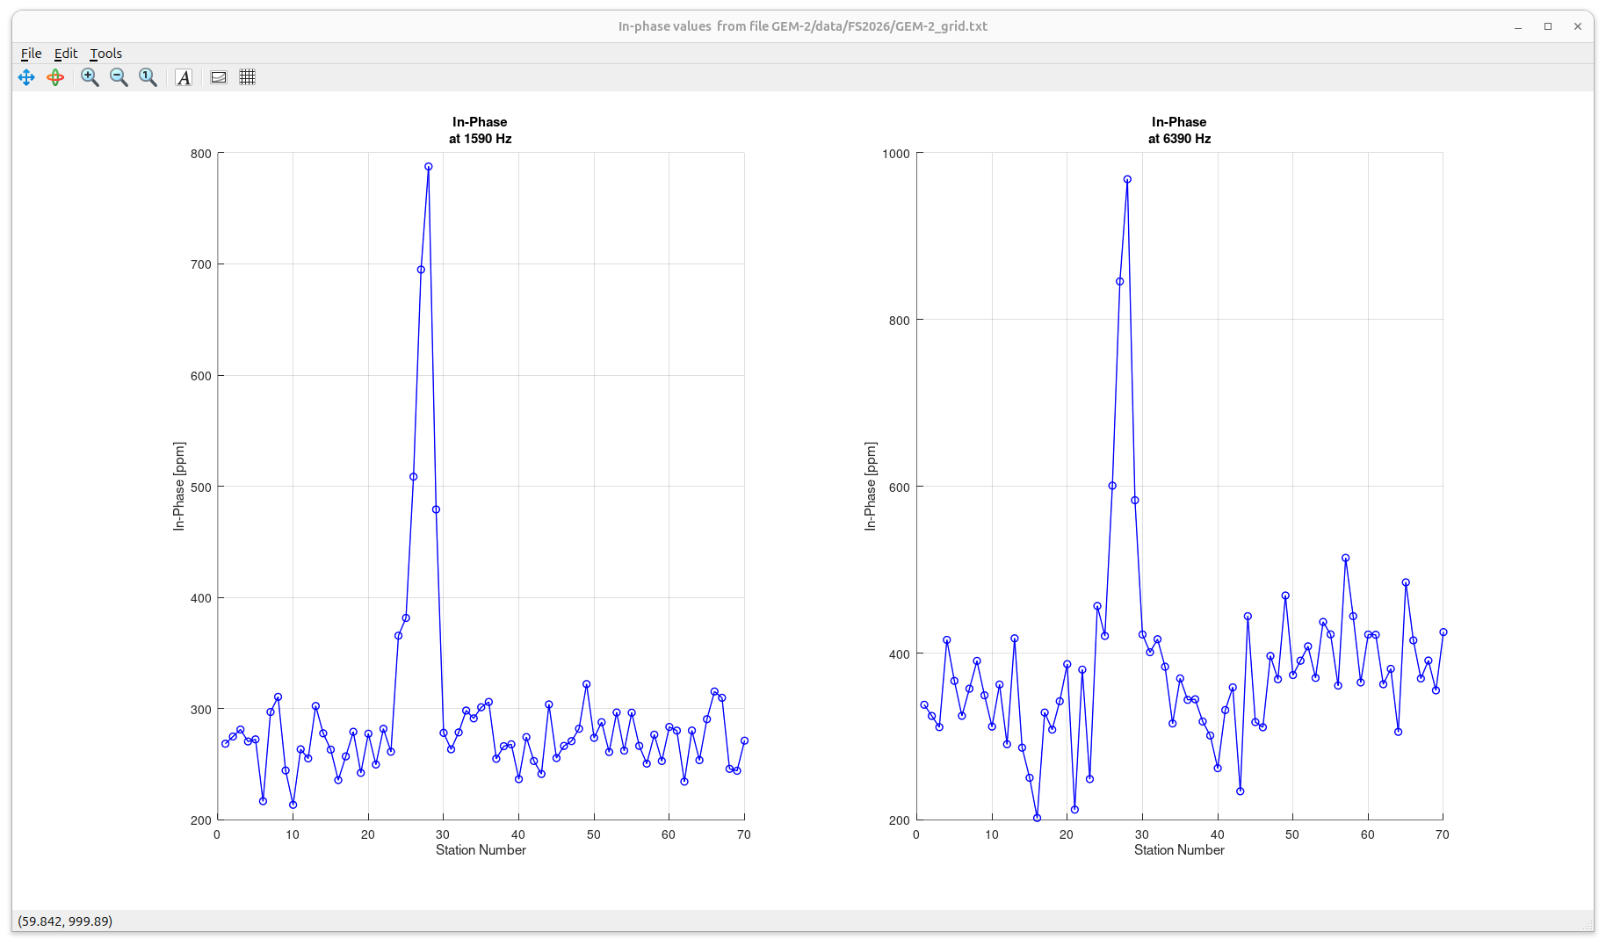

Slide 24
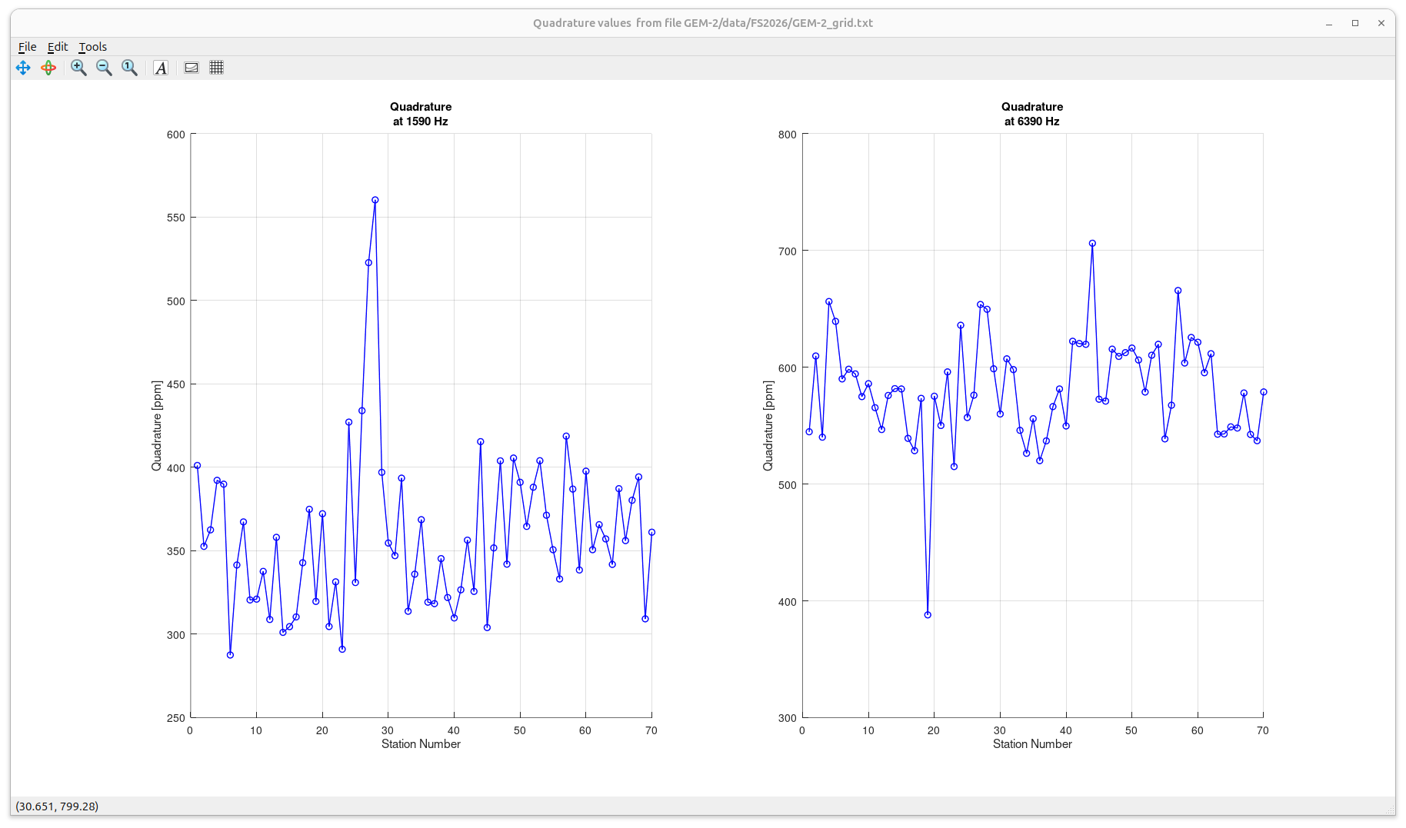

Slide 25
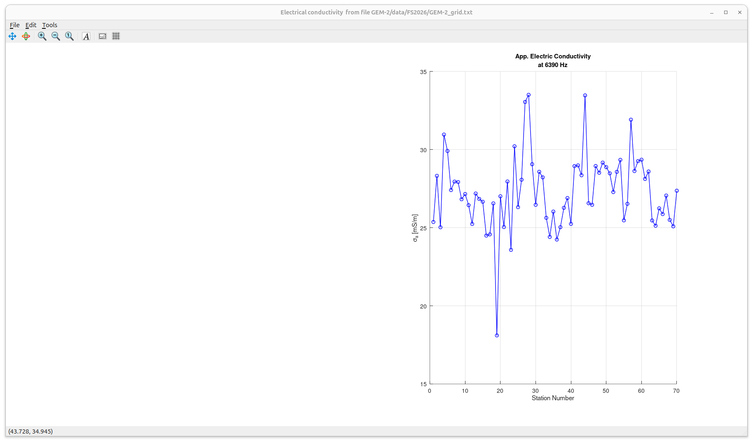

Slide 26
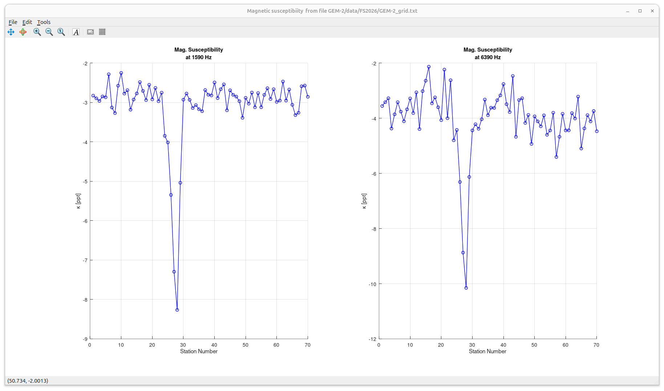

Slide 27
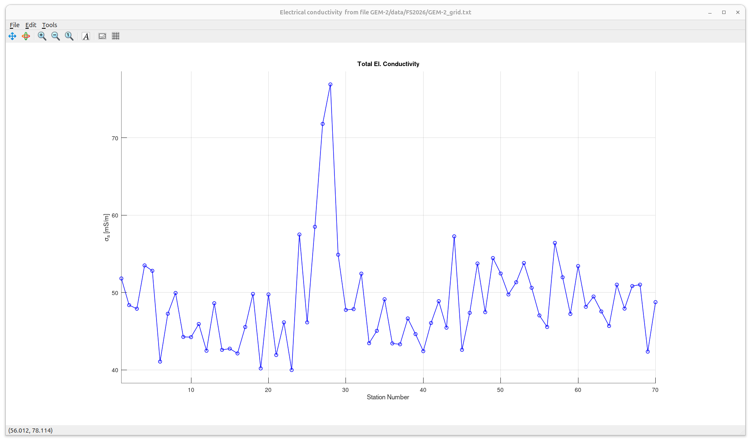

Slide 28
The following slides are from the records from instrument GEM-2 7027 extracted from the time-logged survey of the roughly W-E line in the southern part of the test area.
Strong detections of targets obtained at frequencies 1530, 5310, 18330, and 63030 Hz
I have no coordinates of that line, and so the results are presented as functions of station numbers.

Slide 29
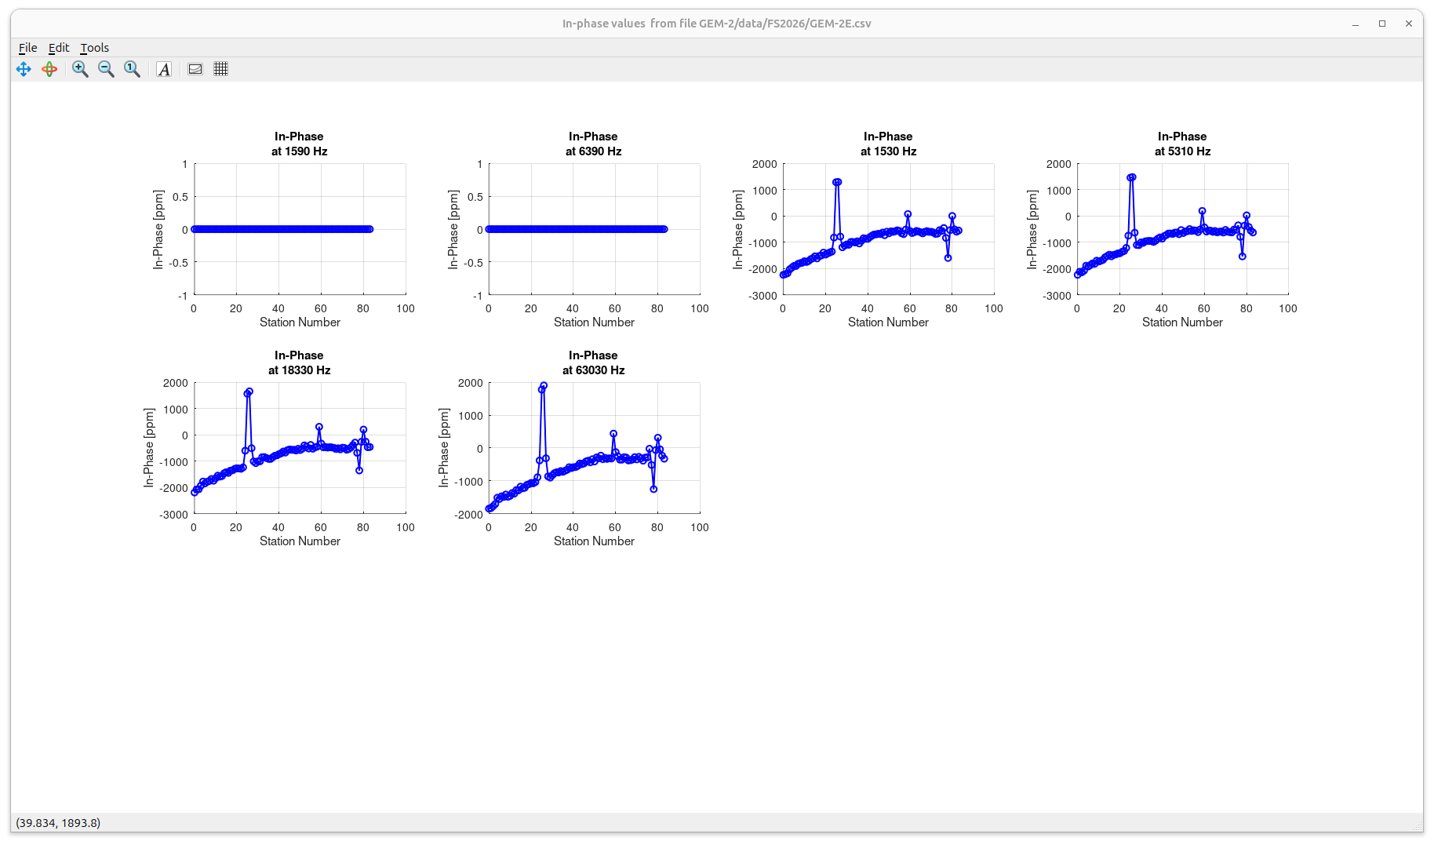
Target 5A produces strong In-Phase peaks at all frequencies
Two other targets crossed by this profile
Note that the peaks are sampled by only about 4 – 6 points for smaller targets. big target 5A, and 1-2 points .
Next time, we need try sampling the shapes of these peaks at denser spacings, and also acquire 2-D grids over them.

Slide 30
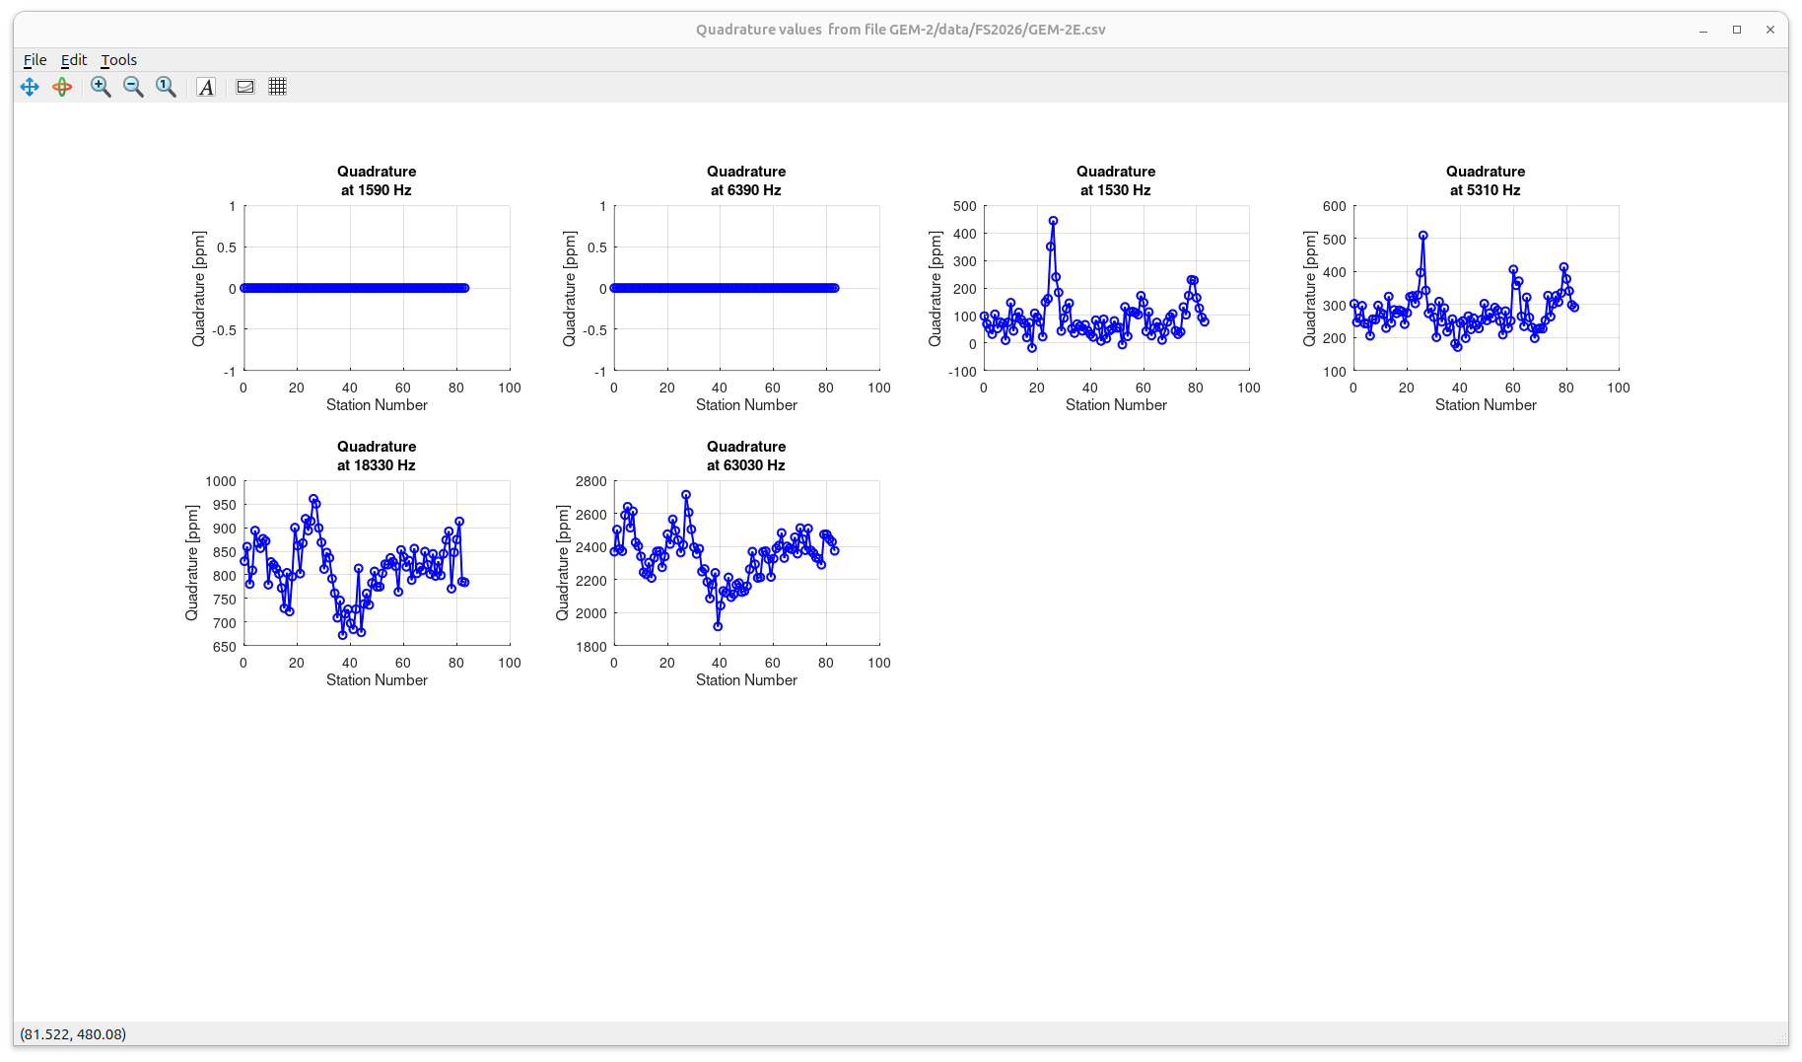
Target produces peaks in Quadrature EM responses. Peaks vary with frequency.

Slide 31
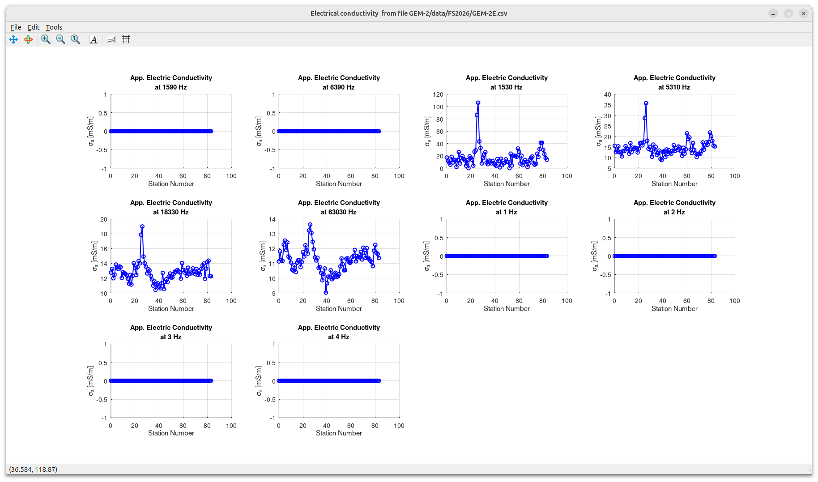
Similar peaks in Electric Conductivity

Slide 32
Similar peaks in Electric Conductivity

Slide 33
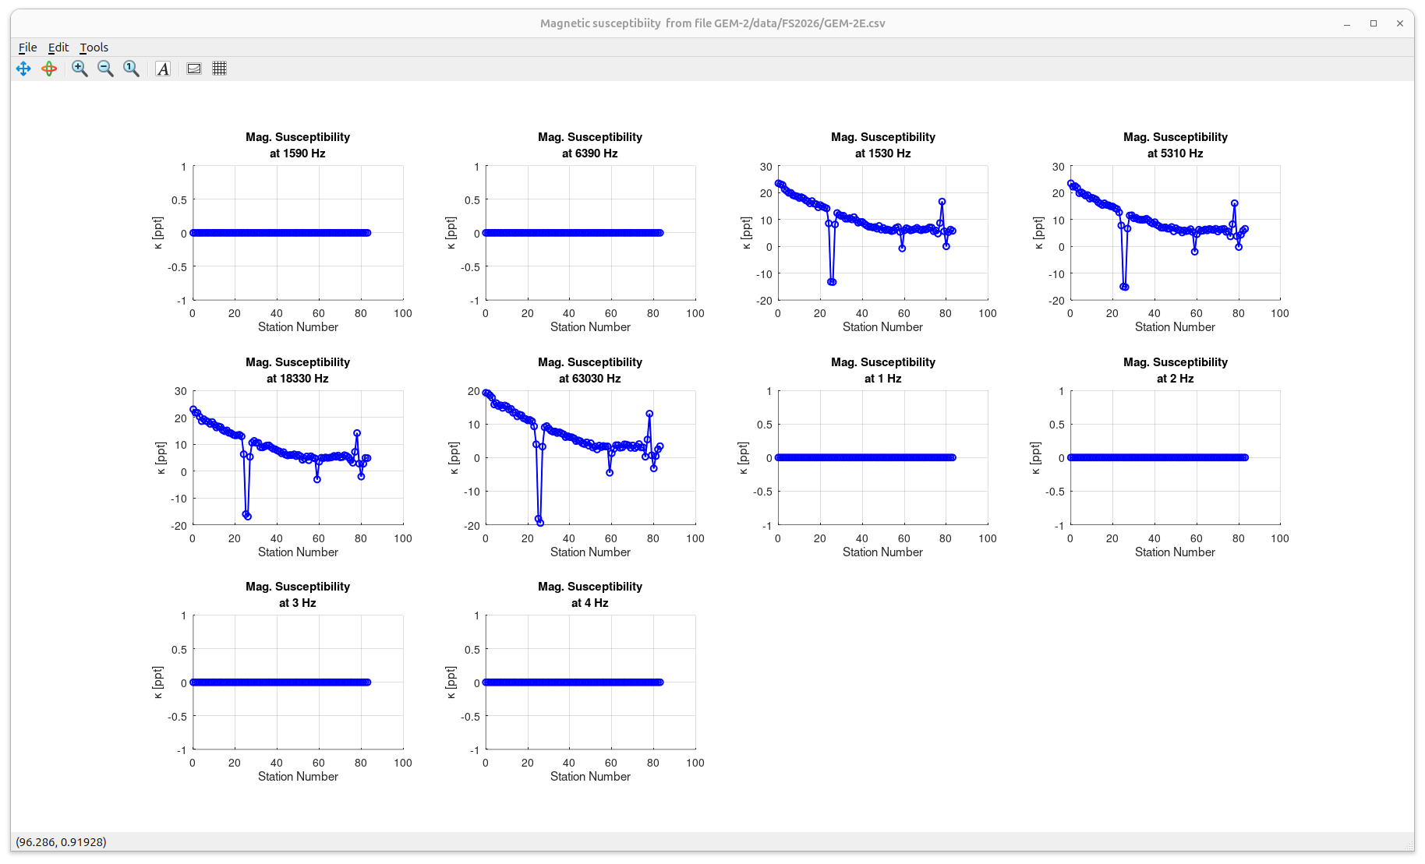
For magnetic susceptibility, the anomalies are reversed

