Slide 1
Geophysical data usually require processing before they can be reliably interpreted; for example:
  Differential coordinate corrections for GNSS data
  Drift, tidal, latitude, elevation, Bouguer, terrain, and other corrections for gravity data
  Base-station corrections for magnetic data
  Reciprocity and geometry-related corrections for resistivity and seismic data
  Flight elevation and tying in-line and cross-line records for air-magnetic and EM data
  Removal of outliers for all types of data
  Removal of regional trends (for practically all types of data)
The following slides illustrate an attempt for processing the gridded EM dataset collected with GEM-2 0460. Such data contain baseline level variations due to topography and differences between operators. Processing was done in two steps:
  Within each line of the grid, regional trend was modelled using a cubic polynomial function and subtracted from the data
  After this, linear trends were evaluated and subtracted in the cross-line direction
As a result, the striped pattern in the data is reduced and the target (buried water-heater tank) is seen somewhat clearer

Slide 2
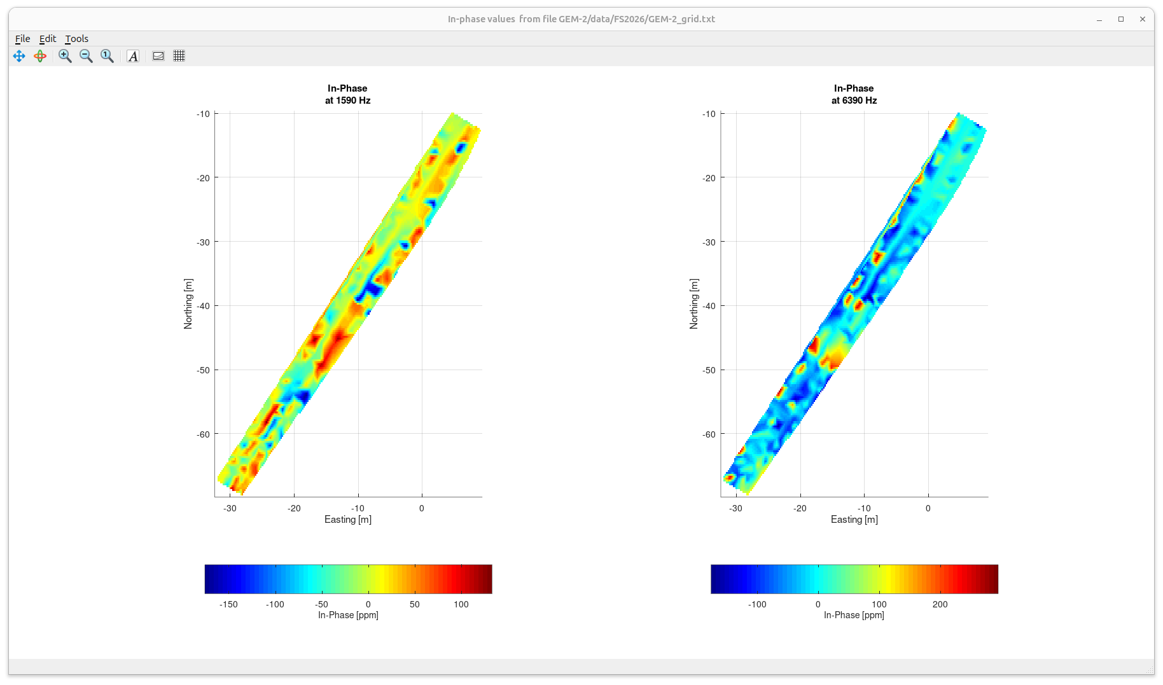
Note that after processing, inconsistencies between adjacent lines 3, 4 and 5 are reduced (although still remain)
target

Slide 3
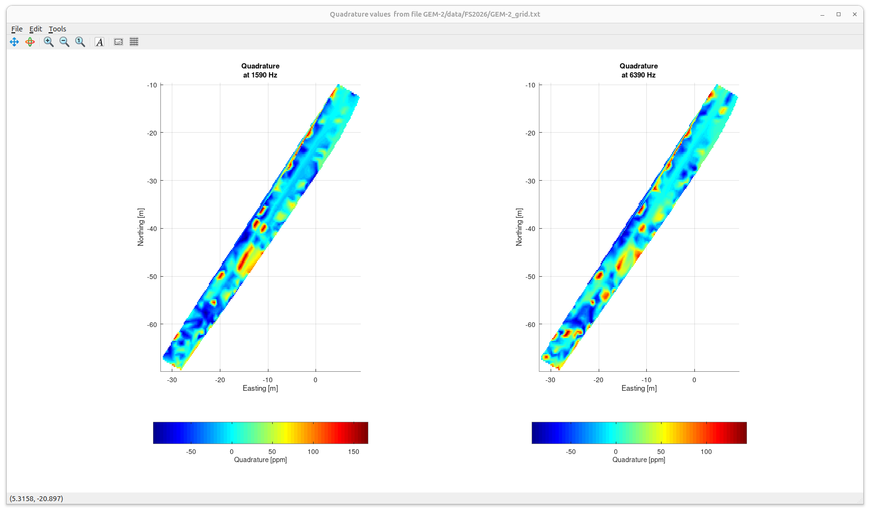
target

Slide 4
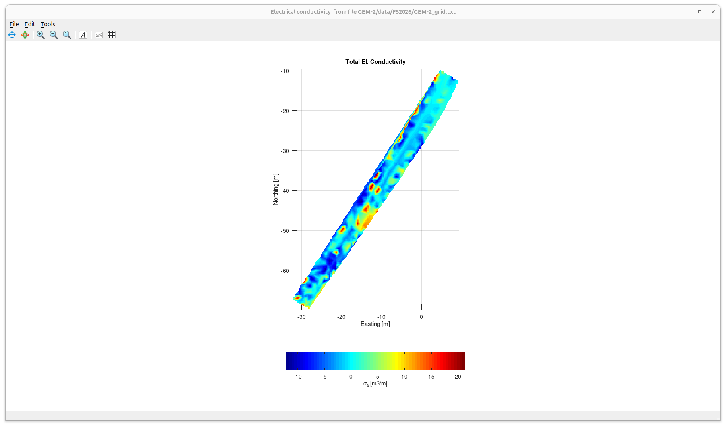

Slide 5
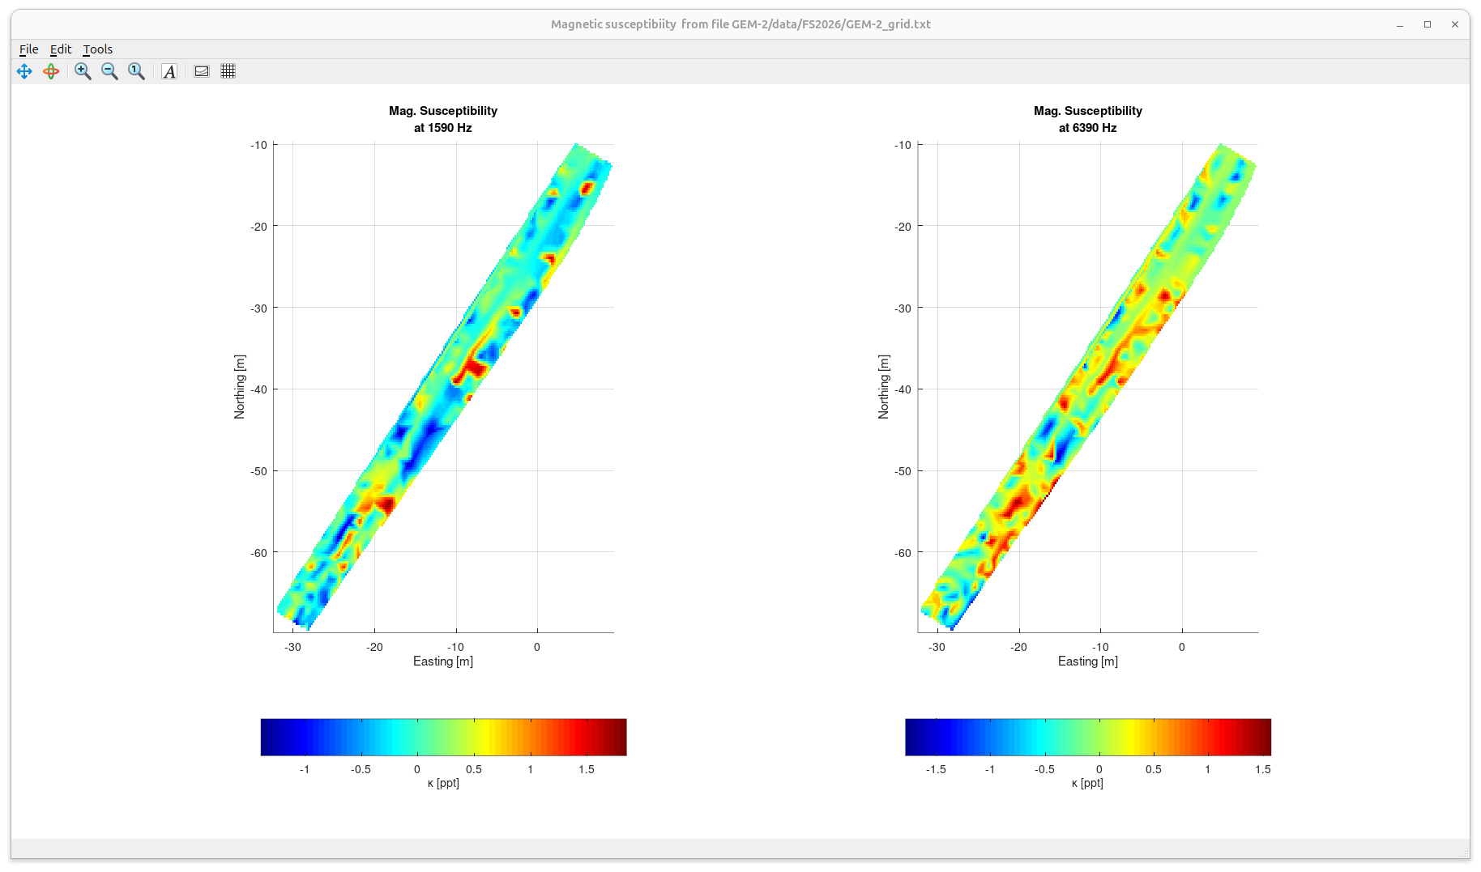
Gridded version of the preceding image

