Slide 1
Randy Brehm recorded a GPR grid over target 6B (two metal pipes at ~0.8 m depth). Lines were oriented across the pipes (see map on the next slide)
Plots of GPR reflections from 41 lines are shown in the following sides (labels slightly blurred because of pasting into PowerPoint)
The radar was high-frequency (500 MHz), and therefore the targets are somewhat below the penetration limit in this soil.
In water-saturated sand or clays/silts, radar wave velocity is about 0.06 – 0.1 m/ns. Therefore, the target should be at around 16 - 27 ns two-way reflection time in these records
As the next slides show, we have a few reflections (looking like hyperbolas) in this time range, including a strong reflection likely coming from the target.

Slide 2
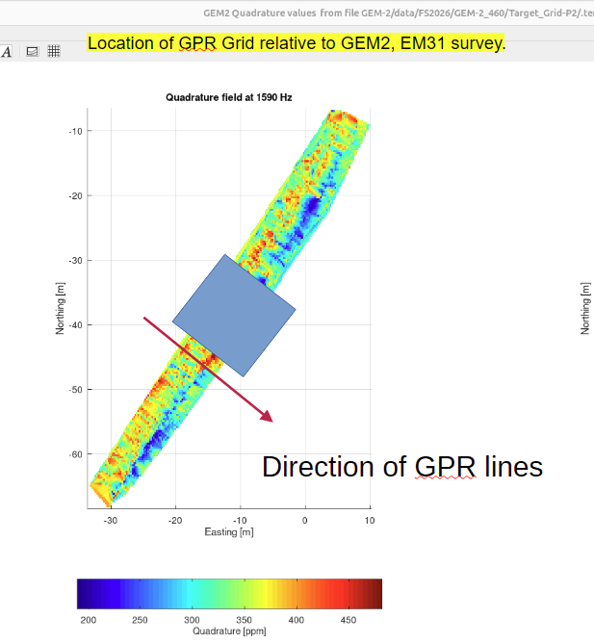
A bit of a puzzle with survey geometry here...
The strong reflection in line 9 (next slides) is about here...
... but the target (water tank) and EM anomalies are here...
Could the lines output from the instrument have been sorted in the opposite direction ?
Image by Randy Brehm

Slide 3
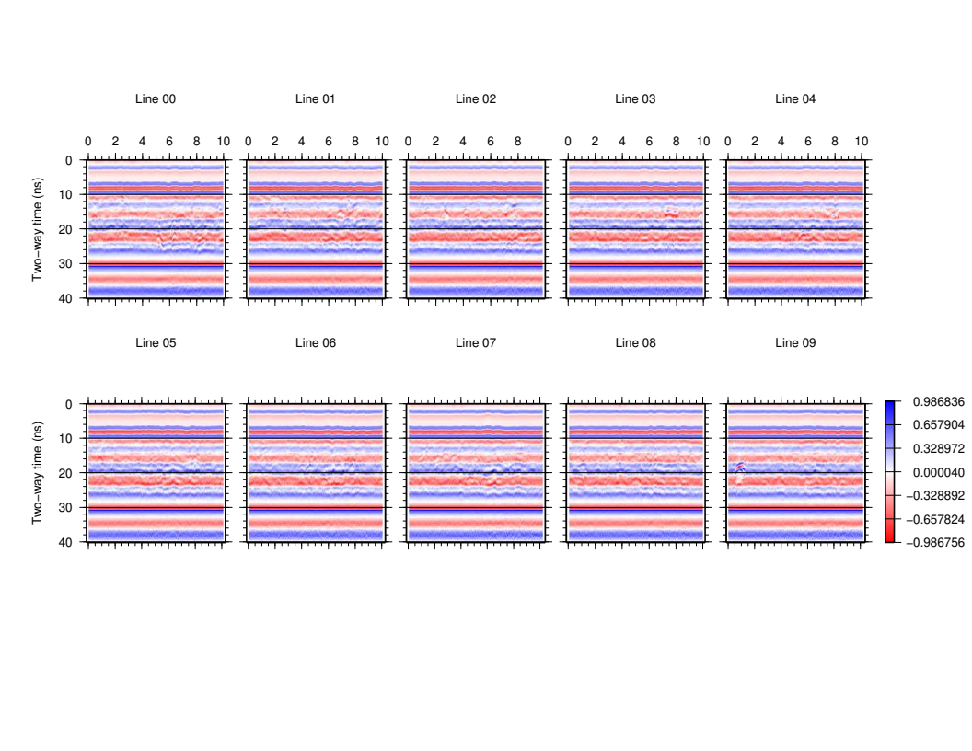
Blue colour here corresponds to positive polarity (as expected for reflections from metal objects)
Reflections from boulders?
Distance [m]
This strong and high-frequency reflection should be our target
GPR and seismic images strongly depend on processing applied to the records.
Here, a simple 10-ns “de-wow” procedure, 170 – 1200 MHz band-pass filter, and 6-ns Automatic Gain Control were applied.
Ignore the horizontally-aligned red and blue stripes across the images. This pattern is the GPR “wow” (up and down undulating baseline of the signal cause by inductive coupling with the ground).
This pattern can be removed by further processing.

Slide 4
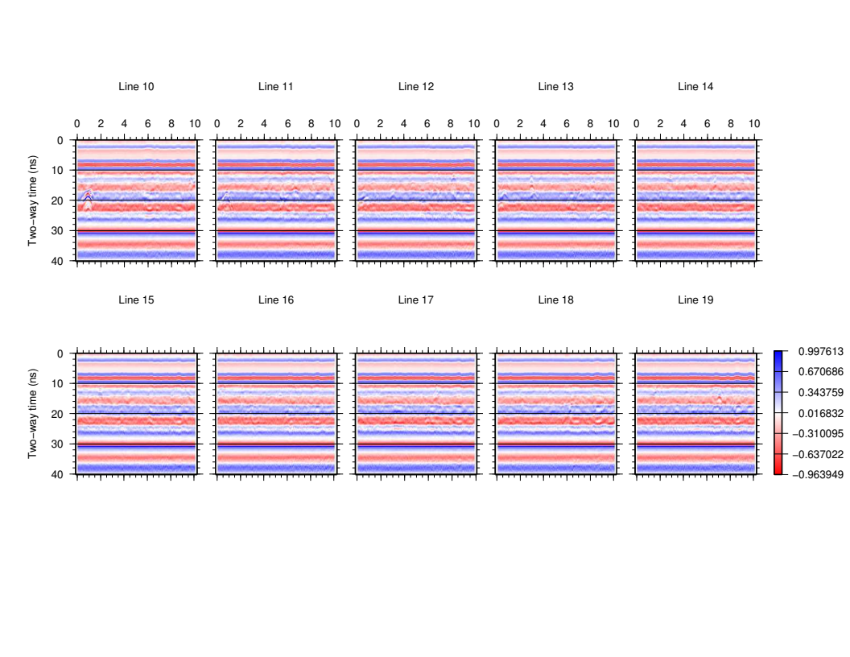
Our metal target?
Rocks, boulders

Slide 5
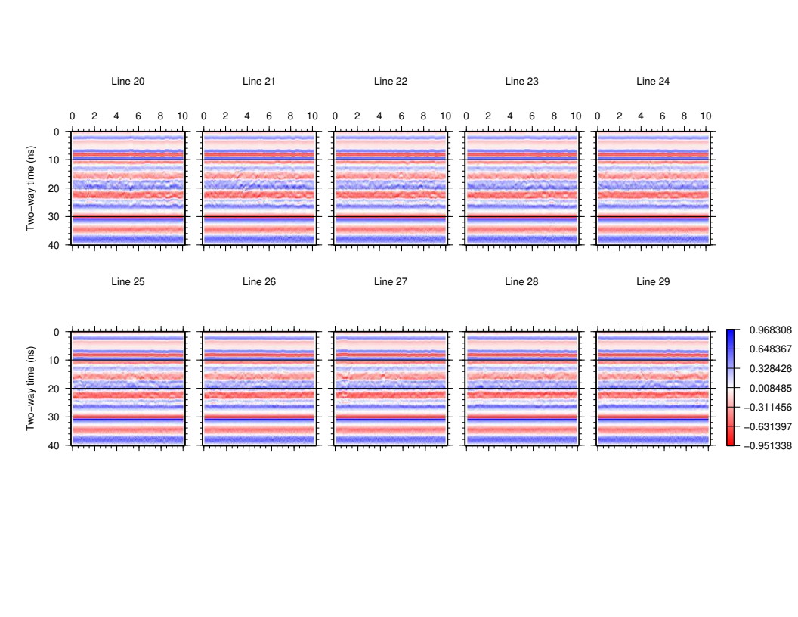
You can see more rocks ...

Slide 6
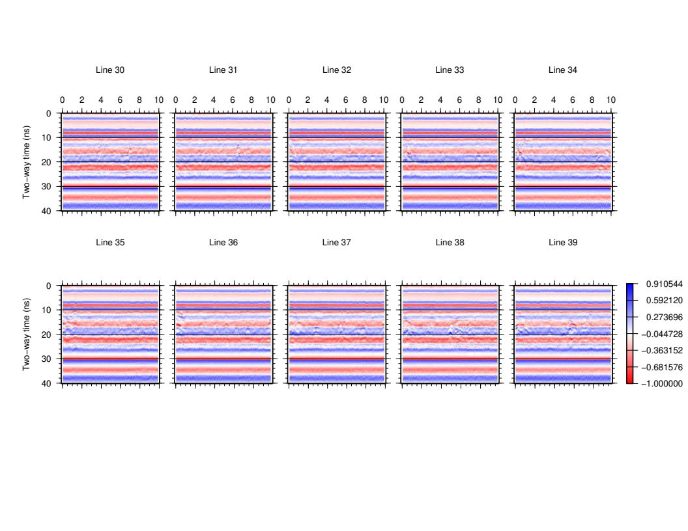
More rocks ...

Slide 7
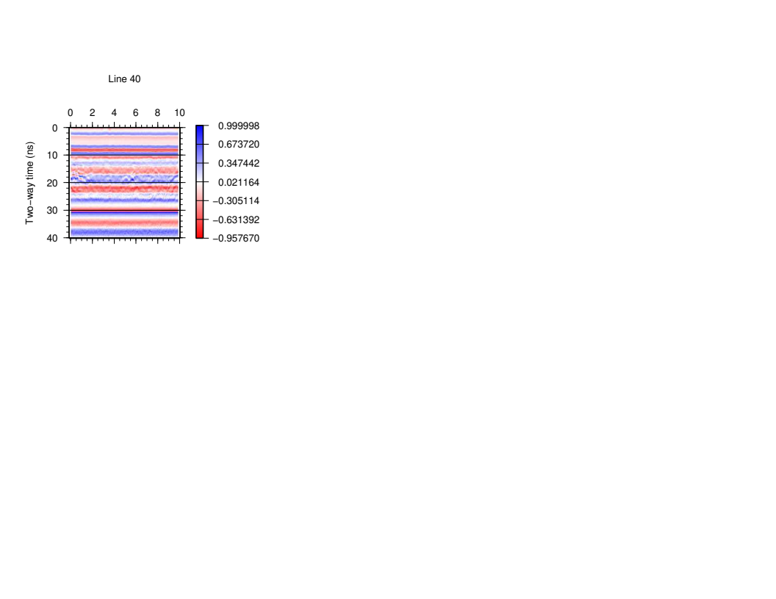

Slide 8
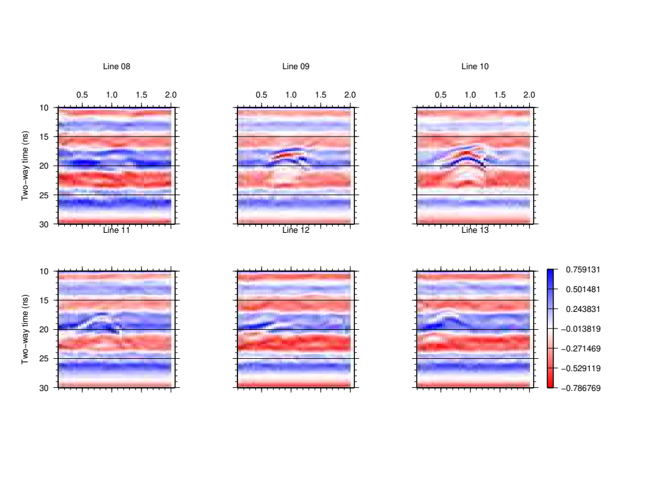
A zoom-in into the strong reflection from the target
Reflections from point-like objects are generally shaped as hyperbolas with apices located directly above the scatterers.
Distance [m]
Note that as we move from line 8 to 13, the location of the apex of the reflection shifts from about 1.2 m to 0.7 m.
This indicates the orientation of the target.
Later, I will try showing “time slices” of this reflection (maps of its amplitude at fixed times).

