Slide 1
On September 4, Nam Vien and Alex Orole, of Nutrien, conducted another GPR test at the field-school site with a low-frequency (80-MHz) Mala radar.
The next slides show images of these records produced by Randy Brehm
Note that the 80-MHz radar also obtains strong reflections from our targets, but the targets are too shallow for easy imaging. Because of the interaction of the antenna with the ground (“air wave, or “ground wave”), reflections from depths shallower than about 3 m are covered by the reverberatory antenna signature.
  However, reflections deeper than ~3 m should be seen well with this radar
Comparing results of 500-MHz and 80-MHz radar tests, it appears that for our site and good-size targets at ~1 to 1.5 m depths, a 250-MHz GPR antenna should be optimal and successful.

Slide 2
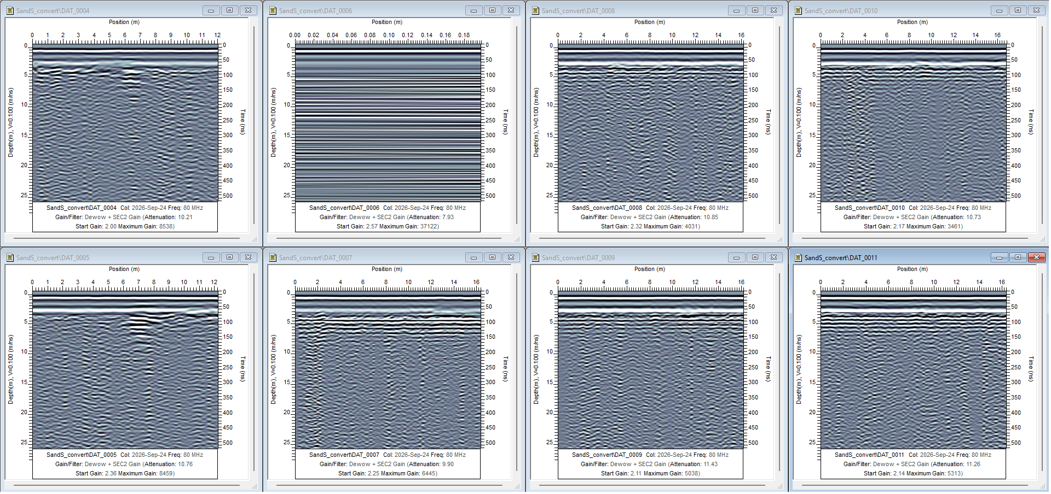
Red arrows show likely reflections from our targets
Because the wavelengths at 80 MHz are long (about 3 m), reflections from shallow targets at ~1.0 - 1.5 m come on top of strong antenna- and air-wave reverberations and hard to see without filtering
This line did not work for some reason
Processing in “Sensors & Software” software and images by Randy Brehm

Slide 3
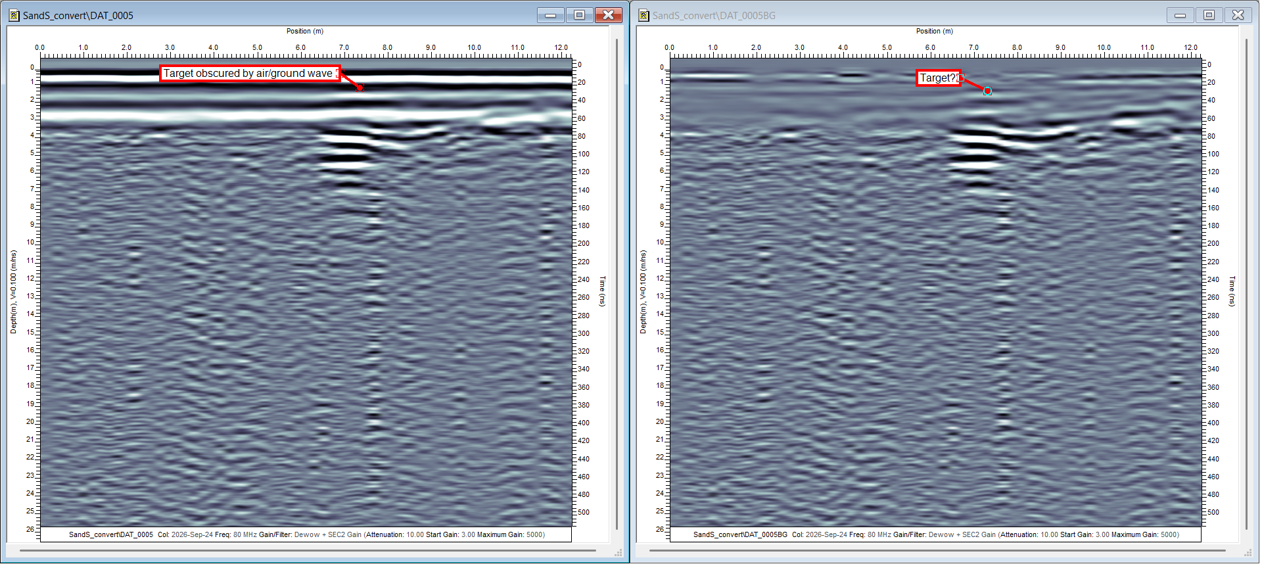
Processing of line DAT_0005 by Randy Brehm by subtracting an averaged record from each trace. This subtraction removes the antenna and air-wave reverberation, which is common in all records The shallow reflection becomes clearer (image on the right).

