Slide 1
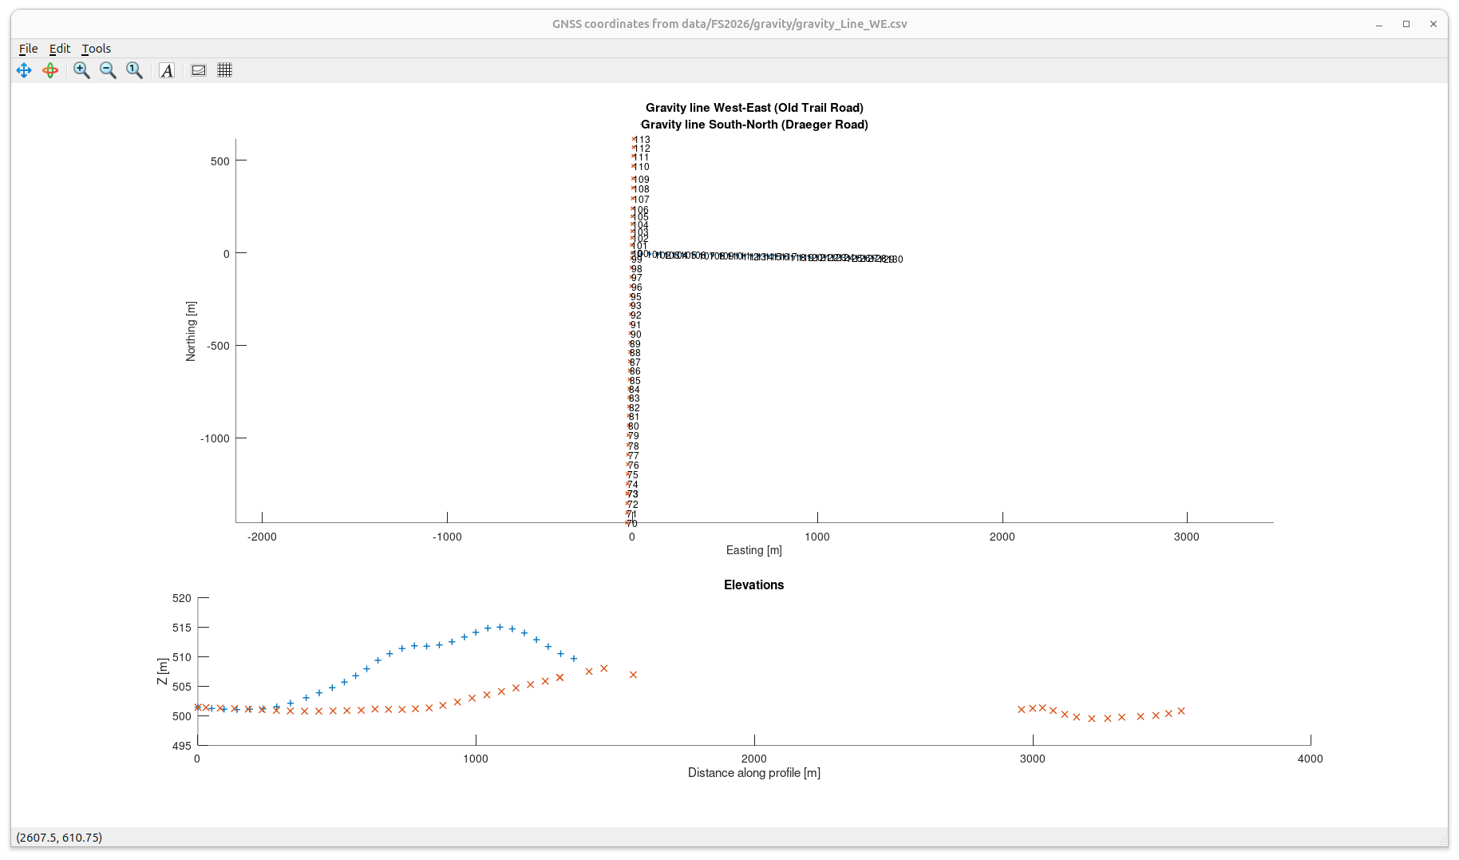
Coordinates of gravity lines
Elevations are shown vs. distance along each individual profile.
The gap in red crosses (S-N line) is because this line was surveyed in two directions from from base station

Slide 2
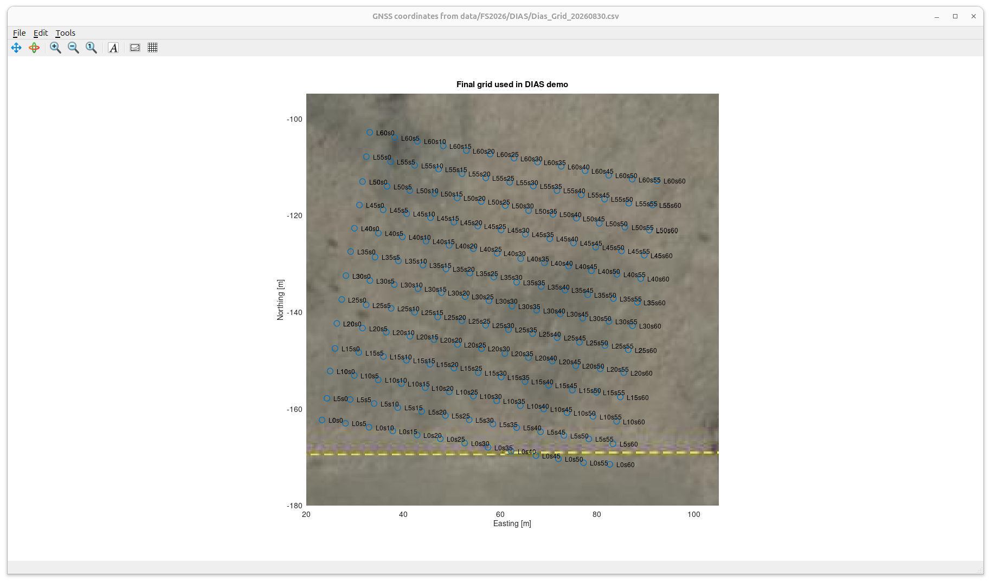
Final grid of injection and potential recording locations we surveyed for DIAS on Aug 30

