Slide 1
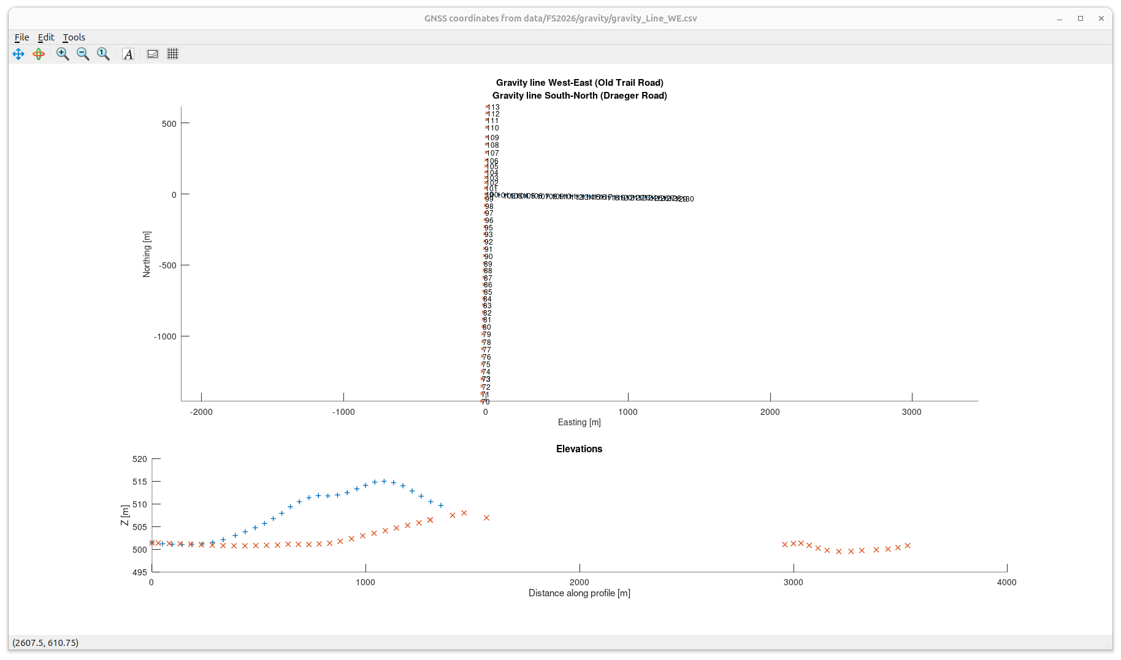
Coordinates of gravity lines
Elevations are shown vs. distance along each individual profile.
The gap in red crosses (S-N line) is because this line was surveyed in two directions from from base station

Slide 2
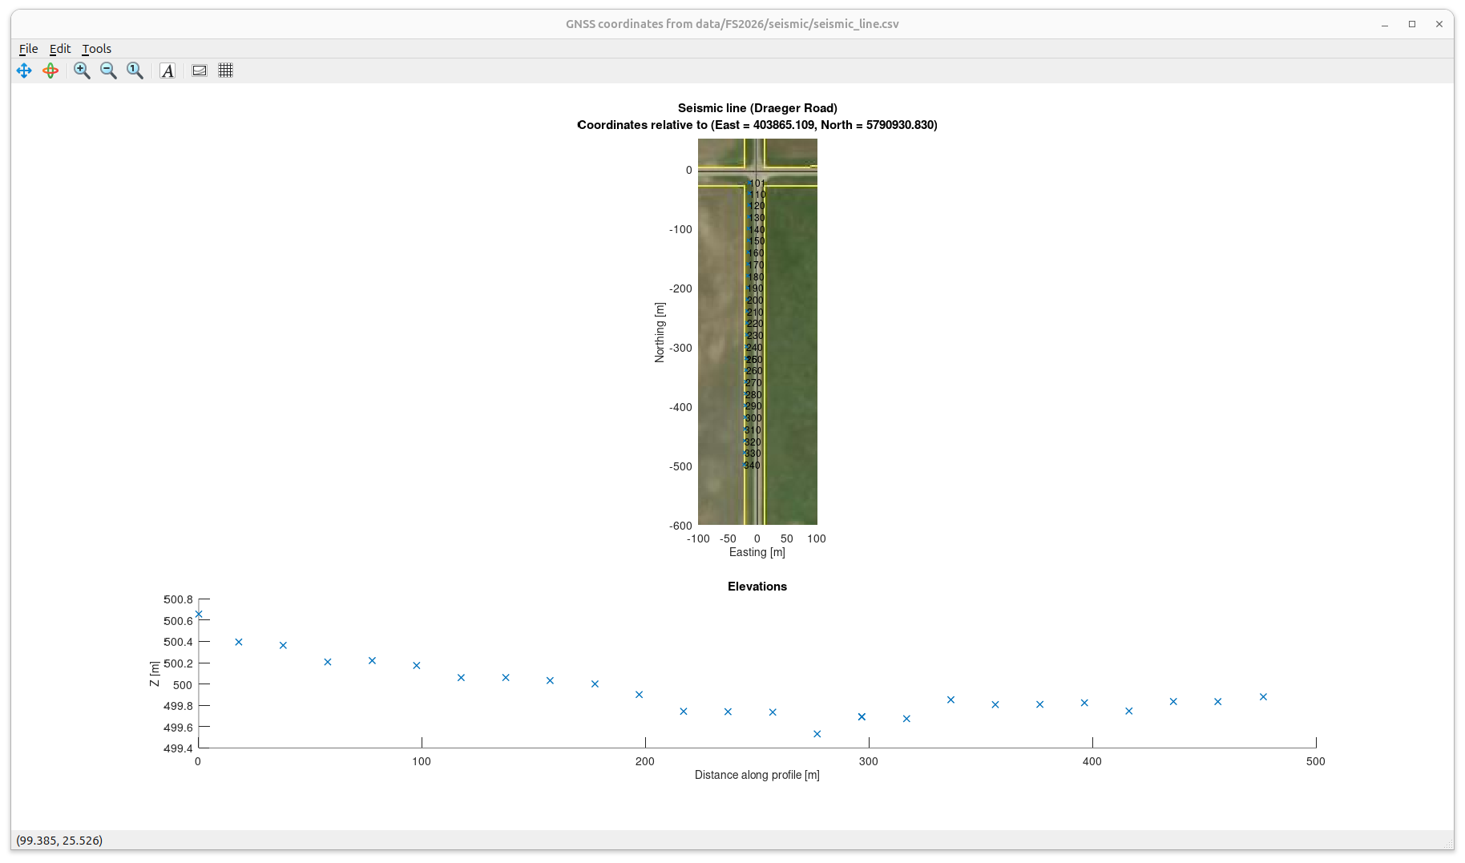
Surveyed GNSS (GPS) points on the seismic line.
To reduce work and increase accuracy of mutual station positions, coordinates were surveyed at selected points (every about 10th point here) and interpolated after loading in the database

Slide 3
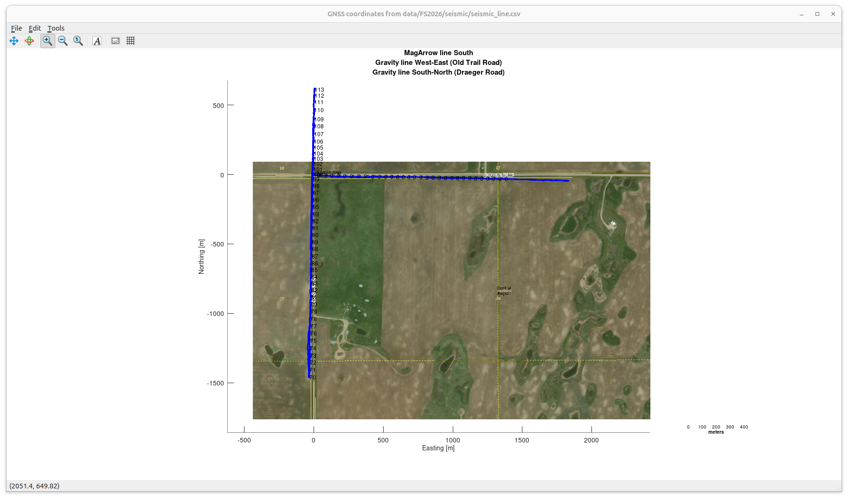
Interpolated positions of all seismic stations magnetometer tracks, and all gravity stations (numbered)
Unfortunately, the orthoscopic mosaic image is missing here
Unfortunately, the orthoscopic mosaic image is missing here
Seismic line
The original plan was to do N-S gravity and magnetic lines across this area (private property), but we did not get to them ...

