Slide 1
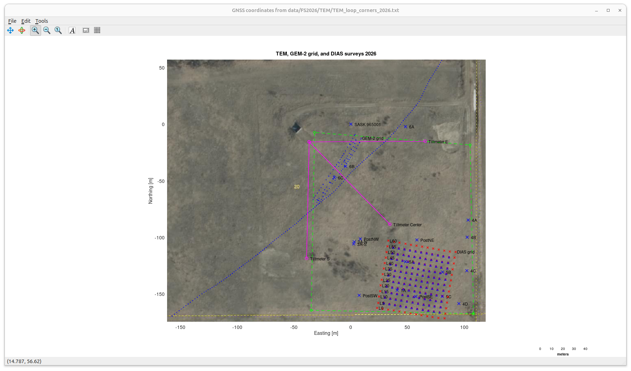
Key surveys in the vault area:
contour of TEM source-current loop,
and grids of DIAS and GEM-2 and magnetometer surveys.
Targets and markers are shown by blue crosses.
Approximate paths of underground tiltmeter tubes are shown by magenta lines.
Seismic and gravity line from 2025 field school.
VLF and MaxMin surveys are conducted along the northern half of this line.

Slide 2
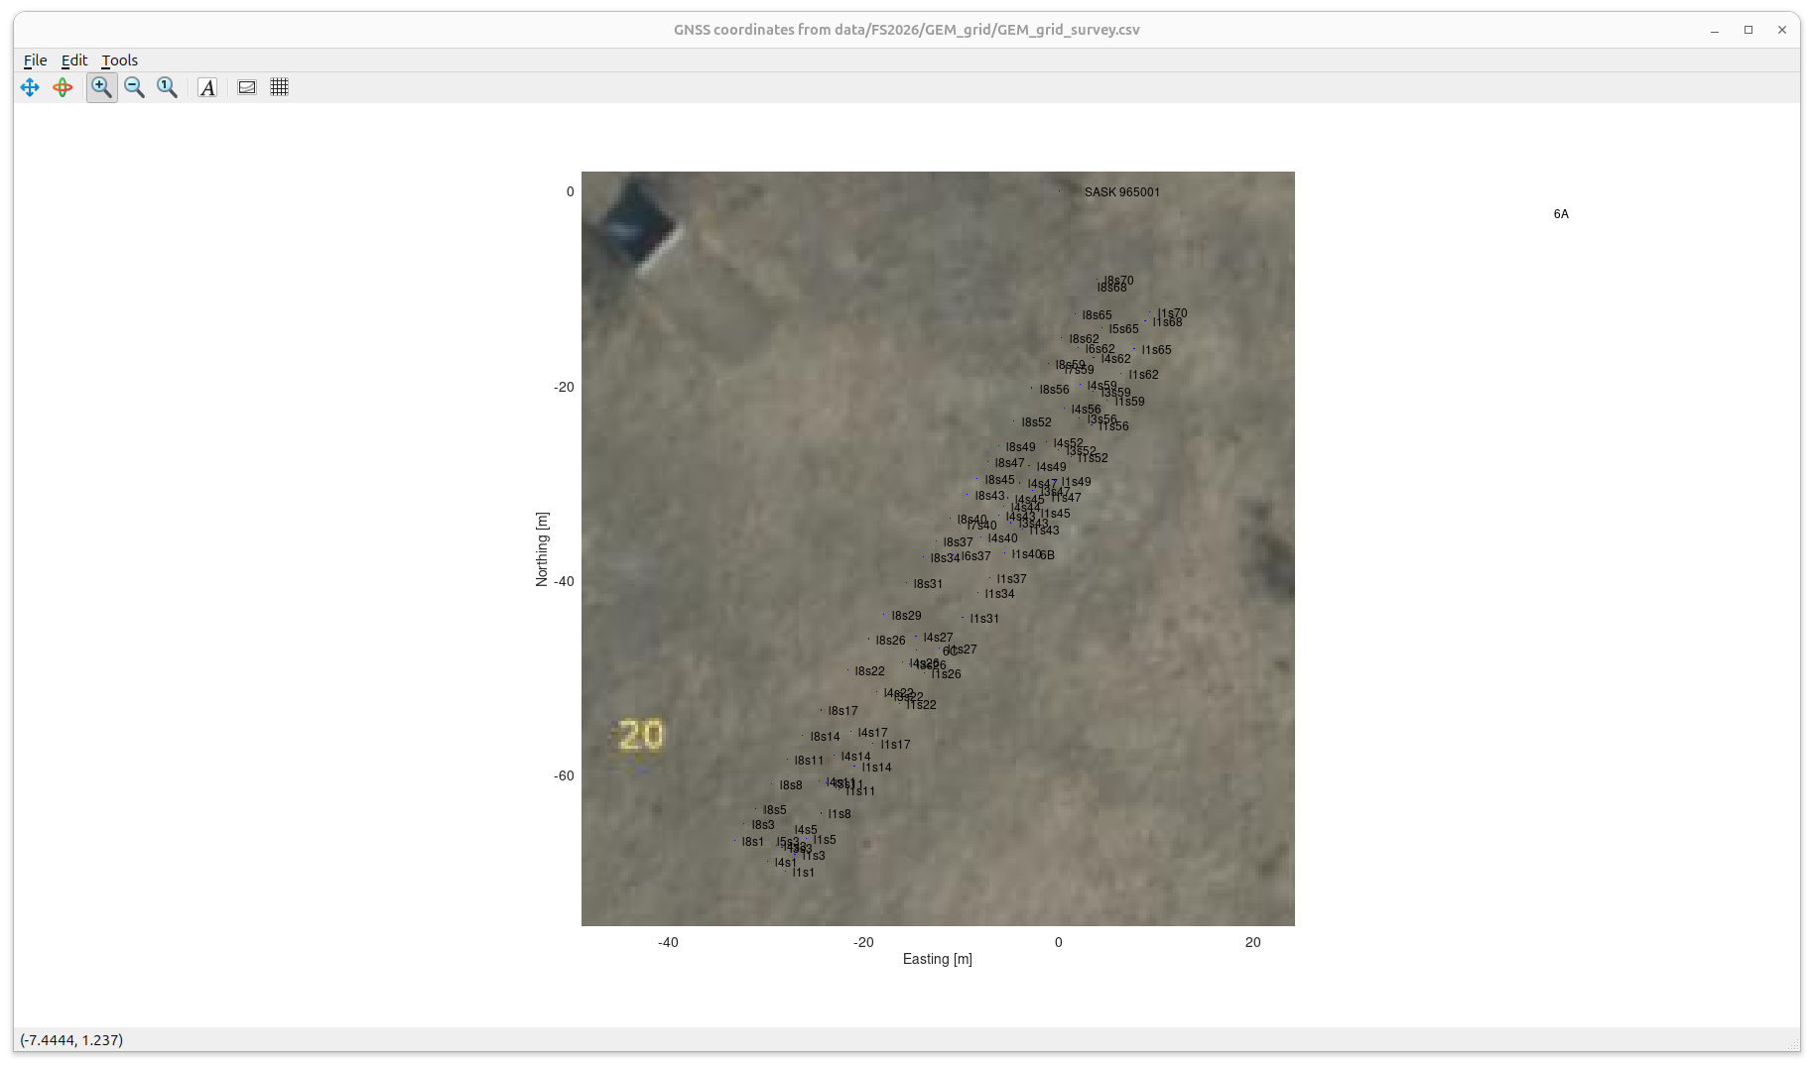
Detail of GEM-2 and MagArrow grid behind vault

Slide 3
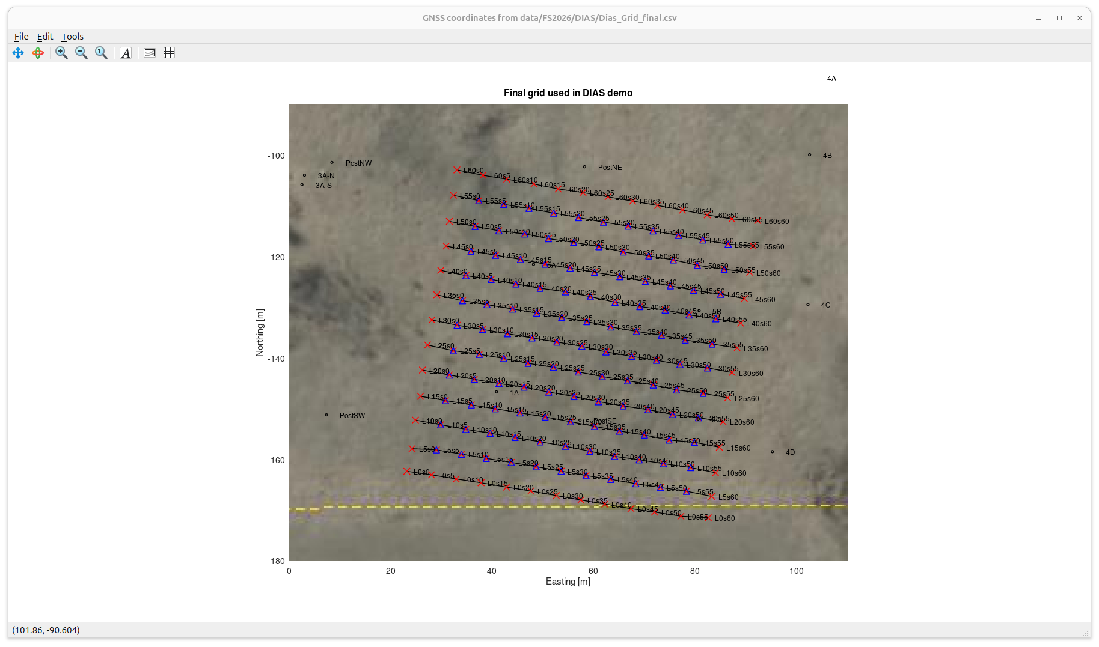
Final grid of injection and potential recording locations we surveyed for DIAS on Aug 30
Electrical/magnetic targets and other markers are indicated

