Slide 1
The following images from the Time-Domain Electro-Magnetic (TDEM, or TEM) method are by Joel Grunerud.
Later, I will try adding more images.
Note that all of our targets show up well in this method.

Slide 2
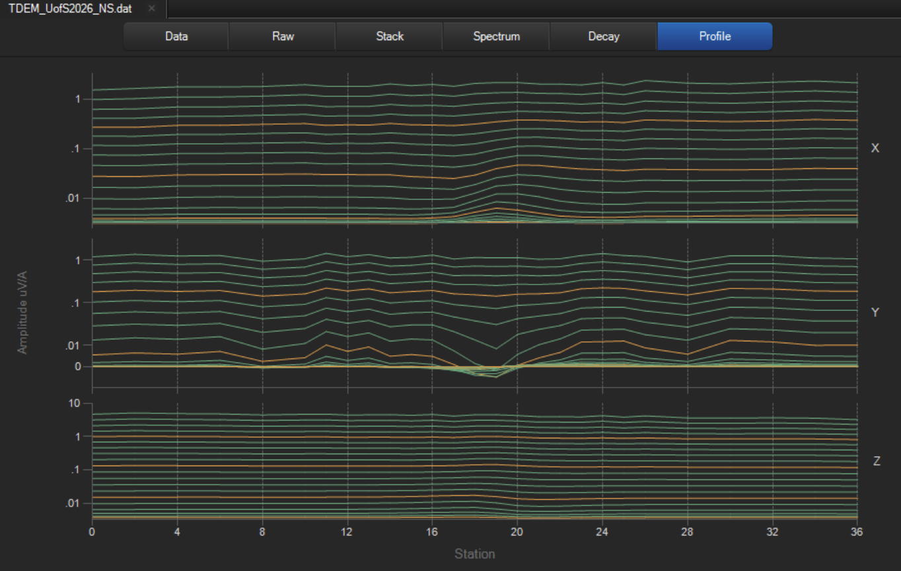
N-S survey line (the old steel sheet target), channels 1-20. X, Y, and Z profiles, logarithmic scale:

Slide 3
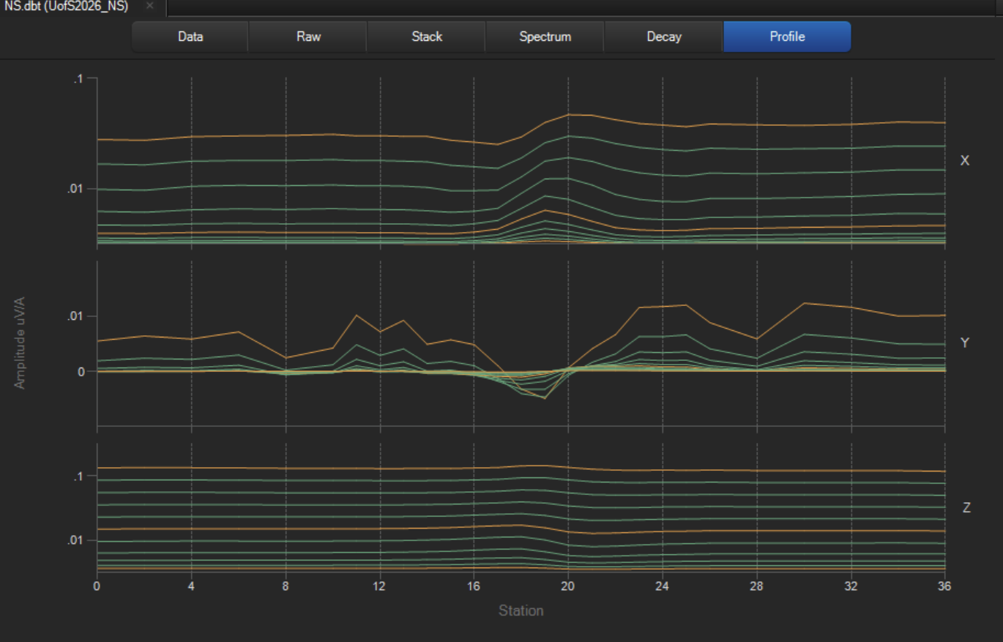
N-S survey line (the old steel sheet target), channels 10-20. X, Y, and Z profiles, log scale:

Slide 4
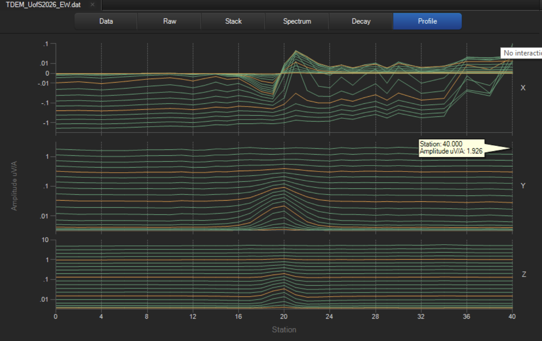
E-W survey line (the new central target), channels 1-20. X, Y, and Z profiles, log scale:

Slide 5
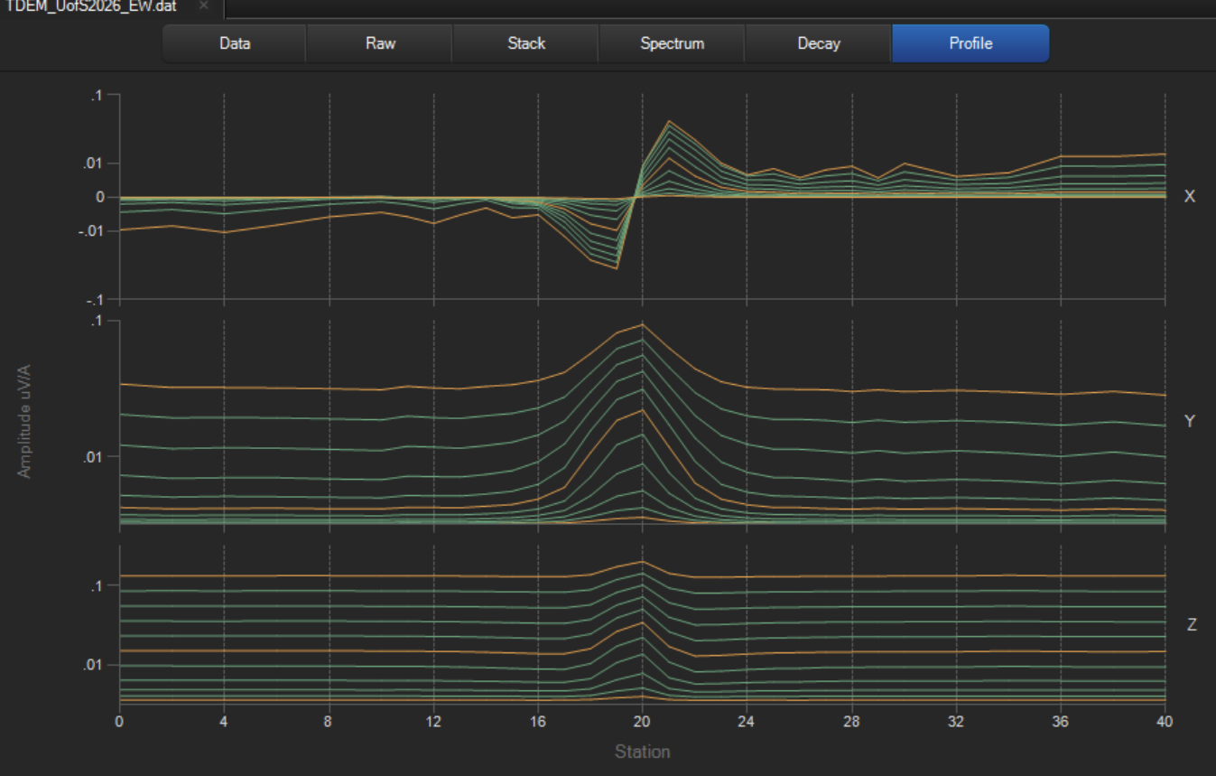
E-W survey line (the new central target), channels 10-20. X, Y, and Z profiles, log scale:

Slide 6
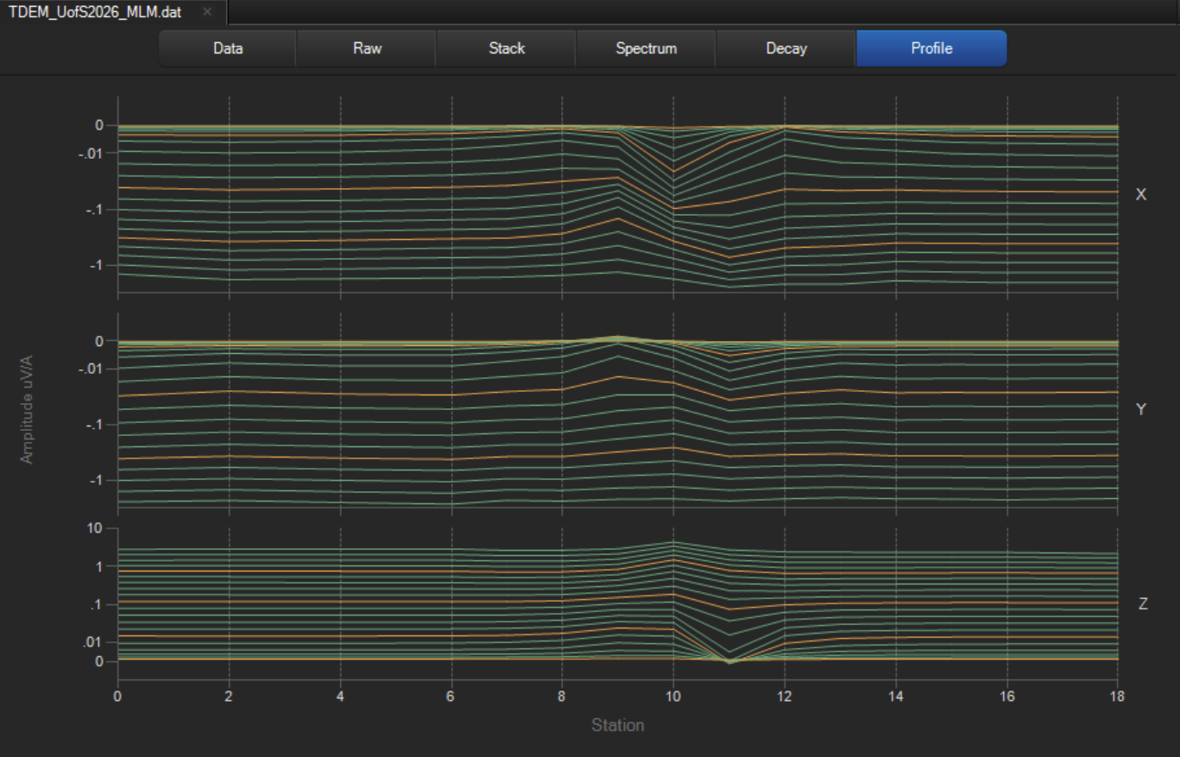
MLM survey line (the mise-a-la-mass target), channels 1-20. X, Y, and Z profiles, log scale:

Slide 7
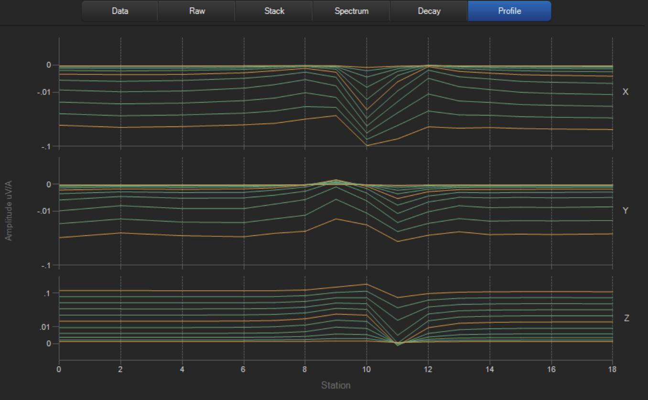
MLM survey line (the mise-a-la-mass target), channels 10-20. X, Y, and Z profiles, log scale:

Slide 8
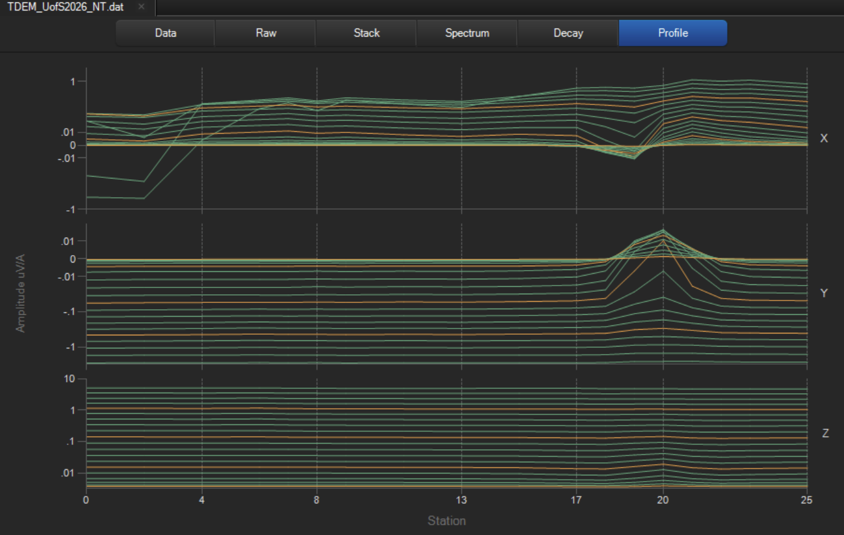
NT survey line (the new targets close to the Vault), channels 1-20. X, Y, and Z profiles, log scale:

Slide 9
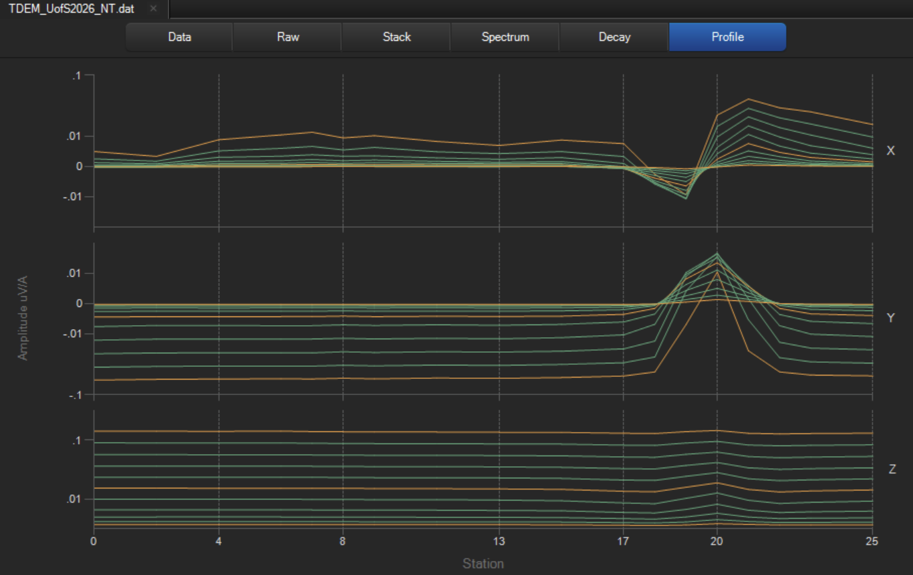
NT survey line (the new targets close to the Vault), channels 10-20. X, Y, and Z profiles, log scale:

