Slide 1
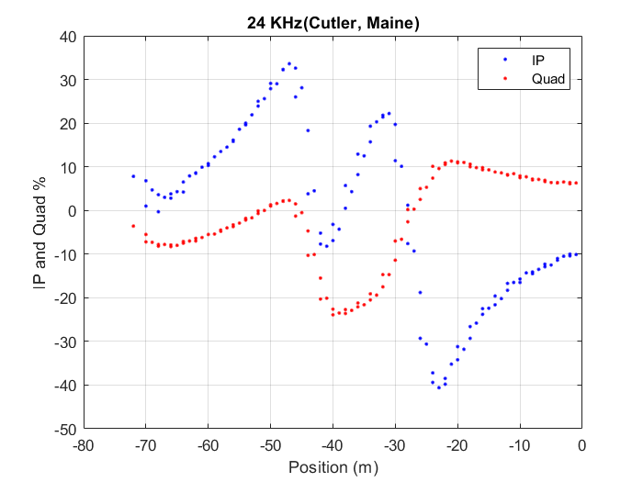
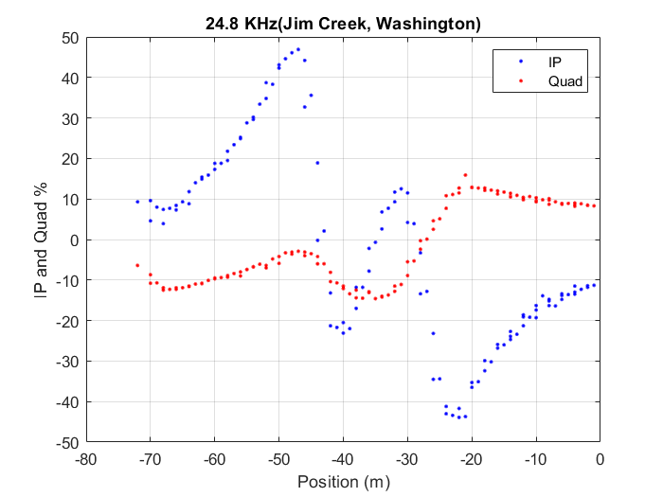
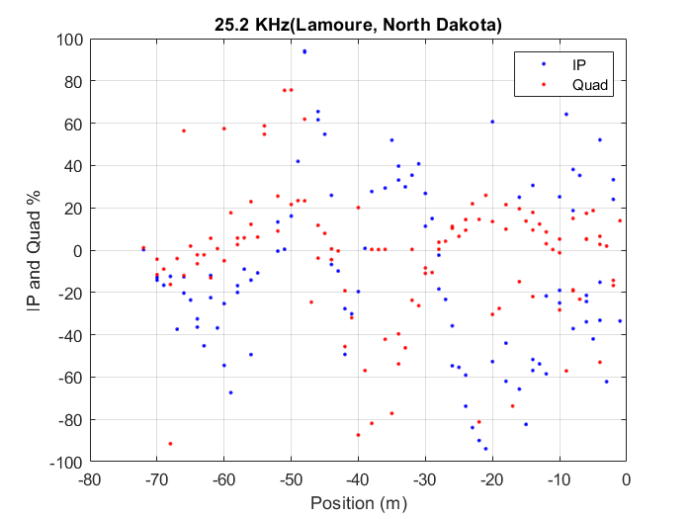
2-m spacing VLF profile near vault (Aug 28).
The targets seem to be best seen at 25.2 kHz (purple)
South
North
South
North
Raw data plots and comments by Prof. Sam Butler. Both the 1-m and 2-m spacing lines are superimposed.
Note that transmitters from Cutler and Jim Creek produce clear records over the targets. We can also see that the total field at 24.8 kHz (Jim Creek) is considerably stronger than at 24 kHz from which we could make inferences about the orientation of the conductor.
The IP and Quad for 25.2 kHz is noisy because the perpendicular horizontal field to the direction of walking is close to zero but it is used for the normalization. While the signal is only slightly above the noise level, we can see hints of peaks at -45 and -28 m in the total field measurement at 25.2 kHz.
Also, the Quad of the more southerly conductor has the opposite polarity of the cross-over (it is negative in the north and positive in the south) which tells us about the length of the conductor relative to the skin depth in the background medium.
South
North

Slide 2
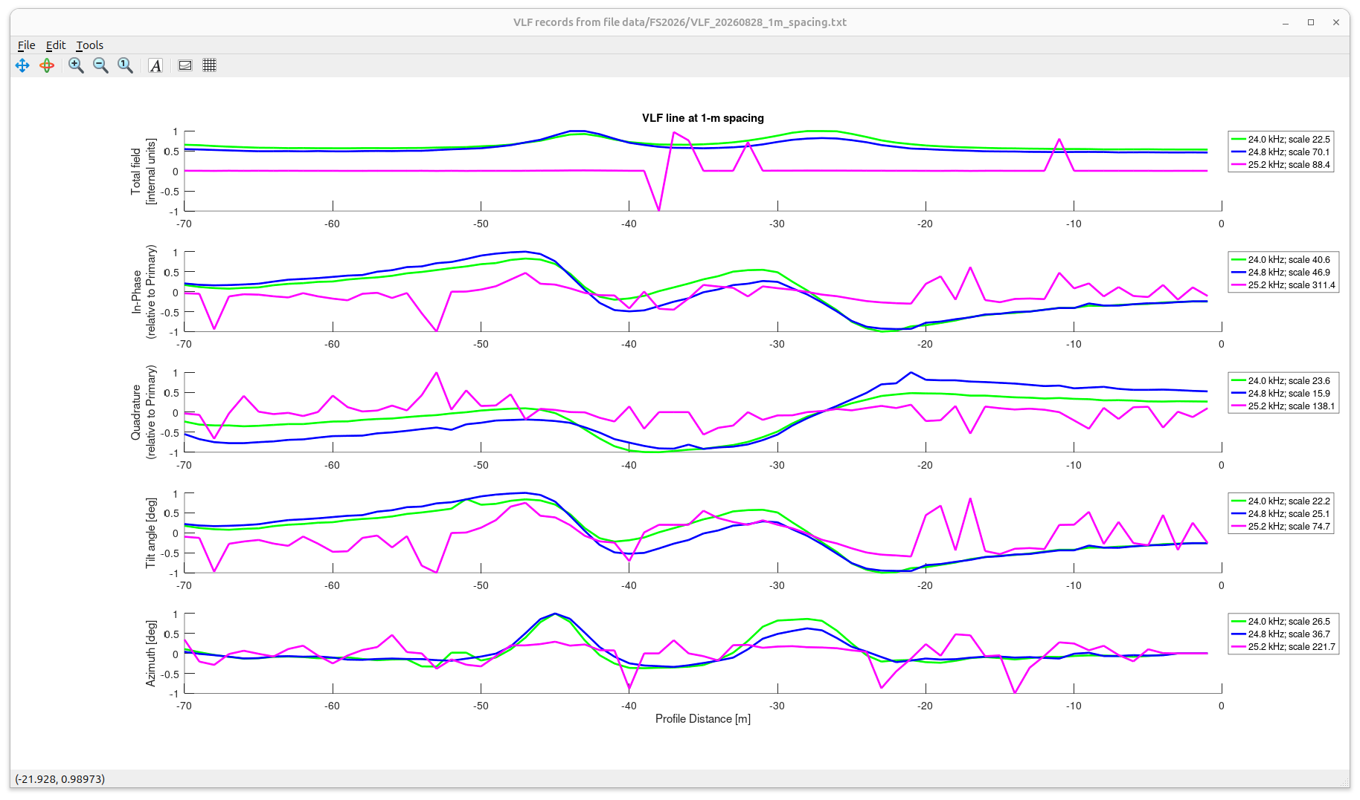
1-m spacing VLF profile after removing the “regional” (about 60-m scale) trends from the data. The trends may be related to surface dip and topography (?)
Peaks of the Total Field and zero-crossings in the In-Phase and Quadrature, and the Tilt angle (of recorded magnetic field) occur over the conductors (cable and target?)

Slide 3
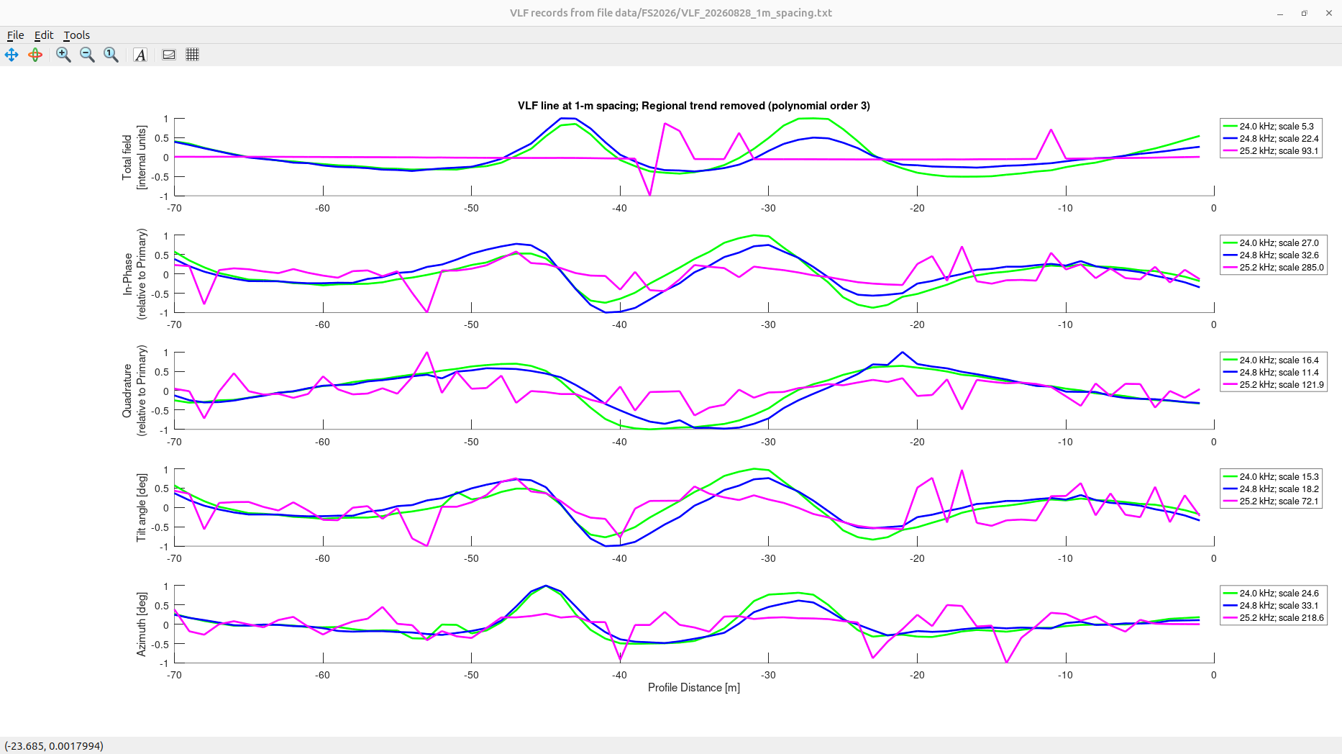
1-m spacing VLF profile after removing the “regional” (about 60-m scale) trends from the data. The trends may be related to surface dip and topography (?)
After detrending, peaks and zero crossings can be identified more accurately.

Slide 4
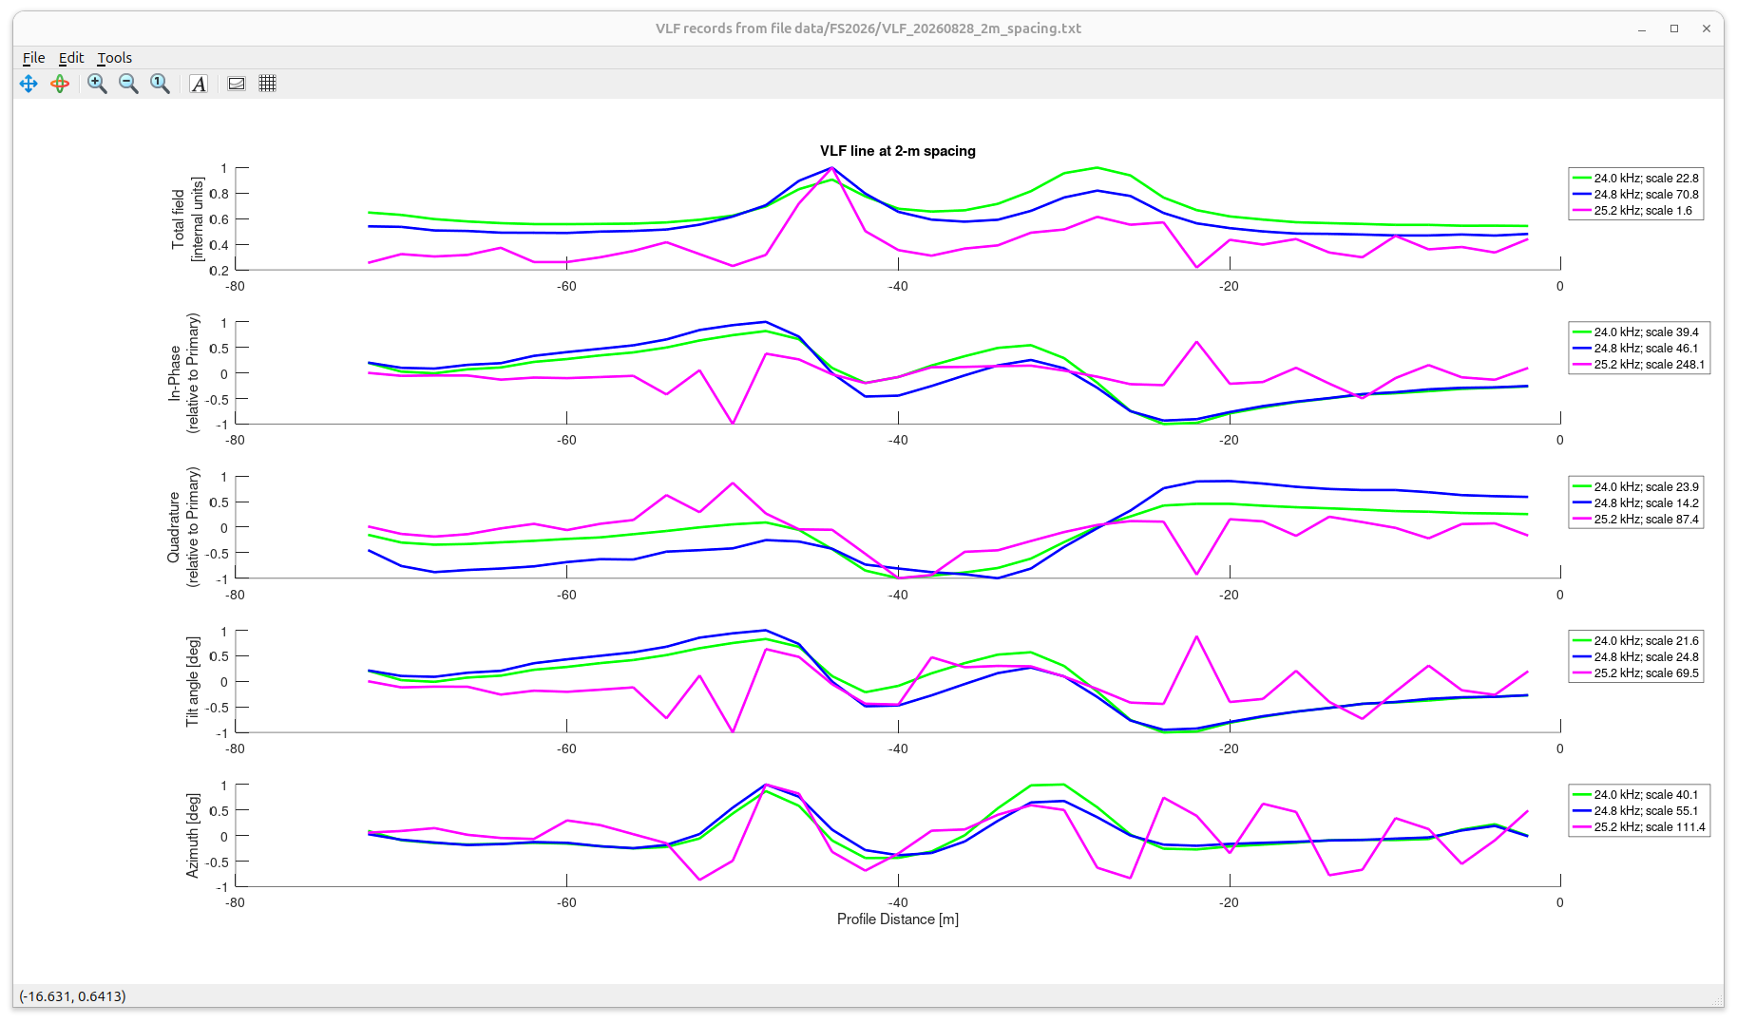
The VLF profile repeated at 2-m spacing gives similar results

Slide 5
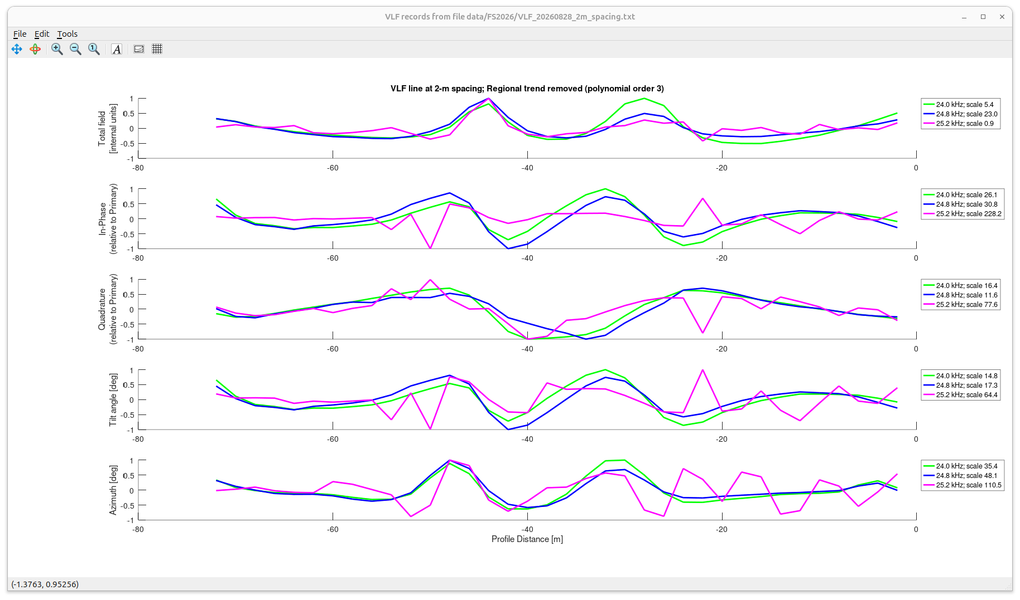
The VLF profile repeated at 2-m spacing gives similar results
However, note that this time, the 25.2 kHz recording worked better and consistently with others (probably because of lower noise)

