Slide 1
Gravity data analysis and results
Note the several processing steps:
Converting dial readings to mGal (“calibration”);
Deriving a “drift model”;
Corrections for latitudes, elevations, and effects of subsurface (“terrain”) density;
Estimates of terrain density by cross-plotting the readings vs. Elevations (this is called the “Parasnis method” )

Slide 2
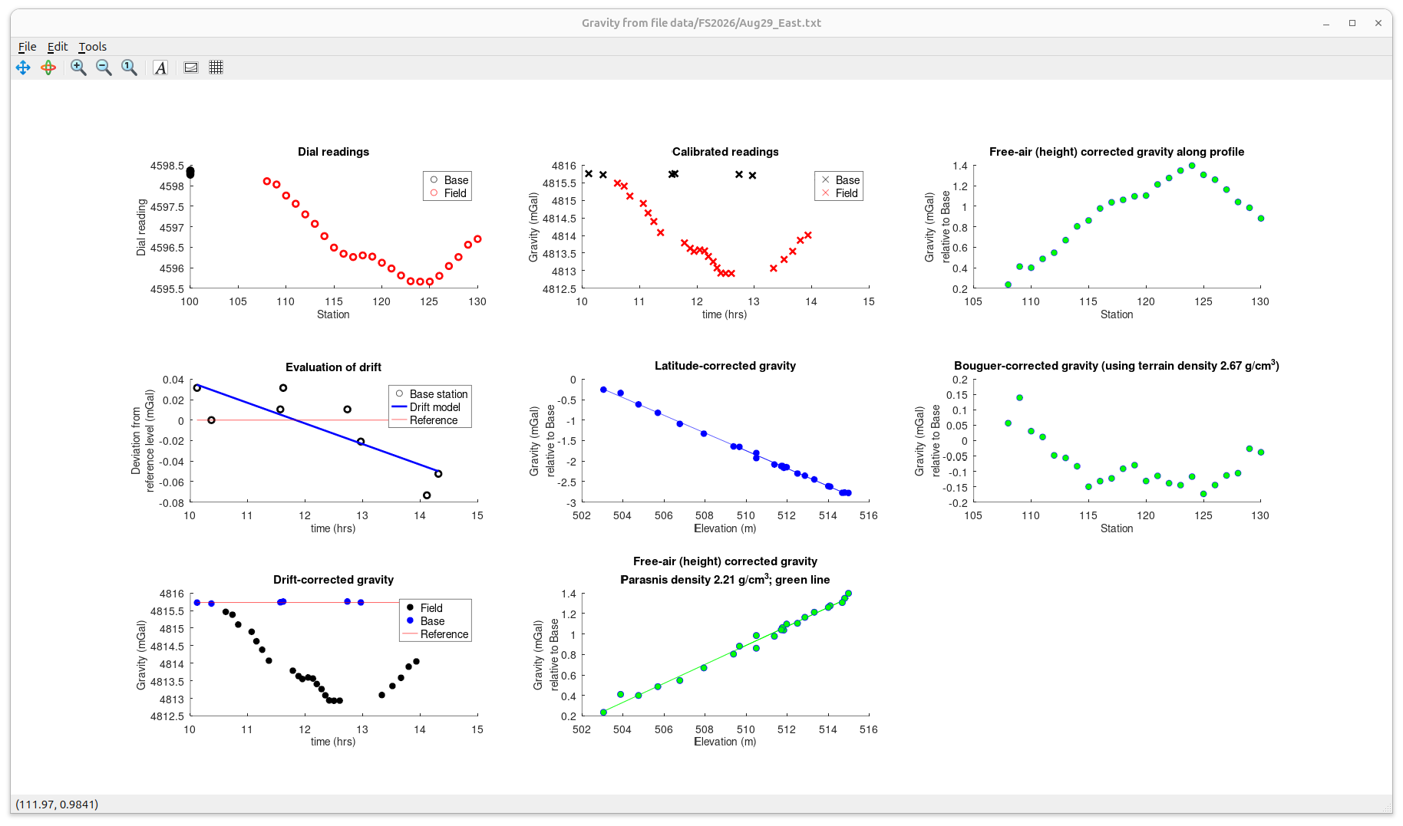
East Line (eastern end)
This line contains many readings and shows clearest results, and so I start with it
Note the instrument/tidal drift model derived from the base-station readings
Note that gravity reduces with elevation (the “free-air” effect)
Bouguer gravity (corrected for both elevations and terrain density) shows that gravity high is present west of about station 116.
This gravity high is also seen in the N-S line (next slides) and can be due to the gravel deposit we are looking for.
Reading at station 109 needs to be repeated though
Parasnis density (slope in this plot) is well resolved, showing that only tills of density about 2.23 g/cm³ are present here.

Slide 3
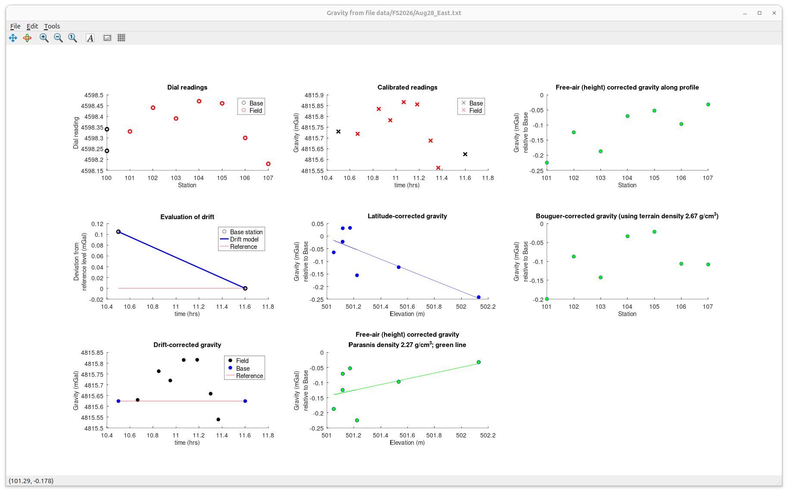
East Line (west part)
Station 101 and 103 may need to be redone

Slide 4
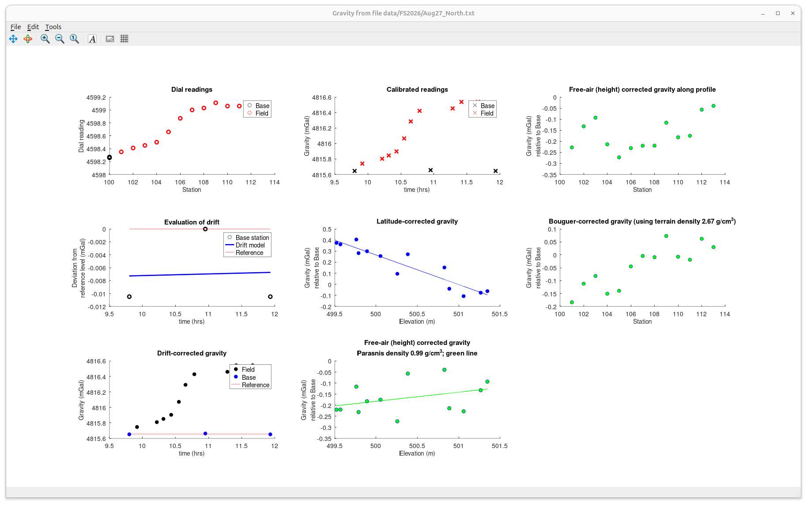
North-South Line (north part)
Increase of gravity toward stations 108 – 114 may be due to the gravel deposit there (?)
Scatters in the two bottom panels in the middle column could also be due to the presence of contrasting materials (tills and gravel)

Slide 5
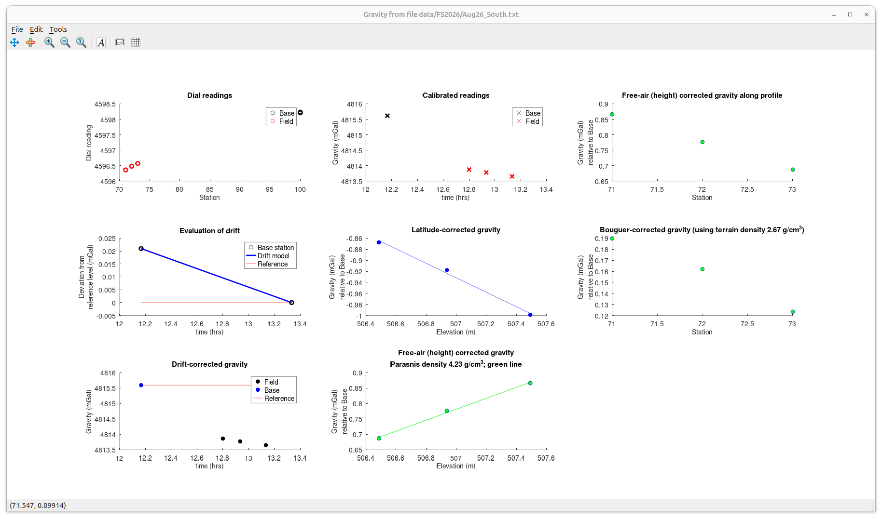
North-South Line (south part)
Too few points for analysis

Slide 6
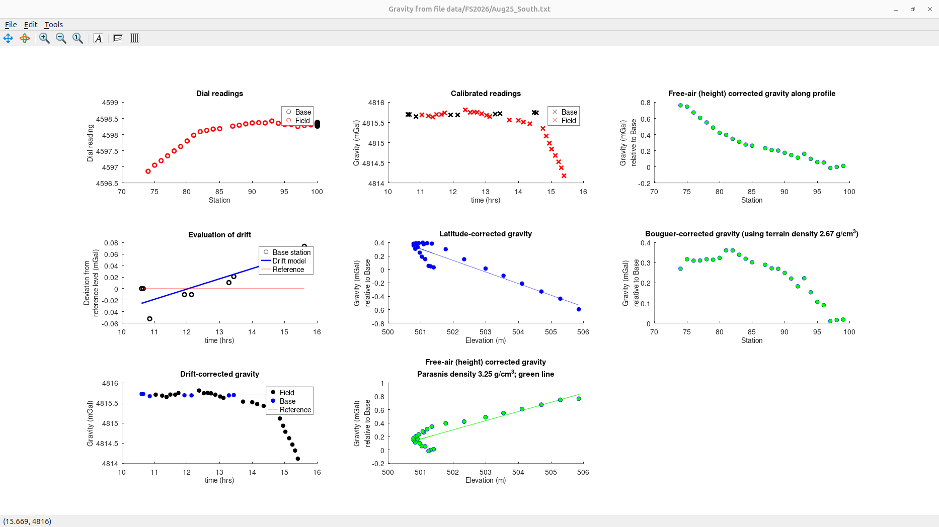
North-South Line
Parasnis density estimate is unreliable (likely several separate trends here)

