Slide 1
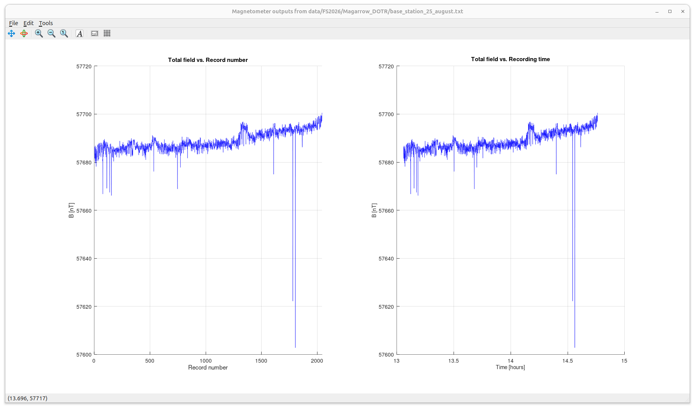
Records from the base station set up at the intersection of the Draeger and Old Trail Roads.
Note the upward drift with time and spikes, apparently due to passing cars and magneto-telluric activity.
Total magnetic field is shown as function of record number (left) and recording time (right).
Note the values of the field in nano Tesla units (nT).
These records are practically the same for continuous recording like the one at the base station or while tracking.
This record is subtracted from the roaming-magnetometer records (in the following slides)

Slide 2
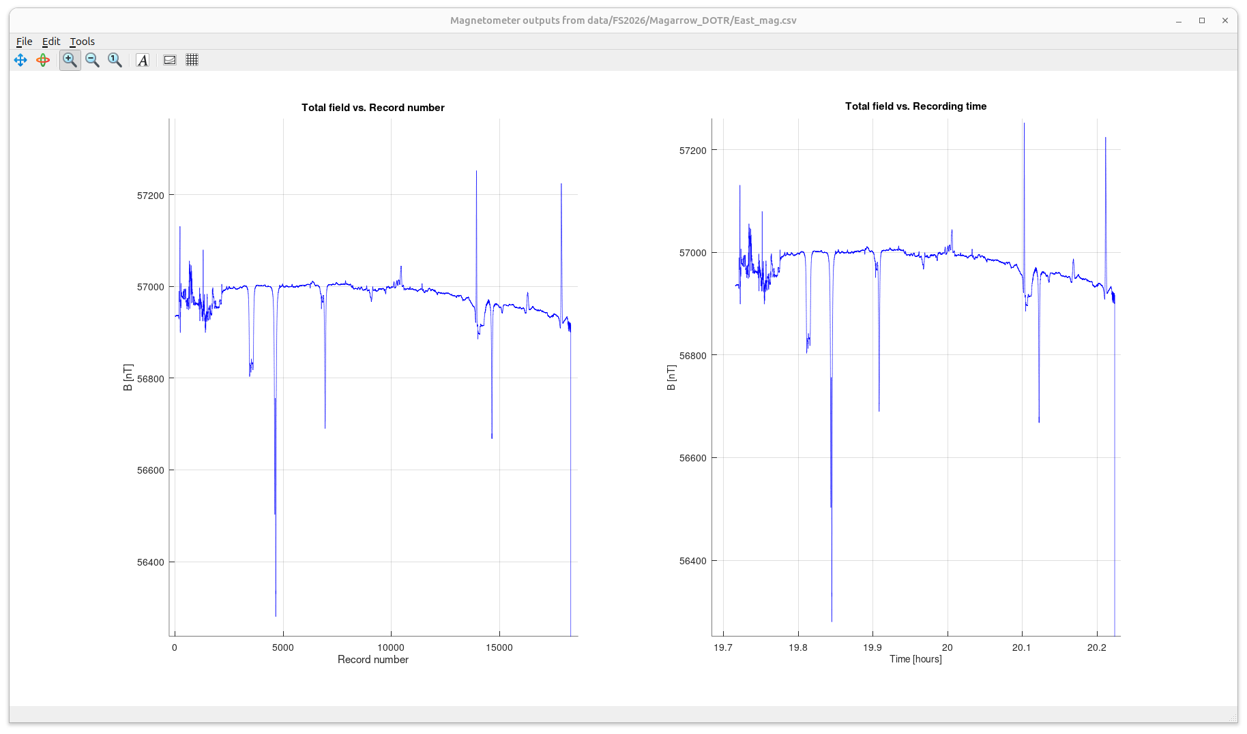
Raw records from MagArrow along East line
Note that the trend of the average magnetic field is opposite to the one in the base station. This means that the magnetic field due to the subsurface decreases to the east.

Slide 3
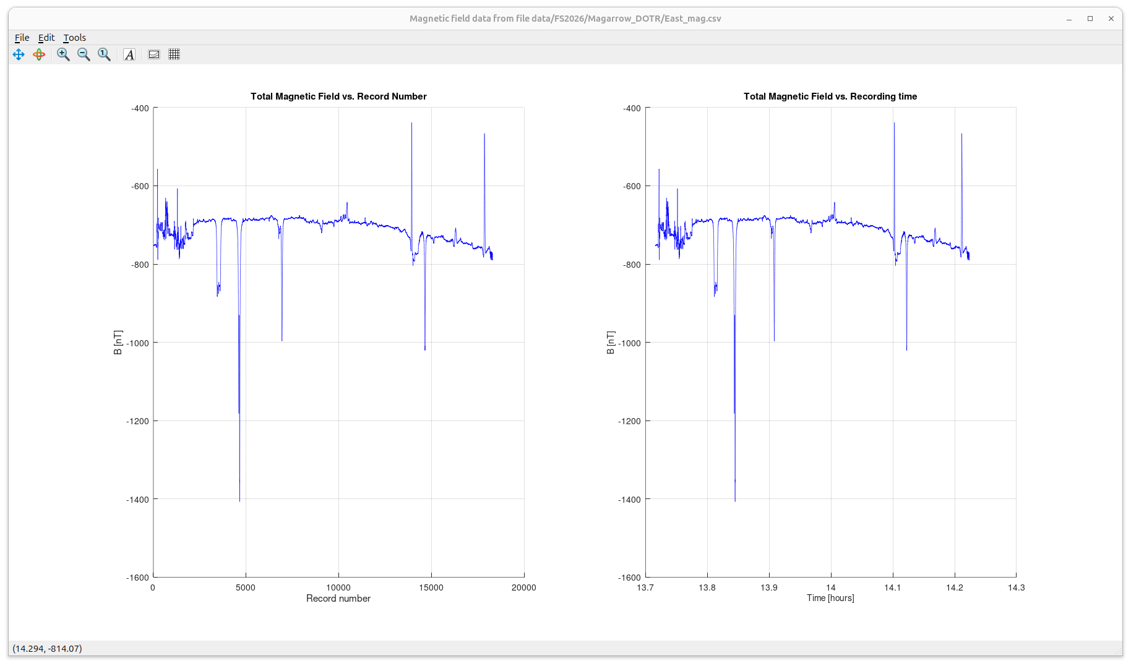
East line records with base-station magnetic field subtracted
Note the difference of about -700 nT from the base station, going slightly up and then decreasing east

Slide 4
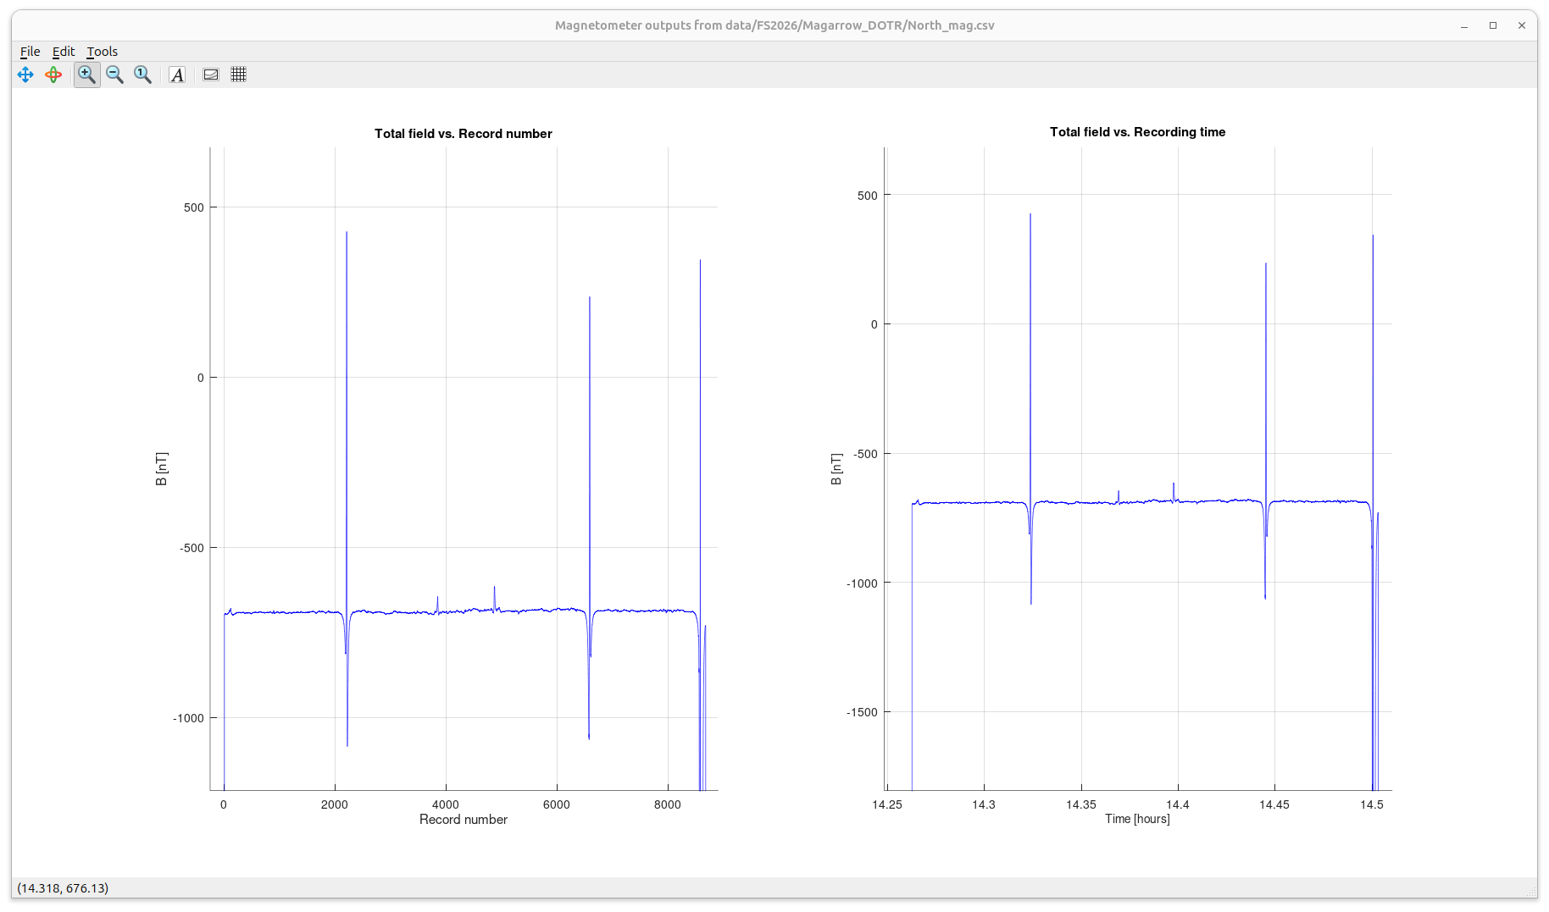
North line records with base-station magnetic field subtracted
Note the same difference of about -700 nT from the base station.
This difference is probably due to a difference in calibration of the GEM magnetometer (base station) and MagArrow (moving station)

Slide 5
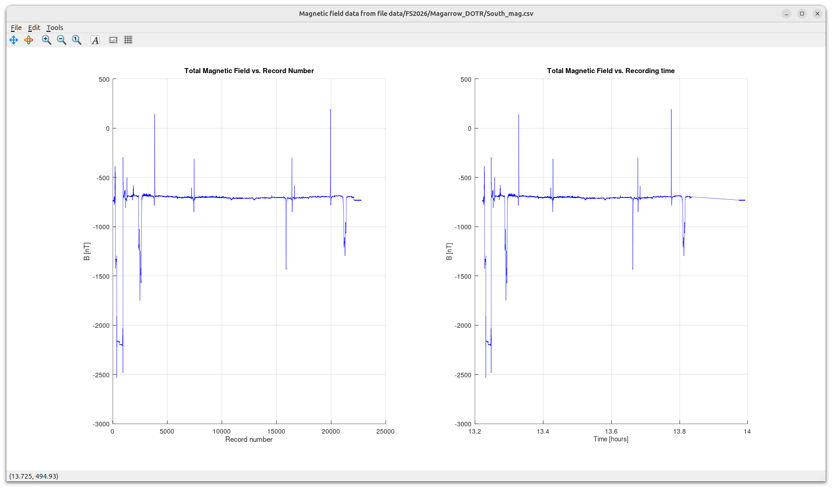
South line records with base-station magnetic field subtracted

Slide 6
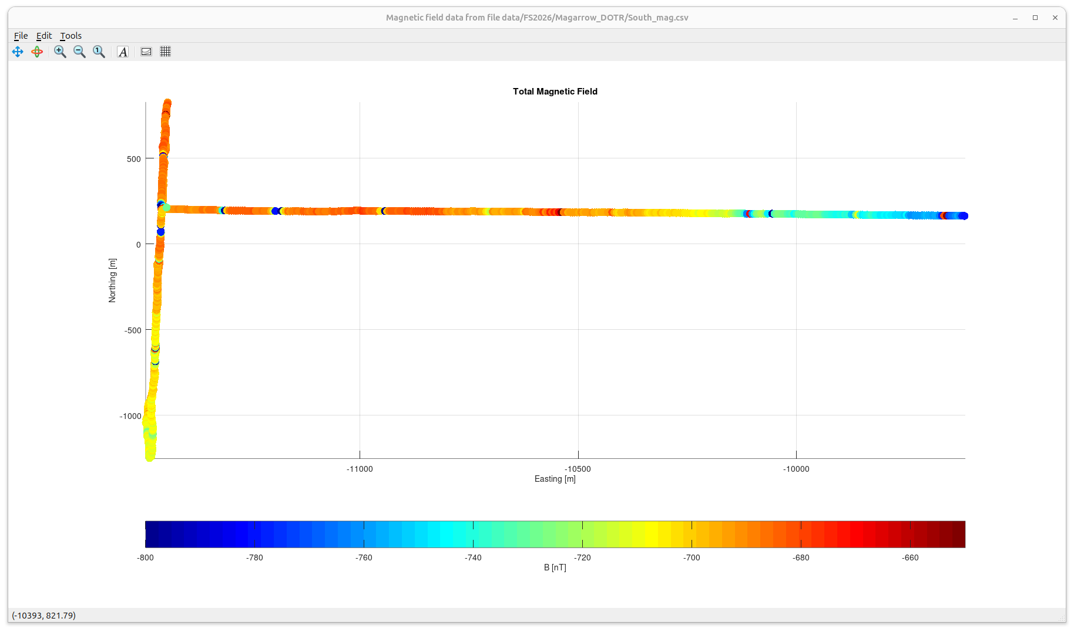
Base-station corrected magnetic field readings from all three lines, plotted by coloured dots along the paths
Base-station corrected magnetic field readings from all three lines, plotted by coloured dots along the tracked paths
Note that the magnetic field decreases to the SE
Could this be related to the gravel deposit in this area?

