Slide 1
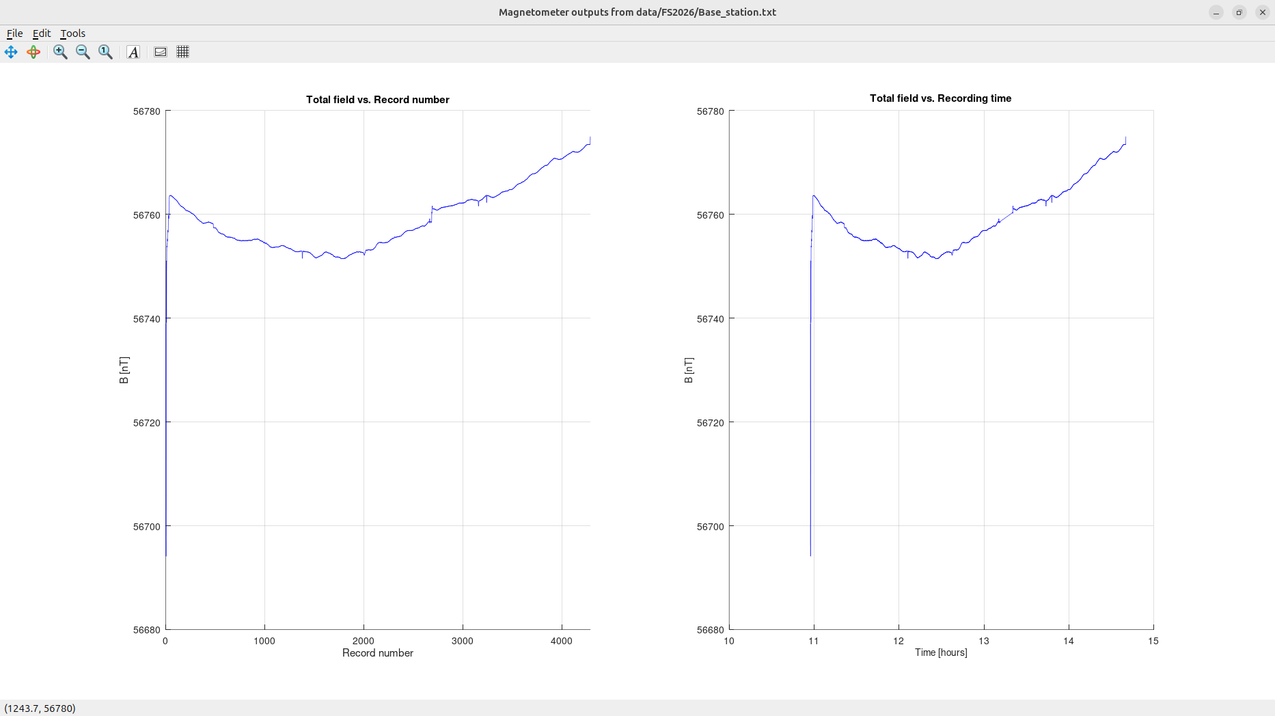
Records from the Base station set up at the intersection of the Draeger and Old Trail Roads.
Note the variability of magnetic field after 9:30 (before 9:30, the big spike is during set-up)
Total magnetic field is shown as function of record number (left) and recording time (right).
Note the values of the field in nano Tesla units (nT).
These records are practically the same for continuous recording like the one at the base station or while tracking.
This reference magnetic field is subtracted (in the following plot) from the fields recorded by moving MagArrow stations

Slide 2
MagArrow Line 1 (near West-East line in the southern part of the test-site area)

Slide 3
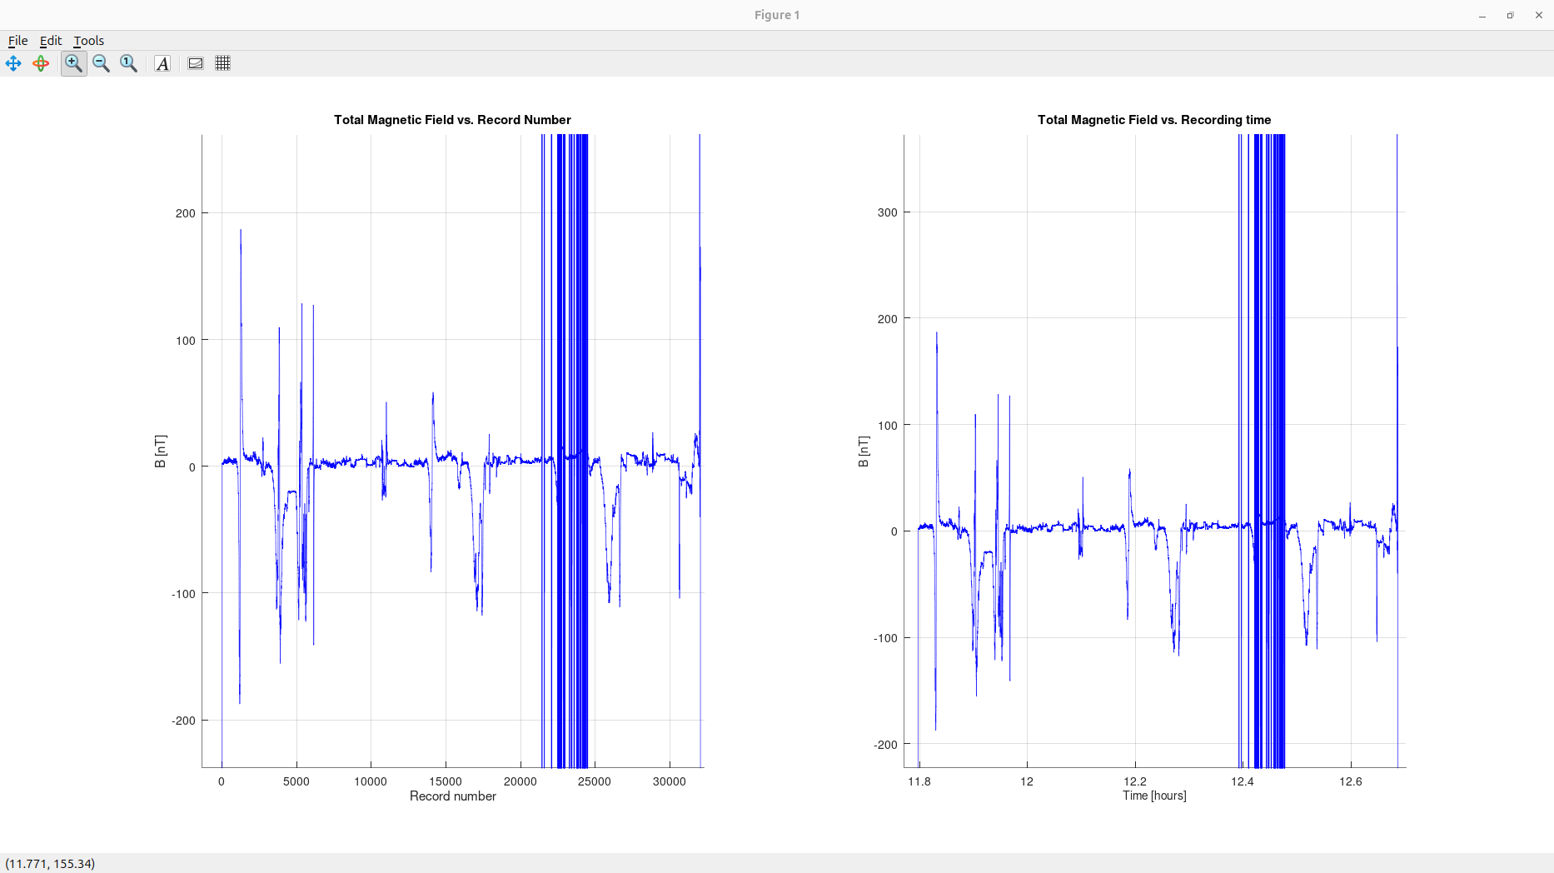
First, you walked through the line without logging the times of visiting each station.
These are the MagArrow records after subtraction of the base-station readings at matching times.
Note that MagArrow reports UTC (GPS) times which differ from Saskatchewan times by 6 hours. This time difference was corrected for.
Note the small difference in the average level (near -15 nT).
The drift of recorded magnetic field was removed by subtraction of the base.
There are some sharp anomalies due to vehicles or electrical bursts near power lines (?)

Slide 4
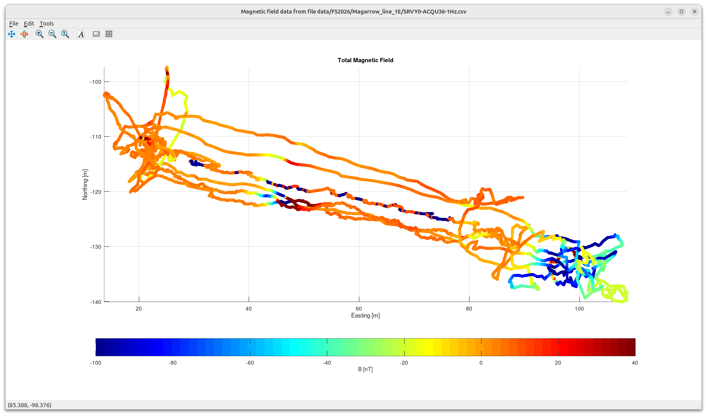
Base-station corrected records plotted by colour at positions reported by MagArrow GPS unit.
Note that non-differential GPS is insufficiently accurate for such small distances, and the track looks scattered.
Note the higher and lower values of magnetic field near the middle and East end of the line.
Could these be due to our targets?

Slide 5
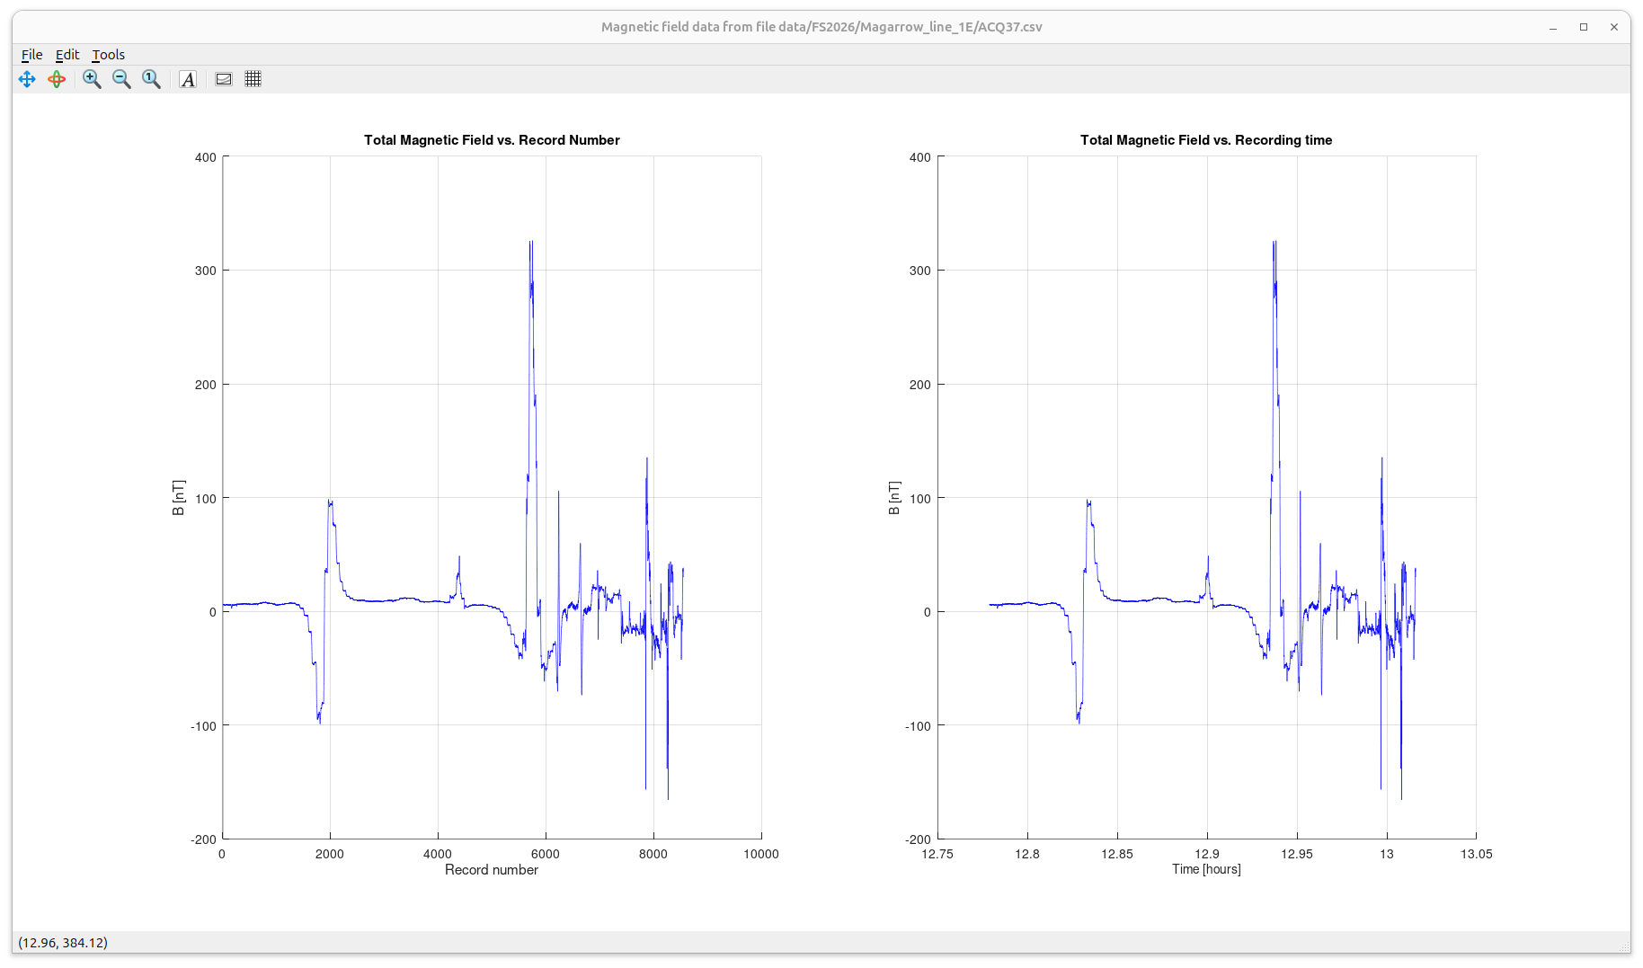
Next, you tried walking through the line carefully logging the times of visiting each station.
Below is the time record of the recorded magnetic field after subtraction of the base-station readings.
Note the magnetic-field troughs and peaks occurring when passing over the magnetic anomaly.

Slide 6
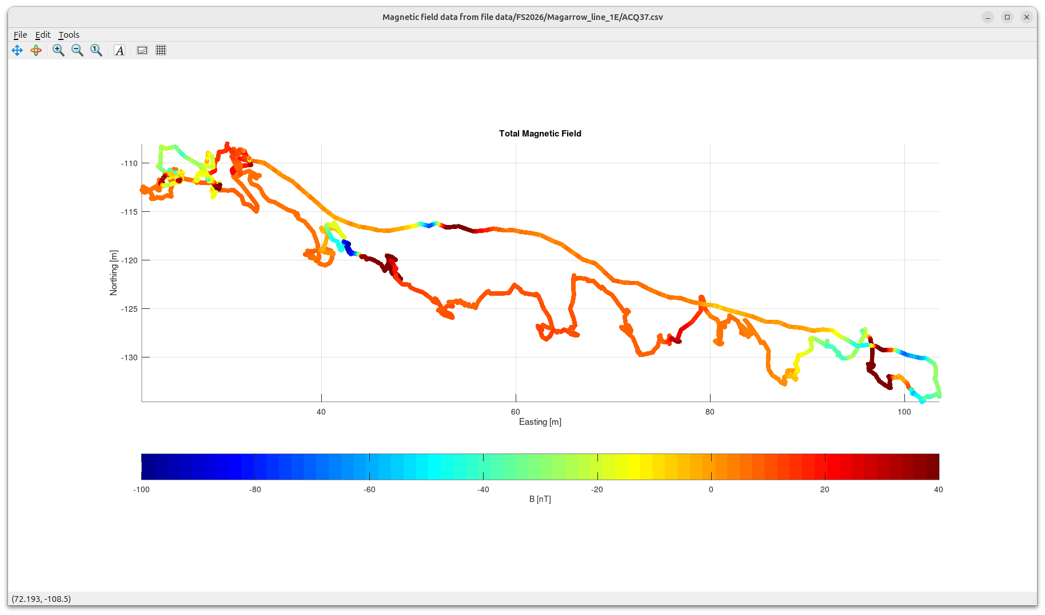
Track of the magnetic field at coordinates reported by the GPS.
Because the non-differential GPS has about 5-8 m positioning errors, the track looks wobbly.
Weaker anomaly?
However, locations of anomalies can be seen
Anomaly

Slide 7
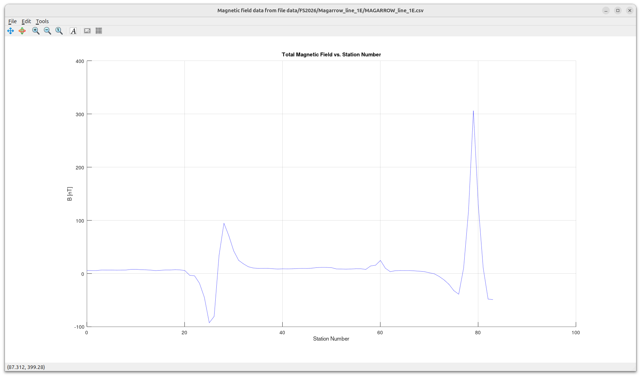
Magnetic field values from preceding plot extracted at locations of stations on the line.
Looks like only one pass through the track was gridded.
The resulting graph gives accurate location of the anomalies.
By careful inversion of the shapes of these anomalies, depths and dips/plunges of these targets can be constrained.
2-D grid mapping would be needed for better estimation of 3-D shapes of target bodies.
Looks like this anomaly is dipping toward the beginning of the line (west?)
The anomaly is truncated here, showing that the line may need to be extended with about 20-30 stations
I do not know the direction of station numbering. The usual convention is to increment station and line numbers from West to East and from South to North

Slide 8
MagArrow grid over new targets behind the vault

Slide 9
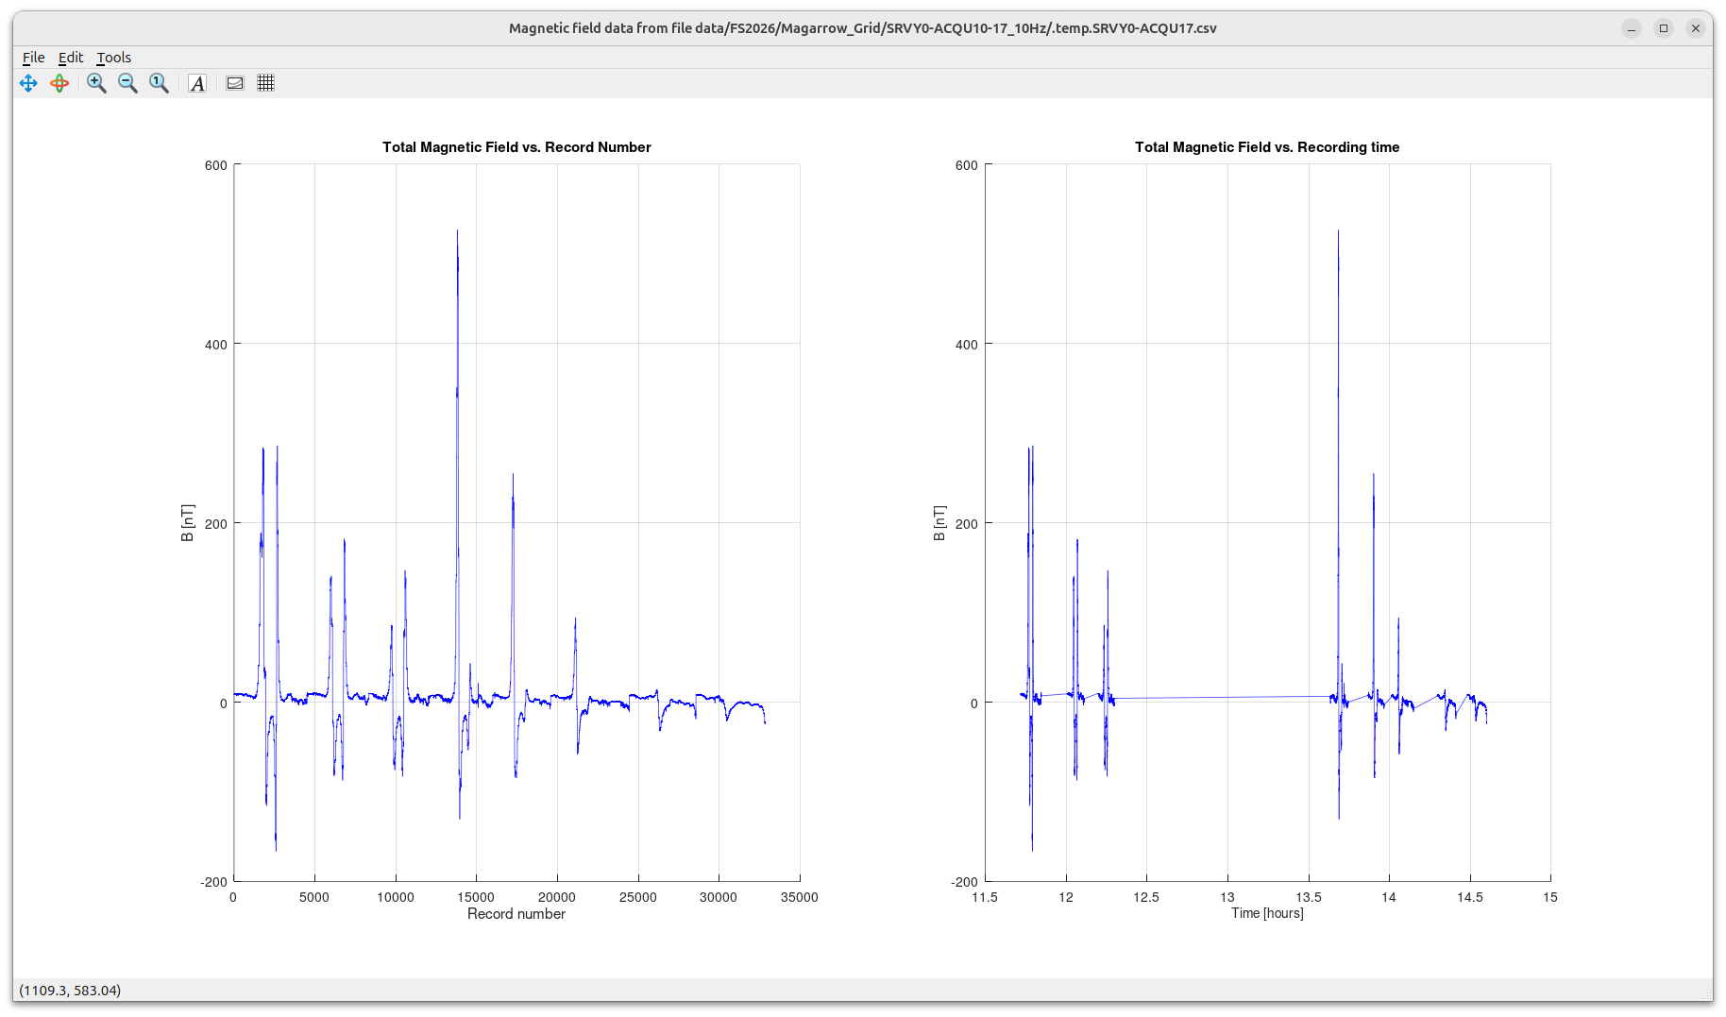
Time records of the gridded dataset (corrected for base-station recordings).
Note the pattern of magnetic-field highs and lows as we crossed the in each line of recording.

Slide 10
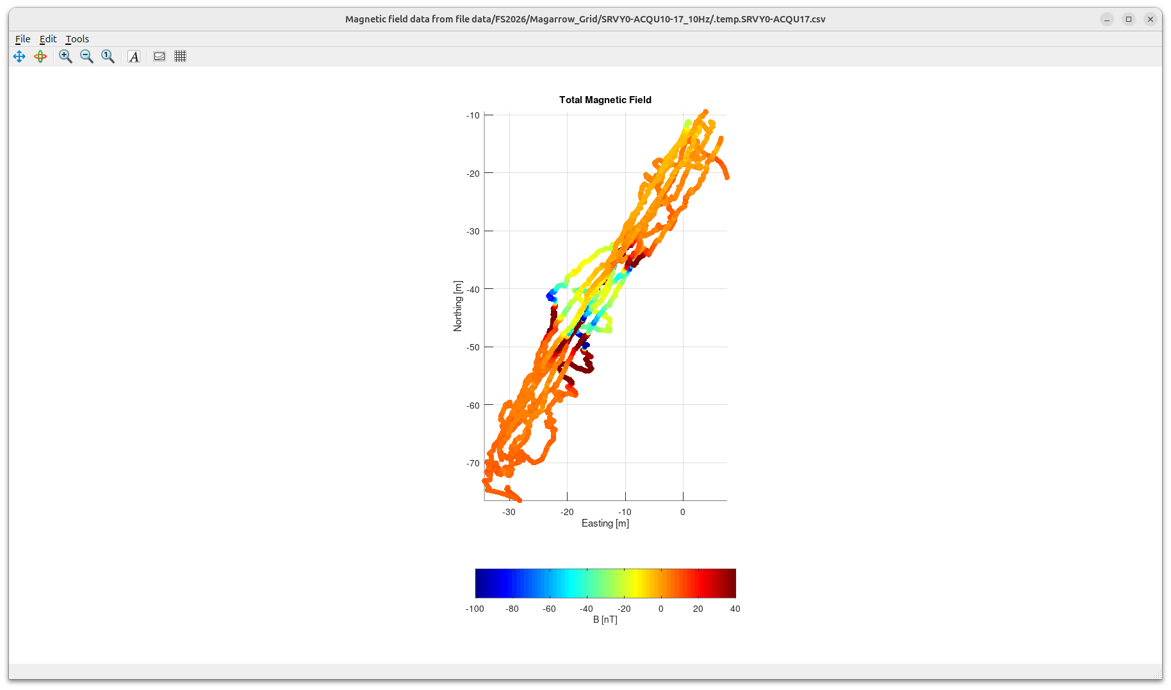
Track of the entire base-station corrected dataset.
Note the inaccuracy of non-differential GPS coordinates, but the anomaly at the middle of the grid is clearly visible.

Slide 11
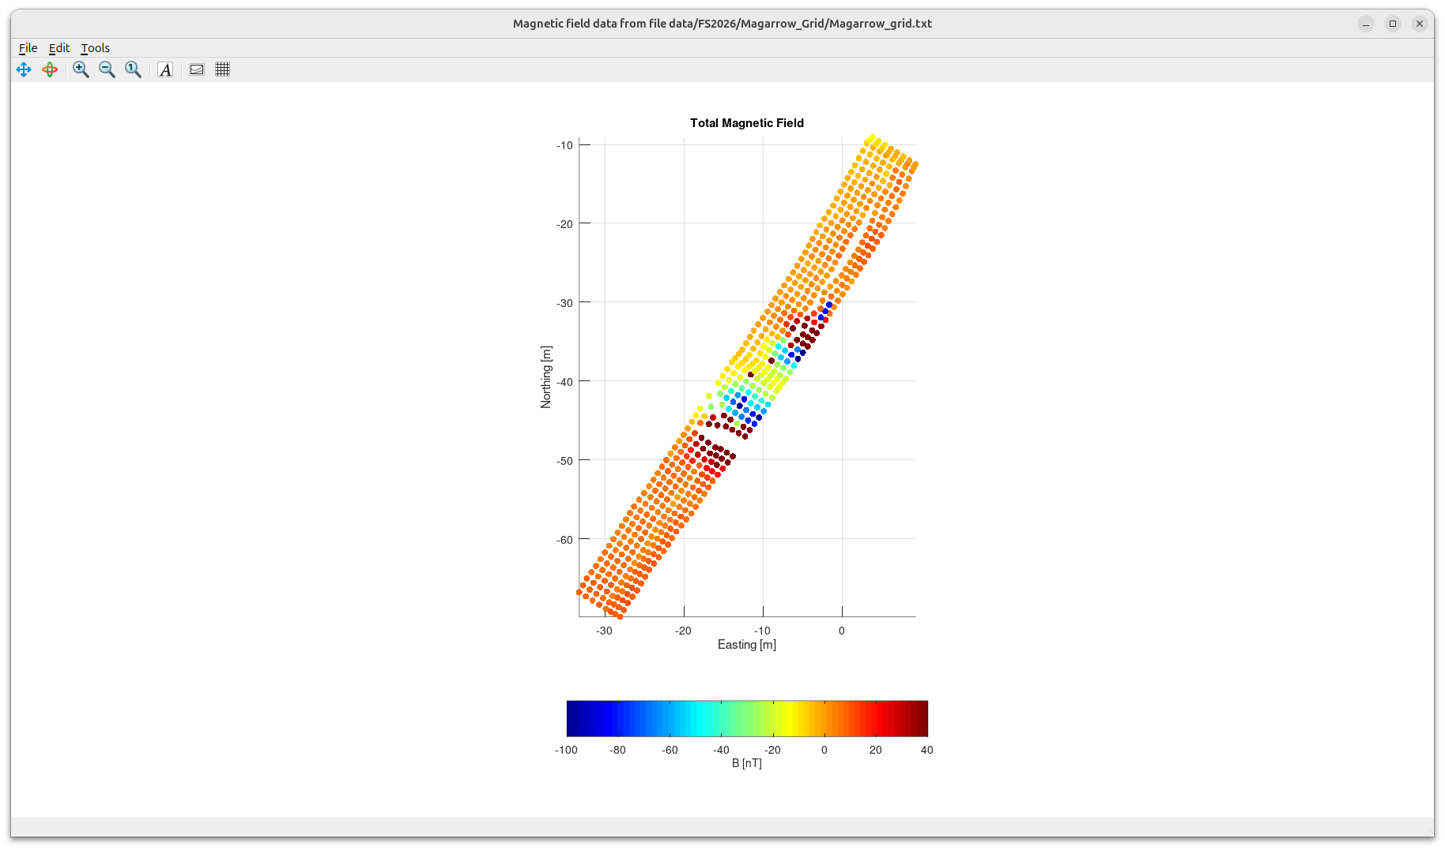
Magnetic field data extracted for the accurate (logged) grid locations.
The grid is now accurate (also showing some errors in the data acquisition procedure around obstacles)

Slide 12
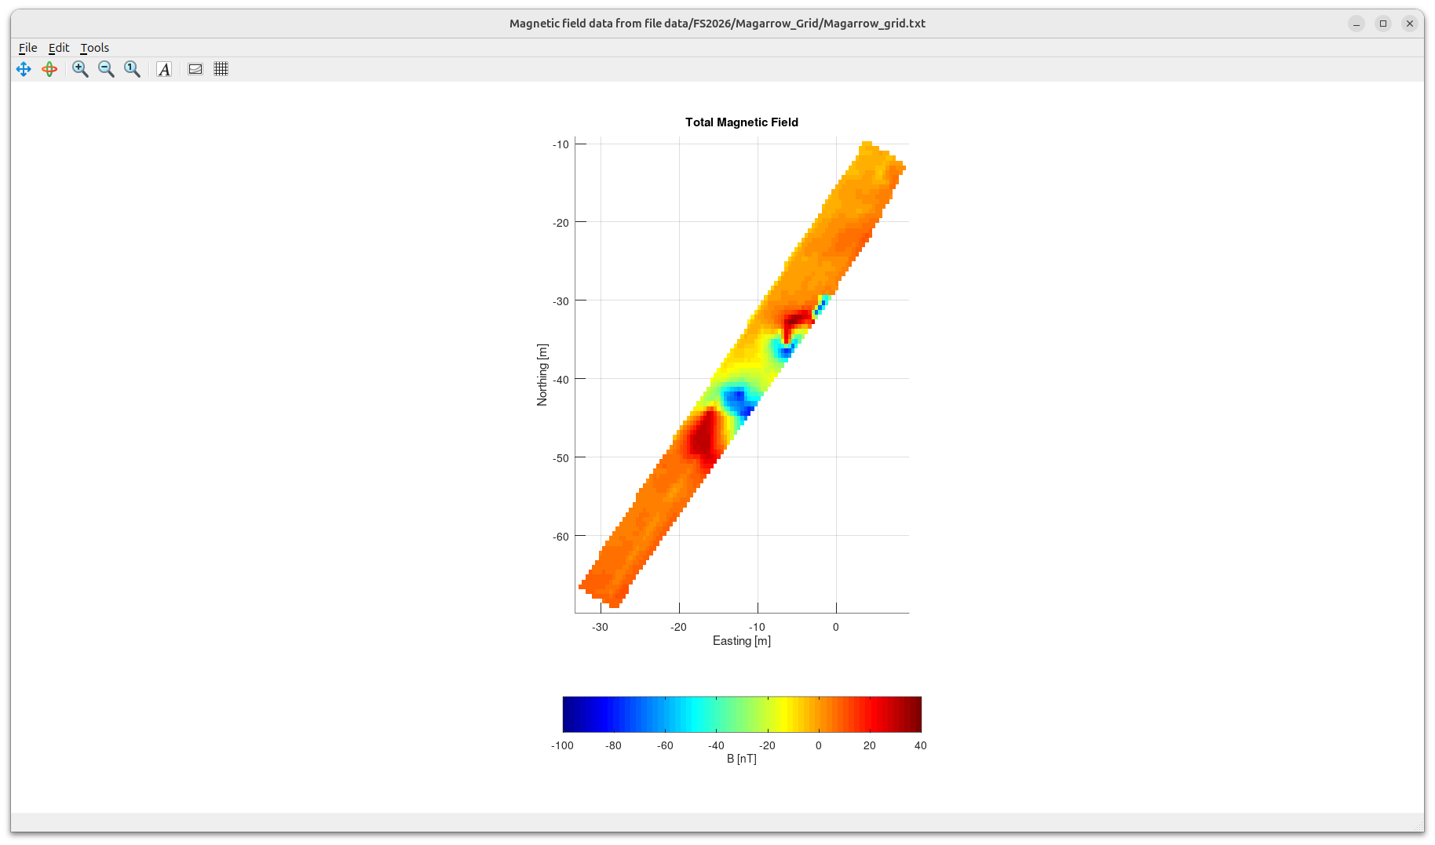
Magnetic field data from the preceding slide interpolated onto a continuous grid.
This is the final step of magnetic mapping.
The magnetic anomalies due to two targets are now clearly seen.
Because of the Earth’s magnetic field being directed downward in this area, the deeper part of a magnetized body produces a magnetic low, and the shallower part – a magnetic high relative to the background.
Thus, we can see that the bigger target (water heater tank) is dipping north-east (as it actually is!)

