Slide 1
I am currently having some difficulties producing a nice merged section of all Betsy gun shots. Stay posted for updates of this .pptx document. However, conclusions for planning the Saturday’s survey can be made by examining the raw seismograph displays (next slides):
Good refracted arrivals are seen to distances 144 m, and so we can try recording to such distances.
Therefore, we can use geophone spacing 2 m which we used with explosive sources before. This will give maximum offsets 48 ✕ 2 m = 96 m with the source located at the middle of the 96-channel recording spread.
Poring water into the holes (tried only twice) appeared to significantly improve record quality So, we’ll try doing this during the main survey.

Slide 2
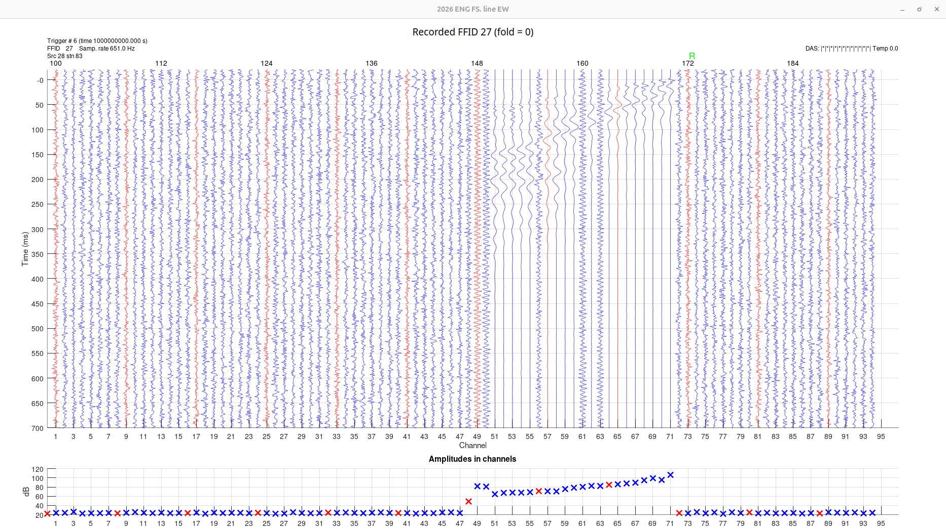

Slide 3
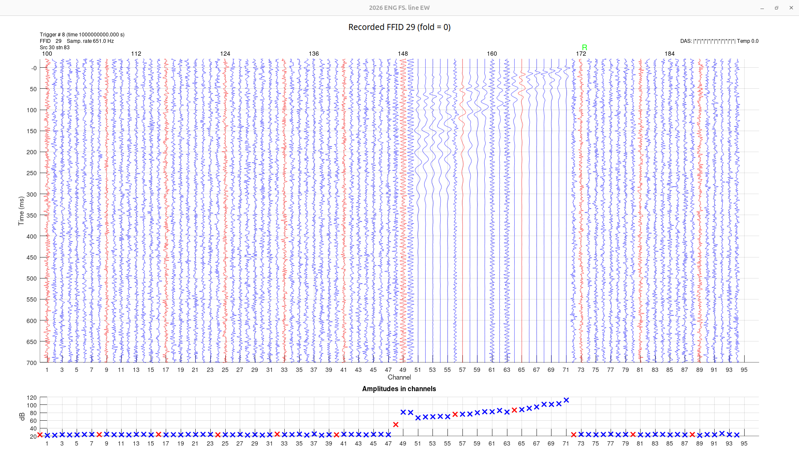
With water

Slide 4
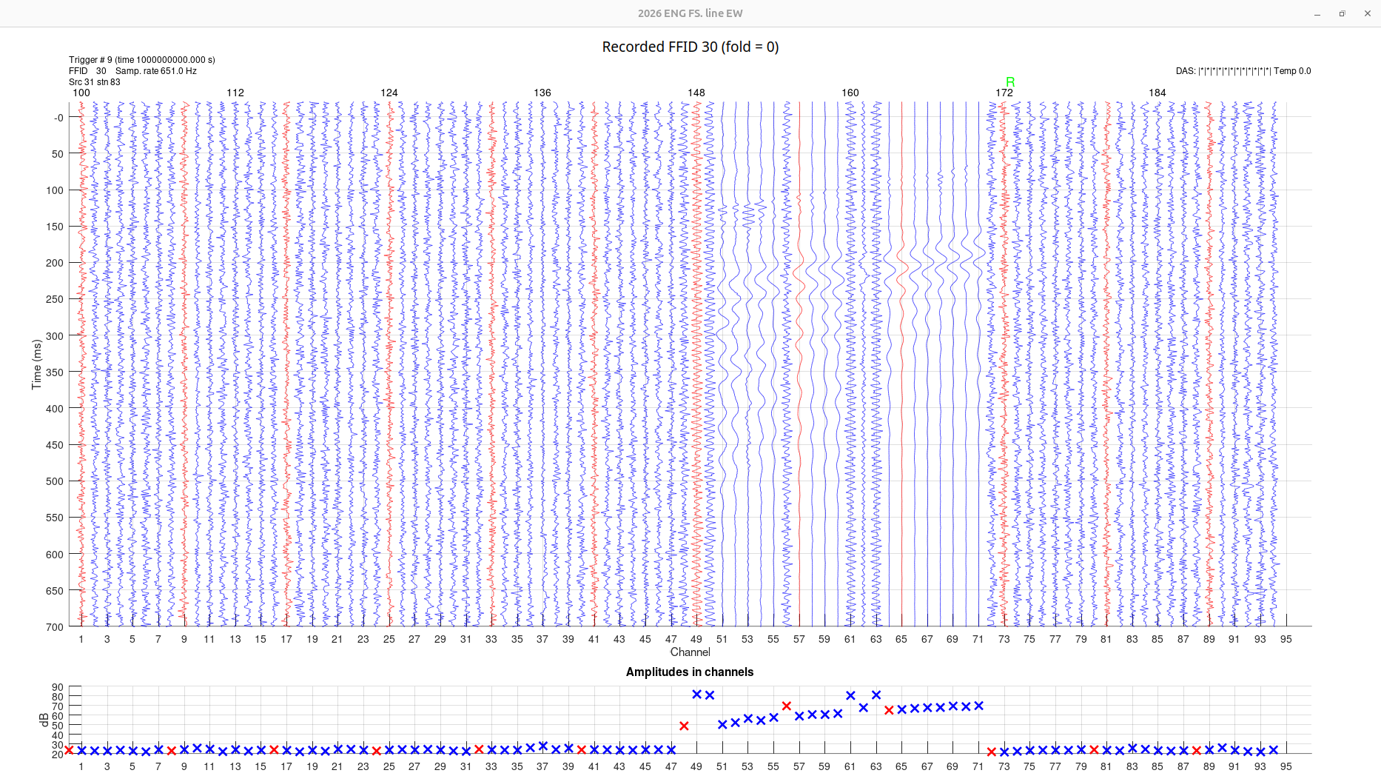
Source moved 24 m farther

Slide 5
Source moved 24 m from nearest geophone

Slide 6
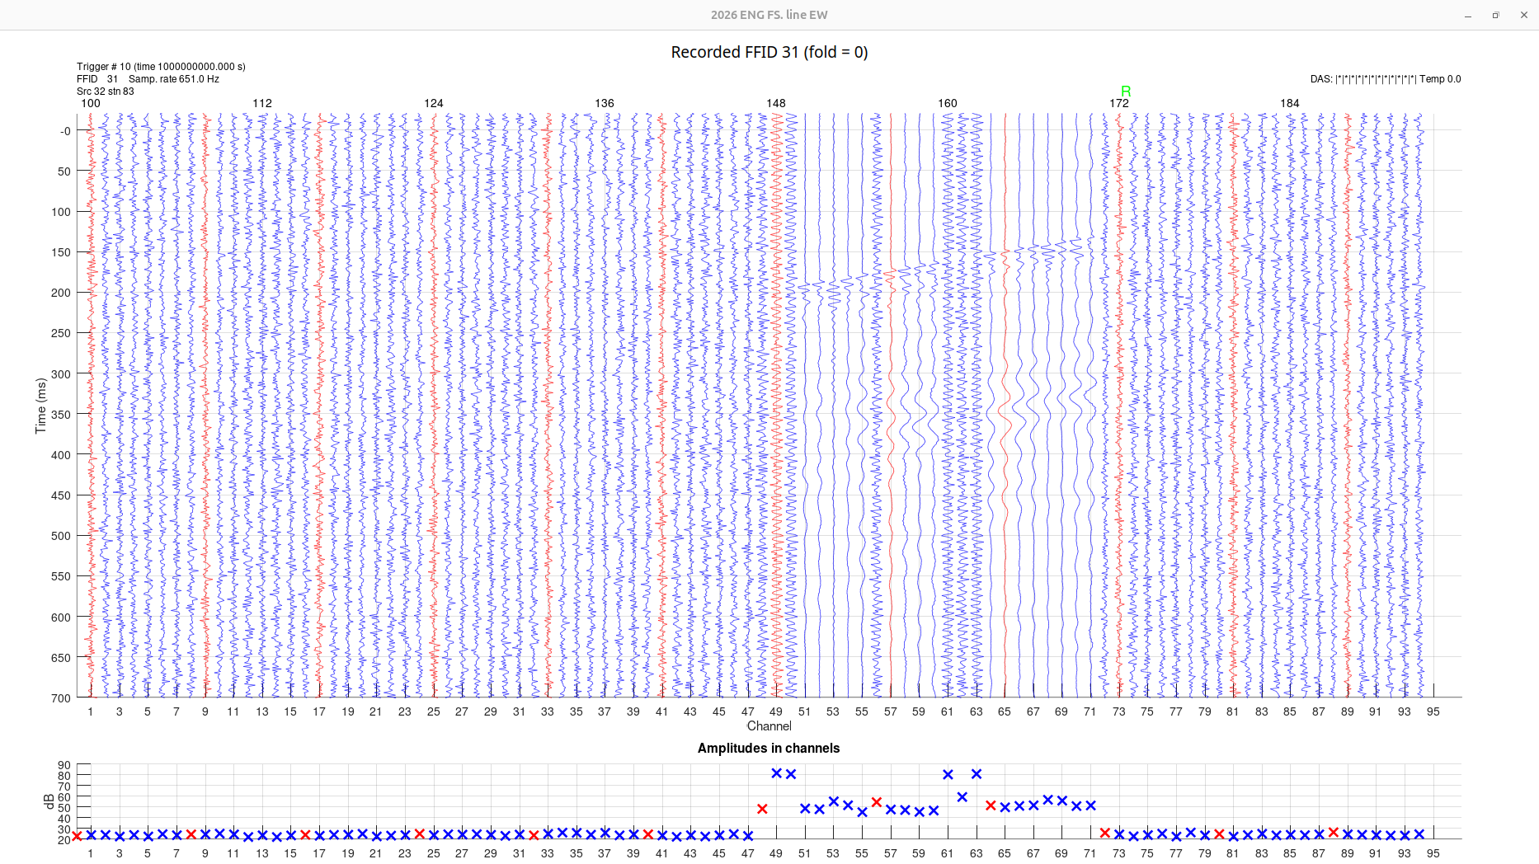
Same with water. Much better.

Slide 7
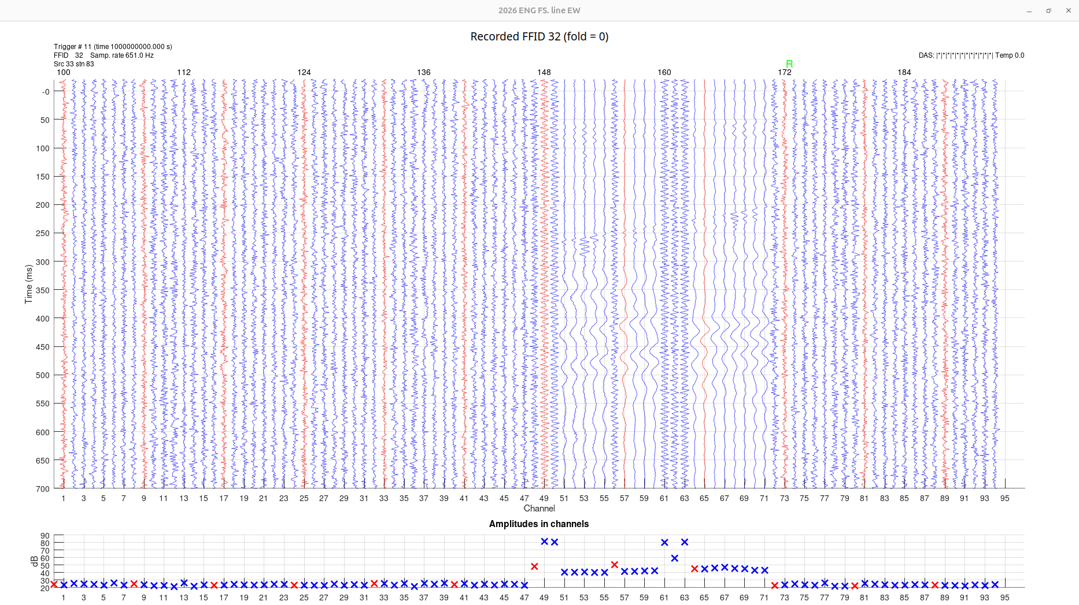
Source at 48 m from nearest geophone

Slide 8
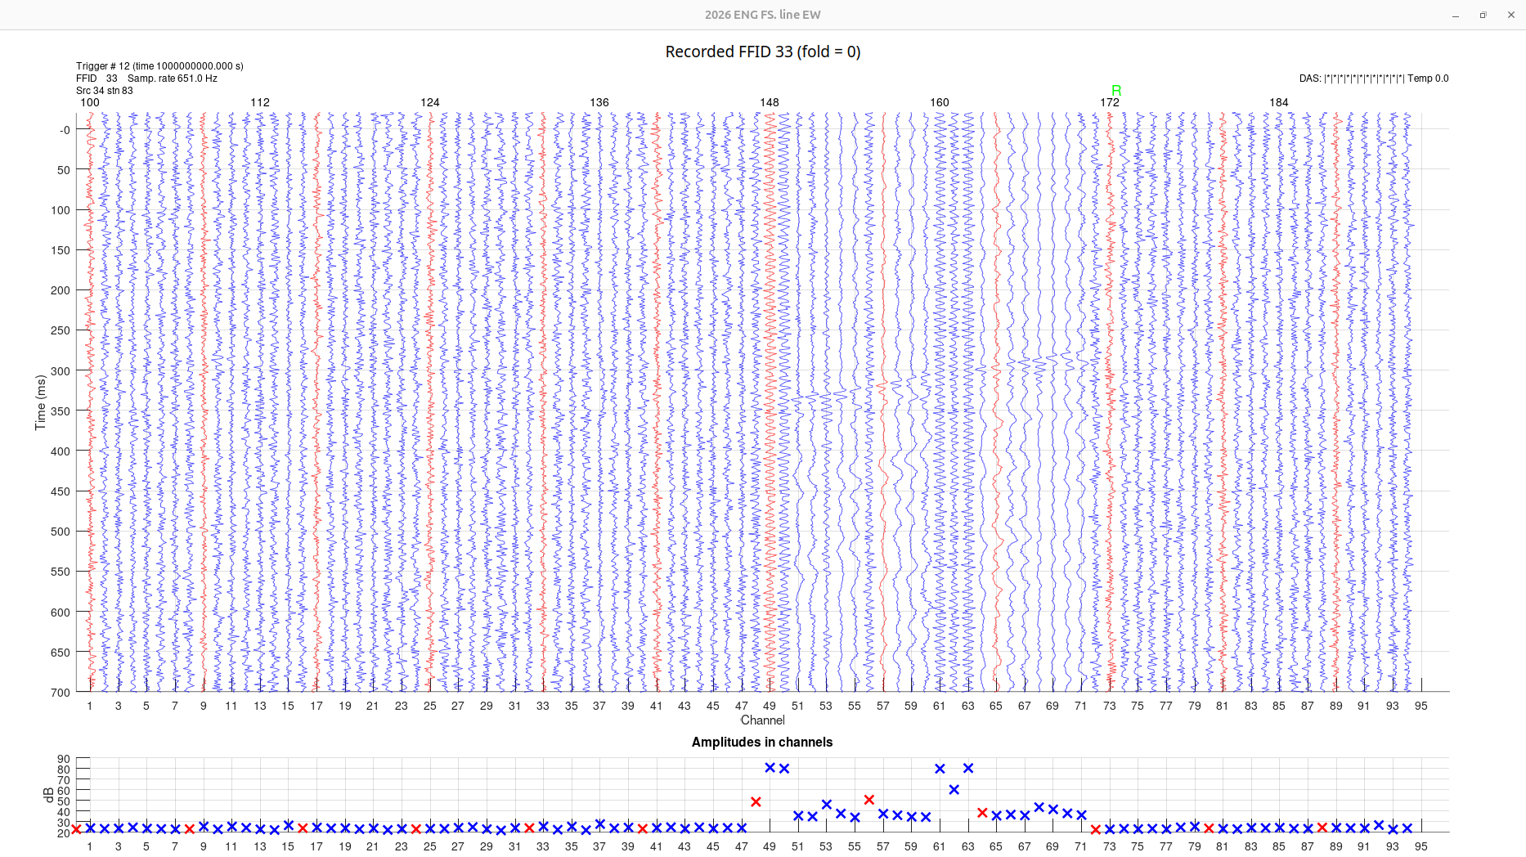
Source at 72 m from nearest geophone

Slide 9
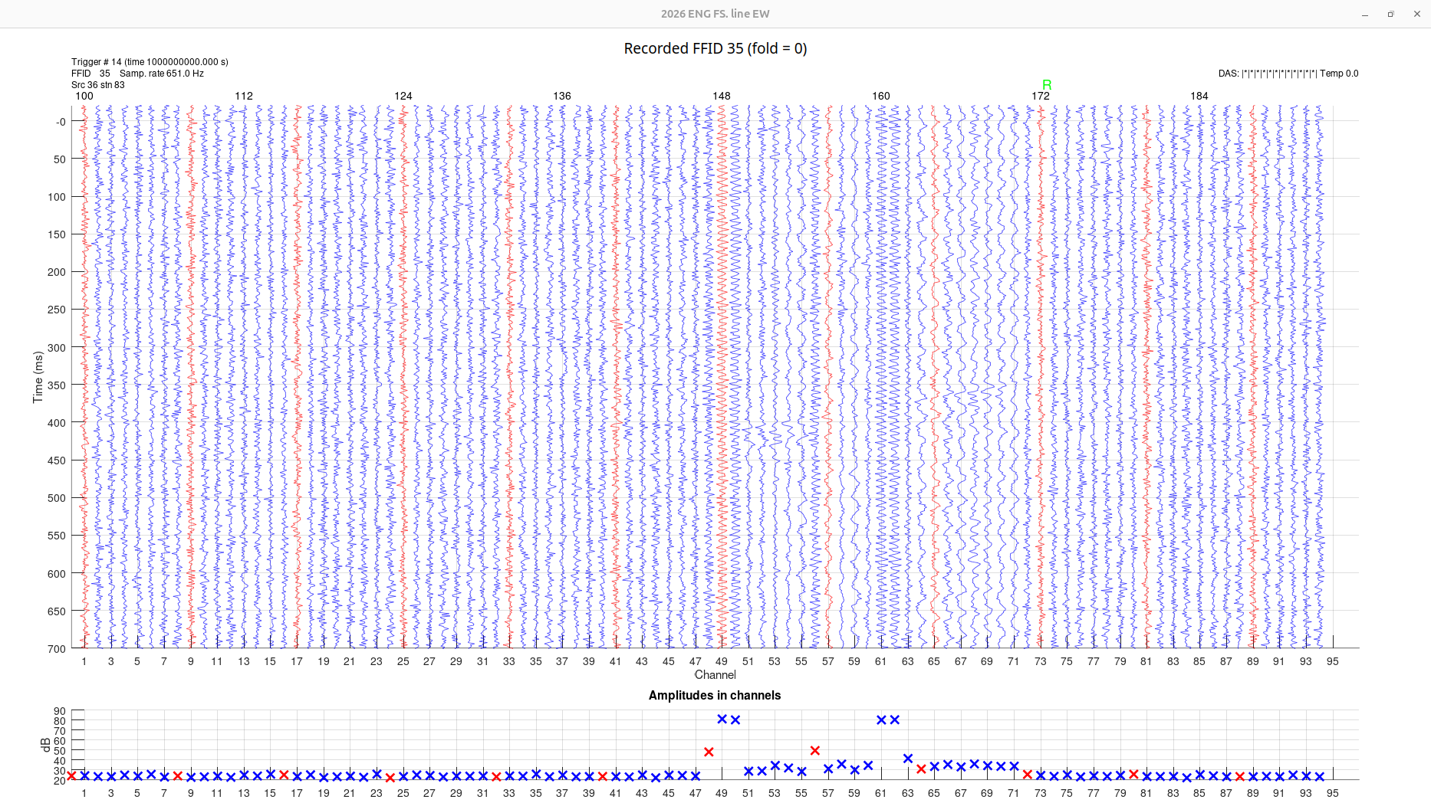
Source at 96 m from nearest geophone

Slide 10
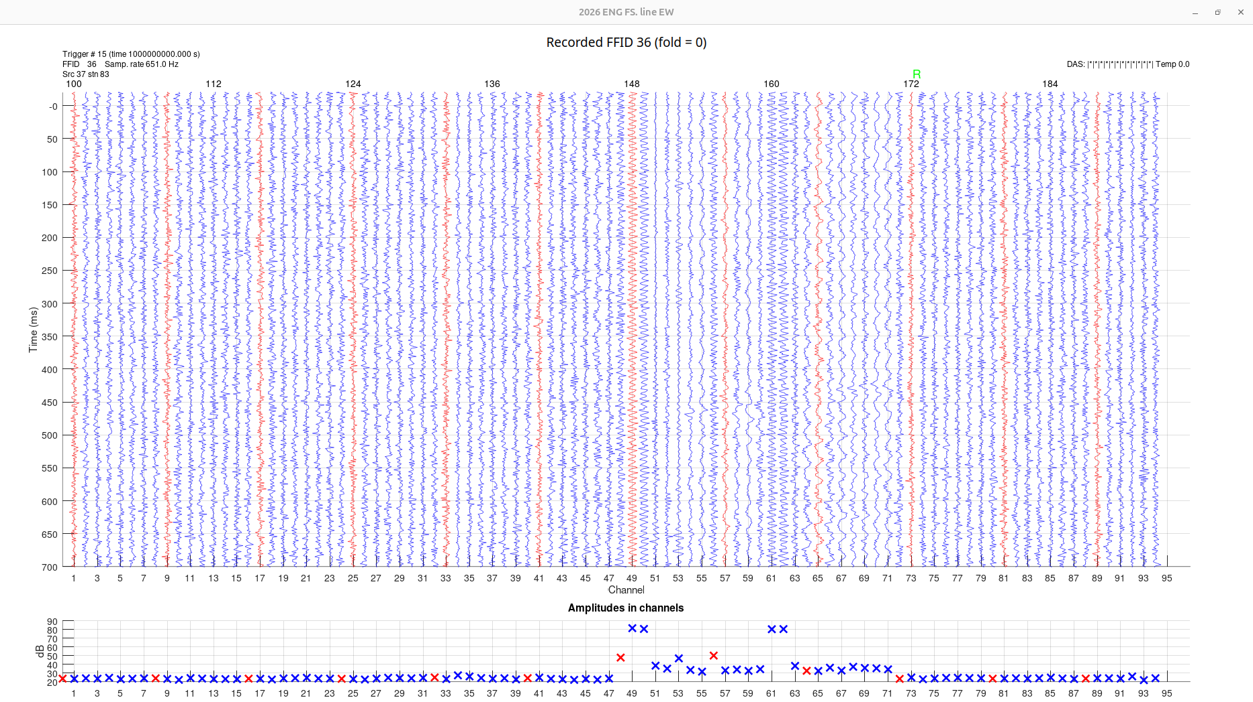
Source at 120 m from nearest geophone. Refracted wave is still seen but not very well.

