Slide 1
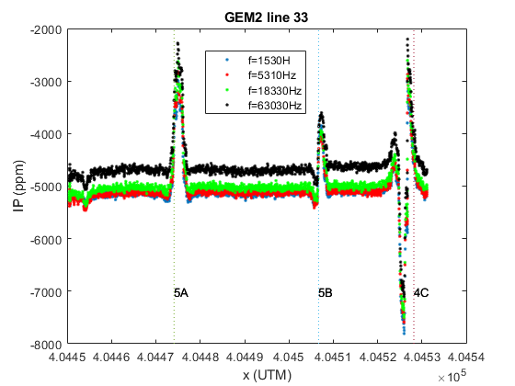
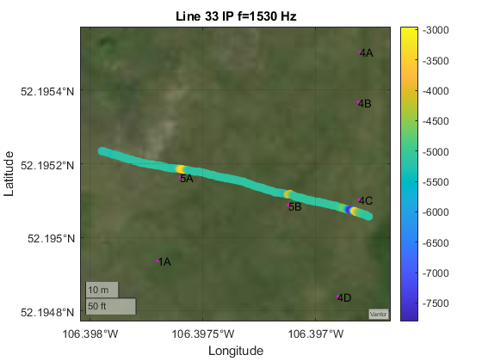
Positions of buried metal
Posible small unknown conductive anomaly.
Line 33 using instrument 7027 crossed three known buried targets which show up very clearly in the In Phase.
Note that the IP responses for all frequencies along this line are very similar.
A scatter plot of the data for one frequency plotted on a satellite image and including the positions of the known anomalies.

Slide 2
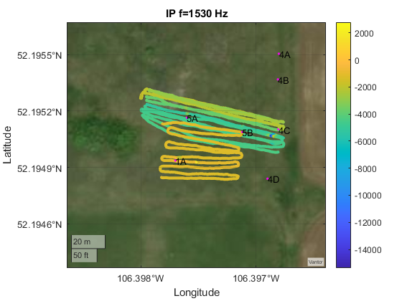
Unfortunately, from the plot of In-Phase for many different lines with the GEM2 carried by different people, we can see that the In-Phase changes a lot from one set of lines to another.
IP was measured in the same region by different operators but different results were obtained indicating a systematic error in the measurement. This map is not reliable.

Slide 3
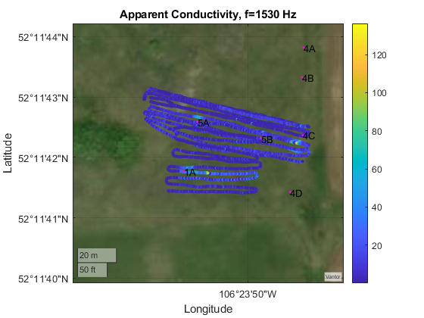
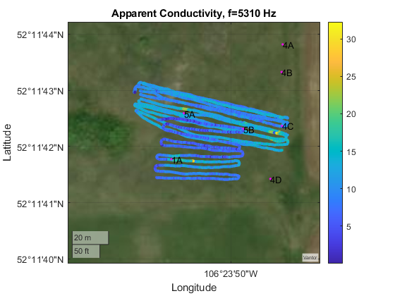
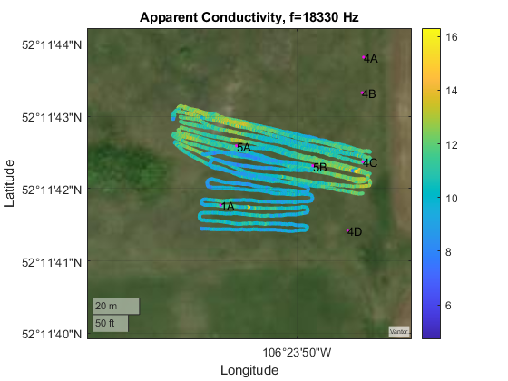
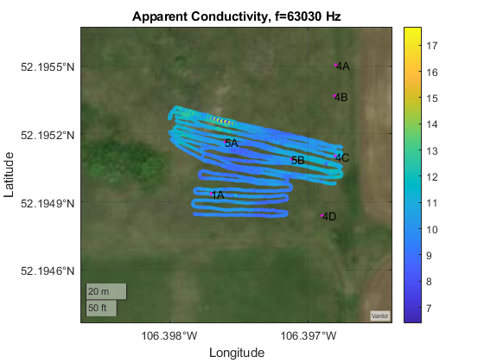
The apparent conductivity is calculated using the quadrature phase.
At low frequencies, we can see large apparent conductivity values caused by the buried metal anomalies.
Higher frequencies are less sensitive to deeper material and the effects of the buried metal anomalies are reduced.
At higher frequencies, we can see regions of slightly higher soil conductivity in the eastern and western regions compared with the central area.

Slide 4
The units for apparent conductivity are mS/m. From the plots, we can see that the background conductivity is around 10 mS/m/ This corresponds to a resistivity of 100 Ωm which is typical resistivity for the ground around the field school area.

