Slide 1
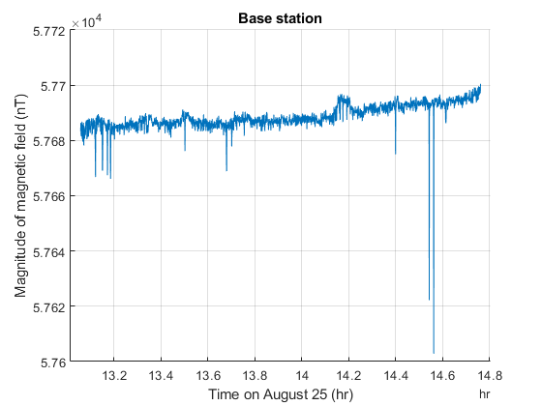
Note the total variation with time even with the big spike is around 100 nT.
Slight award trend
Negative spike may be due to
A vehicle getting close.

Slide 2
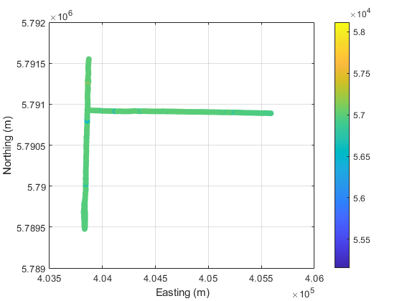
This is a color scatter plot of the data. We can see the two roads on which we walked. It is hard to see much variation in magnetic field because the anomalies are very narrow and probably caused by metal infrastructure like culverts or cables.

Slide 3
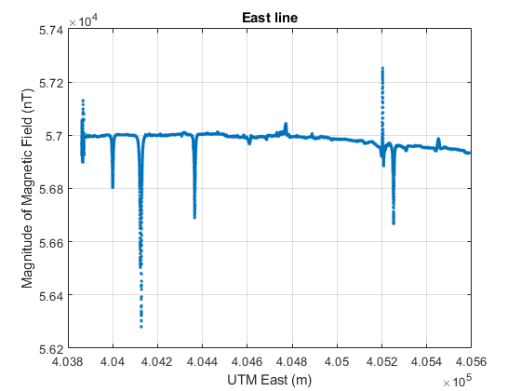
This is the data from the East line. It has not yet been drift corrected. There are some anomalies close to 1000 nT. Note that the anomalies are very narrow (of order m) indicating that they are caused by very shallow features which again, are likely man-made structures.
Note the slight downward trend which may be caused by basement rocks below the sediment.

Slide 4
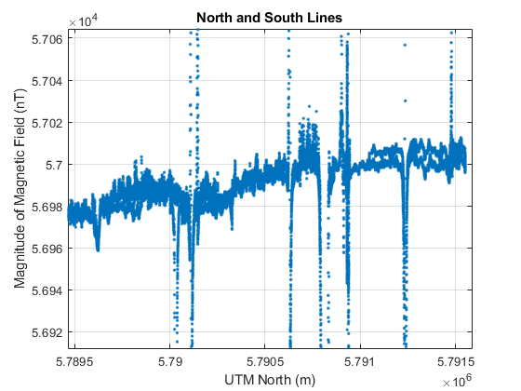
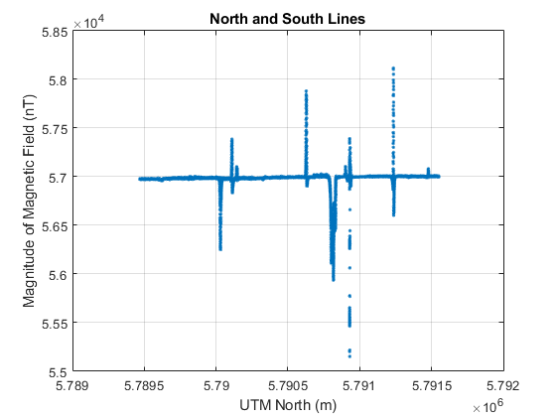
This features is of order 10 m wide indicating that it may have a deeper origin than the other spikes.
This is the data from the north-south line. The plot on the left has reduced the variation on the y axis so that the background trend can be seen. Data from walking both directions is plotted so there are some duplicated points. We can see a general positive trend when moving northward. There are also many very narrow spikes which again are probably metal infrastructure.

