Slide 1
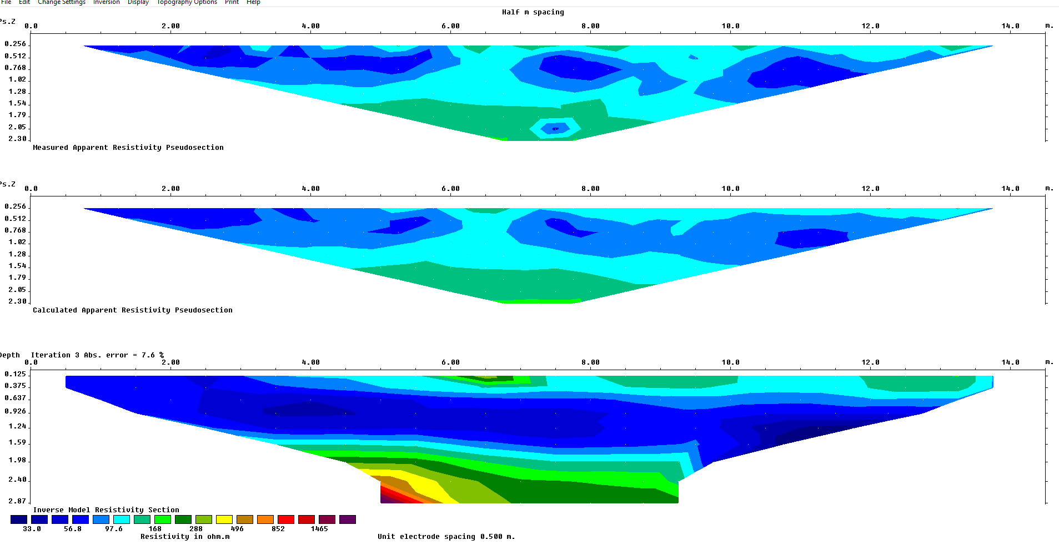
½ m spacing
Possible variations within the till. Could also
be positioning errors.
Till, sand contact

Slide 2
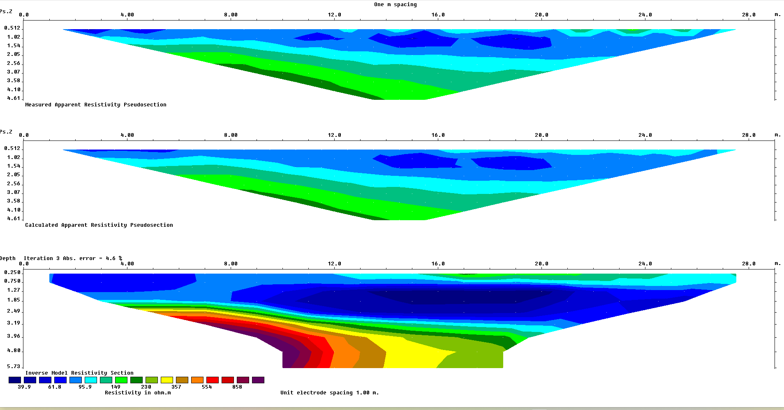
Till, sand contact
Till thickens to the north

Slide 3
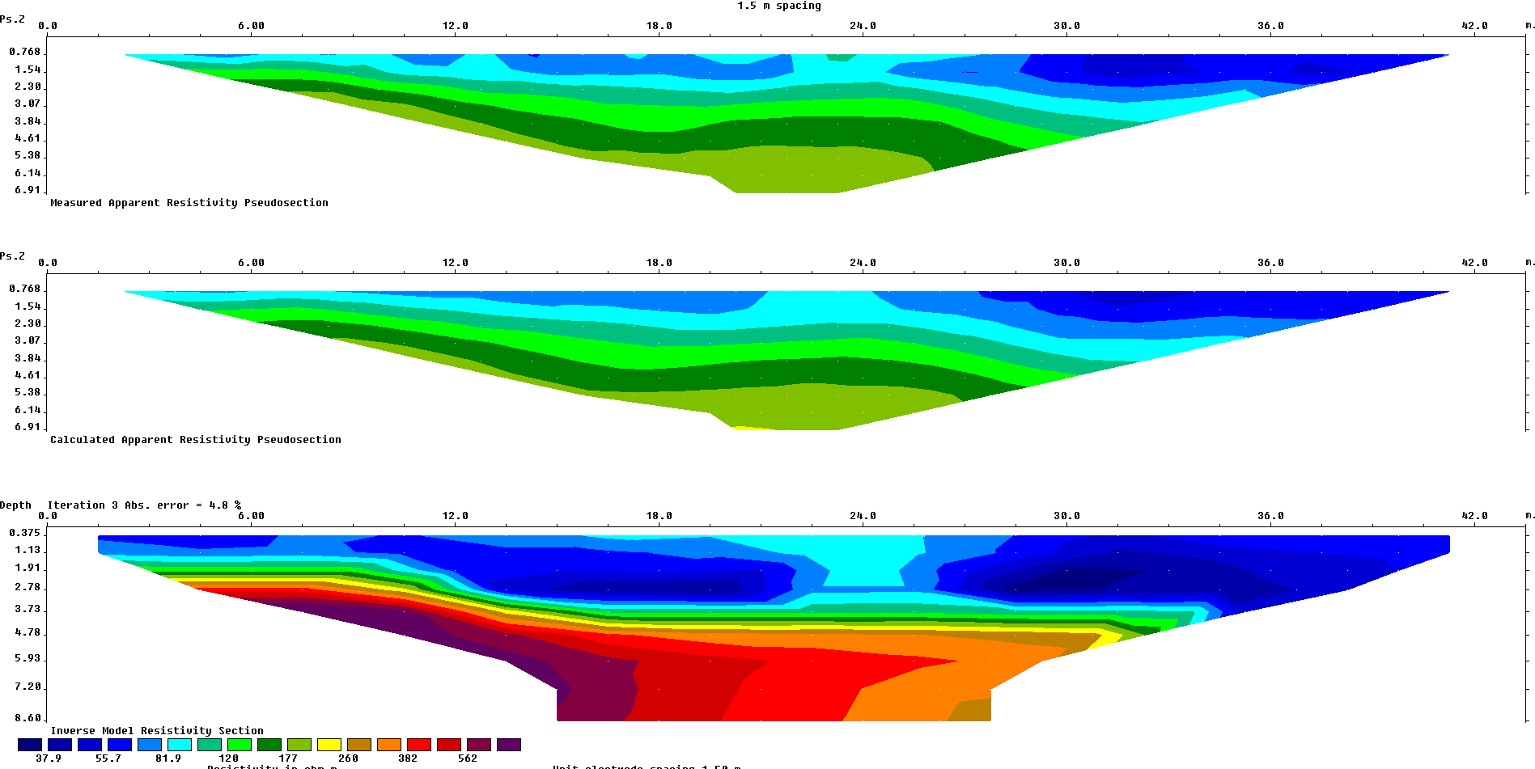
Till, sand contact

Slide 4
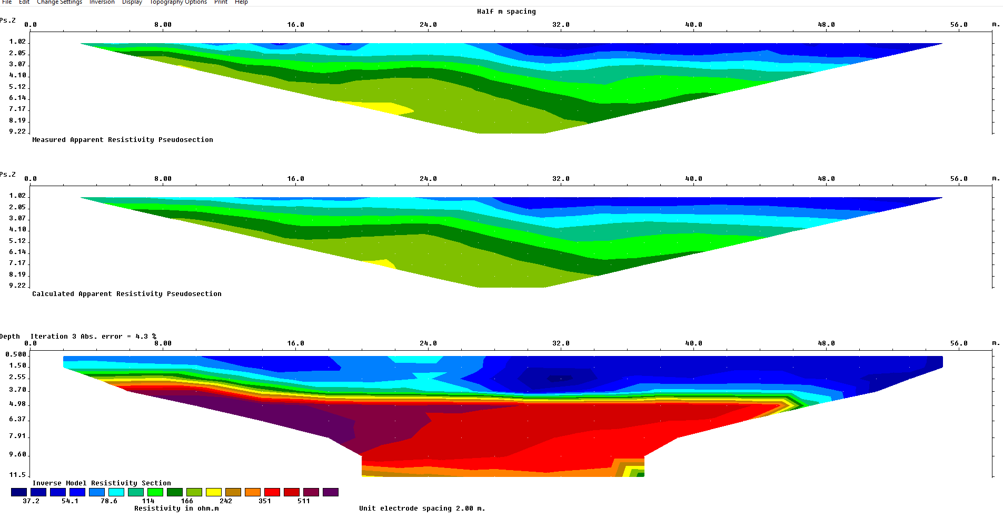
2 m spacing
Till becomes a constant thickness beyond 16m
Till, sand contact
Decrease in resistivity at 10m may be the top of the water table.

Slide 5
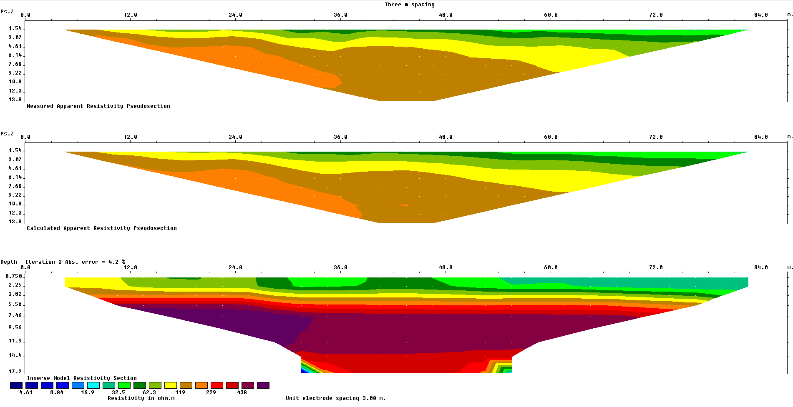
Till, sand contact
Decrease in resistivity at 10m may be the top of the water table.

Slide 6
0.5 m
1 m
1.5 m
2 m
2.5 m

Slide 7
Notes
Note that the x and y axes and the color scales are different for each plot so you need to be very careful while comparing them.
The top graph in each set is a pseudosection which is a plot of the apparent resistivity at the horizontal mid-point of each array and at a fixed fraction of the total array length. It is essentially a plot of the raw data.
The bottom graph is the resistivity for a model of the ground that best fits the data. This is our best estimate of the true resistivity of the ground.
The middle graph is the pseudosection of data calculated using the model shown on the bottom. Comparing the top and middle graphs gives us an idea of how well the model fits the data.

