Slide 1
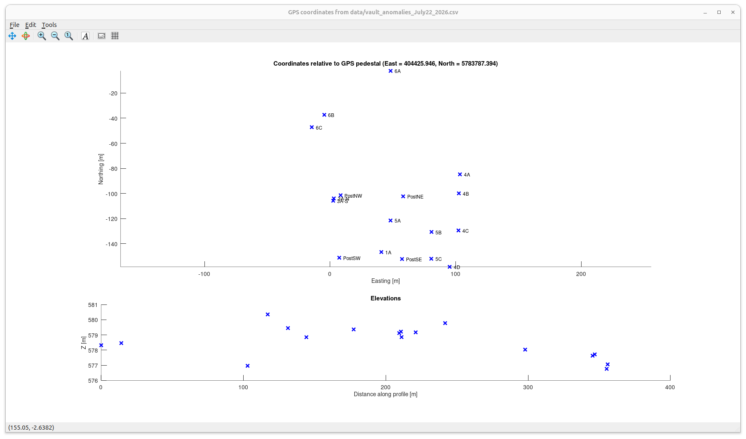
Locations of old and new electrical and magnetic targets installed in the test site near the seismic/gravity vault.
The targets are described in the following pages
These are elevations of the points above in a somewhat random order in which we picked the GNSS coordinates

Slide 2
# Targets and markers installed at vault site
#
# Target numbering is by Jim Merriam's block number followed by literals
#
# For coordinates, refer to file vault_anomalies_July22_2026.csv (image on preceding page)
# =============================================================================
Marker 4x4 posts:
-------------------
PostSW - (100N, 50E) in Jim's map
PostSE - (100N, 100E) in Jim's map
PostNW - (150N, 50E) in Jim's map
PostNE - (150N, 50E) in Jim's map
Targets:
-------------------
1A - Main target used for IP, SP, magnetics, TEM, and 3-D resistivity for years.
Installed around 1987 (?)
4 x 8 ft (1.25 x 7 m) sheet of galvanized iron on wood frame,
Placed vertically with long axis tilted 22 deg down toward W25N
Upper corner at 1 m depth, lower corner at ~4 m depth
3A-S and 3A-N - Two PVC pipes of unknown purpose sticking up out of ground
Installed around 1987 (?)
4A, 4B, 4C - Unknown targets along the eastern edge of the site
Installed around 1987 (?)
4D - Presumably iron sheet as 1A, installed vertically and oriented along W25N
Installed around 1987 (?)
Wired for Applied Potential

Slide 3
5A - 4 x 8 ft (1.25 x 7 m) sheet of galvanized iron on wood frame,
presumably the same as used in target 1A
Installed on July 9, 2026
Placed flat dipping 5 deg North
Upper edge at 1.2 m, lower edge at 1.8 m
Wired for Applied Potential
5B - Round iron dome (firepit base), 0.71 m diameter, at 0.9 m depth
Installed on July 9, 2026
5C - 12 ft iron rod at azimuth 30 deg, mentioned on Jim's map
Installed around 1987 (?)
The new "block 6" targets are oriented relative
to the diagonal SW-NE line across the site:
-----------------------------------------------
6A - 1 m x 1.2 m iron table top,
Installed on July 9, 2026
Oriented with strike along the line and 30-deg dip NW across the line
Upper edge at 0.9 m, lower edge at 1.5 m
Wired for Applied Potential
6B - Two rods at 1.2 m depth,
oriented parallel to the line and spaced about 1.2 m apart:
On NW side - a bundle of eight 4-cm diameter iron pipes, 2.4 m long
On SE side - a copper pipe, 1.85 m long, diameter 4 cm
Installed on July 9, 2026
6C - Cylindrical iron water heater tank; diameter 0.5 m, length 1.27 m
Axis oriented along the line dipping NE
Upper edge (near post) at 0.6 m depth, lower edge at 0.9 m
Wired for Applied Potential

